Slide 1
Berries
The Confederated Tribes
of Grand Ronde Reservation

Slide 2
Table of Contents
01
03
02
04
Grand Ronde Reservation
All About Berries
Identifying berries
Maps & Locating
Life on the Reservation
Chinuk Wawa
Naming berries
Who lives there?

Slide 3
01
Grand Ronde
Reservation
01
02
03
04
05
Let's Get Started
06

Slide 4
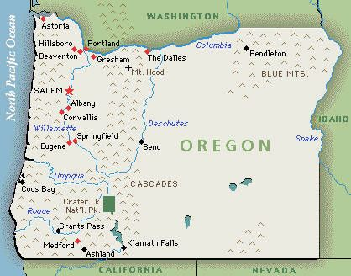

01
02
Grand Ronde Reservation
03
04
05
06
Notes:
Help students locate the Grand Ronde Reservation on the map.
Can students identity where they live on this map?

Slide 5
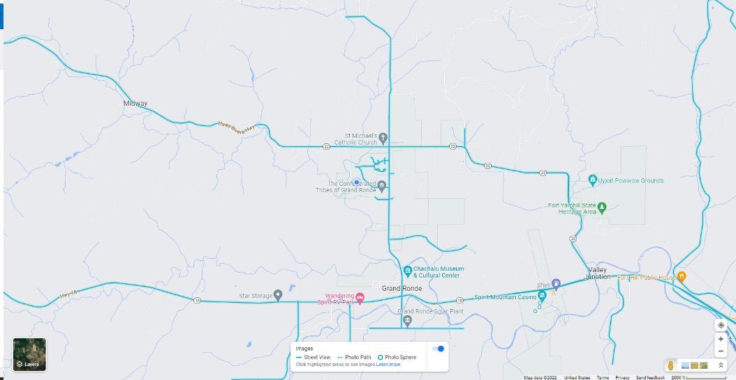
Explore Google Maps
Use this icon to explore the map from ground view

Slide 6
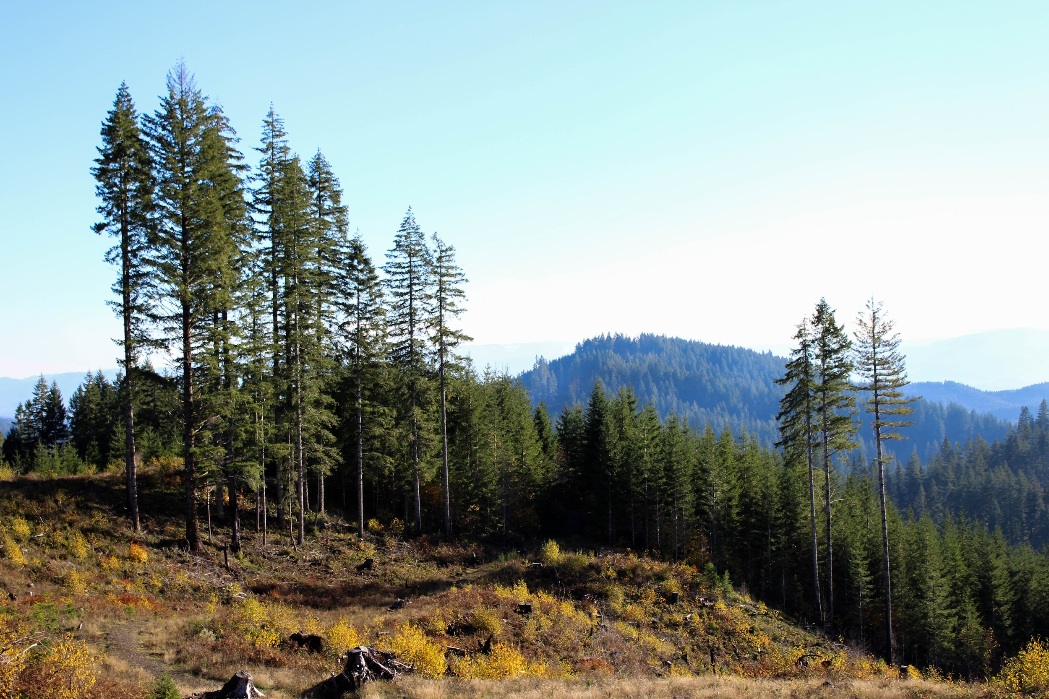
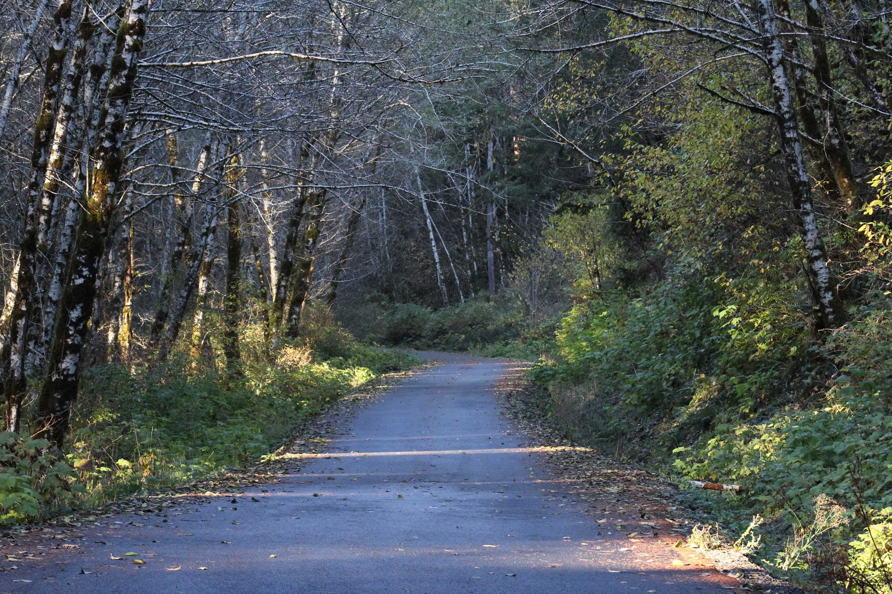
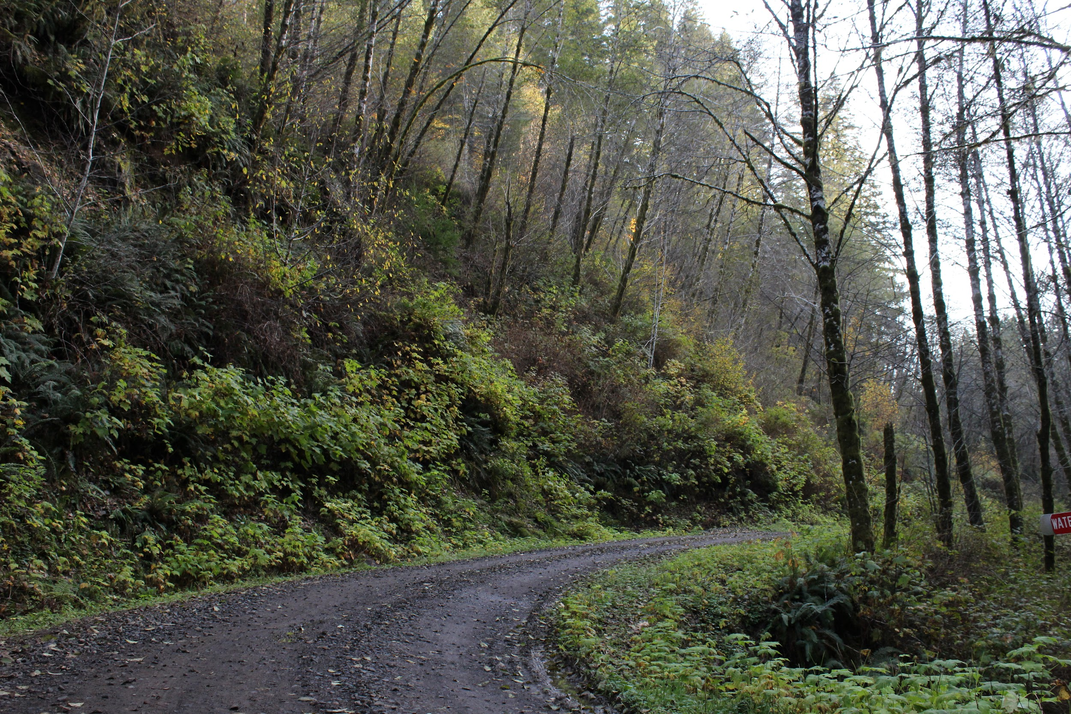
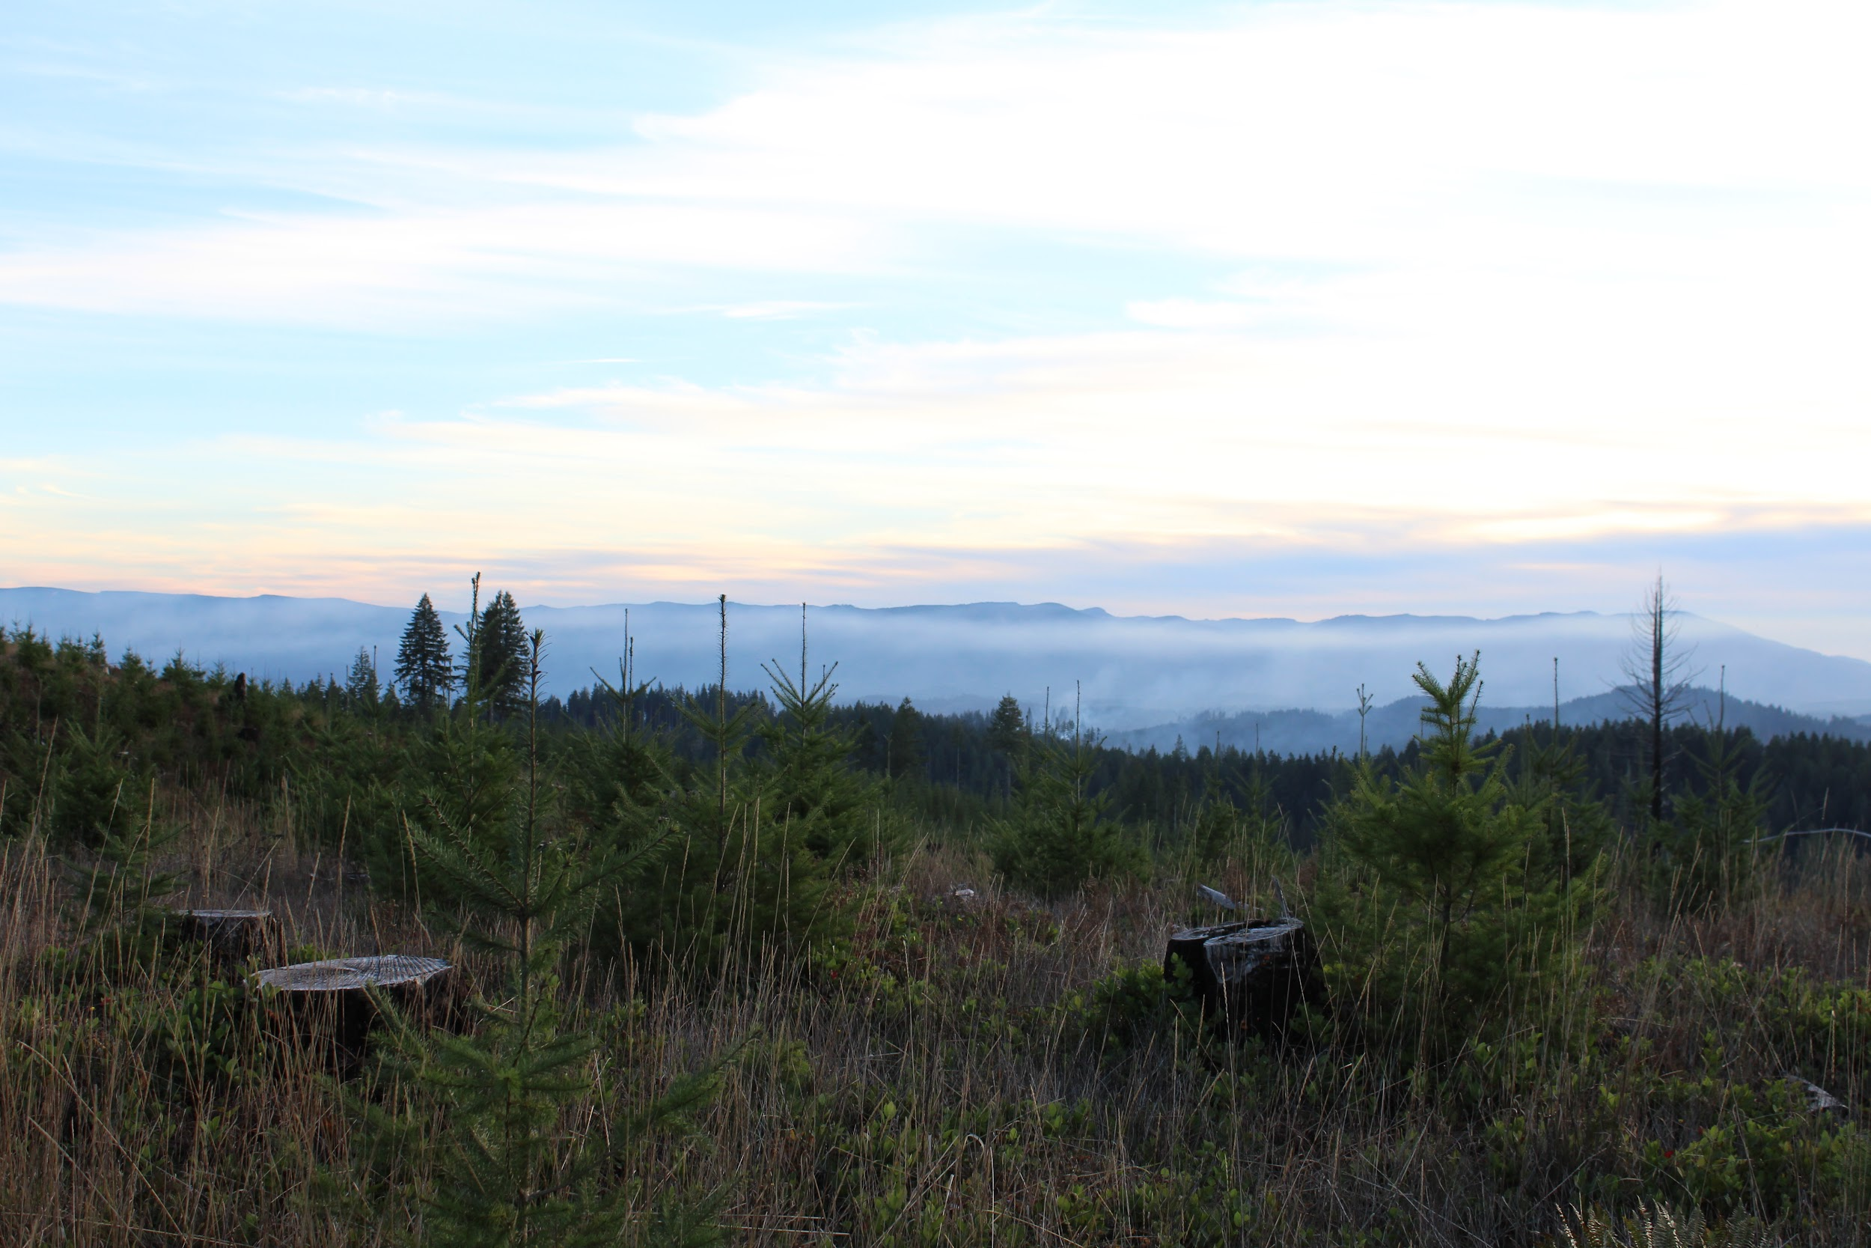
Notes:
Notice the landscape - do you have any ideas about what animals and plants live on the Reservation? Does it look like anywhere you have visited before?

Slide 7
02
Life on the Reservation
01
02
03
04
05
Who and what live on the Reservation?
06

Slide 8
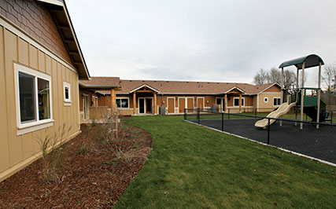
People of
The Confederated Tribes
of Grand Ronde
Notes:
Part of the Grand Ronde Reservation is inhabited by members and families of The Confederated Tribes of Grand Ronde

Slide 9
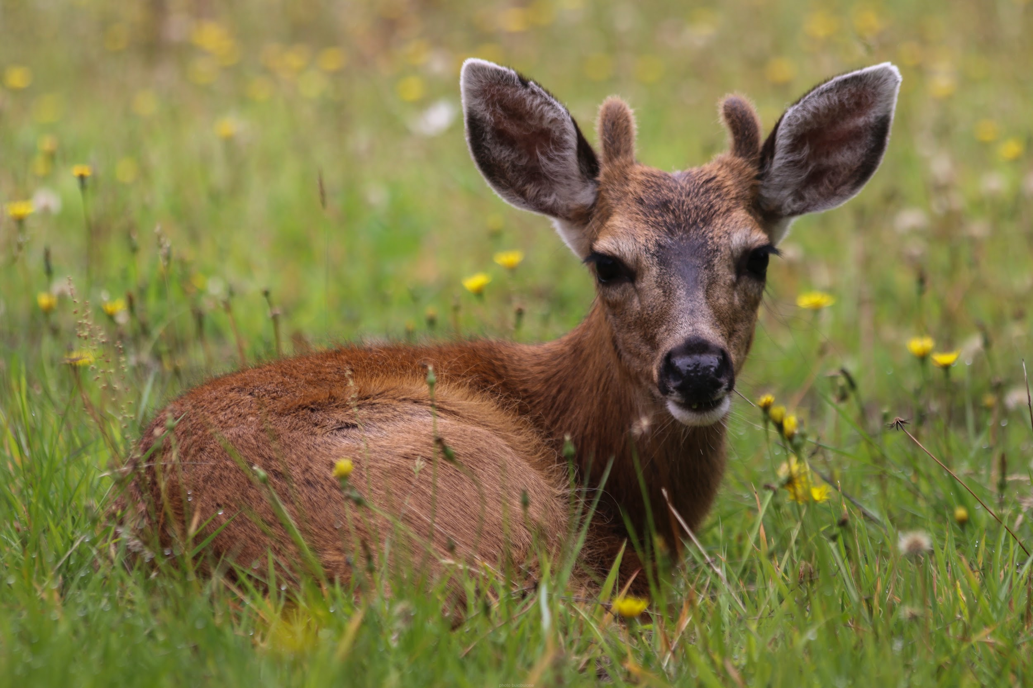
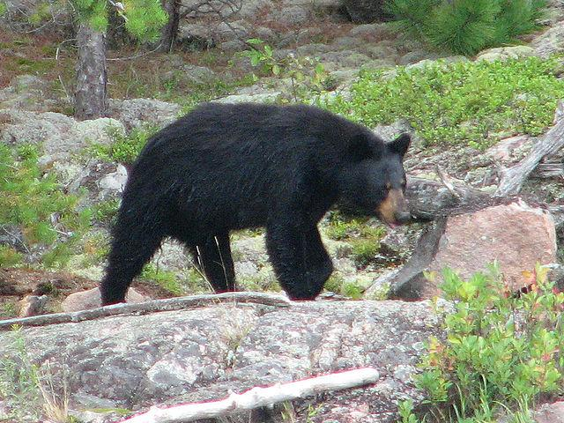
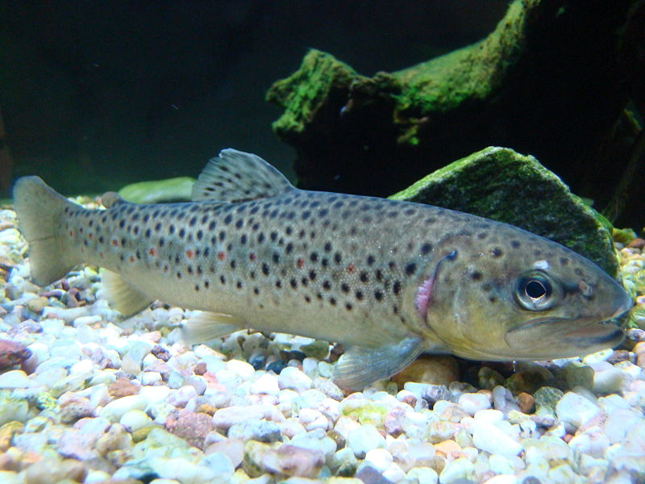
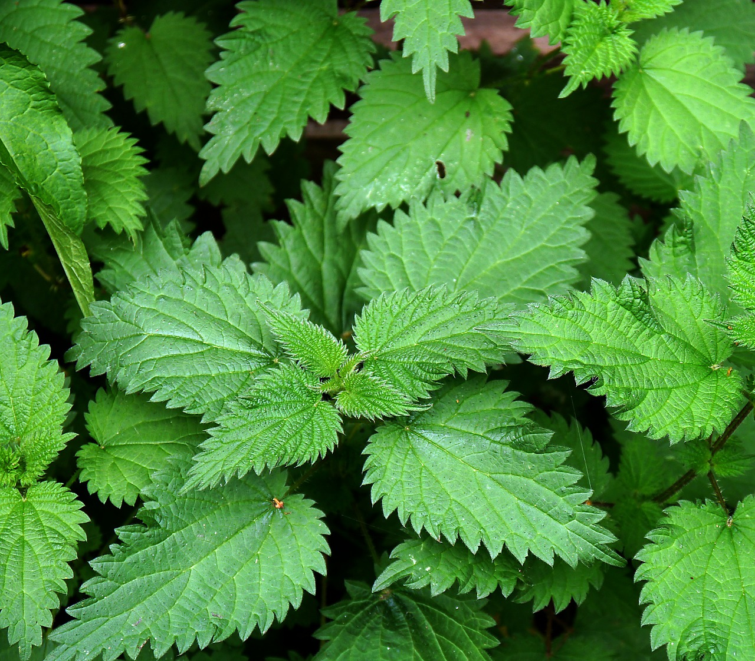
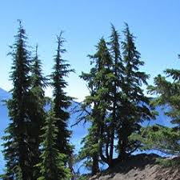
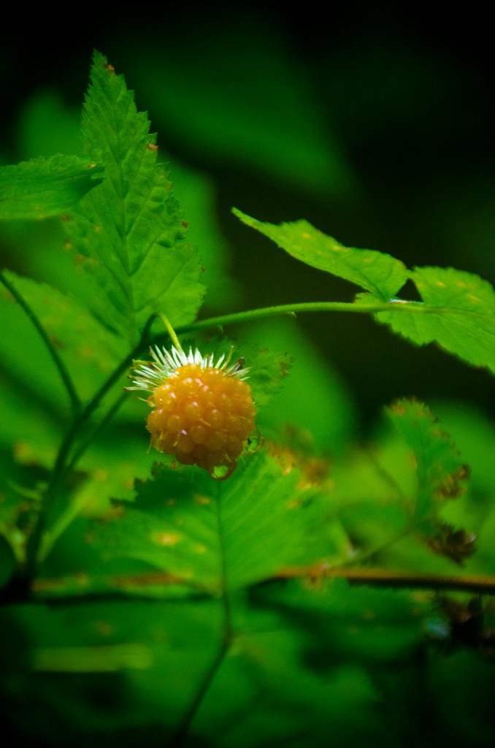
Plants and Animals
Notes:
Most of the Grand Ronde Reservation is inhabited only by plants and animals - including:
Deer
Bear
Fish
Berries
Stinging Nettles
Trees

Slide 10
03
All About Berries
01
02
03
04
05
Help the animals find their way and draw a path while adding the numbers
06
Let's Get Started

Slide 11
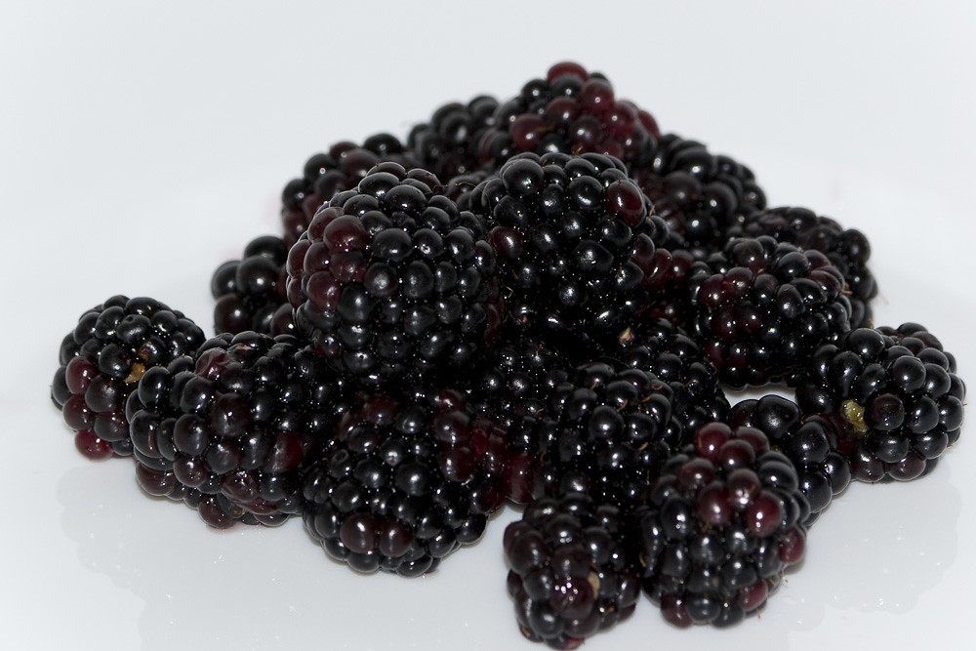
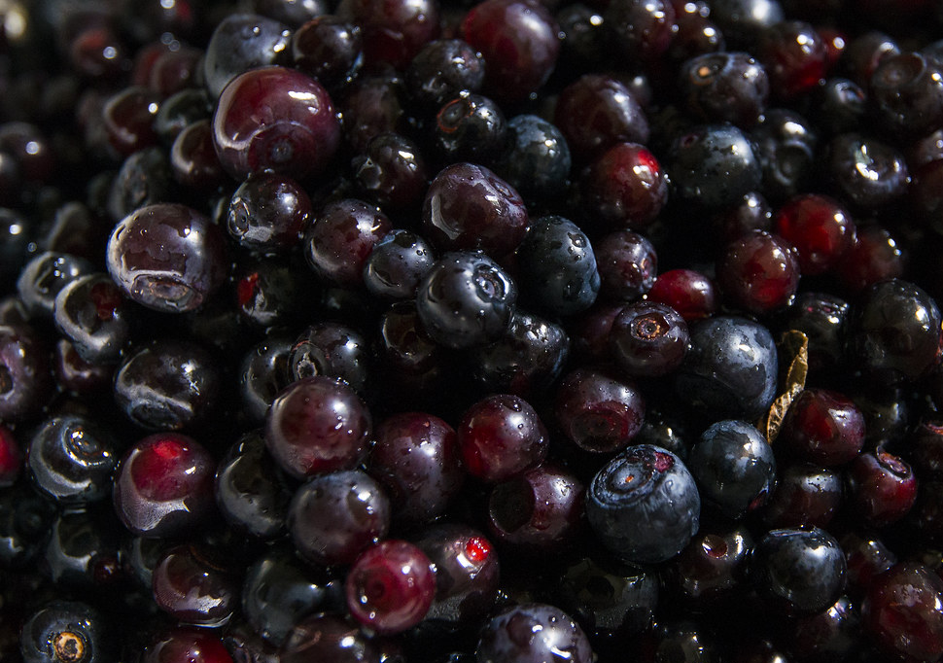
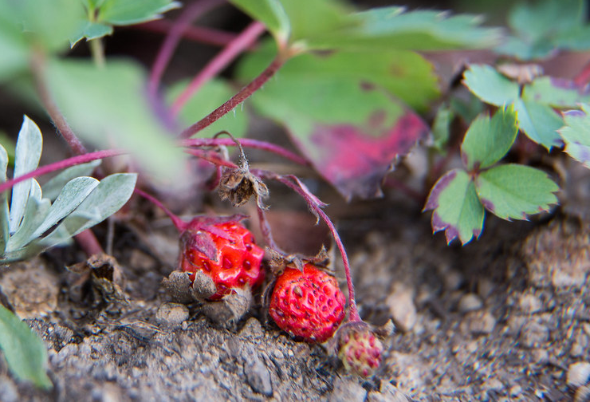
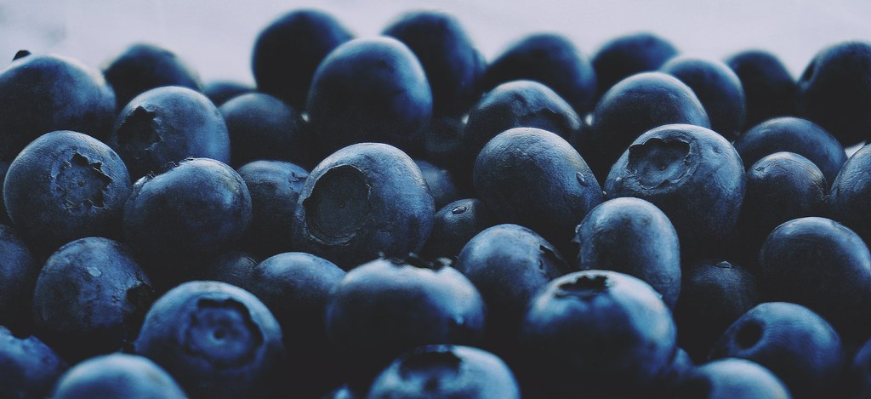
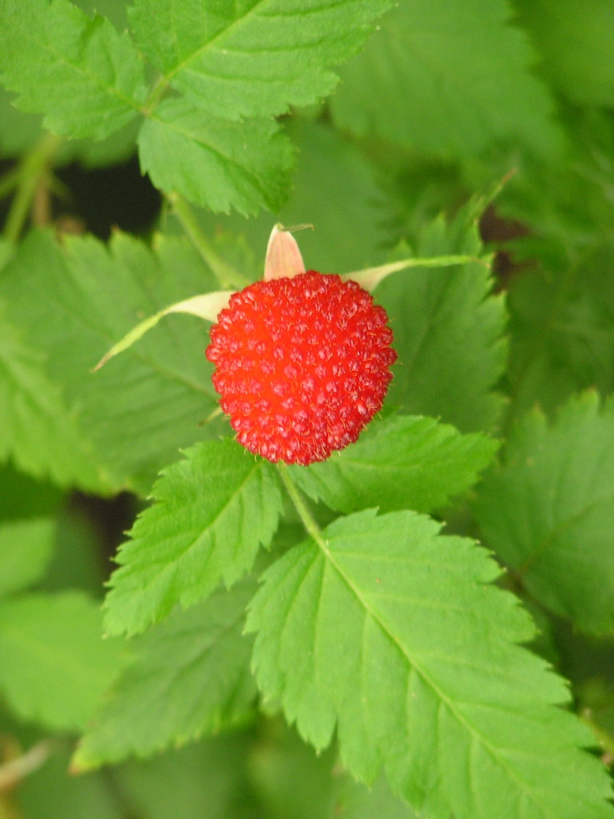
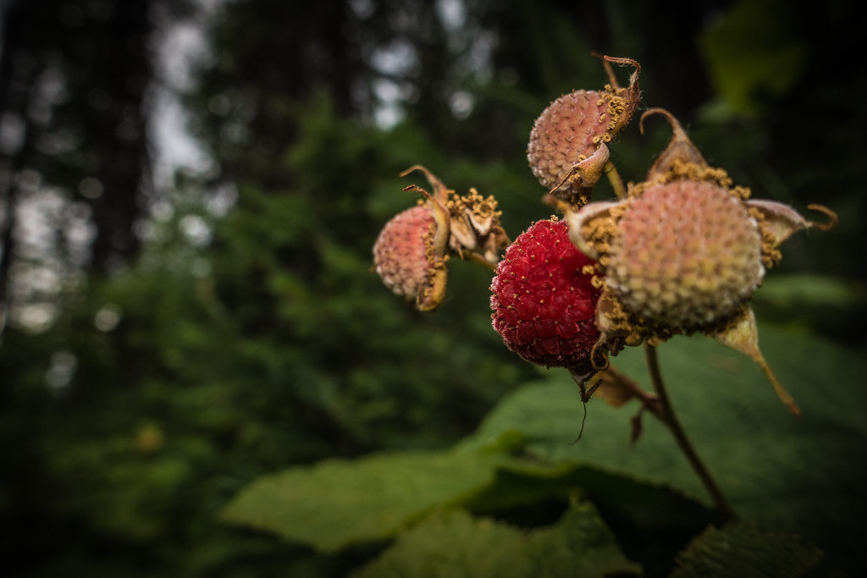
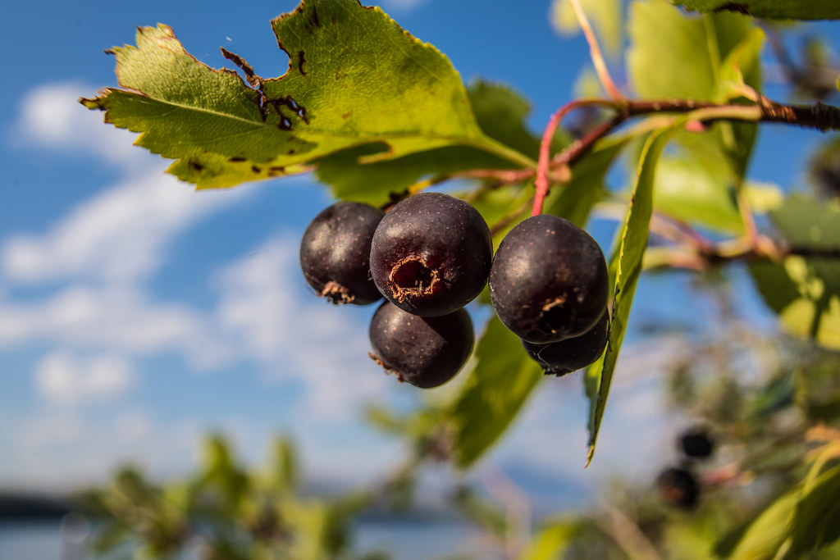
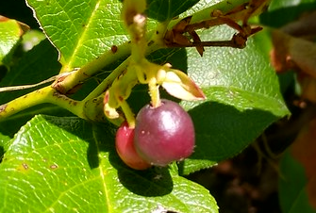
Identifying Berries
Notes:
Before adding the names, can students identify any of the berries on their own? Do they have any guesses?

Slide 12
Identifying Berries
blackberry
salmonberry
huckleberry
strawberry
blueberry
raspberry
thimbleberry
serviceberry
salal berry

Slide 13
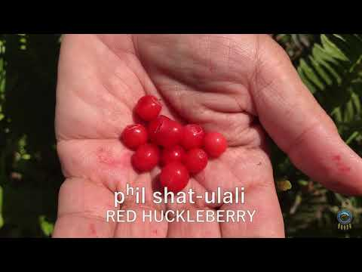
nsayka iliʔi: Reservation
Notes:
Explain to students that they will be watching a video about the berries found on the Grand Ronde Reservation.
Inform students that Greg Archuleta (the person talking about berries in the video) is a Grand Ronde Tribal Member.
The Native language being spoken in this video is chinuk wawa - the language of The Confederated Tribes of Grand Ronde
Watch the video about berries.
Have students focus on the type of berries found on the reservation and how they used the berries.

Slide 14
04
CHINUK
WAWA
01
02
03
04
05
Naming berries in the language of
The Grand Ronde People
06
Let's Get Started

Slide 15

ɬikʰəmuks
Notes:
Review: Ask students what the name of this berry is in English (refer back to slide 12 if needed)
Prepare: Have students look at the name of the berry in chinuk wawa (at the top of the slide). Can students guess how to pronounce the word?
Listen: Click the speaker icon in the bottom right corner. Have students listen to the pronunciation of the word 2-3 times.
Practice: Have students practice pronouncing the word aloud. Say it twice to themselves, then turn to a friend and say it two more times.

Slide 16
samən-ulali
Notes:
Review: Ask students what the name of this berry is in English (refer back to slide 12 if needed)
Prepare: Have students look at the name of the berry in chinuk wawa (at the top of the slide). Can students guess how to pronounce the word?
Listen: Click the speaker icon in the bottom right corner. Have students listen to the pronunciation of the word 2-3 times.
Practice: Have students practice pronouncing the word aloud. Say it twice to themselves, then turn to a friend and say it two more times.

Slide 17
shat-ulali
Notes:
Review: Ask students what the name of this berry is in English (refer back to slide 12 if needed)
Prepare: Have students look at the name of the berry in chinuk wawa (at the top of the slide). Can students guess how to pronounce the word?
Listen: Click the speaker icon in the bottom right corner. Have students listen to the pronunciation of the word 2-3 times.
Practice: Have students practice pronouncing the word aloud. Say it twice to themselves, then turn to a friend and say it two more times.

Slide 18
amuti
Notes:
Review: Ask students what the name of this berry is in English (refer back to slide 12 if needed)
Prepare: Have students look at the name of the berry in chinuk wawa (at the top of the slide). Can students guess how to pronounce the word?
Listen: Click the speaker icon in the bottom right corner. Have students listen to the pronunciation of the word 2-3 times.
Practice: Have students practice pronouncing the word aloud. Say it twice to themselves, then turn to a friend and say it two more times.

Slide 19
qusax̣-pchix̣-ulali
Notes:
Review: Ask students what the name of this berry is in English (refer back to slide 12 if needed)
Prepare: Have students look at the name of the berry in chinuk wawa (at the top of the slide). Can students guess how to pronounce the word?
Listen: Click the speaker icon in the bottom right corner. Have students listen to the pronunciation of the word 2-3 times.
Practice: Have students practice pronouncing the word aloud. Say it twice to themselves, then turn to a friend and say it two more times.

Slide 20
bastən- siyapuɬ-ulali
Notes:
Review: Ask students what the name of this berry is in English (refer back to slide 12 if needed)
Prepare: Have students look at the name of the berry in chinuk wawa (at the top of the slide). Can students guess how to pronounce the word?
Listen: Click the speaker icon in the bottom right corner. Have students listen to the pronunciation of the word 2-3 times.
Practice: Have students practice pronouncing the word aloud. Say it twice to themselves, then turn to a friend and say it two more times.

Slide 21
siyapuɫ-ulali
Notes:
Review: Ask students what the name of this berry is in English (refer back to slide 12 if needed)
Prepare: Have students look at the name of the berry in chinuk wawa (at the top of the slide). Can students guess how to pronounce the word?
Listen: Click the speaker icon in the bottom right corner. Have students listen to the pronunciation of the word 2-3 times.
Practice: Have students practice pronouncing the word aloud. Say it twice to themselves, then turn to a friend and say it two more times.

Slide 22
təmstiyu
Notes:
Review: Ask students what the name of this berry is in English (refer back to slide 12 if needed)
Prepare: Have students look at the name of the berry in chinuk wawa (at the top of the slide). Can students guess how to pronounce the word?
Listen: Click the speaker icon in the bottom right corner. Have students listen to the pronunciation of the word 2-3 times.
Practice: Have students practice pronouncing the word aloud. Say it twice to themselves, then turn to a friend and say it two more times.

Slide 23
salal
Notes:
Review: Ask students what the name of this berry is in English (refer back to slide 12 if needed)
Prepare: Have students look at the name of the berry in chinuk wawa (at the top of the slide). Can students guess how to pronounce the word?
Listen: Click the speaker icon in the bottom right corner. Have students listen to the pronunciation of the word 2-3 times.
Practice: Have students practice pronouncing the word aloud. Say it twice to themselves, then turn to a friend and say it two more times.

