Slide 1
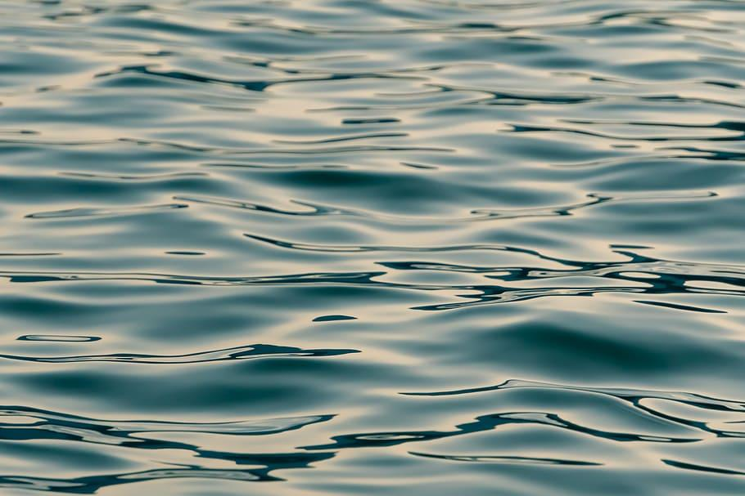

Examining Data
How observant are you?
Notes:
Before teaching the lesson, please read the background notes for the teacher.

Slide 2
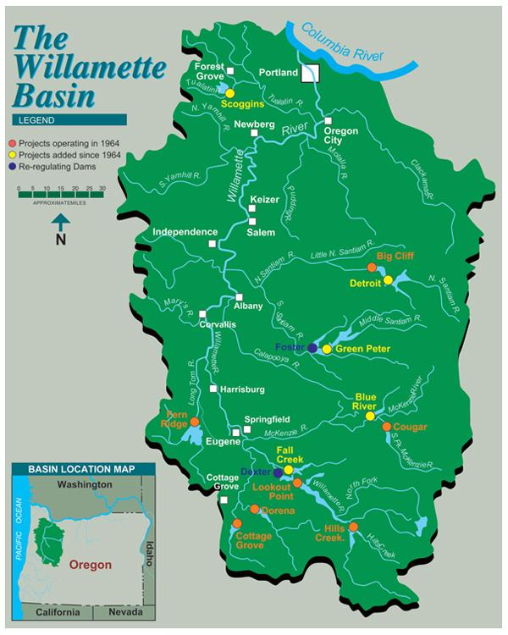
Dams in the Willamette River System
There are 13 dams in the Willamette system
Advantages of having a dam on a river
Provides an abundant source of freshwater for drinking, irrigation, and industrial use.
Can be a renewable energy source through hydroelectric power.
Creates recreational opportunities such as fisheries, boating, and swimming.
Can help to control flooding
Disadvantages of having a dam on a river
Can cause displacement of people living in the area, as well as disruption of animal and plant life.
Can lead to increased sediment buildup, which can alter the natural flow of the river.
Can cause changes in local water temperatures, which can have a negative effect on aquatic life.
Can lead to increased erosion of the riverbanks, which can lead to land instability and landslides.
Notes:
Optional Information to Share: Dams can potentially block off key habitat to salmon & lamprey species and interrupt natural flows to rivers among many other things. Dams also can create bottlenecks as fish try to use passages. At dams where passage is available, it can become a hotspot for predators, like sea-lions at Willamette Falls.

Slide 3
Examine the map and consider the information you just heard.
What do you notice? Record your observations
What do you wonder? Record questions you have about the data

Slide 4
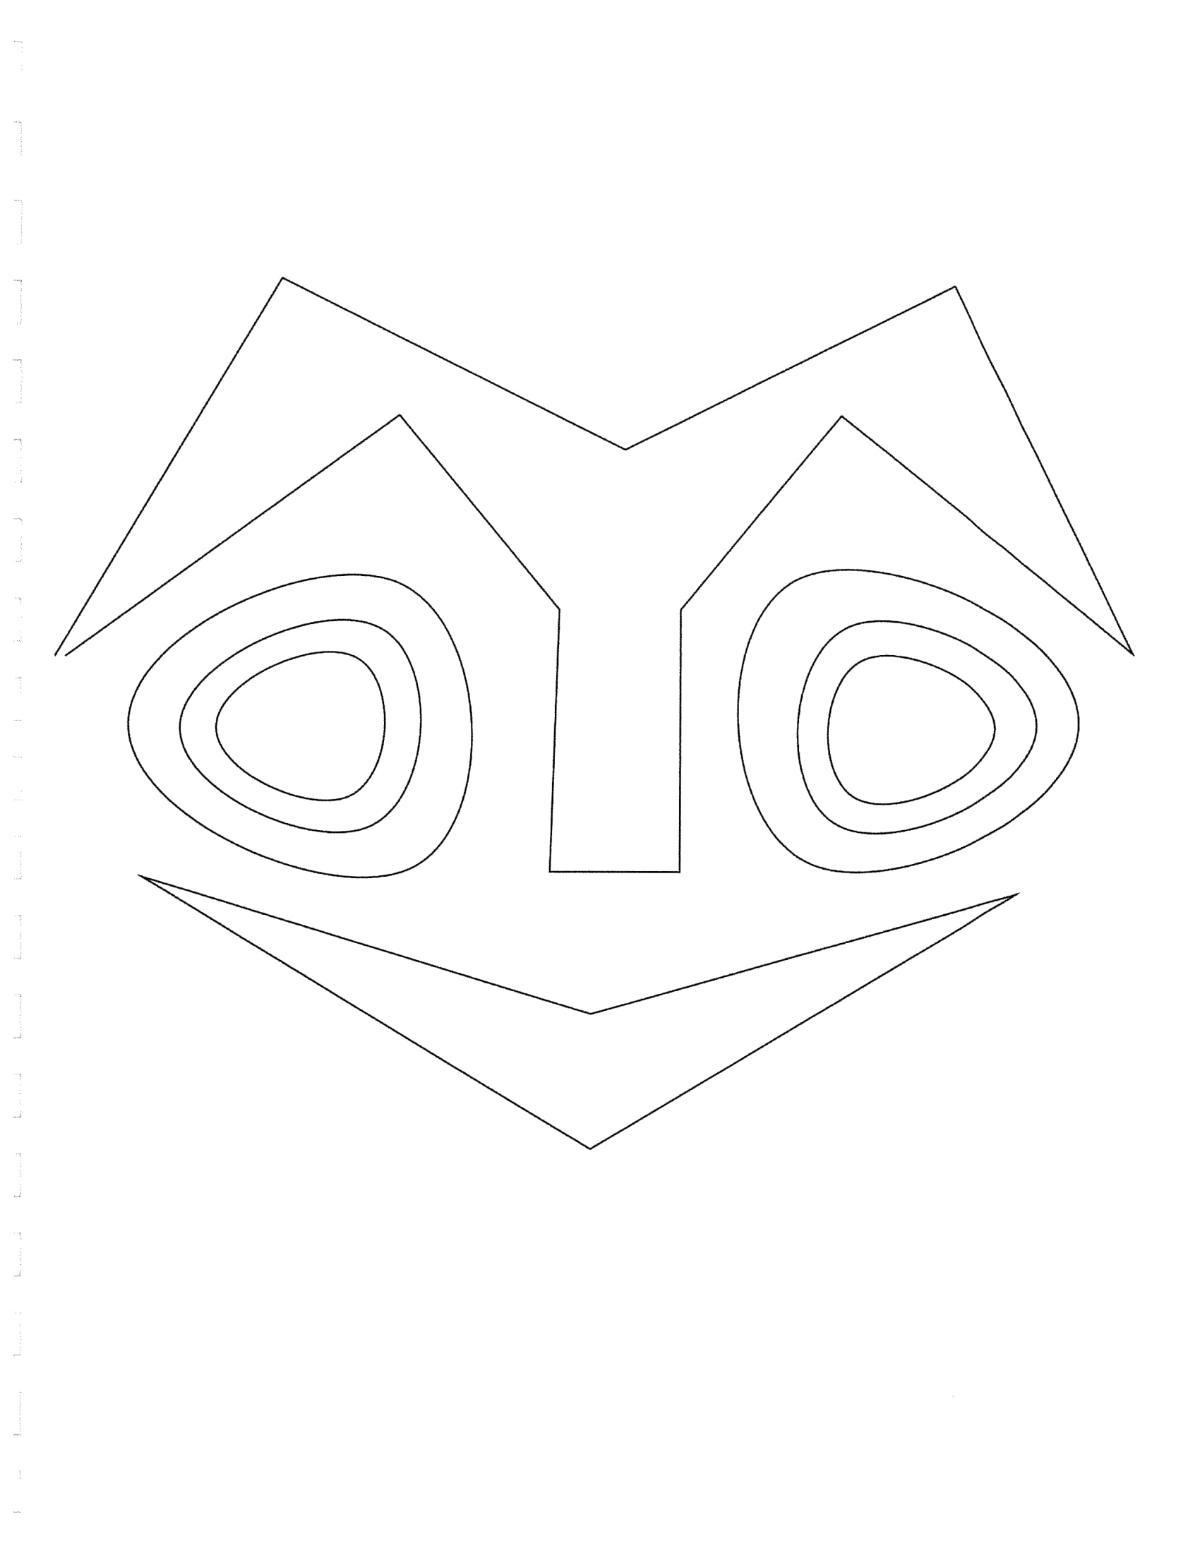
What Did You Notice?
Person 1 starts by sharing what they noticed, followed by Person 2, etc...
Person 4 records the noticings for the group.
After everyone has shared what they noticed, repeat for questions. Person 3 records the questions for the group.

Slide 5
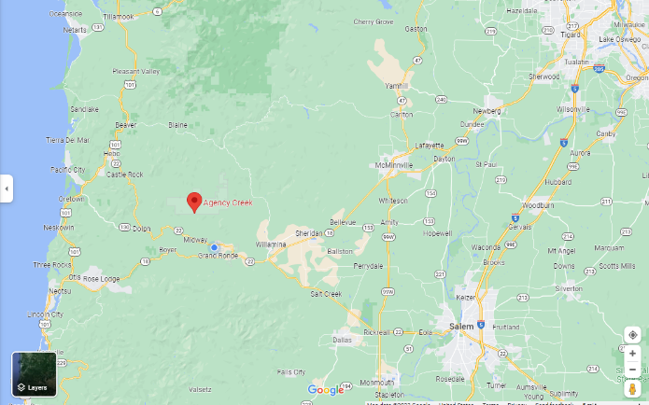
Notes:
The next two sets of data are from Agency Creek on the Confederated Tribes of Grand Ronde Reservation. Have students locate where they would be on the map compared to Agency Creek. Also have students consider the potential amount of impact from human presence, pollution, etc. How would this compare to other water sources in Oregon?

Slide 6
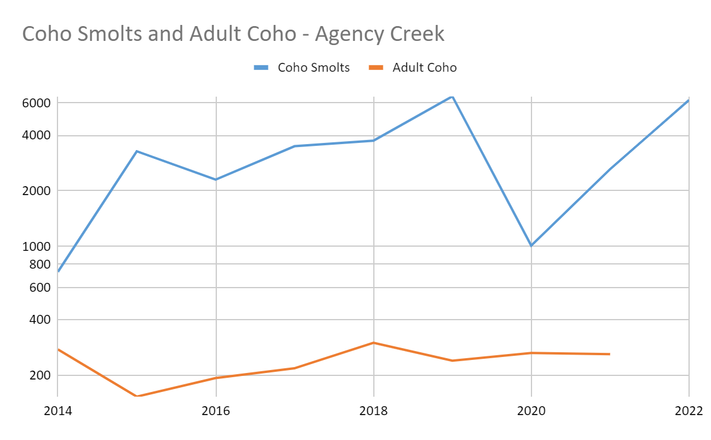
Agency Creek Fish Counts
Year | Coho Smolts | Adult Coho
2013 | 228 | 398
2014 | 728 | 276
2015 | 3280 | 153
2016 | 2302 | 193
2017 | 3493 | 218
2018 | 3742 | 300
2019 | 6508 | 240
2020 | 1009 | 264
2021 | 2625 | 260
2022 | 6219
Notes:
Agency creek fish counts are done by Tribal Biologists at the weir and day camp one mile from Agency creek’s confluence with the South Yamhill River. Smolt counts are obtained using a screw trap and a capture/recapture method. Adult counts were obtained in two different ways. (2007-2015) Fish were hand counted at weir, but counts were subject to flow and data tended to be inaccurate. (2016-Present) Data was collected using a sonar device that allows for 24/7 monitoring.

Slide 7
What Did You Notice?
Person 1 starts by sharing what they noticed, followed by Person 2, etc...
Person 4 records the noticings for the group.
After everyone has shared what they noticed, repeat for questions. Person 3 records the questions for the group.

Slide 8
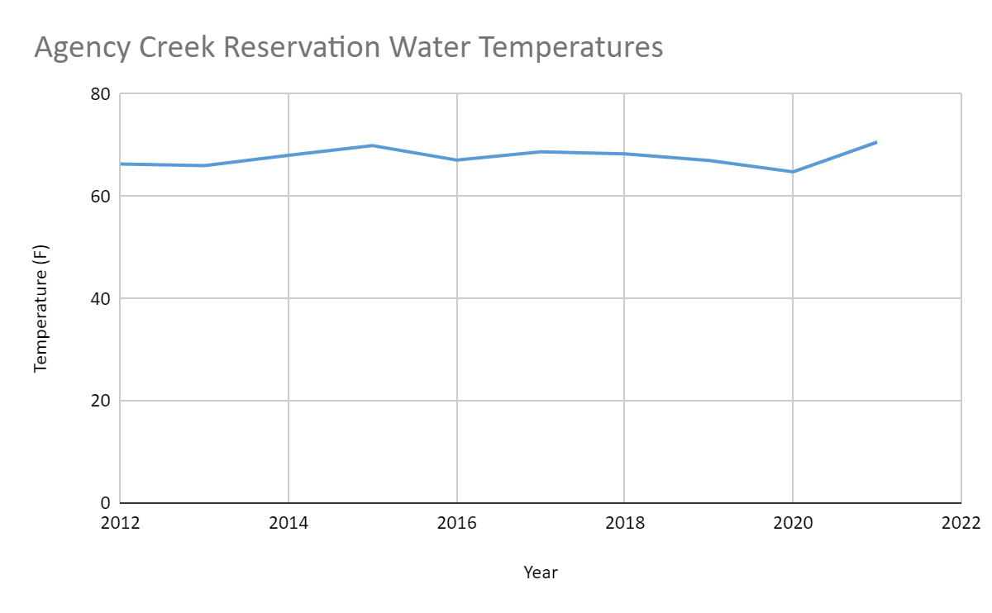
Year | Degrees (Fahrenheit)
2012 | 66.3
2013 | 66
2014 | 68
2015 | 69.9
2016 | 67.1
2017 | 68.7
2018 | 68.3
2019 | 67
2020 | 64.8
2021 | 70.6
2022
Notes:
Water quality temperatures are compared using 7-day maximum averages. This is the calculation of the average of a daily maximum temperature from seven consecutive days on a rolling basis. Water Quality data was obtained by Tribal Biologists from the reservation and surrounding areas.

Slide 9
What Did You Notice?
Person 1 starts by sharing what they noticed, followed by Person 2, etc...
Person 4 records the noticings for the group.
After everyone has shared what they noticed, repeat for questions. Person 3 records the questions for the group.
Notes:
In teams of 4, have students number off 1 - 4. Starting with the 1’s, each team member shares what they noticed (not the questions). The number 4 person records the collective noticings. Once sharing begins, students do not need to share something that’s already been shared - they can add anything that someone else hasn’t already said. Then, repeat for questions but Person 3 records the questions.

Slide 10
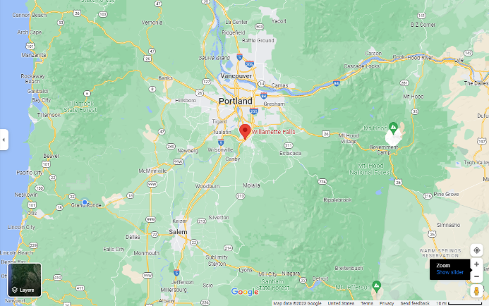
Notes:
The next set of data is from Historic Willamette Falls in Oregon City. Have students locate where they would be on the map compared to Willamette Falls. Also have students consider the potential amount of impact from human presence, pollution, etc. How would this compare to other water sources in Oregon?

Slide 11
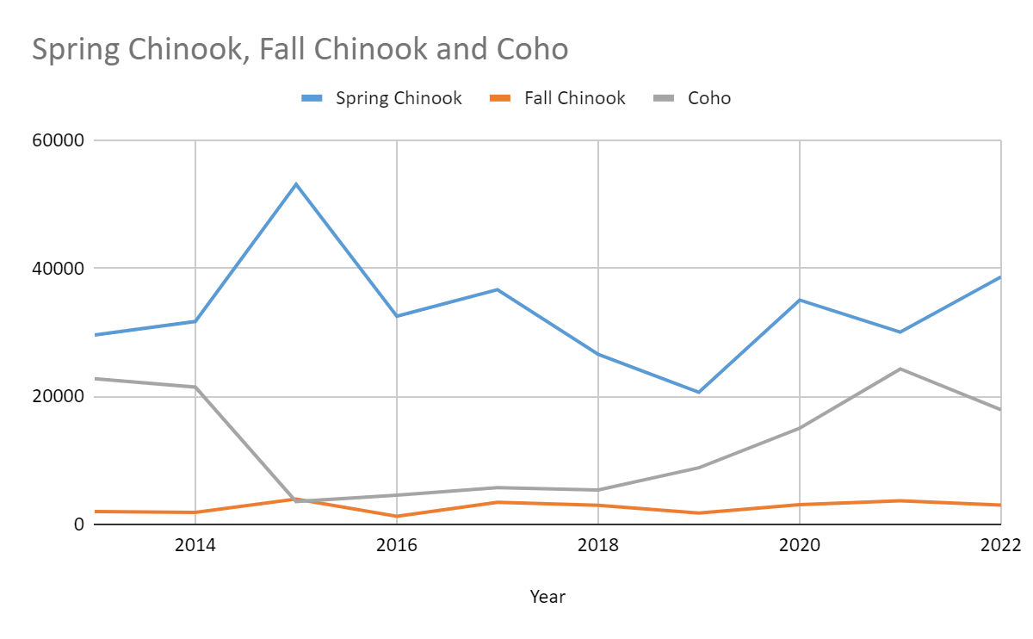
Historical Willamette Falls Fish Counts
Year | Spring Chinook | Fall Chinook | Coho
2013 | 29561 | 1999 | 22738
2014 | 31669 | 1862 | 21441
2015 | 53088 | 3953 | 3573
2016 | 32478 | 1263 | 4550
2017 | 36628 | 3462 | 5721
2018 | 26542 | 2977 | 5361
2019 | 20617 | 1766 | 8843
2020 | 35012 | 3082 | 15004
2021 | 30025 | 3682 | 24257
2022 | 38629 | 3021 | 17890
Notes:
These runs are counted by Oregon Department of Fish and Wildlife at the Willamette Falls fish ladder. Some of these runs, like Spring Chinook are maintained by strong hatchery runs, while native runs suffer. Fall chinook are good examples of mainly native fish runs and the graphs represent that with such a steep decline.

Slide 12
What Did You Notice?
Person 1 starts by sharing what they noticed, followed by Person 2, etc...
Person 4 records the noticings for the group.
After everyone has shared what they noticed, repeat for questions. Person 3 records the questions for the group.
Notes:
In teams of 4, have students number off 1 - 4. Starting with the 1’s, each team member shares what they noticed (not the questions). The number 4 person records the collective noticings. Once sharing begins, students do not need to share something that’s already been shared - they can add anything that someone else hasn’t already said. Then, repeat for questions but Person 3 records the questions.

Slide 13

Class Noticings and Wonderings
Person 2 will share what their group noticed.
Person 1 will share questions the group has.
Notes:
Have each group share their noticings and questions. Record on chart paper or on a white board the noticings that come up and questions. For things groups noticed that may not be evident, be sure to ask what they think it may mean.

Slide 14
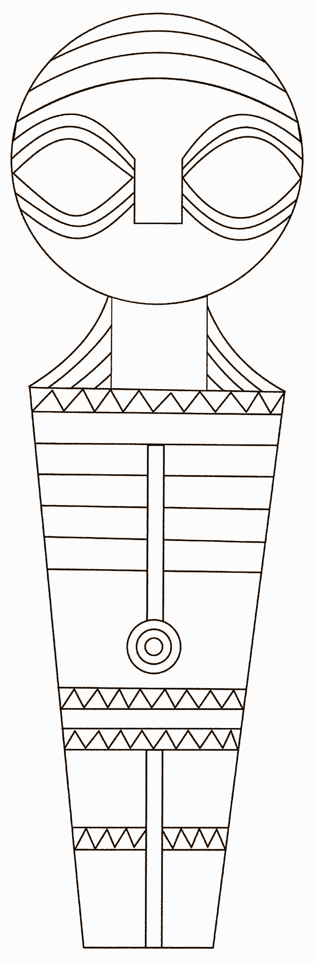
Design a Method Activity
Work with your team to review your human impact scenario. Answer the following questions:
What is the human impact on the environment in this situation?
What is the effect of the human impact on the fish populations?
In what ways could the fish population be monitored?
Design a plan to reduce the human impact on the environment in this situation.

Slide 15

Additional Information?
What questions do you still have?

