Slide 1

Harvesting Timber

Slide 2
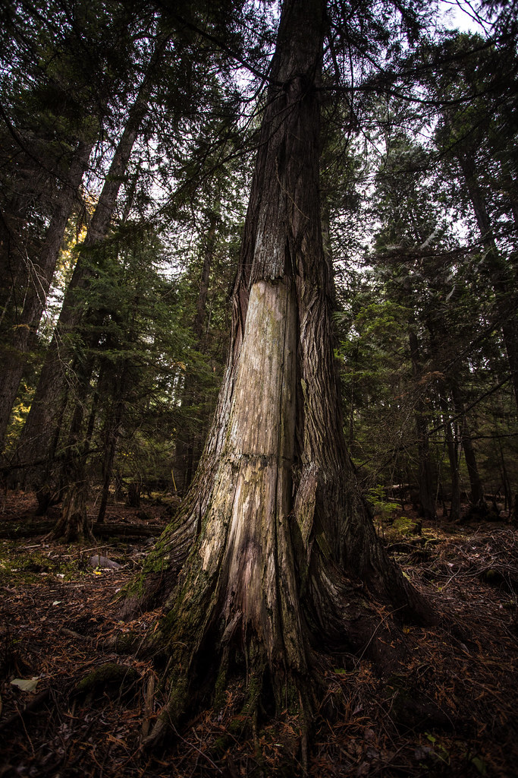
Historical Harvesting Methods
Sustainability
Management vs. Clearing
Tools
  Fire
Controlled Harvest
Uses:
  Canoes
  Plankhouses
  Art
  Clothing/Basketry
  Tools
Notes:
Since time immemorial, Native peoples have worked to live with the land in an equal relationship. The land gives to the people and the people give to the land. This type of relationship ensures survival for both parties long-term. Today, this process is widely known as sustainability. (definition: Sustainability consists of fulfilling the needs of current generations without compromising the needs of future generations, while ensuring a balance between economic growth, environmental care and social well-being.) Native peoples have always emphasized the process of managing the land versus clearing the land.
Historically, Native peoples used both fire and tools for land management. Controlled burns (definition: also known as hazard reduction burning, backfire, swailing, or a burn-off, is a fire set intentionally for purposes of forest management, farming, prairie restoration or greenhouse gas abatement) were set to clear underbrush, stimulate berry and root production, and to fertilize and clear the soil. Fire has been one of the most powerful tools for Native people for thousands of years. The use of fire as a land management tool was misunderstood by many settlers when they arrived in the Pacific Northwest. These settlers were not accustomed to this practice and did not understand the carefully crafted method developed by tribes. Due to these misconceptions, settlers began clearing land using their own strategies and practices - which often led to decimation of resources.
Native peoples of the Pacific Northwest also used other hand-crafted tools in their land management practices. Some of these tools can be viewed on the following slide. Tools were often crafted using bone, stone, shell, hides, plant materials, and wood. The wood harvested with these tools served many purposes within the tribe. Planks were harvested from live standing trees, mainly straight grain trees, such as western red cedar and redwood. The bark of cascara sagrada and many other species of trees was harvested for medicine and food or to create baskets for berry picking. Cedar bark can also be used to weave clothing items such as hats and skirts. (see slide 4)

Slide 3

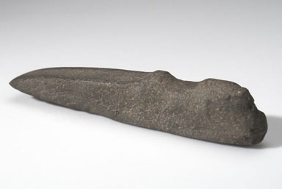
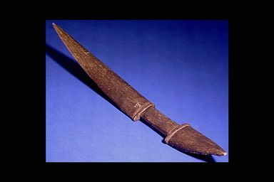
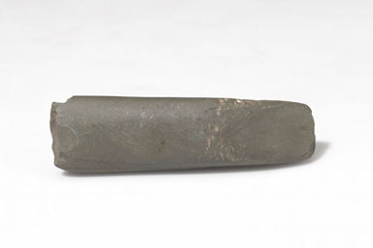
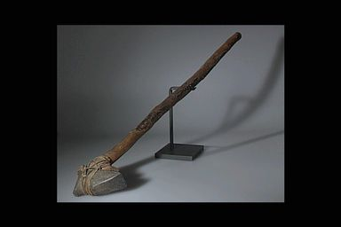
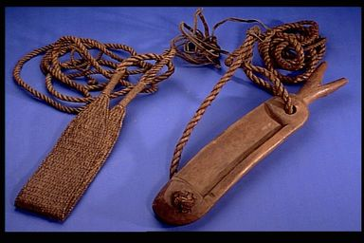
Digging Stick
Axe
Bone Knife
Adze
Axe
Bark Cutter
Images from AMNH Collections: Pacific Northwest Coast

Slide 4
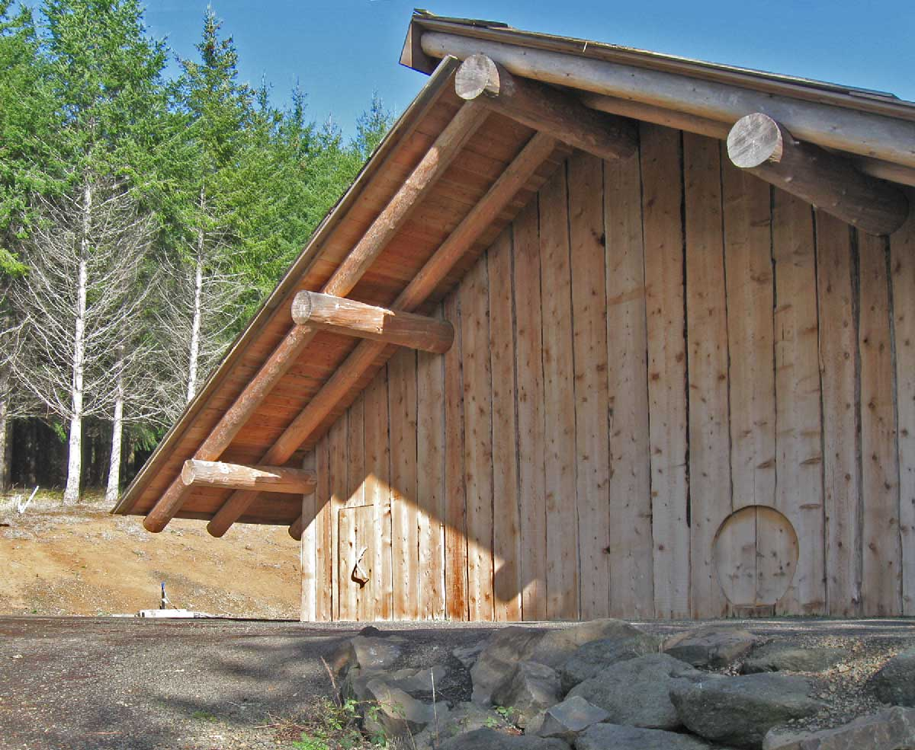

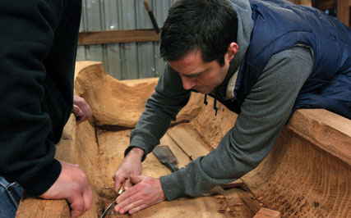

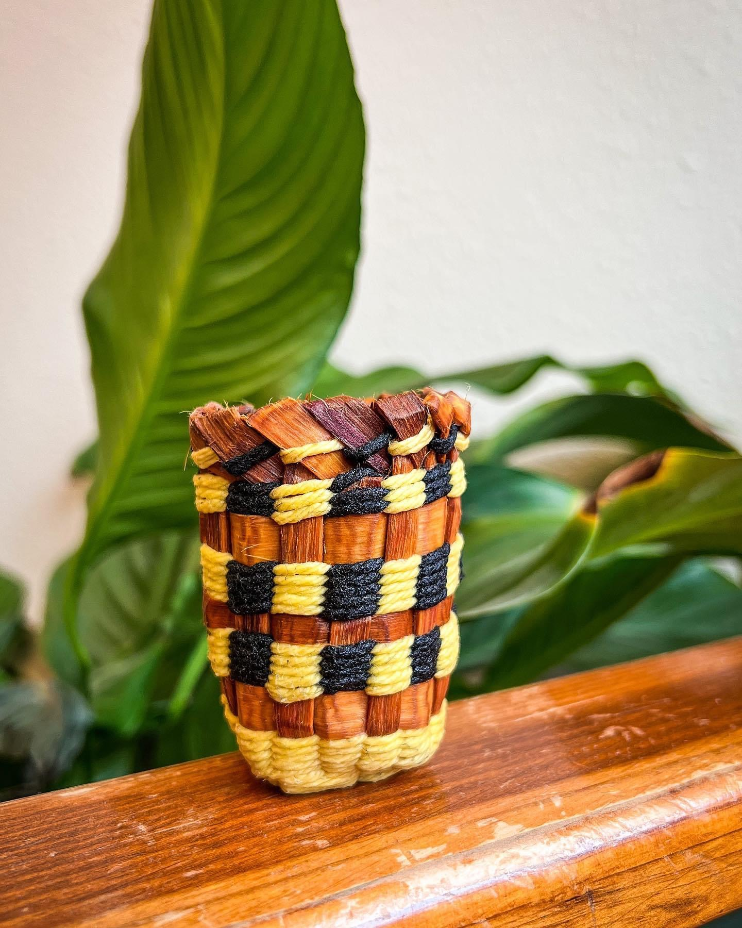
Cedar
Hat
Canoe
Plankhouse
Cedar
Skirt
Cedar Basket
Cedar
Shawl
Uses
of
Harvest

Slide 5
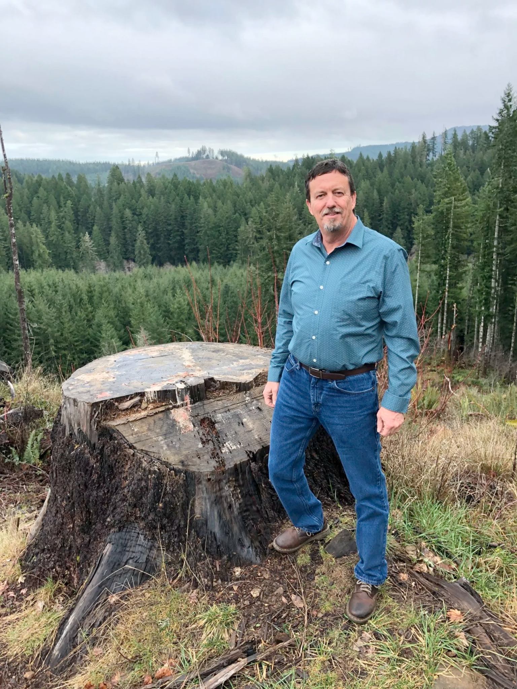
Modern Harvesting Methods
Logging
Continued emphasis on sustainability
Greater diversity in trees and plants
Balance between harvesting for income, harvesting for culture, restoring diversity and long-term land viability.
Examples of Practices:
  Trees are thinned to accommodate foraging areas for elk and deer.
  Brush is cut by hand instead of using aerial herbicides
  Prescribed burns control slash and enable certain growth that benefit the ecosystem.
Watch: Green Feathers | A Story of Native American Logging
Michael Wilson, former Director of Natural Resources for the Confederated Tribes of the Grand Ronde, on part of the tribe's acreage.
Notes:
Native peoples continued their investment in land management through logging. During removal and relocation in the mid-1850s, Native peoples from the reservations in Grand Ronde, Siletz, Warm Springs, and Klamath traveled to the Willamette Valley and other Oregon agricultural areas to work the harvests. Many families worked as groups to harvest hops, berries, and beans through the summer months while living at tribal encampments. Native men quickly figured out that logging provided a more reliable income than seasonal harvests.
“By the late nineteenth century, native men had become principal workers in the logging industry. Many men left their reservations for months or years at a time to work in the woods. They traveled to wherever logging was paying well, from Alaska to California, and many became the lead loggers in their outfits. While their families remained on the reservation, these workers lived in logging camps and sent money home to help pay the bills.” -Oregon Encyclopedia
Although some of the practices for land management have changed and modernized, the Tribe has always placed sustainability at the front of the priority list. The Tribe continues to focus on cultivating and maintaining the land for generations to come - as many other aspects of Native culture do as well. Because of this, lands managed by tribes tend to have more diversity in their plants and trees when compared to forest lands managed by timber companies. Many of these trees and plants are essential to continue cultural practice such as weaving, carving, and the usage of medicinal herbs. Managing Native forest lands is truly a balance of harvesting for income, harvesting for culture, restoring and maintaining diversity, and sustaining long-term land viability.
As we said earlier, harvesting methods have changed some since the methods used thousands of years ago. Today, tribes must work with their Natural Resources or Lands Management divisions to decide what is best for the land being harvested. At the Confederated Tribes of Grand Ronde, the Natural Resources Department must also work with the Timber Committee - which is comprised of community tribal members used as advisors for timber decisions. A few examples of modern harvesting methods include:
Instead of clear-cutting or burning out entire areas, the forests are often thinned (definition: a few trees are cut down within the forest to make room for the others to grow). This practice of thinning trees allows for more light to reach the understory and forest floor layers. This can help promote the growth of smaller bushes and plants, as well as create better foraging areas for elk and deer.
Brush on the tribal lands is cut by hand versus eliminated using herbicides (definition: chemicals used to manipulate or control undesirable plant growth). By cutting the brush by hand, it reduces the risk of air, water and soil pollution. Herbicides can contaminate the soil as well, and the rainwater can carry these chemicals to other areas which will eventually pollute the waterways. Herbicide-contaminated waters can kill fish and other aquatic life.
Prescribed burns are still used in areas of land management. The right fire at the right place at the right time can reduce overcrowding of trees which reduces the risk of large, uncontrollable wildfires in the future. Prescribed burns can also minimizes the spread of pest insects and disease and recycle nutrients back into the soil.
Have students watch this short video on Native American logging in the Pacific Northwest.

Slide 6
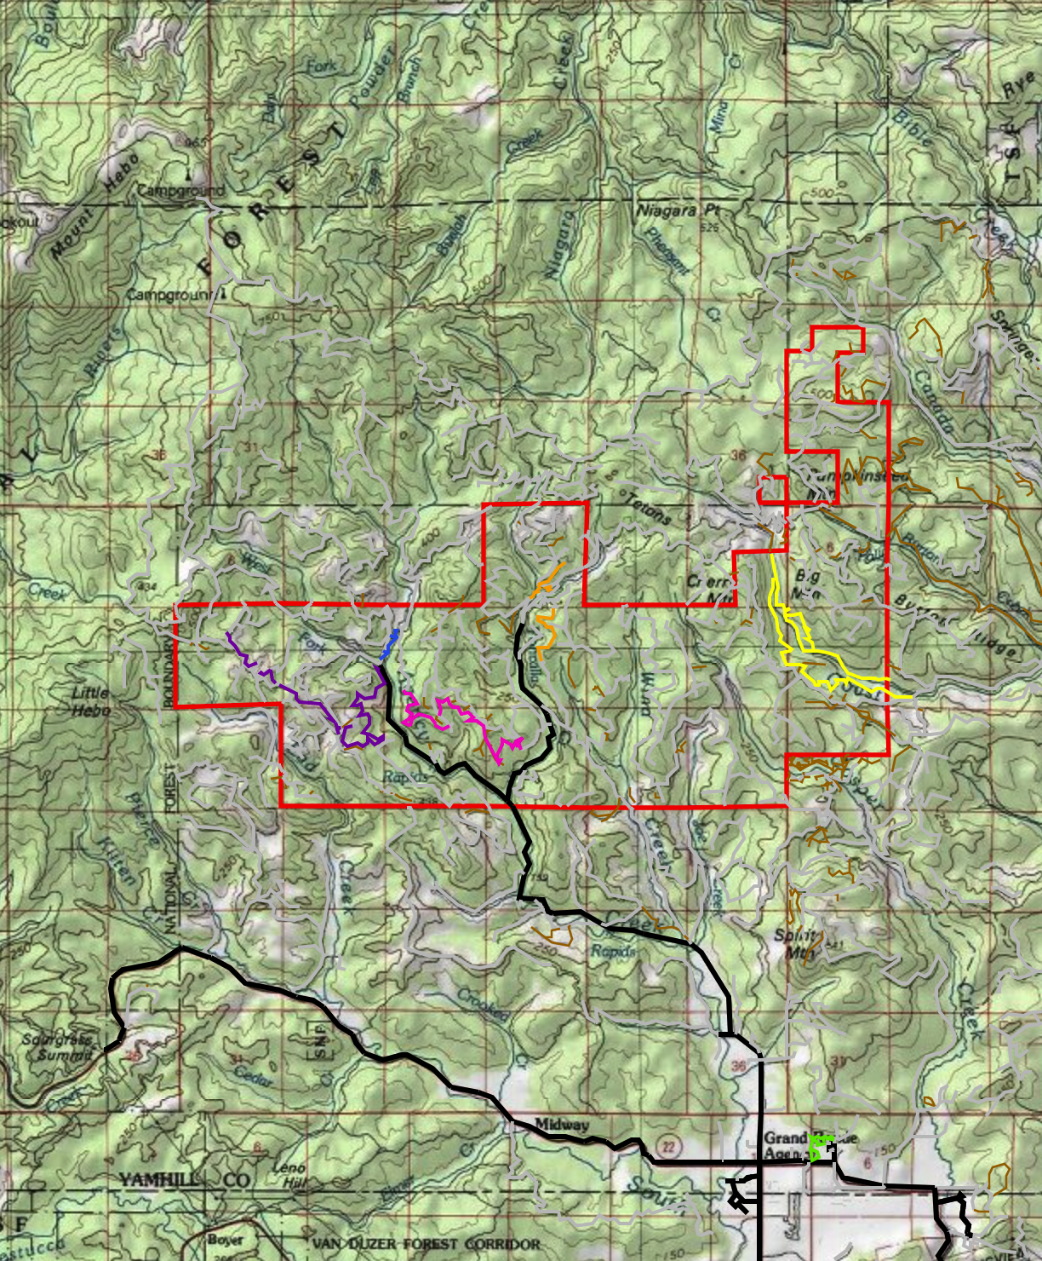
Managing Native Lands
The Confederated Tribes of Grand Ronde manages approximately 11,000 acres of land surrounding Grand Ronde, OR and other significant areas within the state.
The Tribe’s 2013-2022 Natural Resources Management Plan (NRMP) allows an average annual timber harvest of 7.12 million board feet.
The Tribe must work with surrounding agencies, such as Bureau of Land Management, the United States Forest Service, and private landowners.
Money from the timber harvest goes back to the Tribe and its people.

Slide 7
Resources
Timber and Roads | Confederated Tribes of Grand Ronde
AMNH Division of Anthropology Collections
Native American Loggers in Oregon
Native American Tribes Gaining Recognition For Timber And Forestry Practices
CTGR Maps | Reservation
Reservation Road Map

