Slide 1
CHEMAWA INDIAN SCHOOL
History & Images

Slide 2
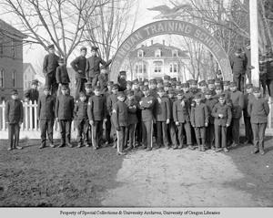

Slide 3
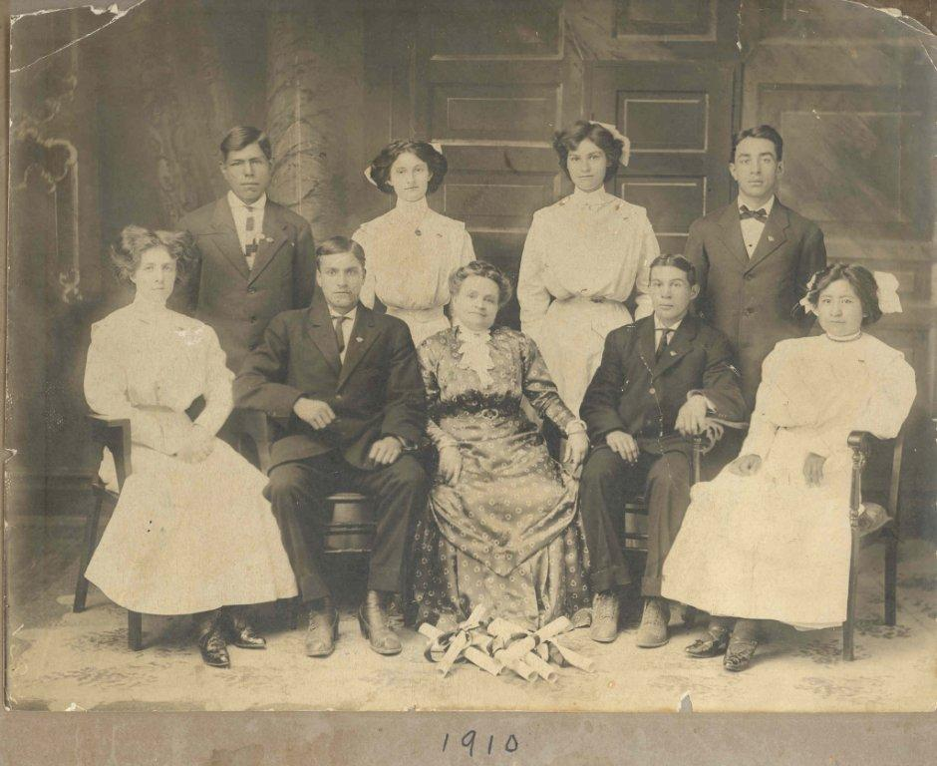

Slide 4
HISTORY
Step One: Read Aloud
“Chemawa Indian School opened in 1880 in Forest Grove as part of the federal government’s efforts to forcibly assimilate Native American youth. The school moved five years later. The school moved to Salem thanks in no small part to the labor of American Indian students. They earned money growing produce, making shoes and picking hops.”

Slide 5
HISTORY
Step Two: Listen
Follow the link below -
https://www.opb.org/news/series/chemawa/indian-school-oregon-finance-history-board-future/
Listen to the audio recording at the top of the page. (Approximately 6 mins)

Slide 6
HISTORY
Step Three: Research
Using the two information sources listed below - read about the history of Chemawa Indian School.
Think about the stories both articles tell. How are they similar? How are they different?
Source One: https://chemawa.bie.edu/history.html#:~:text=Chemawa%20History,operation%20on%20the%20East%20Coast
Source Two: https://www.oregonencyclopedia.org/articles/chemawa_indian_boarding_school/#.YuxQknbMK70

