Slide 1
Portland, OR (Hybrid)
October 13, 2022
Constitutional Amendment Education Meeting #1

Slide 2
Process
This election is a federal election and is being conducted by the Bureau of Indian Affairs (BIA) for the Tribe in accordance with Federal Regulations.
You must have returned a register for this election.
Challenges for the posted Registered Voters List were due October 7th.
Mailout ballots with instructions were mailed out on the 7th after the Registered Voter List was finalized.
No request is required to receive a mailout ballot. Ballots will be sent to all registered voters listed on the final Registered Voters List.
The Mailout ballots must be received by mail no later than 12 pm noon on November 2, 2022, at the Grand Ronde Post Office.

Slide 3
Timeline
September 12, 2022
The Tribe submitted the request for the election; the election was then authorized by the BIA.
September 15, 2022
The first board meeting was held by the election board.
September 23, 2022
Packets and registration forms mailed out to all eligible members.
October 4, 2022
Registration deadline and voting list posted.
October 7, 2022
Voter list challenge deadline.
October 14 , 2022
Request a replacement Ballot from Greg Norton if you have not received one by the 14th.
November 2, 2022
Election day – The mail out ballots must be received by mail no later than 12:00 p.m. on November 2, 2022, at the Grand Ronde Post Office.
November 7, 2022
Election challenge deadline

Slide 4
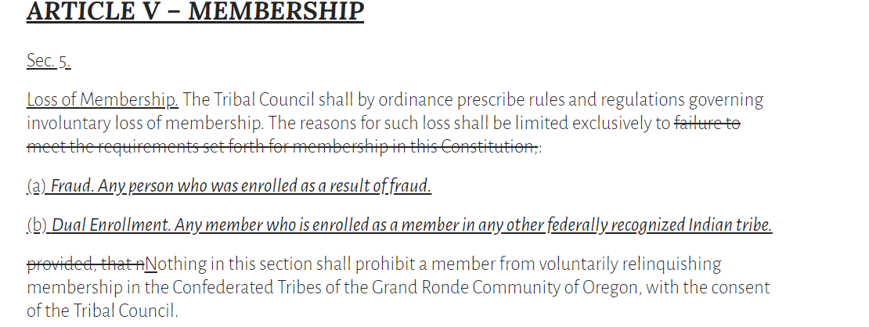
Amendment Language

Slide 5
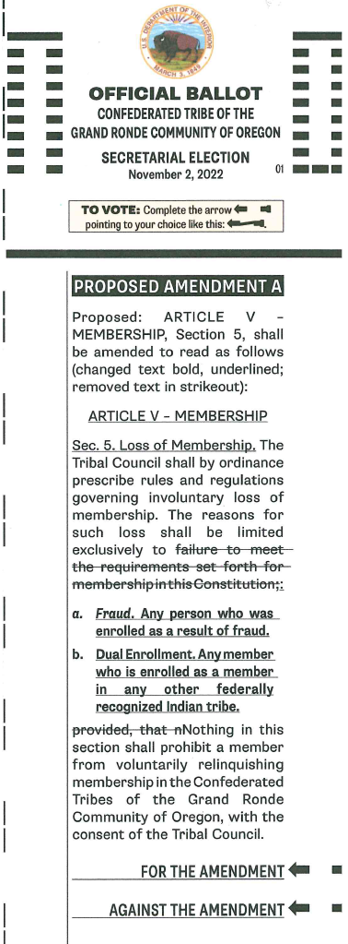
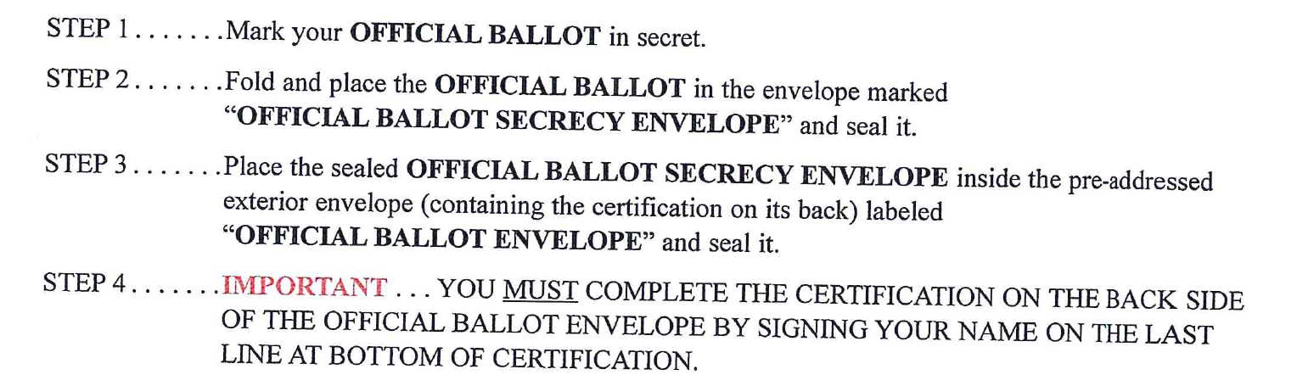
The Ballot

Slide 6
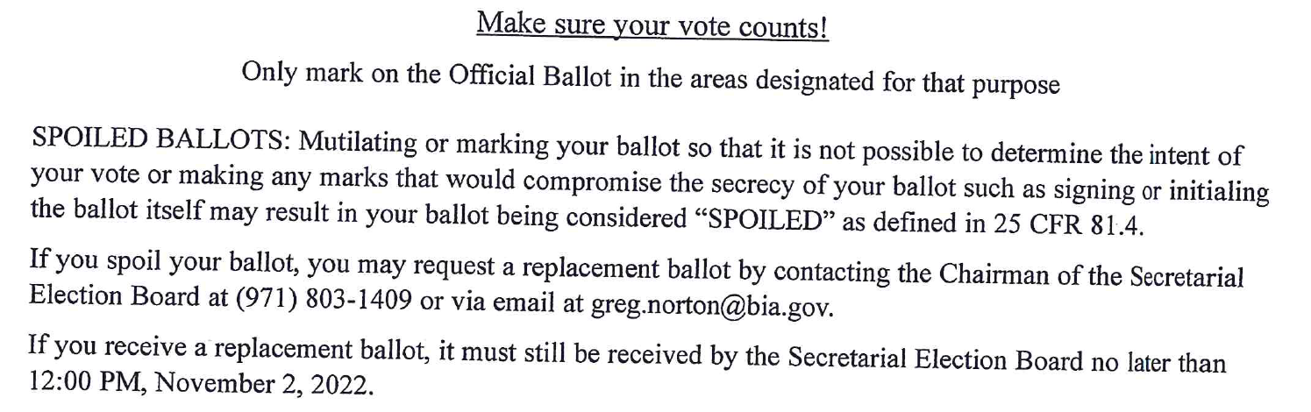

Slide 7
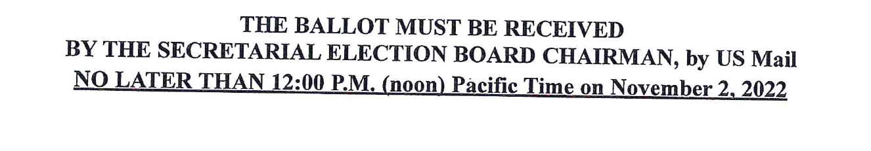

Slide 8
Frequently Asked Questions
•Q: How many people must register for the election?
A: There is no minimum number of registered voters required.
•Q: How many votes does it take to pass the Amendment?
A:2/3 of the members who have registered to vote, must vote in favor of the Amendment for it to pass.
•Q: How many registered voters must vote?
A: 30% of the qualified voters must vote for the election to be valid.
•Q: I haven’t received my registration packet yet; what should I do?
A: Contact Greg Norton, the Election Board Chair as soon as possible. All registration forms have to be received back by October 4, 2022.
•Q: Does this amendment conflict with the membership requirement provision of the Constitution, and will the BIA have an issue with it?
A: This provision applies after someone becomes a member, while the membership requirements apply at the time of enrollment. The BIA has already reviewed this language and did not express any concerns with it.

Slide 9
Frequently Asked Questions Cont.
•Q: What is the definition of Fraud?
A: Fraud is an intentional misrepresentation of the facts relevant to enrollment during the enrollment process.
•Q: Who has been hired to work in the Enrollment member files?
A: No one was hired to work just in Enrollment member files, however, Enrollment Staff does work to research and correct files when they find errors during any enrollment processes.
•Q: When was the auditing of the files in this manner authorized? What was the scope of the Audit? Was the audit of Enrollment Members files brought to the attention of the Tribal members before it was even started? Was the Auditing of Enrollment Members files approved to proceed by Resolution?
A: There is no audit of files, however, errors are consistently being discovered during regular enrollment processes.
•Q: How can anyone actually determine accurate blood quantum that was listed differently in various Grand Ronde Reservation Federal Indian Census Rolls before Restoration?
A: The Tribe recognizes that the Census records are not consistent. We do currently have a genealogist working in Enrollment with the skills to trace families back multiple generations. However, these type of record issues is some of the reasons we have the current issues with our files.
•Q: Why is Tribal Council not addressing the removal of the Parent on the Roll at birth requirement?
A: Tribal Council did hear this concern during the Community Input Meetings on Enrollment. This requirement is one that will be addressed when the Tribe moves forward with a Constitutional Amendment for Lineal Dependency or a 4/4 change.

Slide 10
Upcoming Meetings
Tuesday, October 18, 2022
Educational meeting (hybrid / Grand Ronde) – 5:30PM
  Governance Center – Tribal Council Chambers
Thursday, October 20, 2022
Educational meeting (hybrid / Salem) – 4:00 PM
  Salem Library
Wednesday, October 26, 2022
Educational meeting (hybrid / Grand Ronde) - 5:30PM
  Governance Center – Tribal Council Chambers

Slide 11
Contact
Greg Norton, Tribal Government Specialist, Election Board Chair for the Election
Division of Tribal Government Services
BIA Northwest Regional Office
911 NE 11th Avenue
Portland, Oregon 97232
Cell: (971) 803-1409
Email: greg.norton@bia.gov

