Slide 1

Spirit Mountain
THE CONFEDERATED TRIBES OF GRAND RONDE

Slide 2

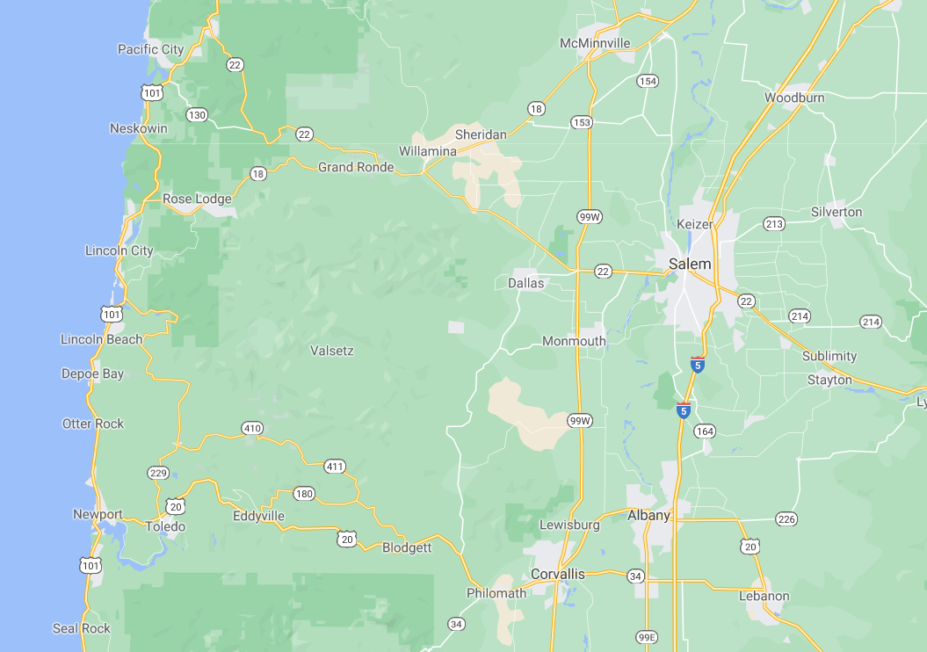

Where is The Confederated Tribes of Grand Ronde?
Notes:
The Confederated Tribes of the Grand Ronde Community of Oregon is a federally recognized Tribe that includes over 30 Tribes and bands from western Oregon, northern California, and southwest Washington. These include tribal bands from the Kalapuya, Molalla, Chasta, Umpqua, Rogue River, Chinook, and Tillamook. The Tribe is active throughout its ancestral homelands but located in western Oregon where it has a 11,500-acre reservation in Yamhill County.

Slide 3
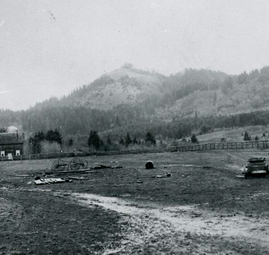
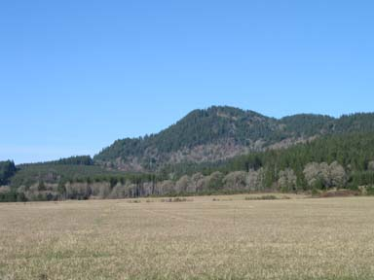
Spirit Mountain
Notes:
Spirit Mountain, whose chinuk wawa name is “t’ǝmanǝwas-lamǝtay” is a sacred site to the people of The Confederated Tribes of Grand Ronde. Spirit Mountain is in the traditional homeland of the Yamel Kalapuyans, who occupied the land at the foot of the mountain and the surrounding river valleys. The Grand Ronde Reservation was established at the base of the mountain in the Grand Ronde Valley in 1856, and the people of an estimated twenty-nine western Oregon tribes were removed to join the Yamhills there. The mountain continued as a significant sacred site to people on the reservation.

Slide 4
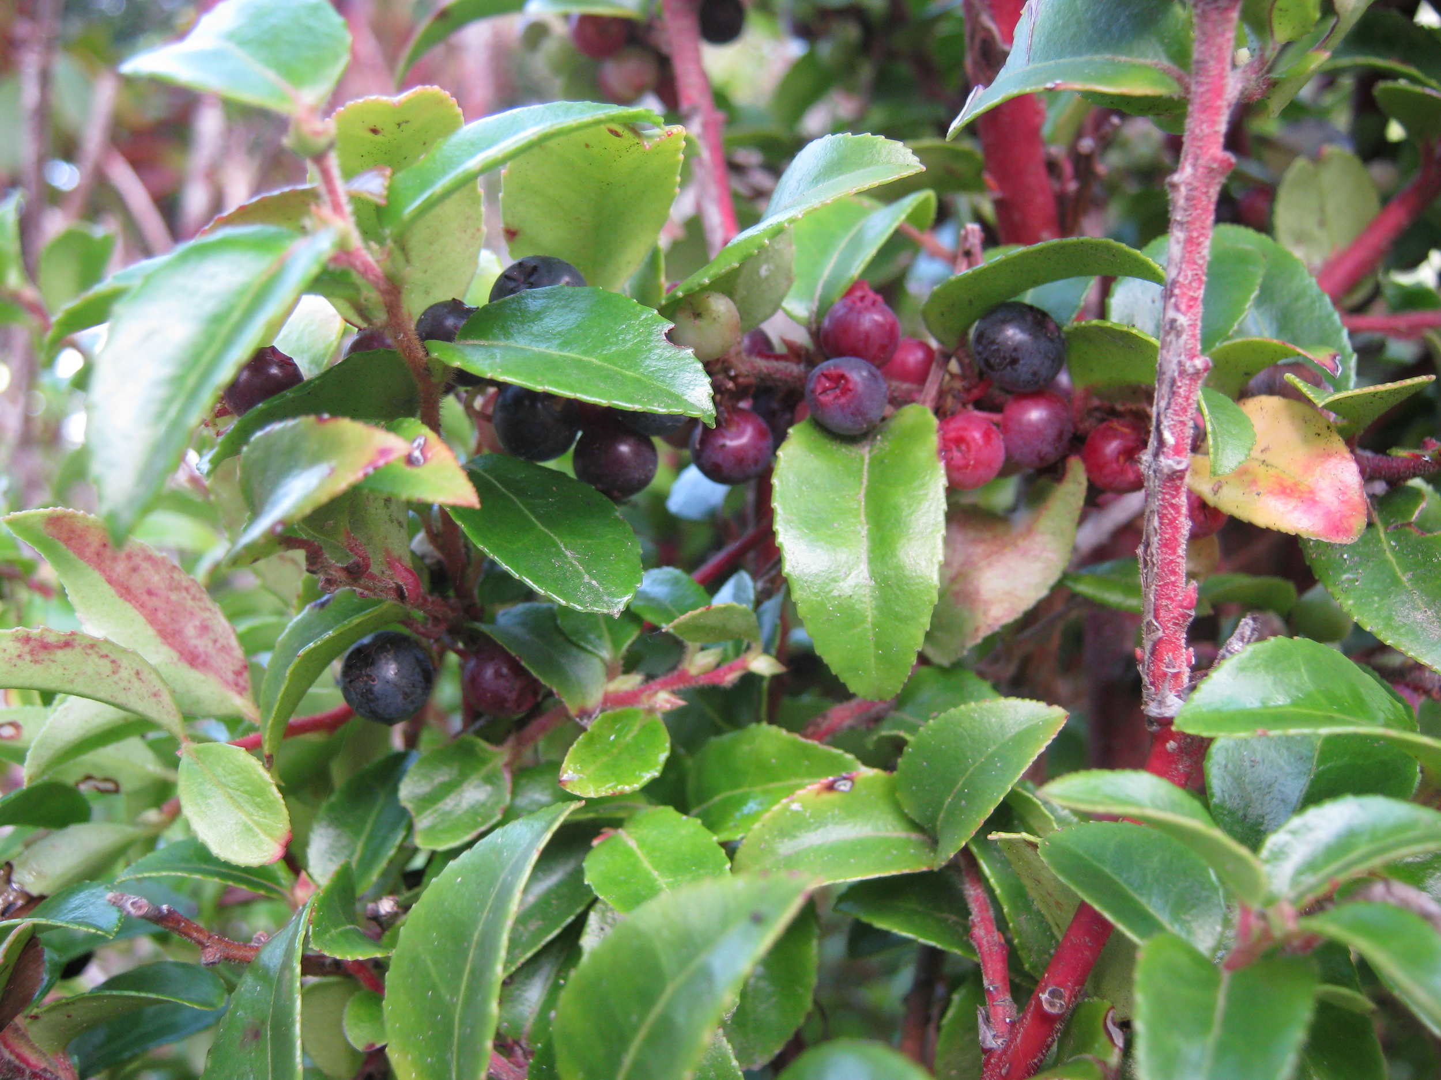
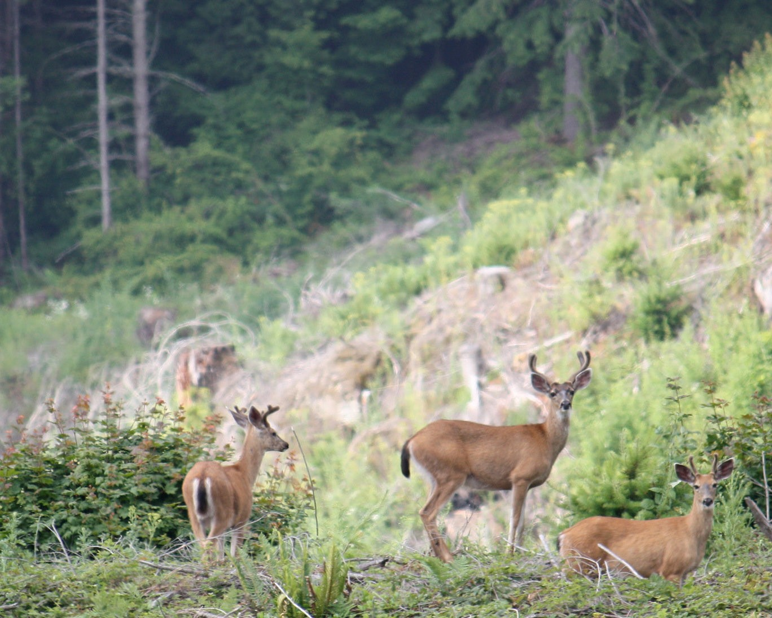
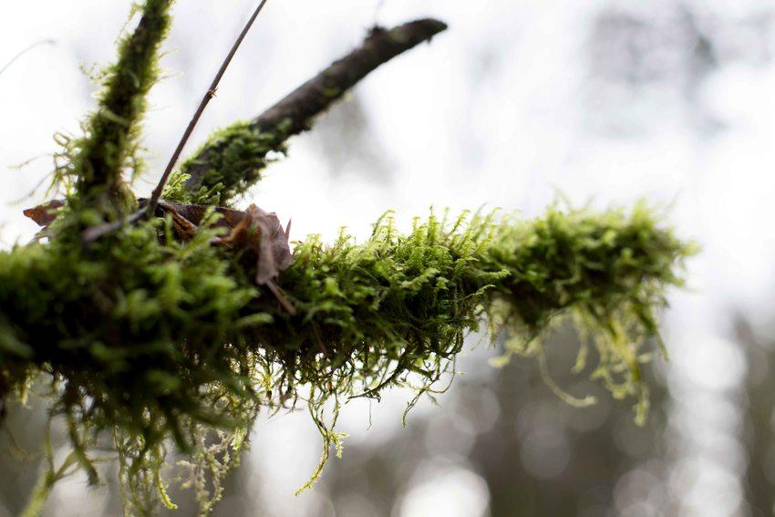

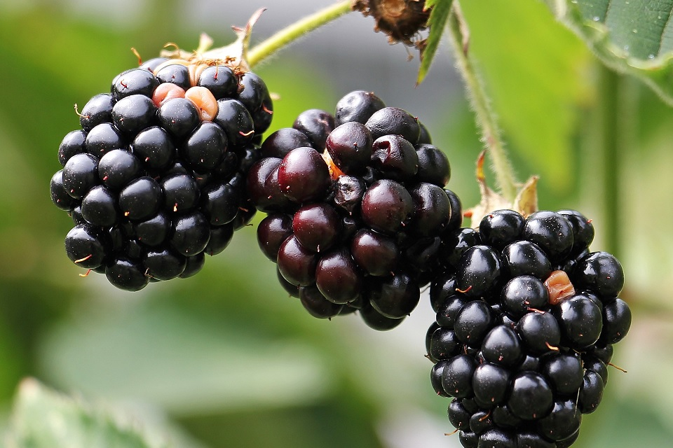
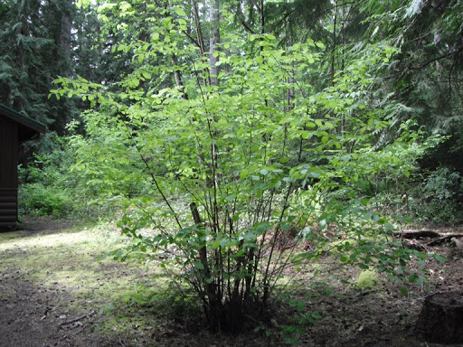
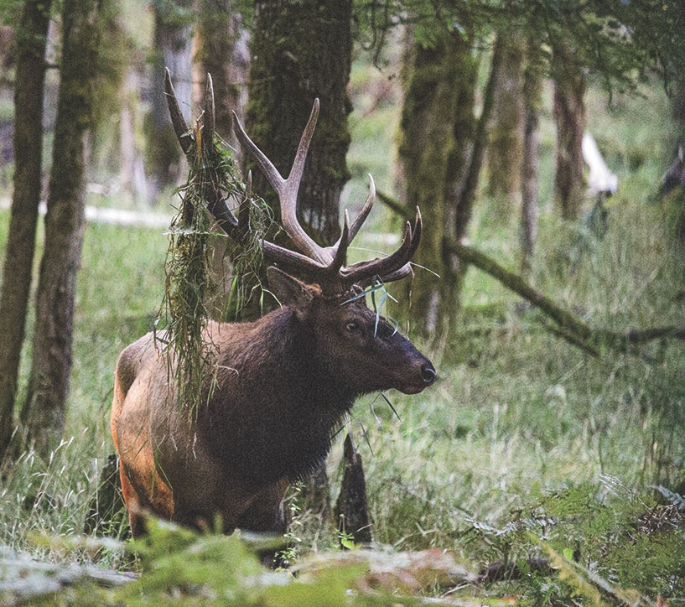
Hunting and Gathering on Spirit Mountain
huckleberries
blacktail deer
moss
blackberries
hazel
elk
Notes:
Click the speaker button in the corner of each word to hear it pronounced in chinuk wawa - the Native language of the people of The Confederated Tribes of Grand Ronde.
Huckleberries - shat-ulali
Deer - mawich
Moss - iliʔi-yaqsu
Blackberries - ɬikʰəmuks
Hazel - taqwǝla
Elk - mulak

Slide 5
Fast Facts About Spirit Mountain
Spirit Mountain sits just north of where the Grand Ronde tribal campus sits now.
Spirit Mountain is the site of reservation land for the Confederated Tribes of Grand Ronde.
The Tribe gained the 9,811 acres around Spirit Mountain five years after being restored.
Many tribal members still hunt and gather on the land today.

