Slide 1
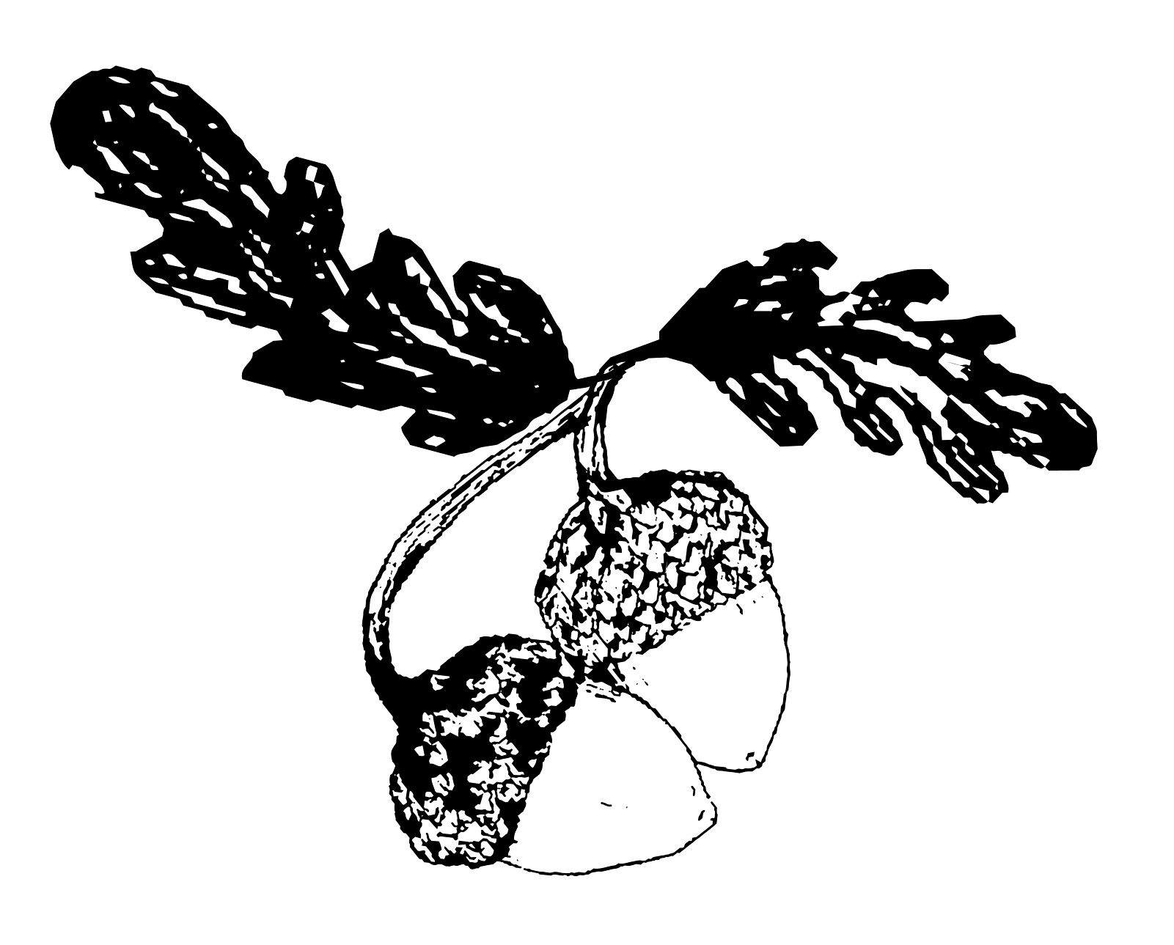
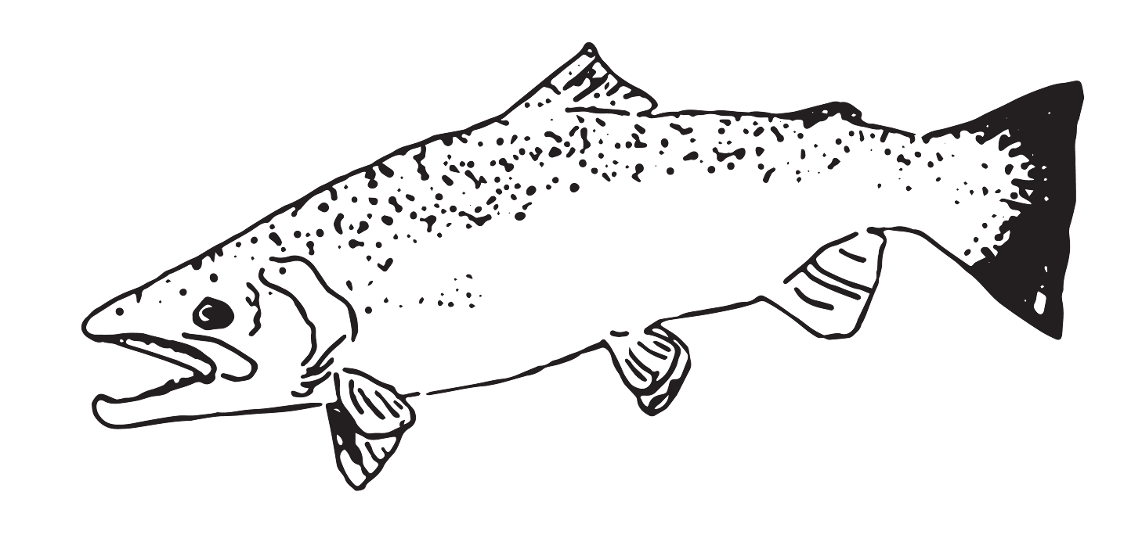
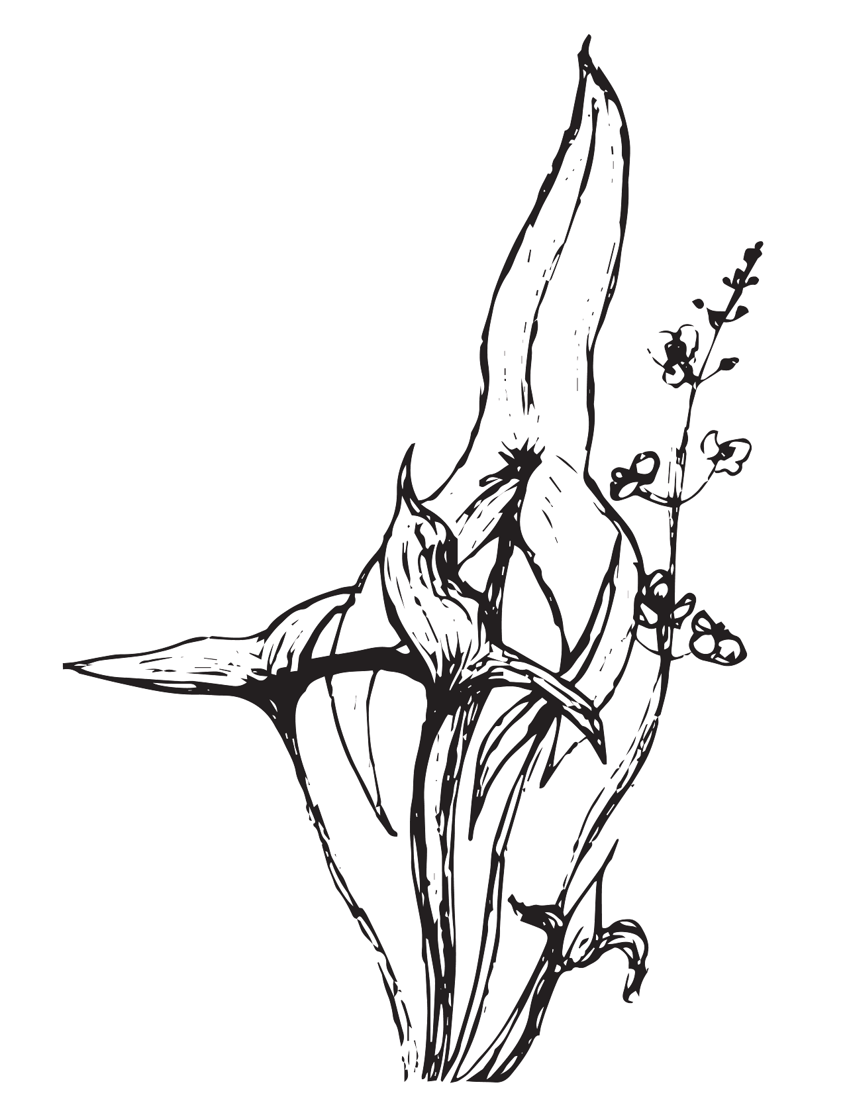
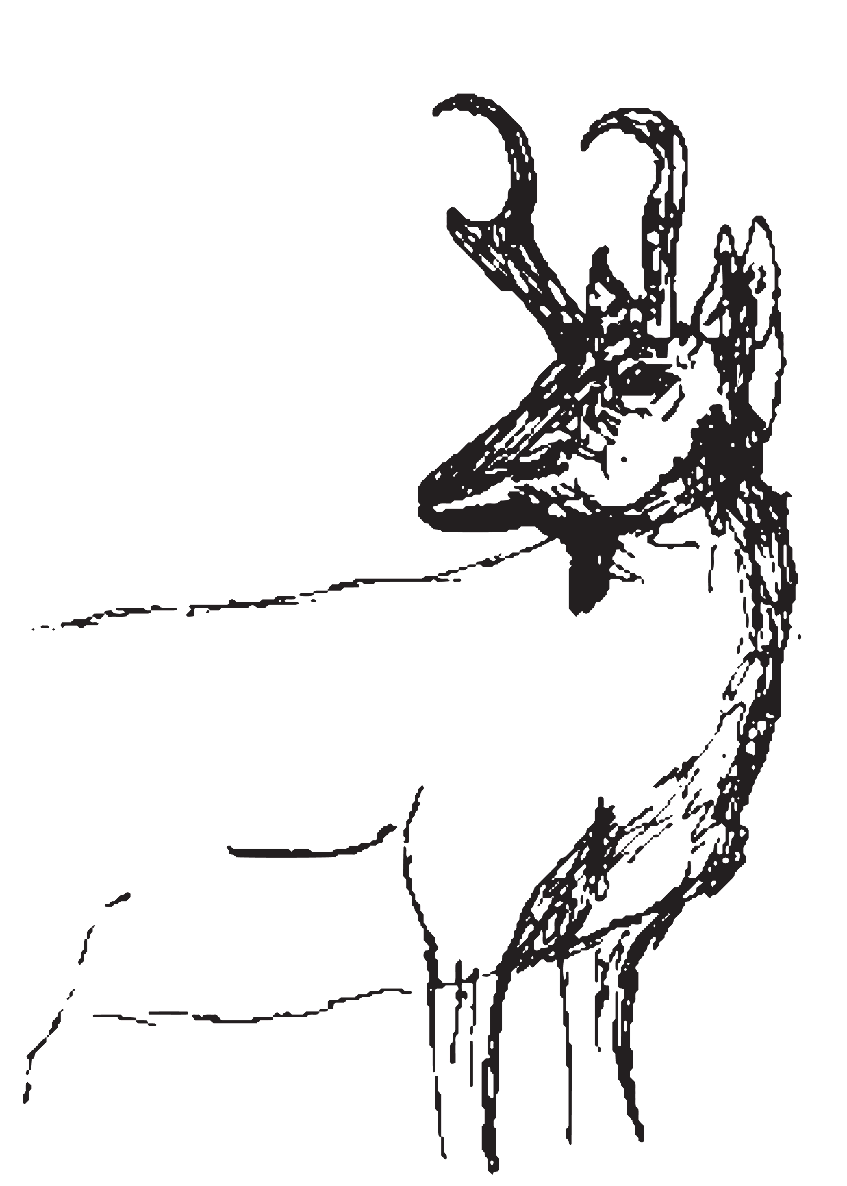
First Foods

Slide 2
What are First Foods?
These are traditional foods that the people of Grand Ronde ate since relocating to Grand Ronde and still eat today.
They are foods that can be gathered around Oregon.
Remember - These foods are only safe when prepared and cooked in the right way. Always talk to an adult before eating something that you gather!

Slide 3
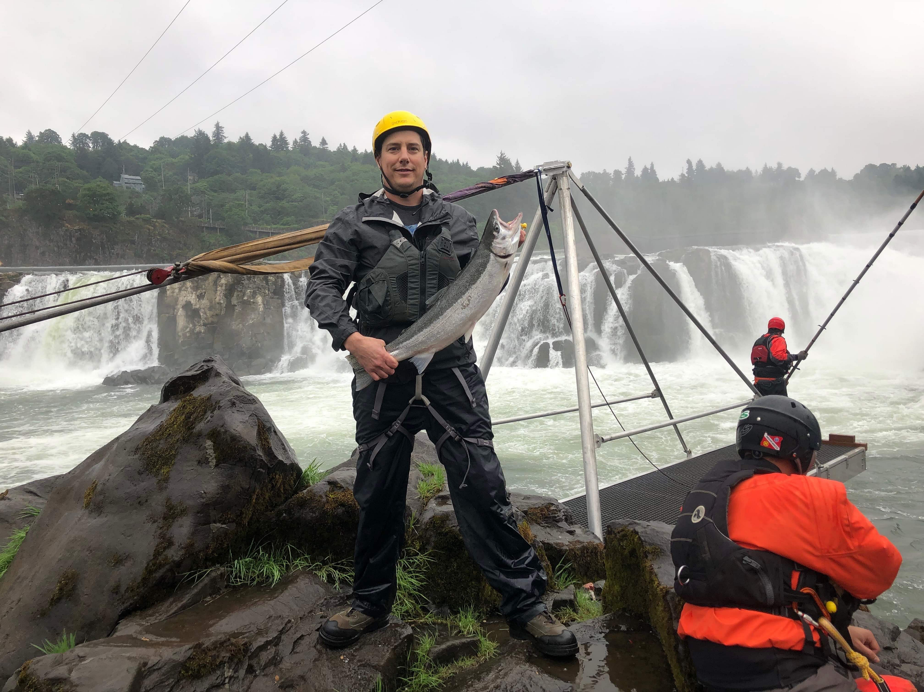
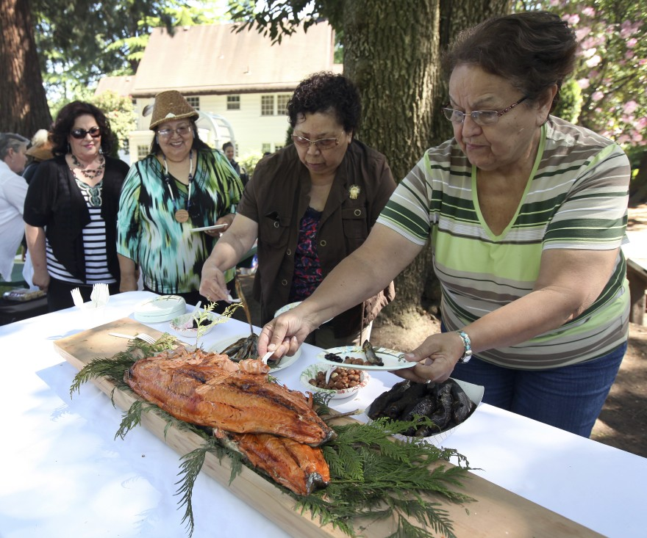
Salmon
Gathered from lakes and rivers
Gathered using fishing poles and nets
Can be cooked right away or dried/smoked to save for later

Slide 4
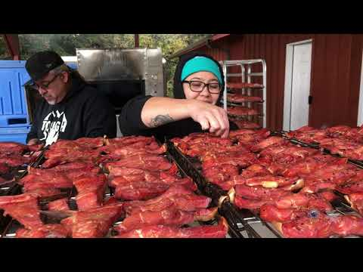

Slide 5
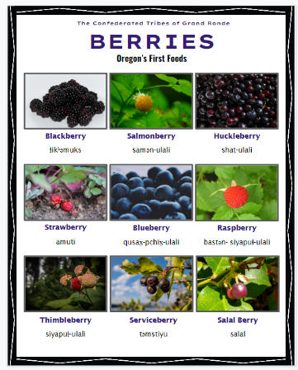
Berries
Gathered from bushes and trees around the Reservation
Women and children gather the berries and place them into baskets.
Can be eaten right away, used in other recipes, or dried to save for later

Slide 6
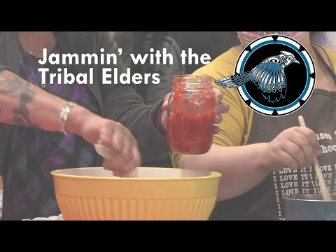

Slide 7
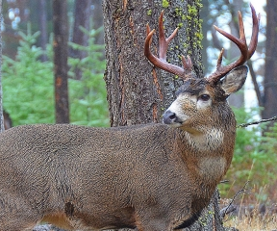
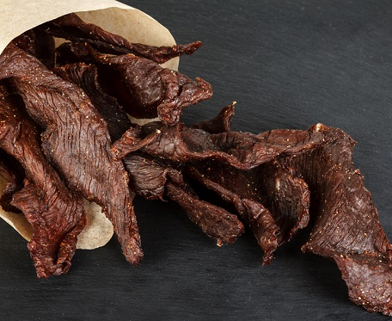
Deer & Elk
Harvested from wooden areas and grasslands around Oregon
Harvested using bows, arrows, and hunting rifles
Can be cooked right away or dried/smoked to save for later

Slide 8
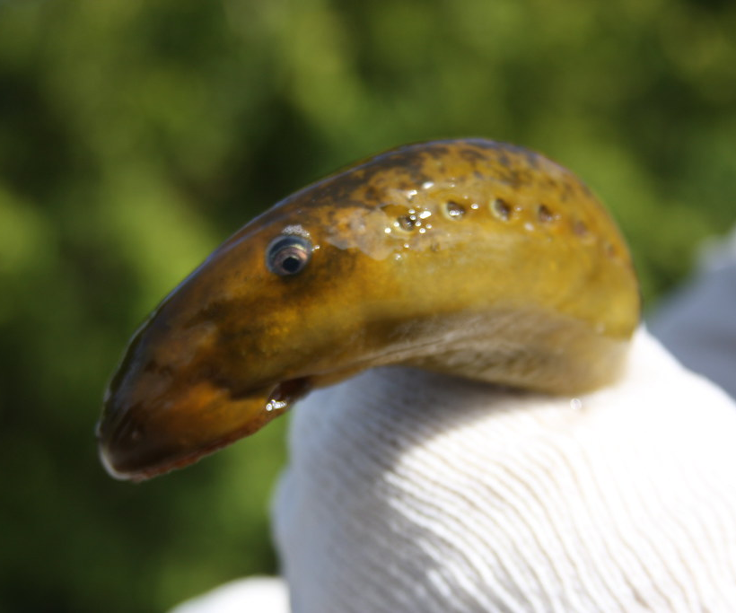
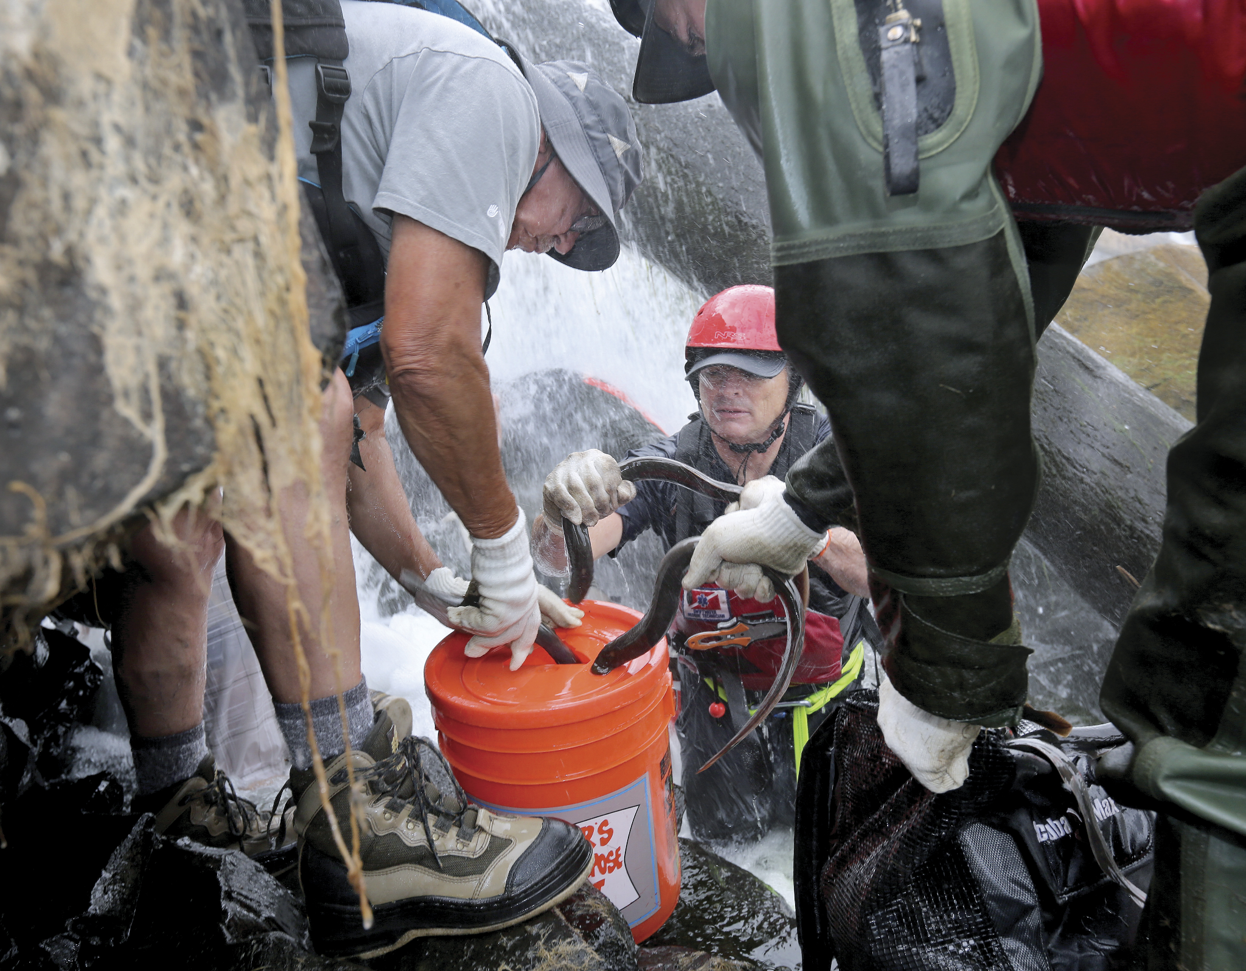
Lamprey
Harvested from Willamette Falls and other areas
Harvested by hand or by using a skak^{h}wǝl-ik^{h}ik-stik (traditional eeling stick with a hook)
Can be cooked right away by roasting over the fire or dried/smoked to save for later

Slide 9
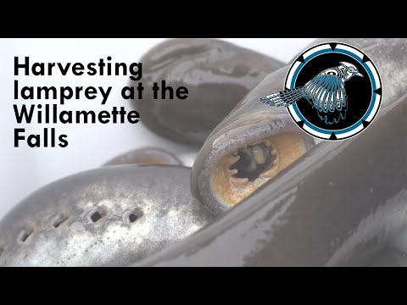

Slide 10
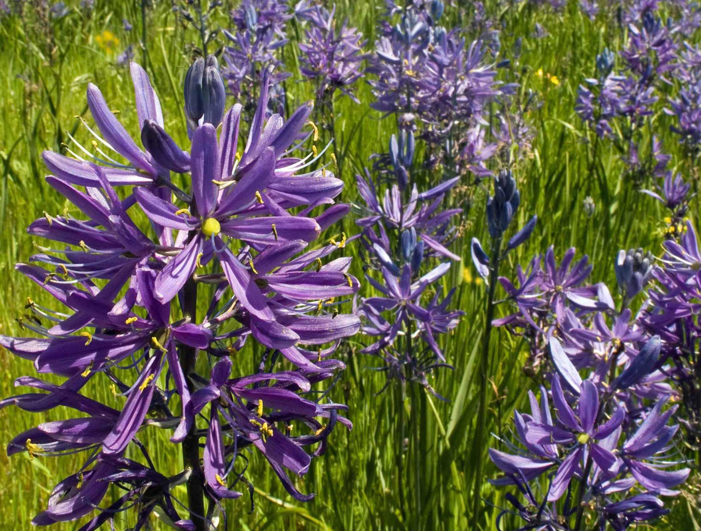
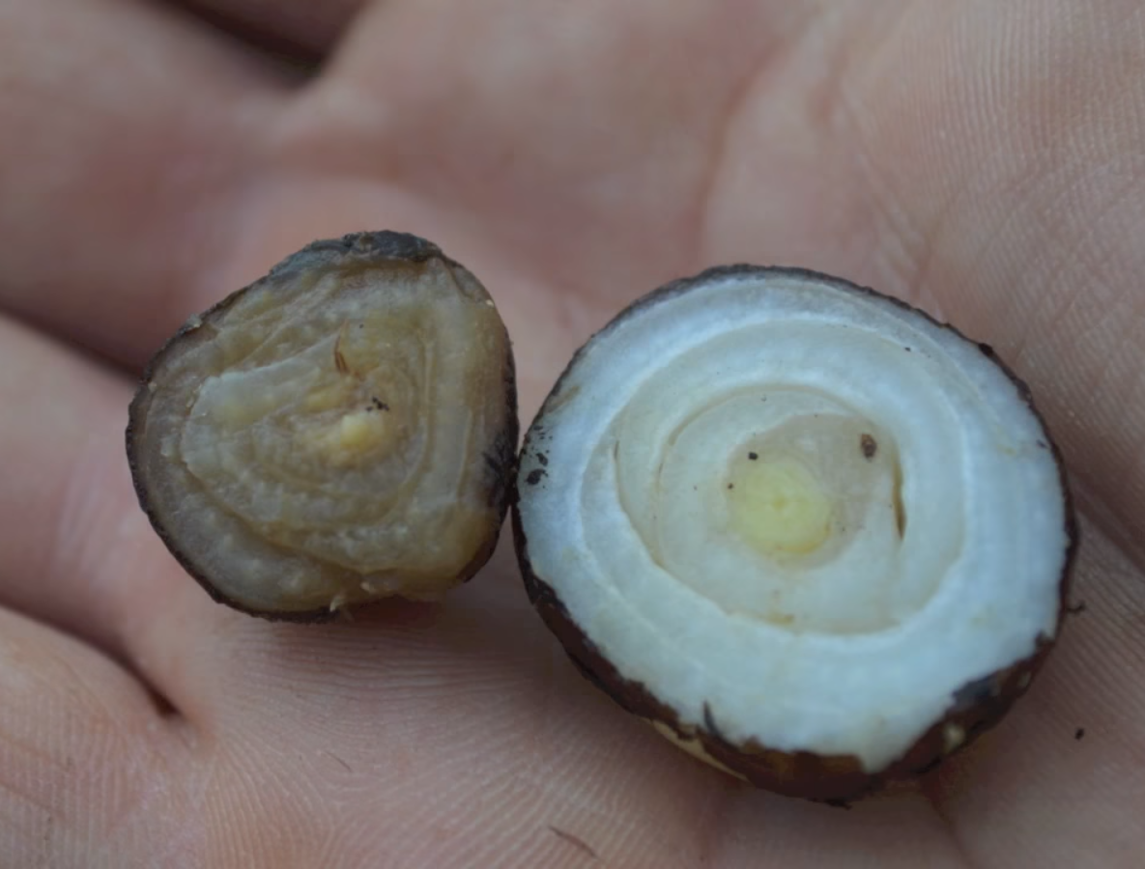
Camas
Harvested from wet prairie environments in the Willamette Valley
Harvested using a camas digging stick made of wood and deer/elk antler
Baked in an in-ground oven for 3-5 days, can be eaten right away or dried for later, and can also be mashed up into cakes.

Slide 11
