Slide 1
Grand Ronde Native American Artifacts
The Confederated The Tribes of Grand Ronde
The Confederated Tribes of Grand Ronde

Slide 2
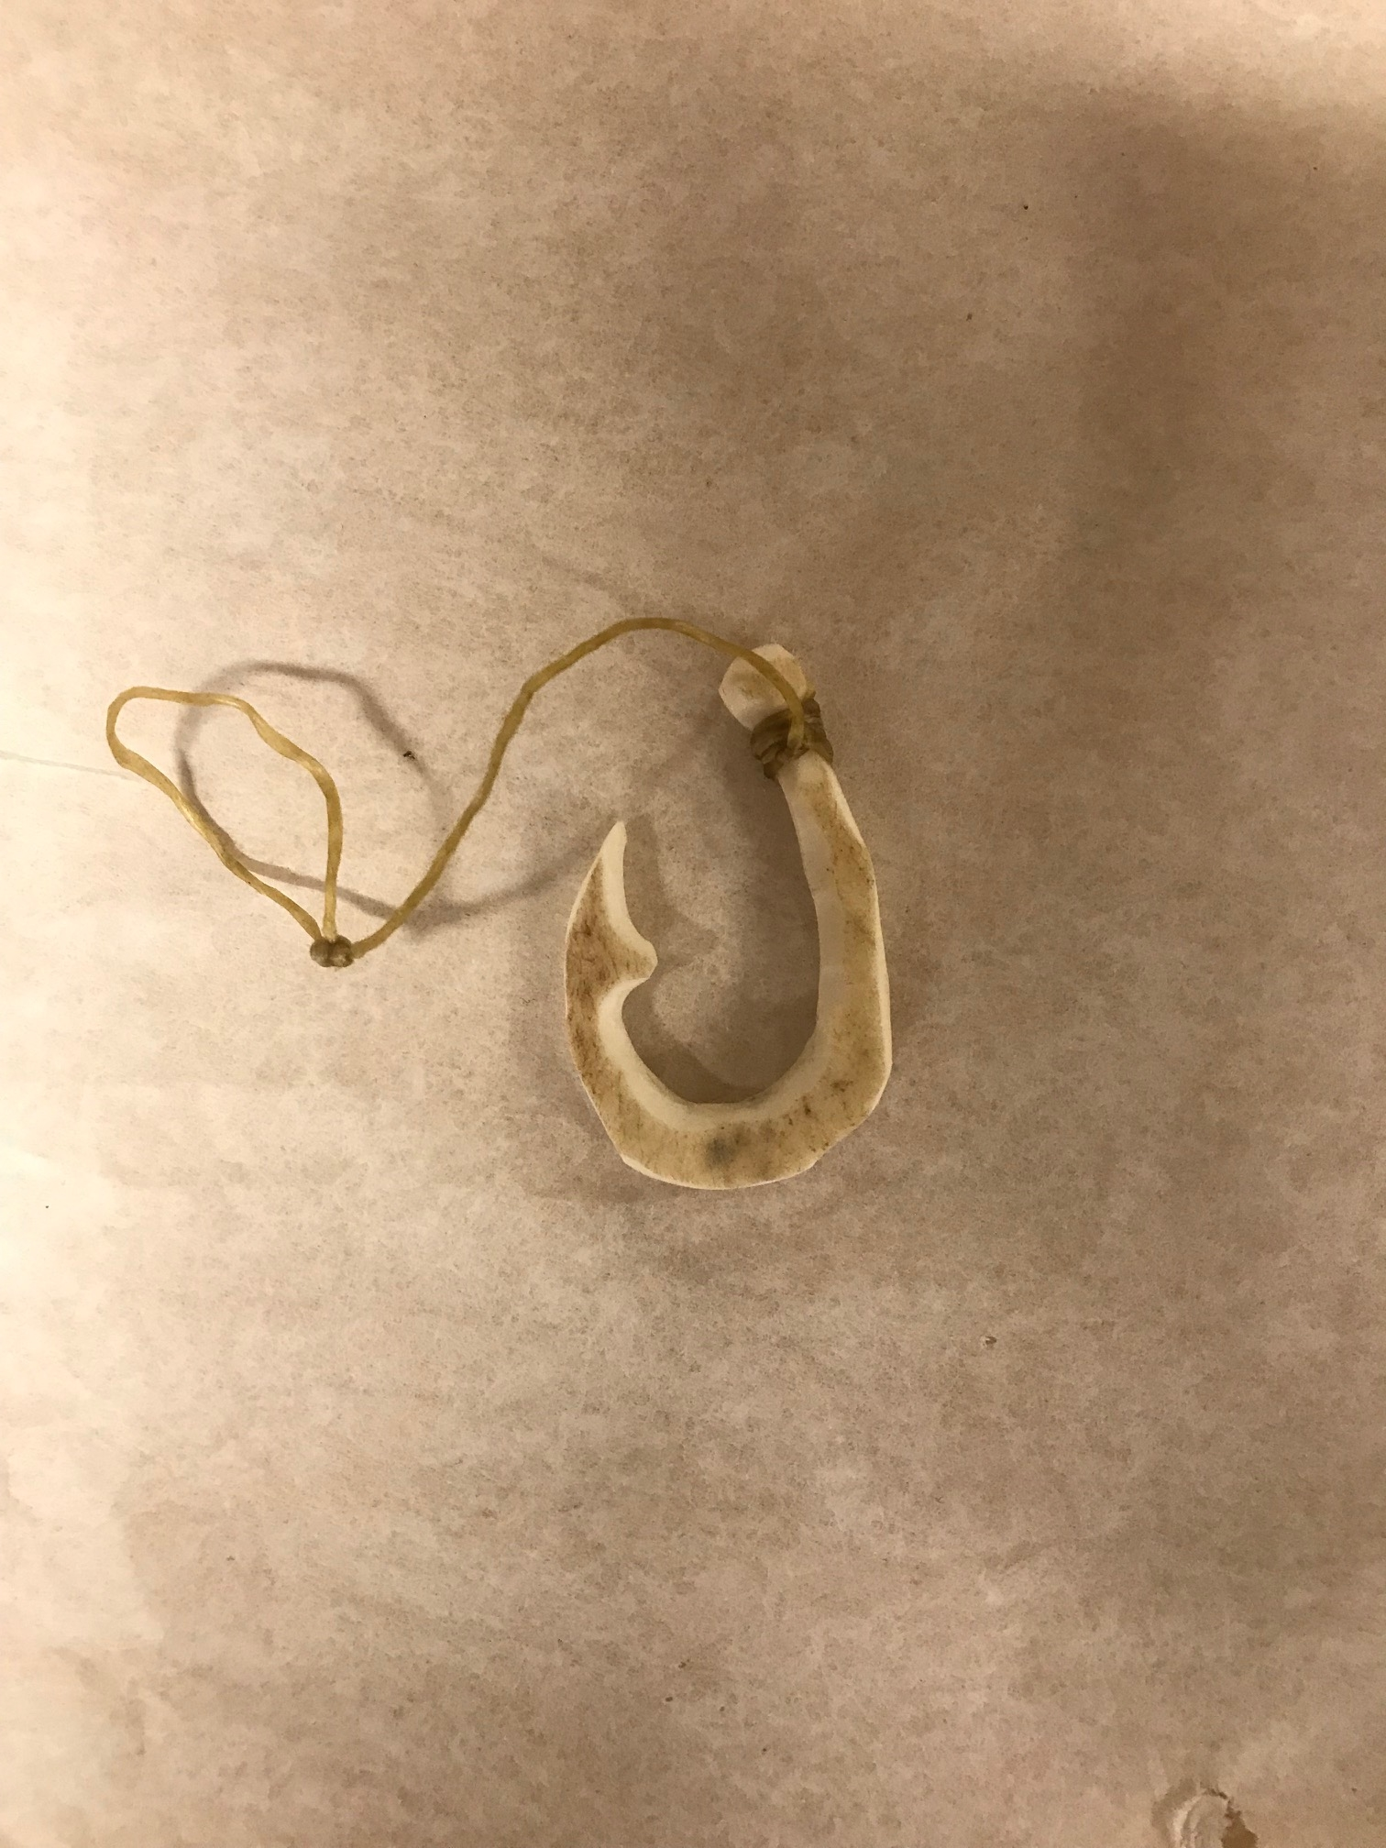
Fish Hook

Slide 3
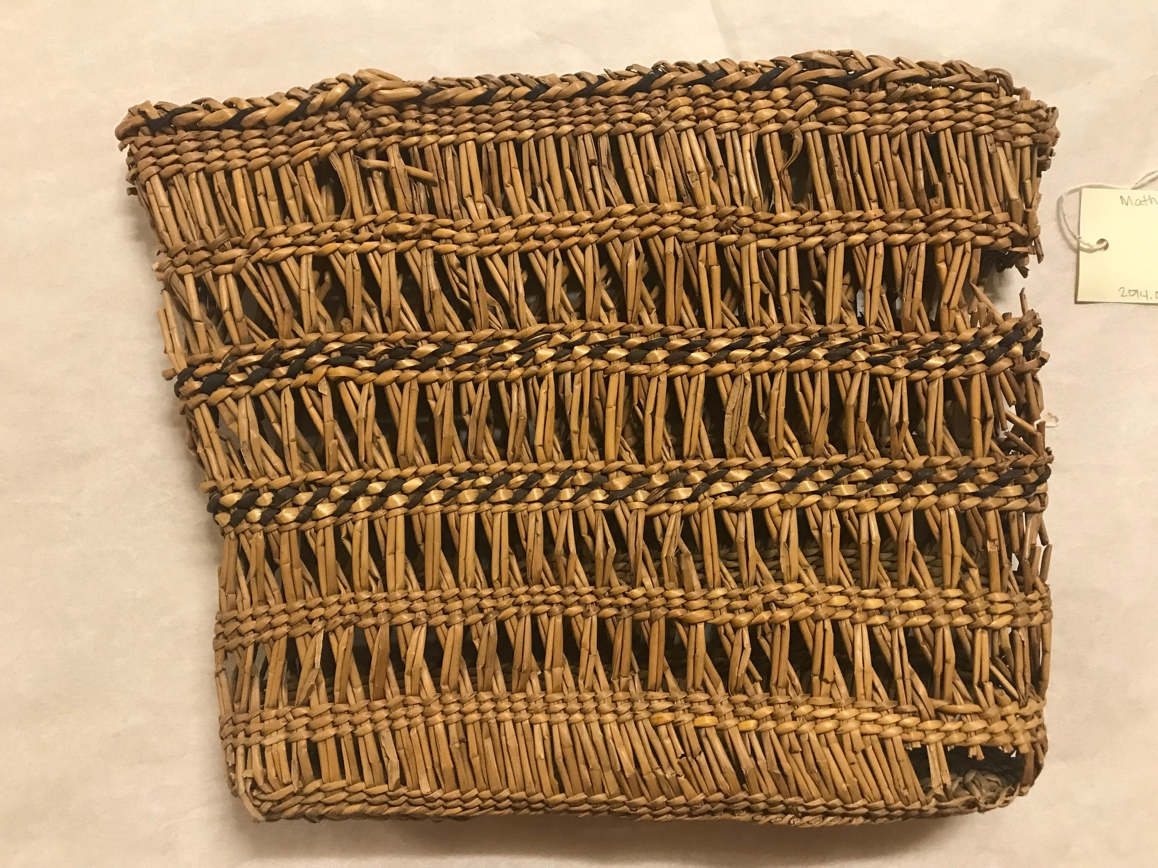
Grand Ronde Purse
This purse is made from juncus, white beargrass and black dyed maple bark.

Slide 4
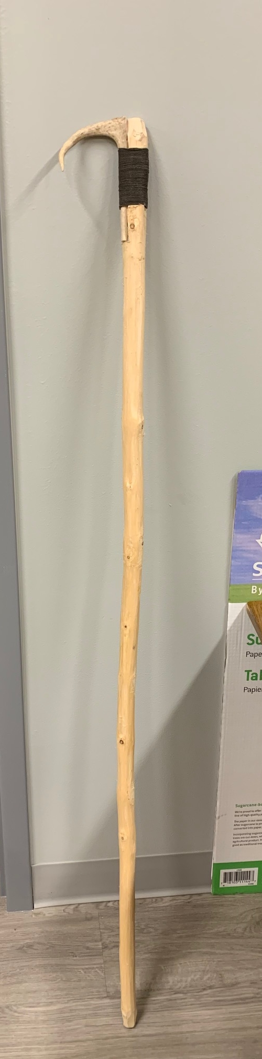
Traditional Gaff Hook
Gaff hooks were used to fish for eel in the waterfalls.

Slide 5
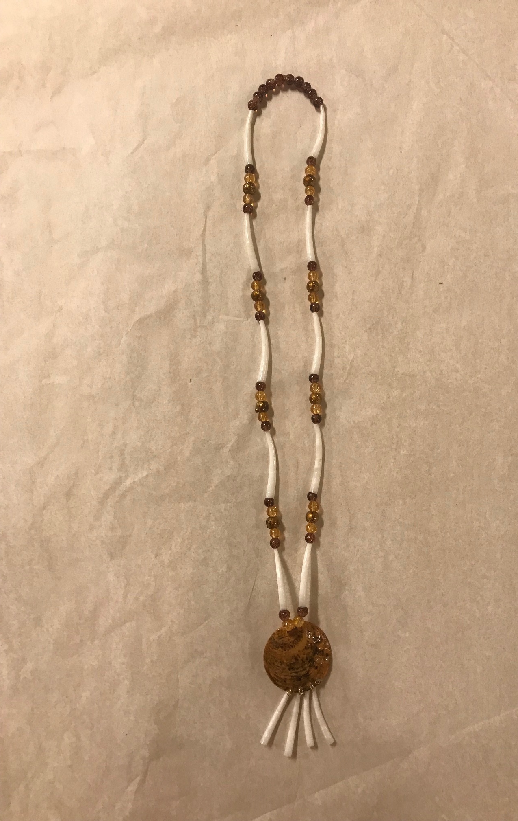
Necklace
Traditional Grand Ronde necklace that is made of beads and dentalium shells.

