Slide 1
Grand Ronde Restoration
The Confederated Tribes of Grand Ronde

Slide 2
Did You Know
There are nine nations in Oregon
The Confederated Tribes of Grand Ronde
The Confederated Tribes of Siletz Indians
The Confederated Tribes of Coos, Lower Umpqua and Siuslaw Indians
Confederated Tribes of Umatilla Reservation
Confederated Tribes of Warm Springs
Cow Creek Band of Umpqua Indians
Coquille Indian Tribe
Klamath Tribes
Notes:
Ask students what they think it means to be a nation

Slide 3
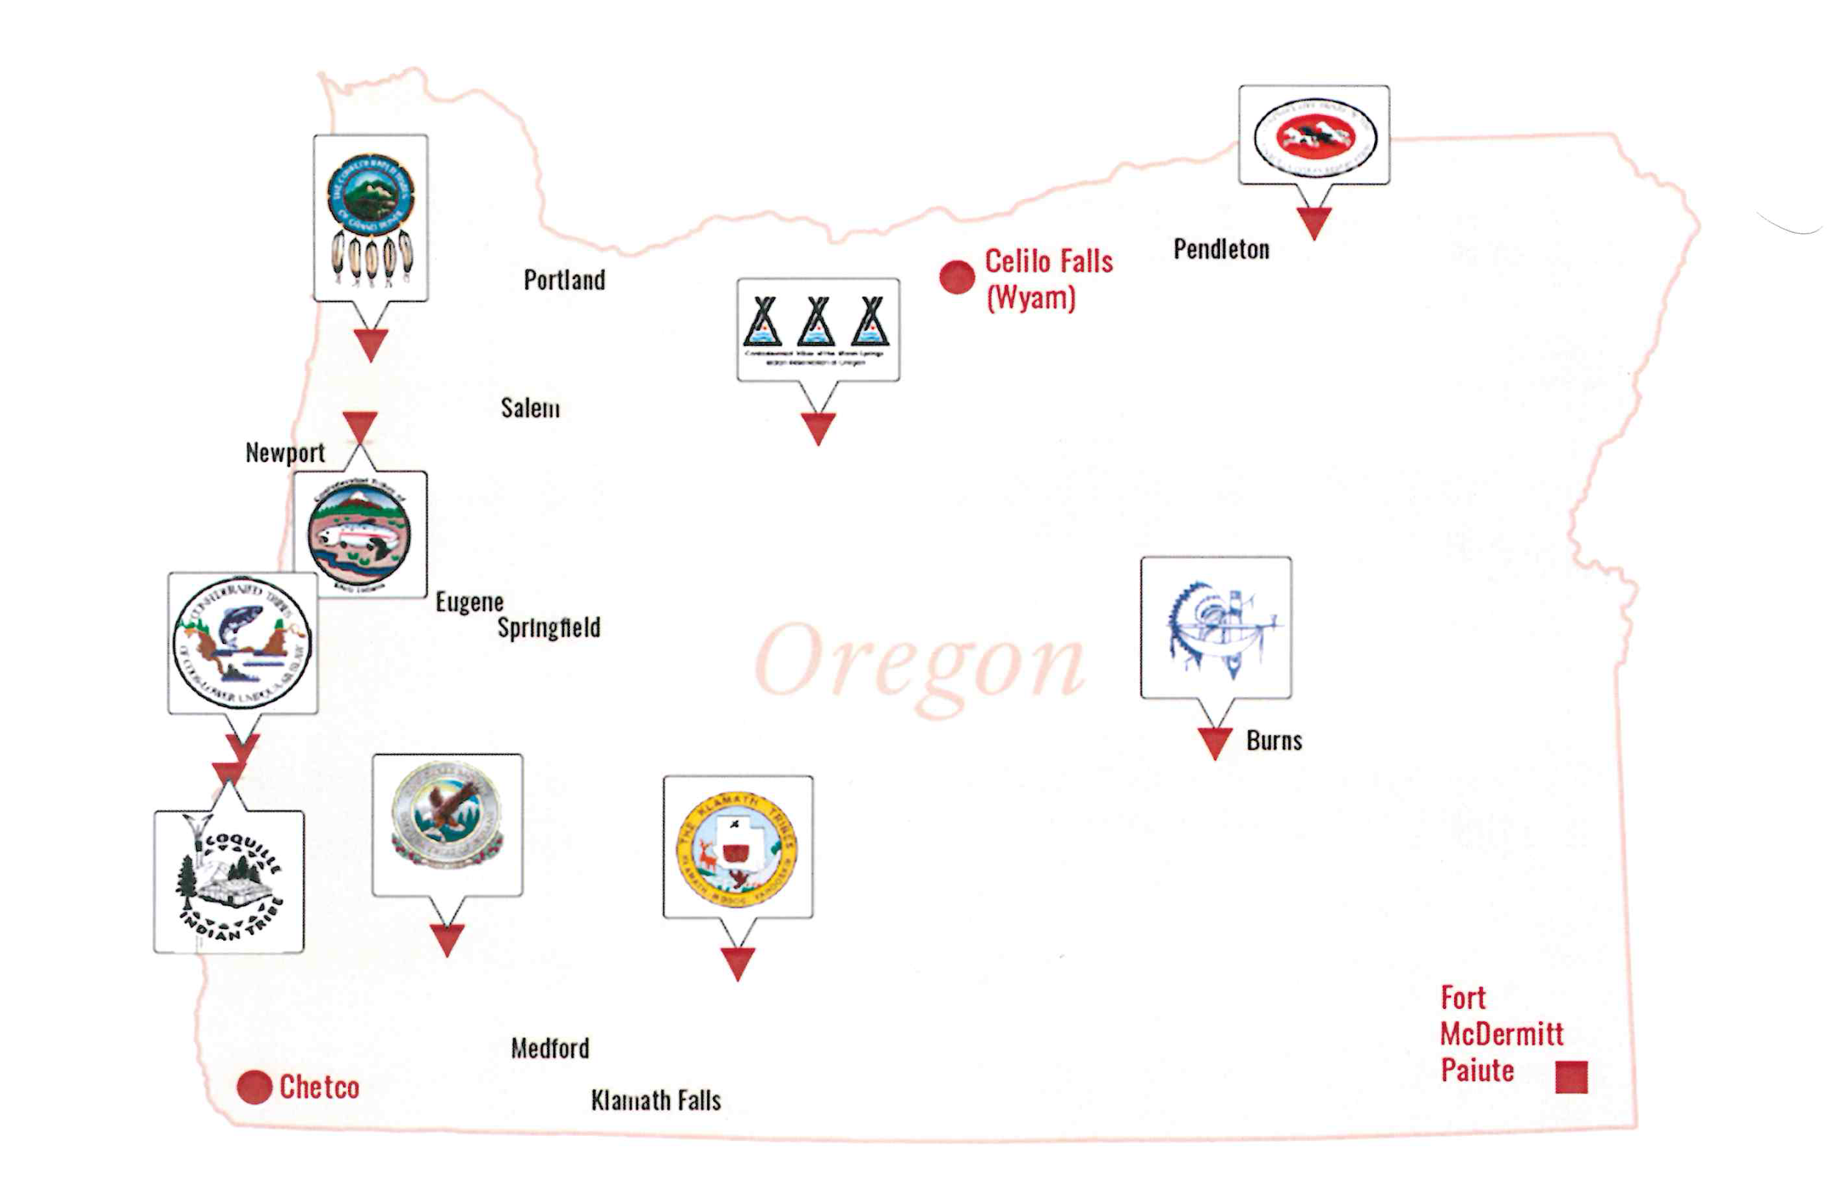
Notes:
Point out that each of these logos represents a tribal nation in Oregon. Explain to students that each one of the tribes is a nation and has a government to government relationship with the state of Oregon and the federal government and that this is key when differentiating Native Americans from other groups of people in the United States.

Slide 4
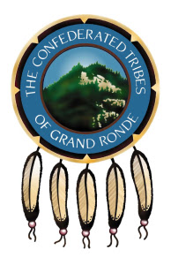
The Confederated Tribes of Grand Ronde:
Who Are We?
Notes:
Ask for 4 students to volunteer. Give each student a section of the read aloud of Termination and Restoration. Ask volunteer number 1 to read section number 1 out loud to the class.

Slide 5
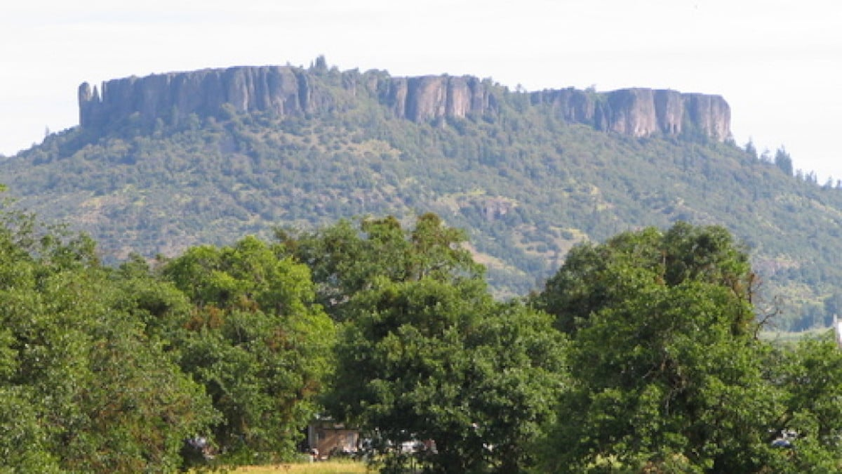
How Did the Tribe get the Reservation?
Notes:
Ask student number 2 to read section number 2 out loud to the class.

Slide 6
Termination
Long ago, tribes were rounded up and forced onto reservations. After several decades of living on reservations, seven out of the nine tribes were terminated by the federal government. Tribal members were forced to move from the reservation to find housing and jobs to support their families.
What do you think the word terminated means?
Notes:
Ask volunteer number 3 to read section number 3 to the class. Afterwards, explain to students that being terminated meant that the federal government no longer recognized the tribe or people as being Indian. It also meant that all of the reservation land was taken away and didn’t exist anymore. Any of the programs and help that the government was giving to tribal people all went away too. Tribal members no longer had access to education or health care. If a tribal member couldn’t buy the land their house was on on the reservation then they had to move and find new housing and employment somewhere else. Ask students what they think happened to the land. Explain to students that the government sold off the land and made money off of it. Many indian people were treated poorly during this time. Some families were denied jobs and housing because they were Indian.

Slide 7
Termination Video

Slide 8
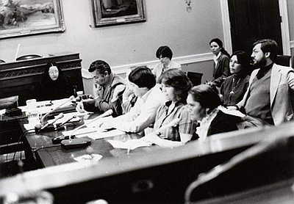
After being terminated for almost 30 years, a group of elders on the Grand Ronde reservation began fighting for the tribe to be restored and seeked restoration.
What do you think the word restoration means?
Grand Ronde Restoration Hearing 1983
Courtesy Oregon Historical Society Lib., OrHi101587
Notes:
Explain to students that restoration means being recognized by the federal government and restored back to its original state.
Additional video that talks about restoration https://www.youtube.com/watch?v=ykHt2SHWIi8
For a tribe to seek restoration there are things a tribe must do first:
Get a consensus from members that they want restoration.
Gain support from tribes, other tribal organizations, churches and local and state government officials.
Show proof that the tribe maintained its identity.
Write a bill for restoration.
Find a congressman to introduce the bill.
Lobby for the bill.

Slide 9
Grand Ronde Restoration
After traveling back and forth to Washington DC a lot, testifying in front of Congress and a whole lot of other planning, on November 22, 1983 the Grand Ronde Restoration Act was signed into law and the Confederated Tribes of Grand Ronde became recognized by the state of Oregon and the federal government.
Notes:
Elders fundraised through bake sells and sold baskets and other handmade goods to help raise money for elders to travel back and forth to DC to testify and support the bill. After the tribe was terminated the only land they had left was a 1 acre cemetery and that is where they would gather and meet to make a plan.

Slide 10
Tribe | Total Acres of the Reservation | Date the Tribe was Restored
The Confederated Tribes of Grand Ronde | 11,040 | 1983
The Confederated Tribes of Siletz Indians | 4,204 | 1977
The Confederated Tribes of Umatilla | 172,882 | Never terminated
The Confederated Tribes of Warm Springs | 644,000 | Never terminated
The Confederated Tribes of Coos, Lower Umpqua, and Siuslaw | 127 | 1984
Cow Creek Band of Umpqua Indians | 3,236 | 1982
Klamath Tribes | 390 | 1986
Coquille Indian Tribe | 6,512 | 1989
Burns Paiute Tribe | 11,736 | 1972
Notes:
Explain the table to students. Ask them if they notice anything. Two of the tribes were never terminated. What do they notice about them and those tribes reservations. Explain to students that restoration policy doesn’t include restoring reservation land. Grand Ronde and Siletz were two of the tribes who were able to secure and re-establish small reservations as part of their restoration act that was passed by Congress.

Slide 11
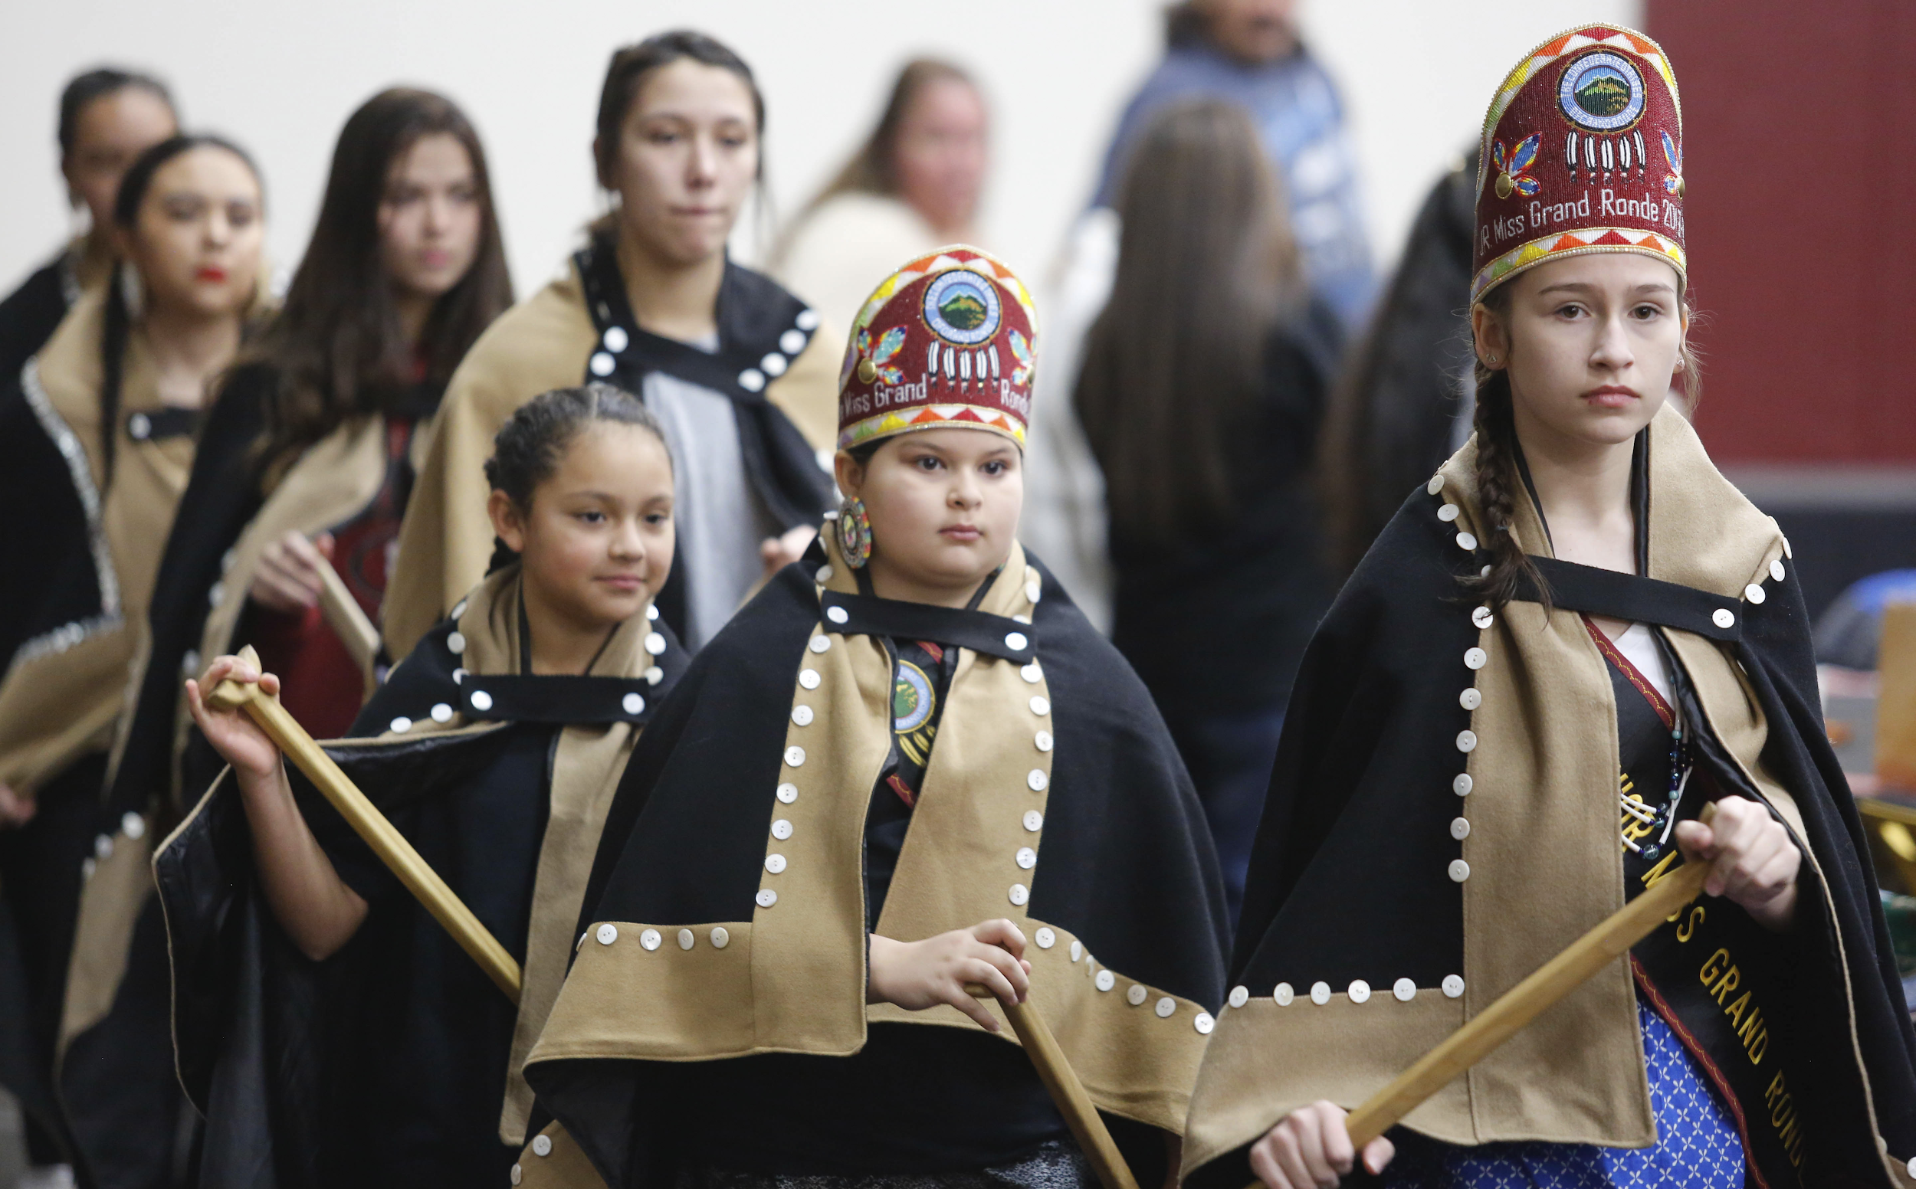
Today
The Confederated Tribes of Grand Ronde celebrates every year on November 22nd and hosts a Restoration Celebration and powwow for tribal members and community members to come take part in and give thanks to our ancestors and elders who helped fight for our Tribe.
Photo courtesy of Timothy J. Gonzalez
Notes:
Explain to students that today the tribe now provides for itself and provides health care and education opportunity for tribal members. The tribe now owes Spirit Mountain Casino and has a tribal court, health and wellness clinic, education department, police department and offers housing.

Slide 12
