Slide 1
Virtual Field Trip
Fort Yamhill, Grand Ronde OR

Slide 2
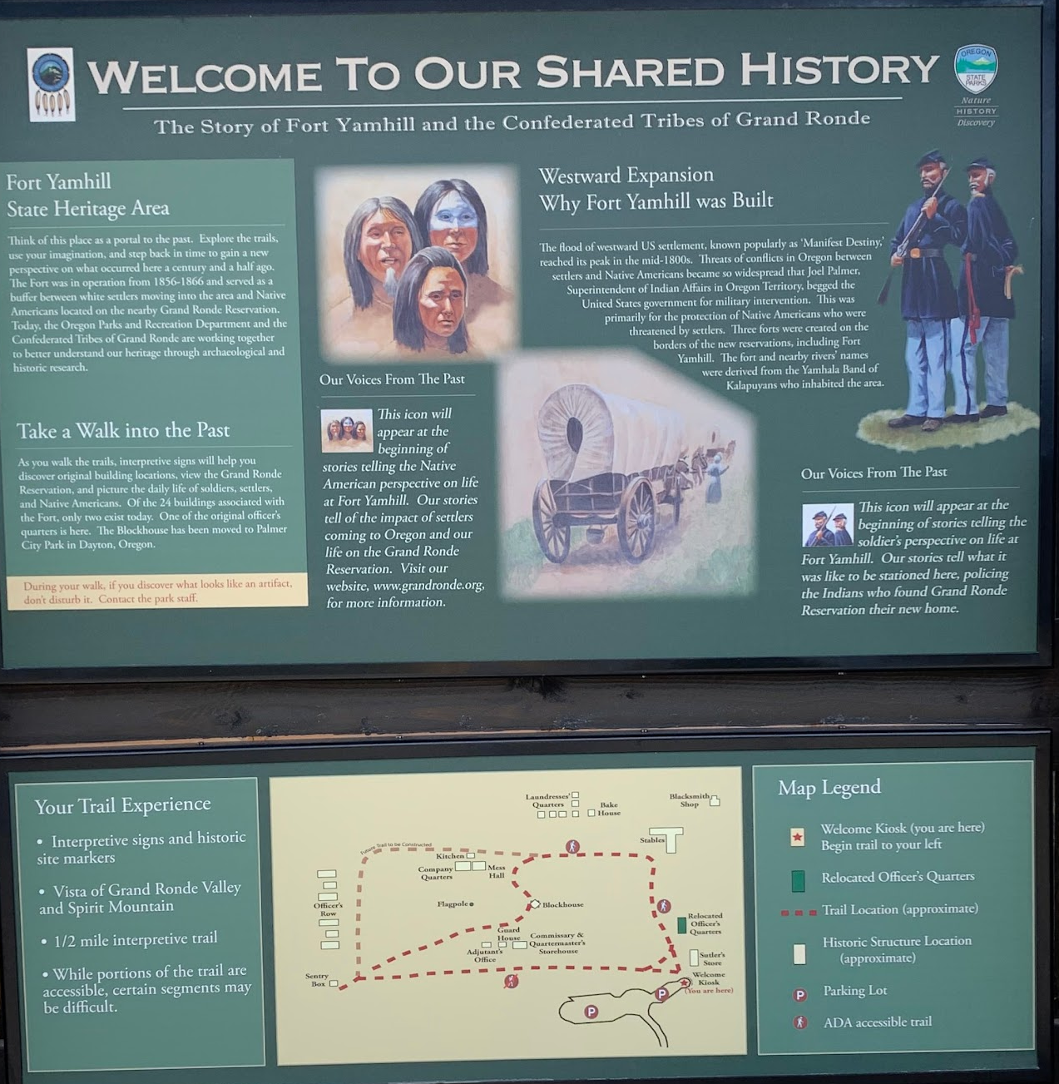
Notes:
Welcome sign at the kiosk

Slide 3
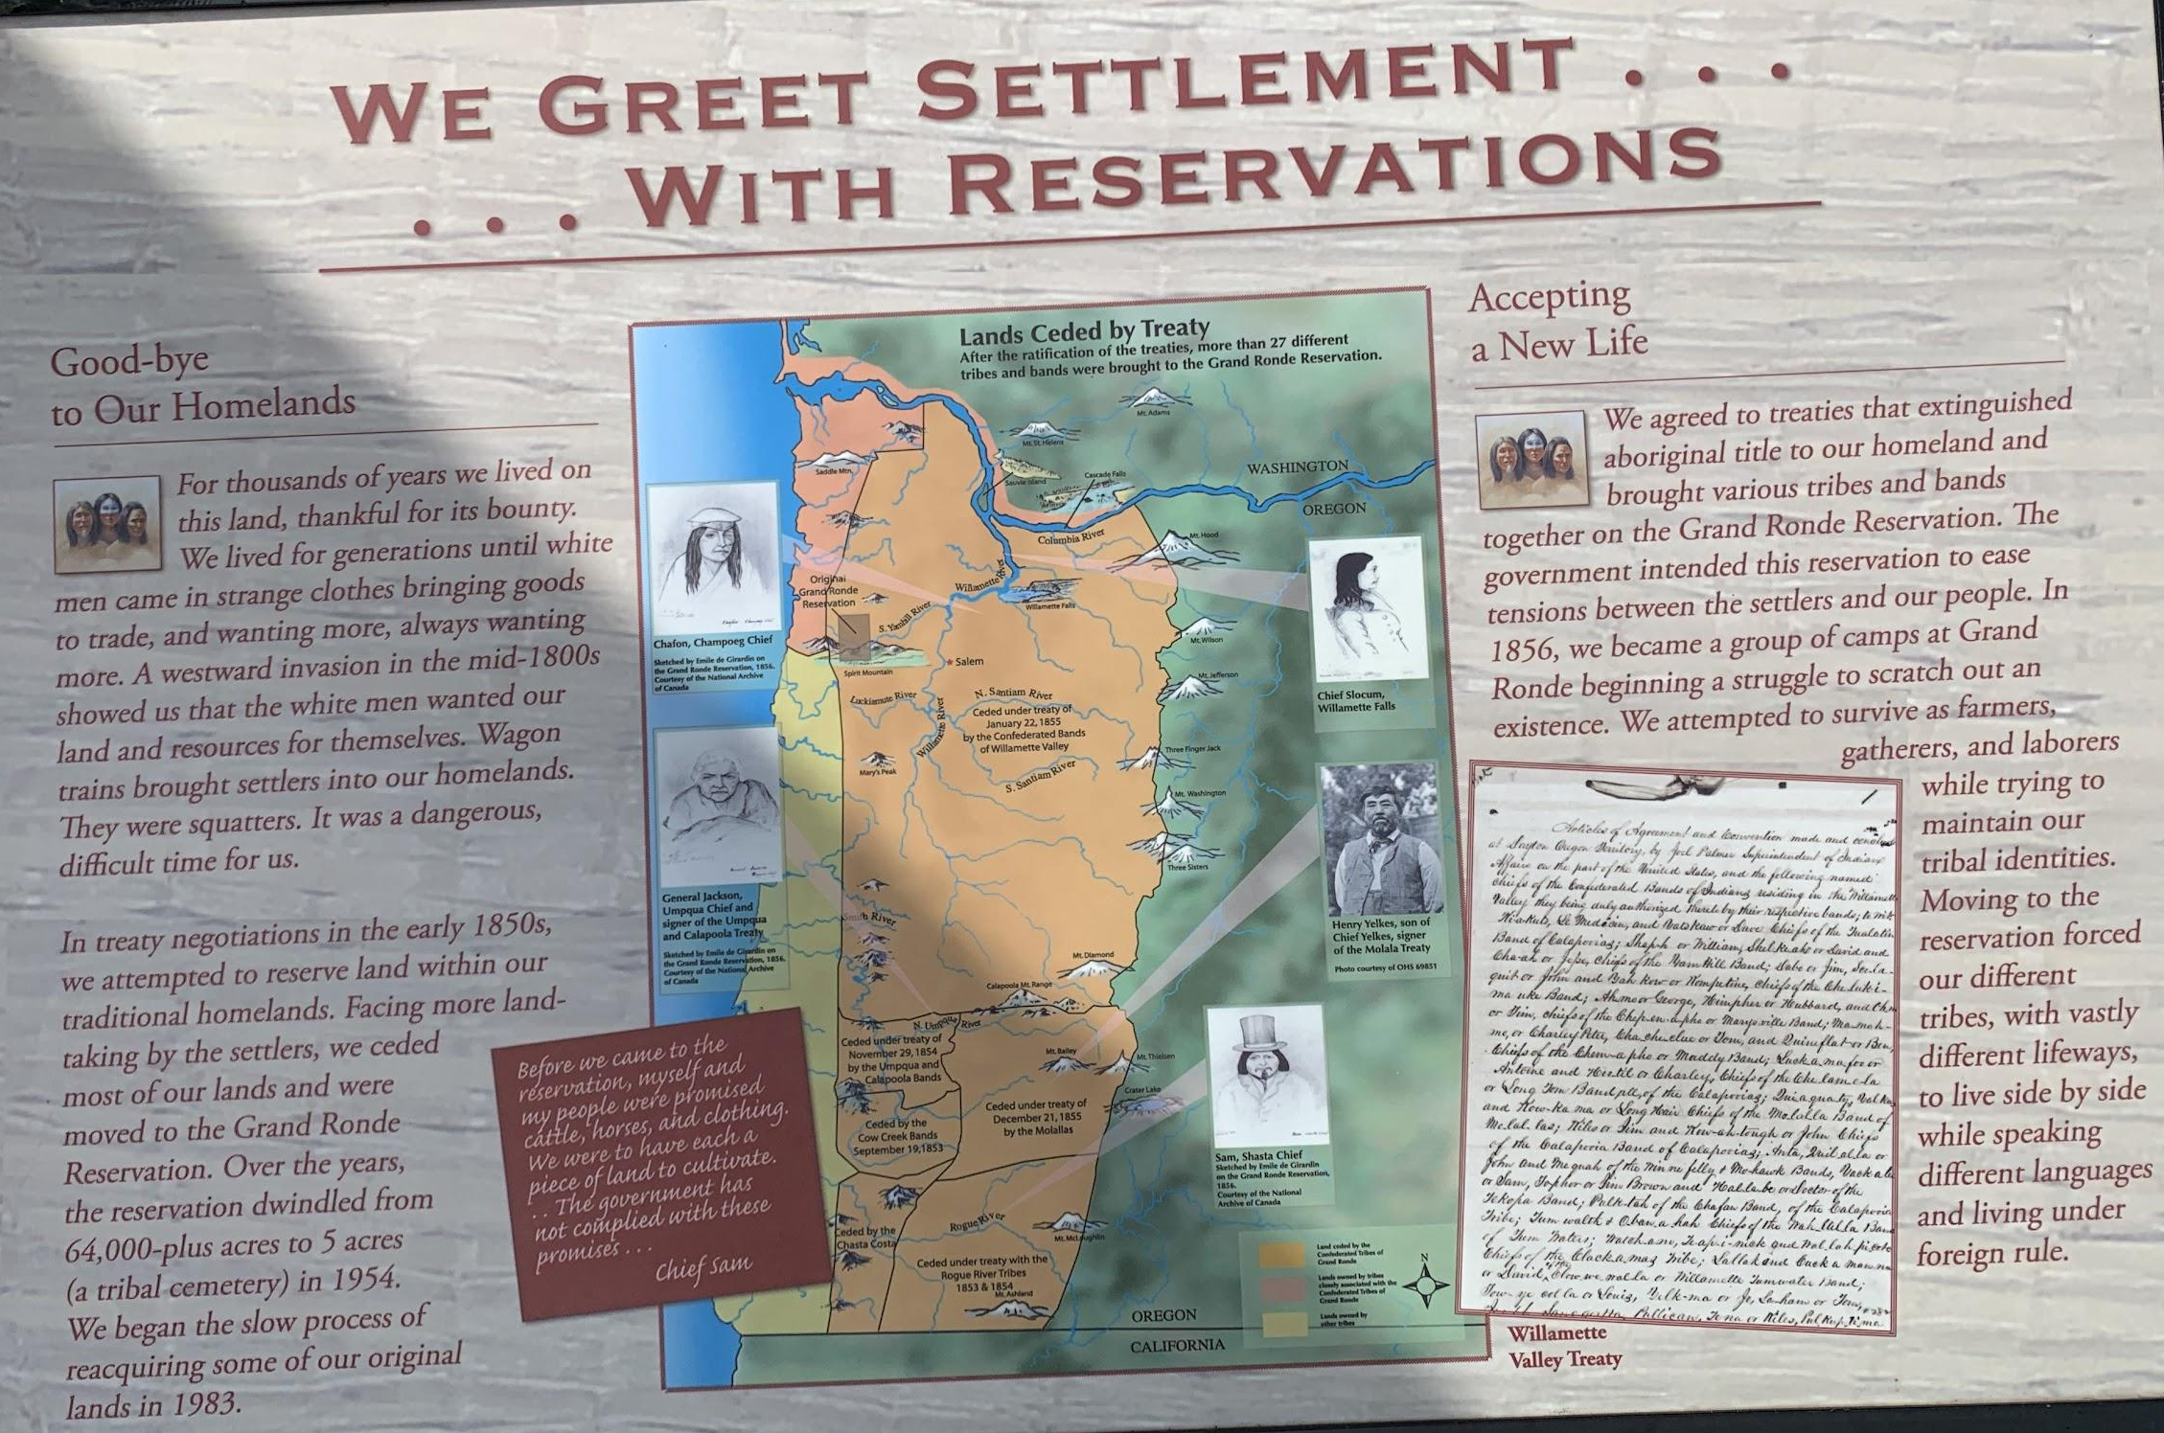
Notes:
Additional welcome sign

Slide 4
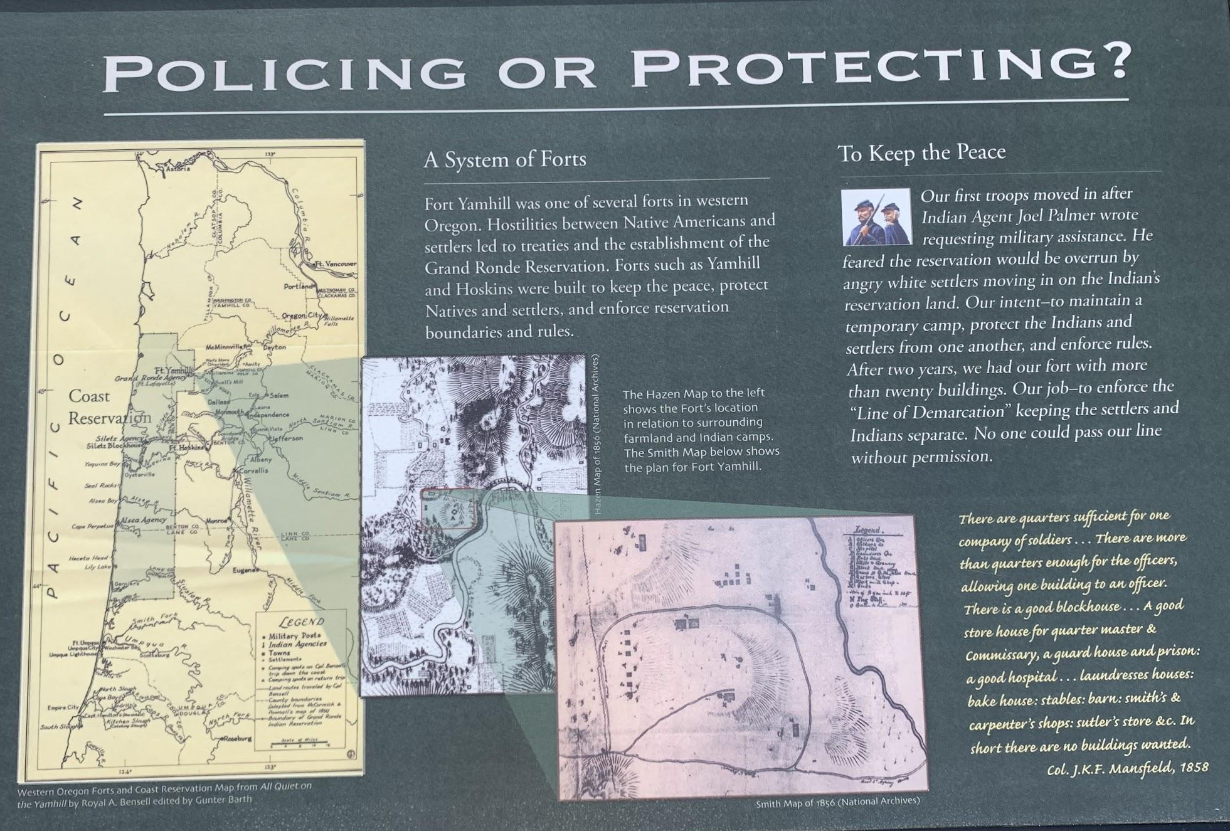
Notes:
Additional welcome sign

Slide 5
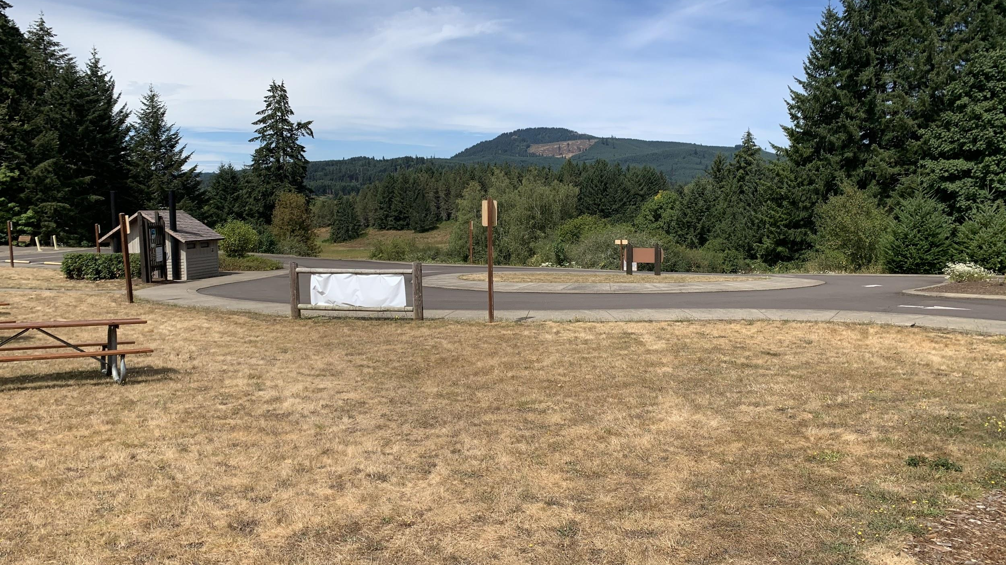
Notes:
Looking at the welcome signage area from the start of the trail

Slide 6
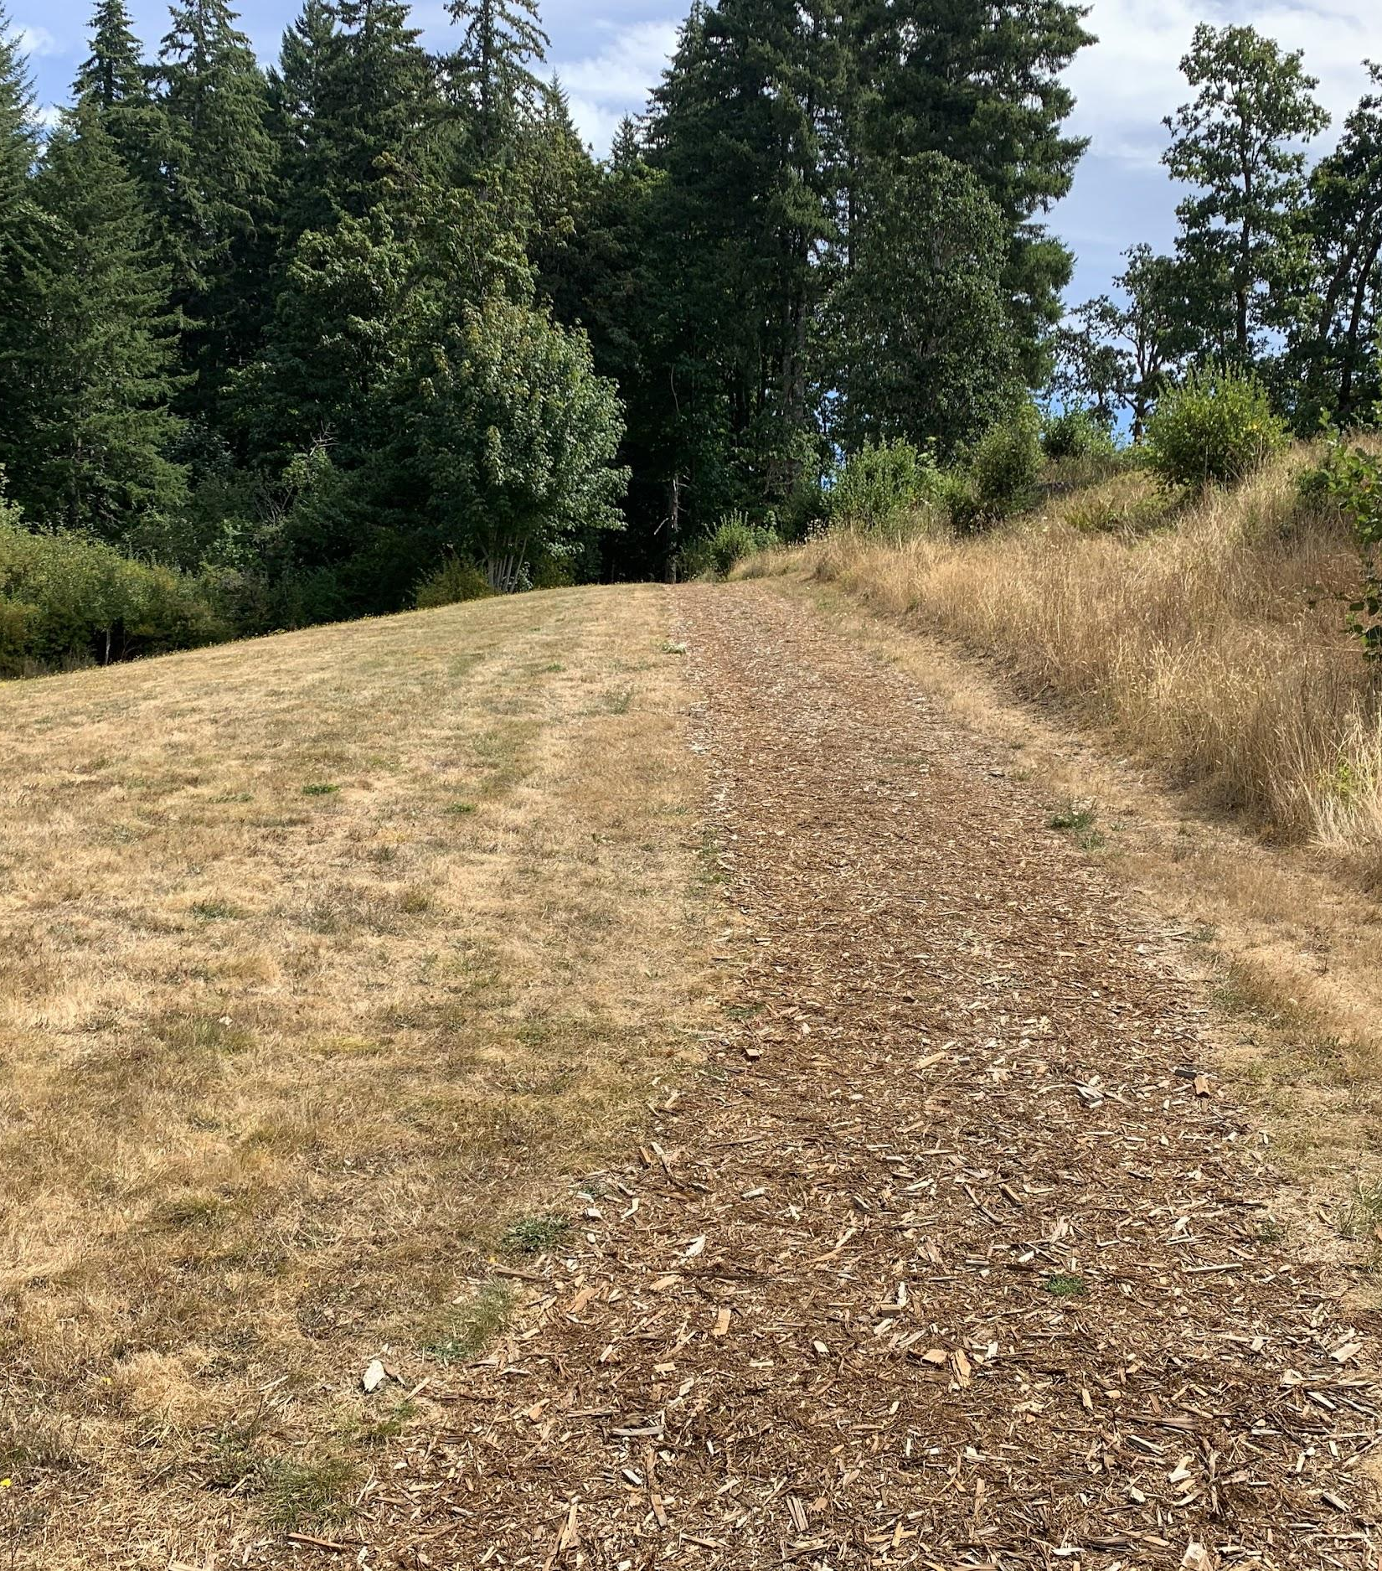
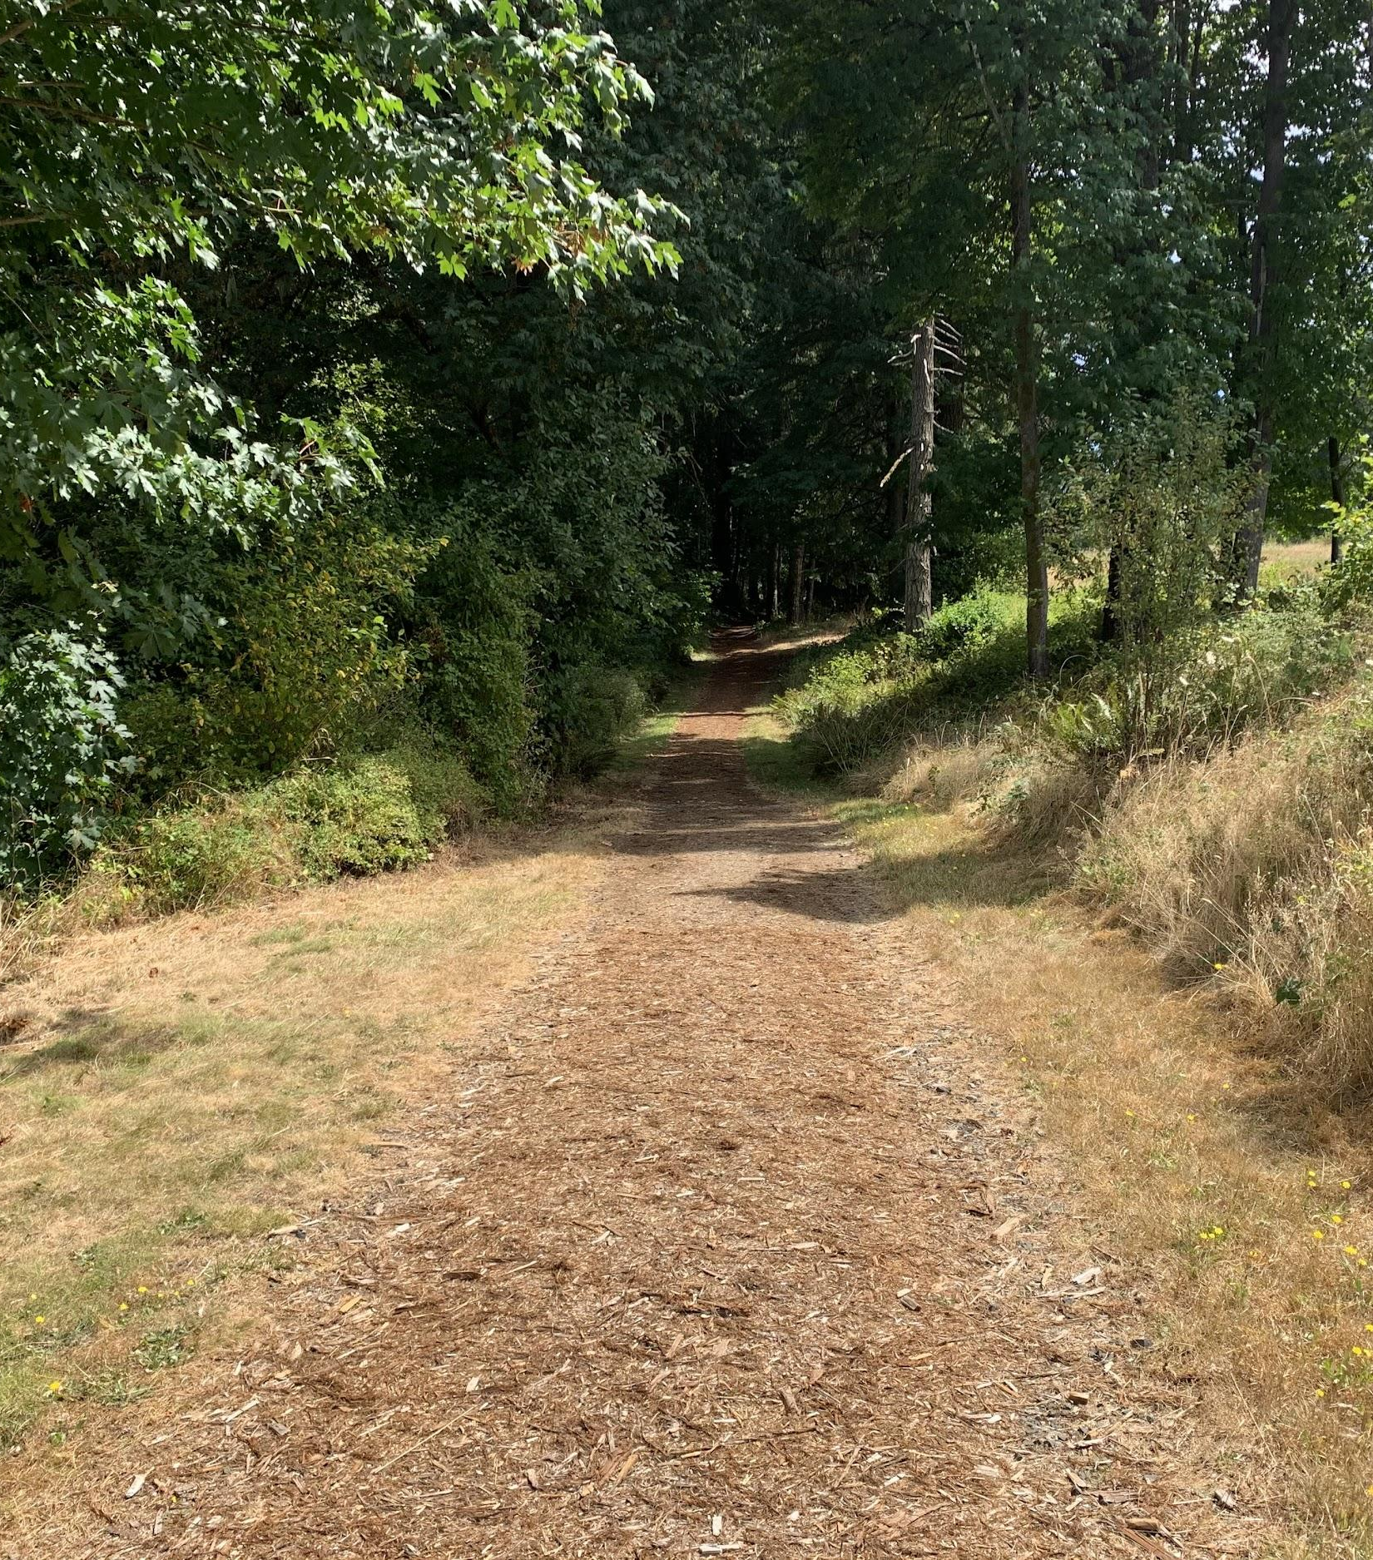
Notes:
Beginning of the trail

Slide 7
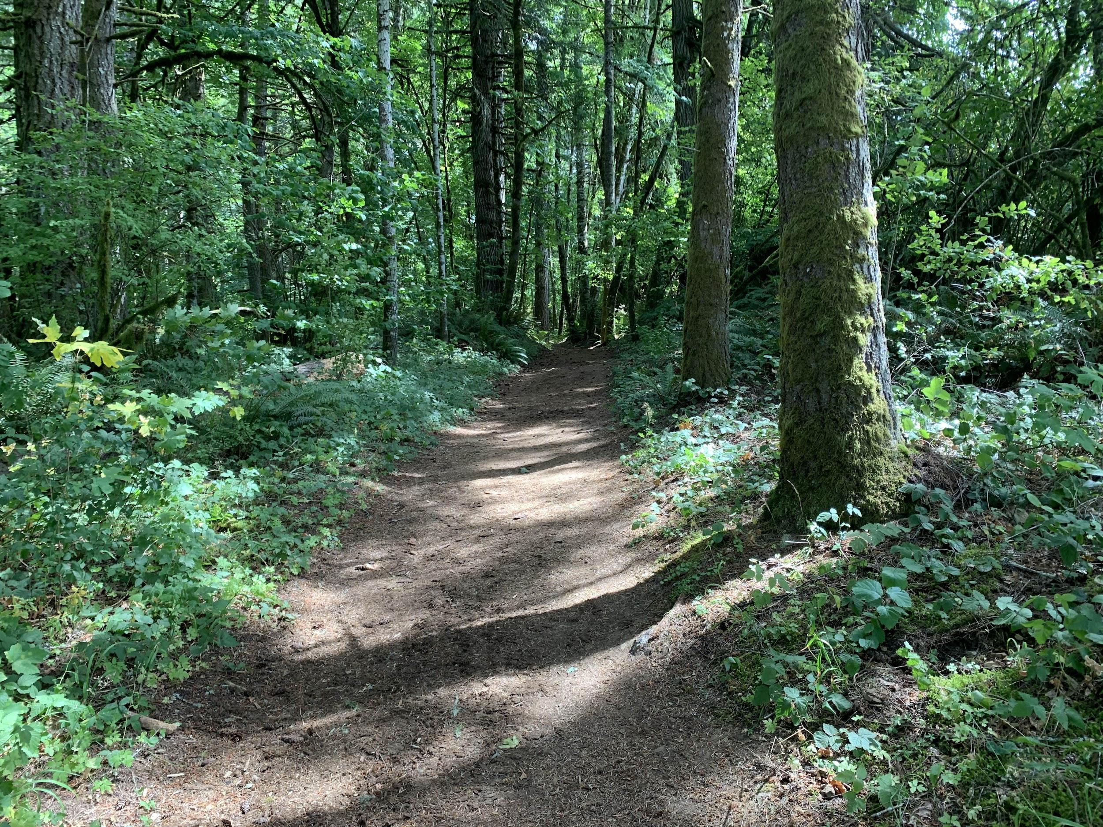
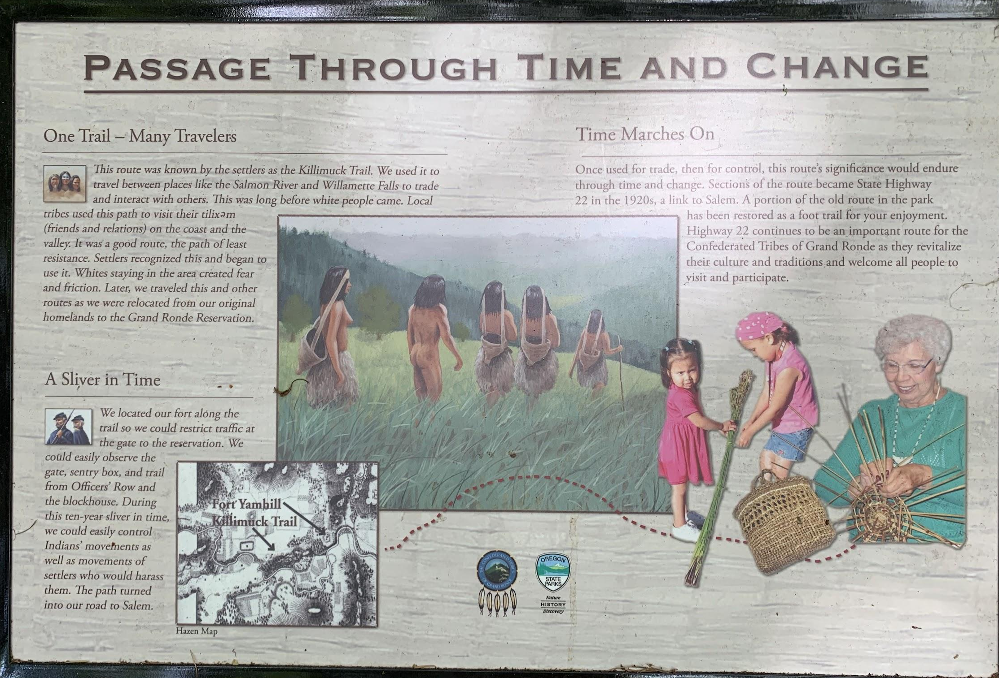
Notes:
Killamook Trail -ancient travel route from Valley to Coast
-path of least resistance, today’s Hwy
-recognized by military for strategic potential

Slide 8
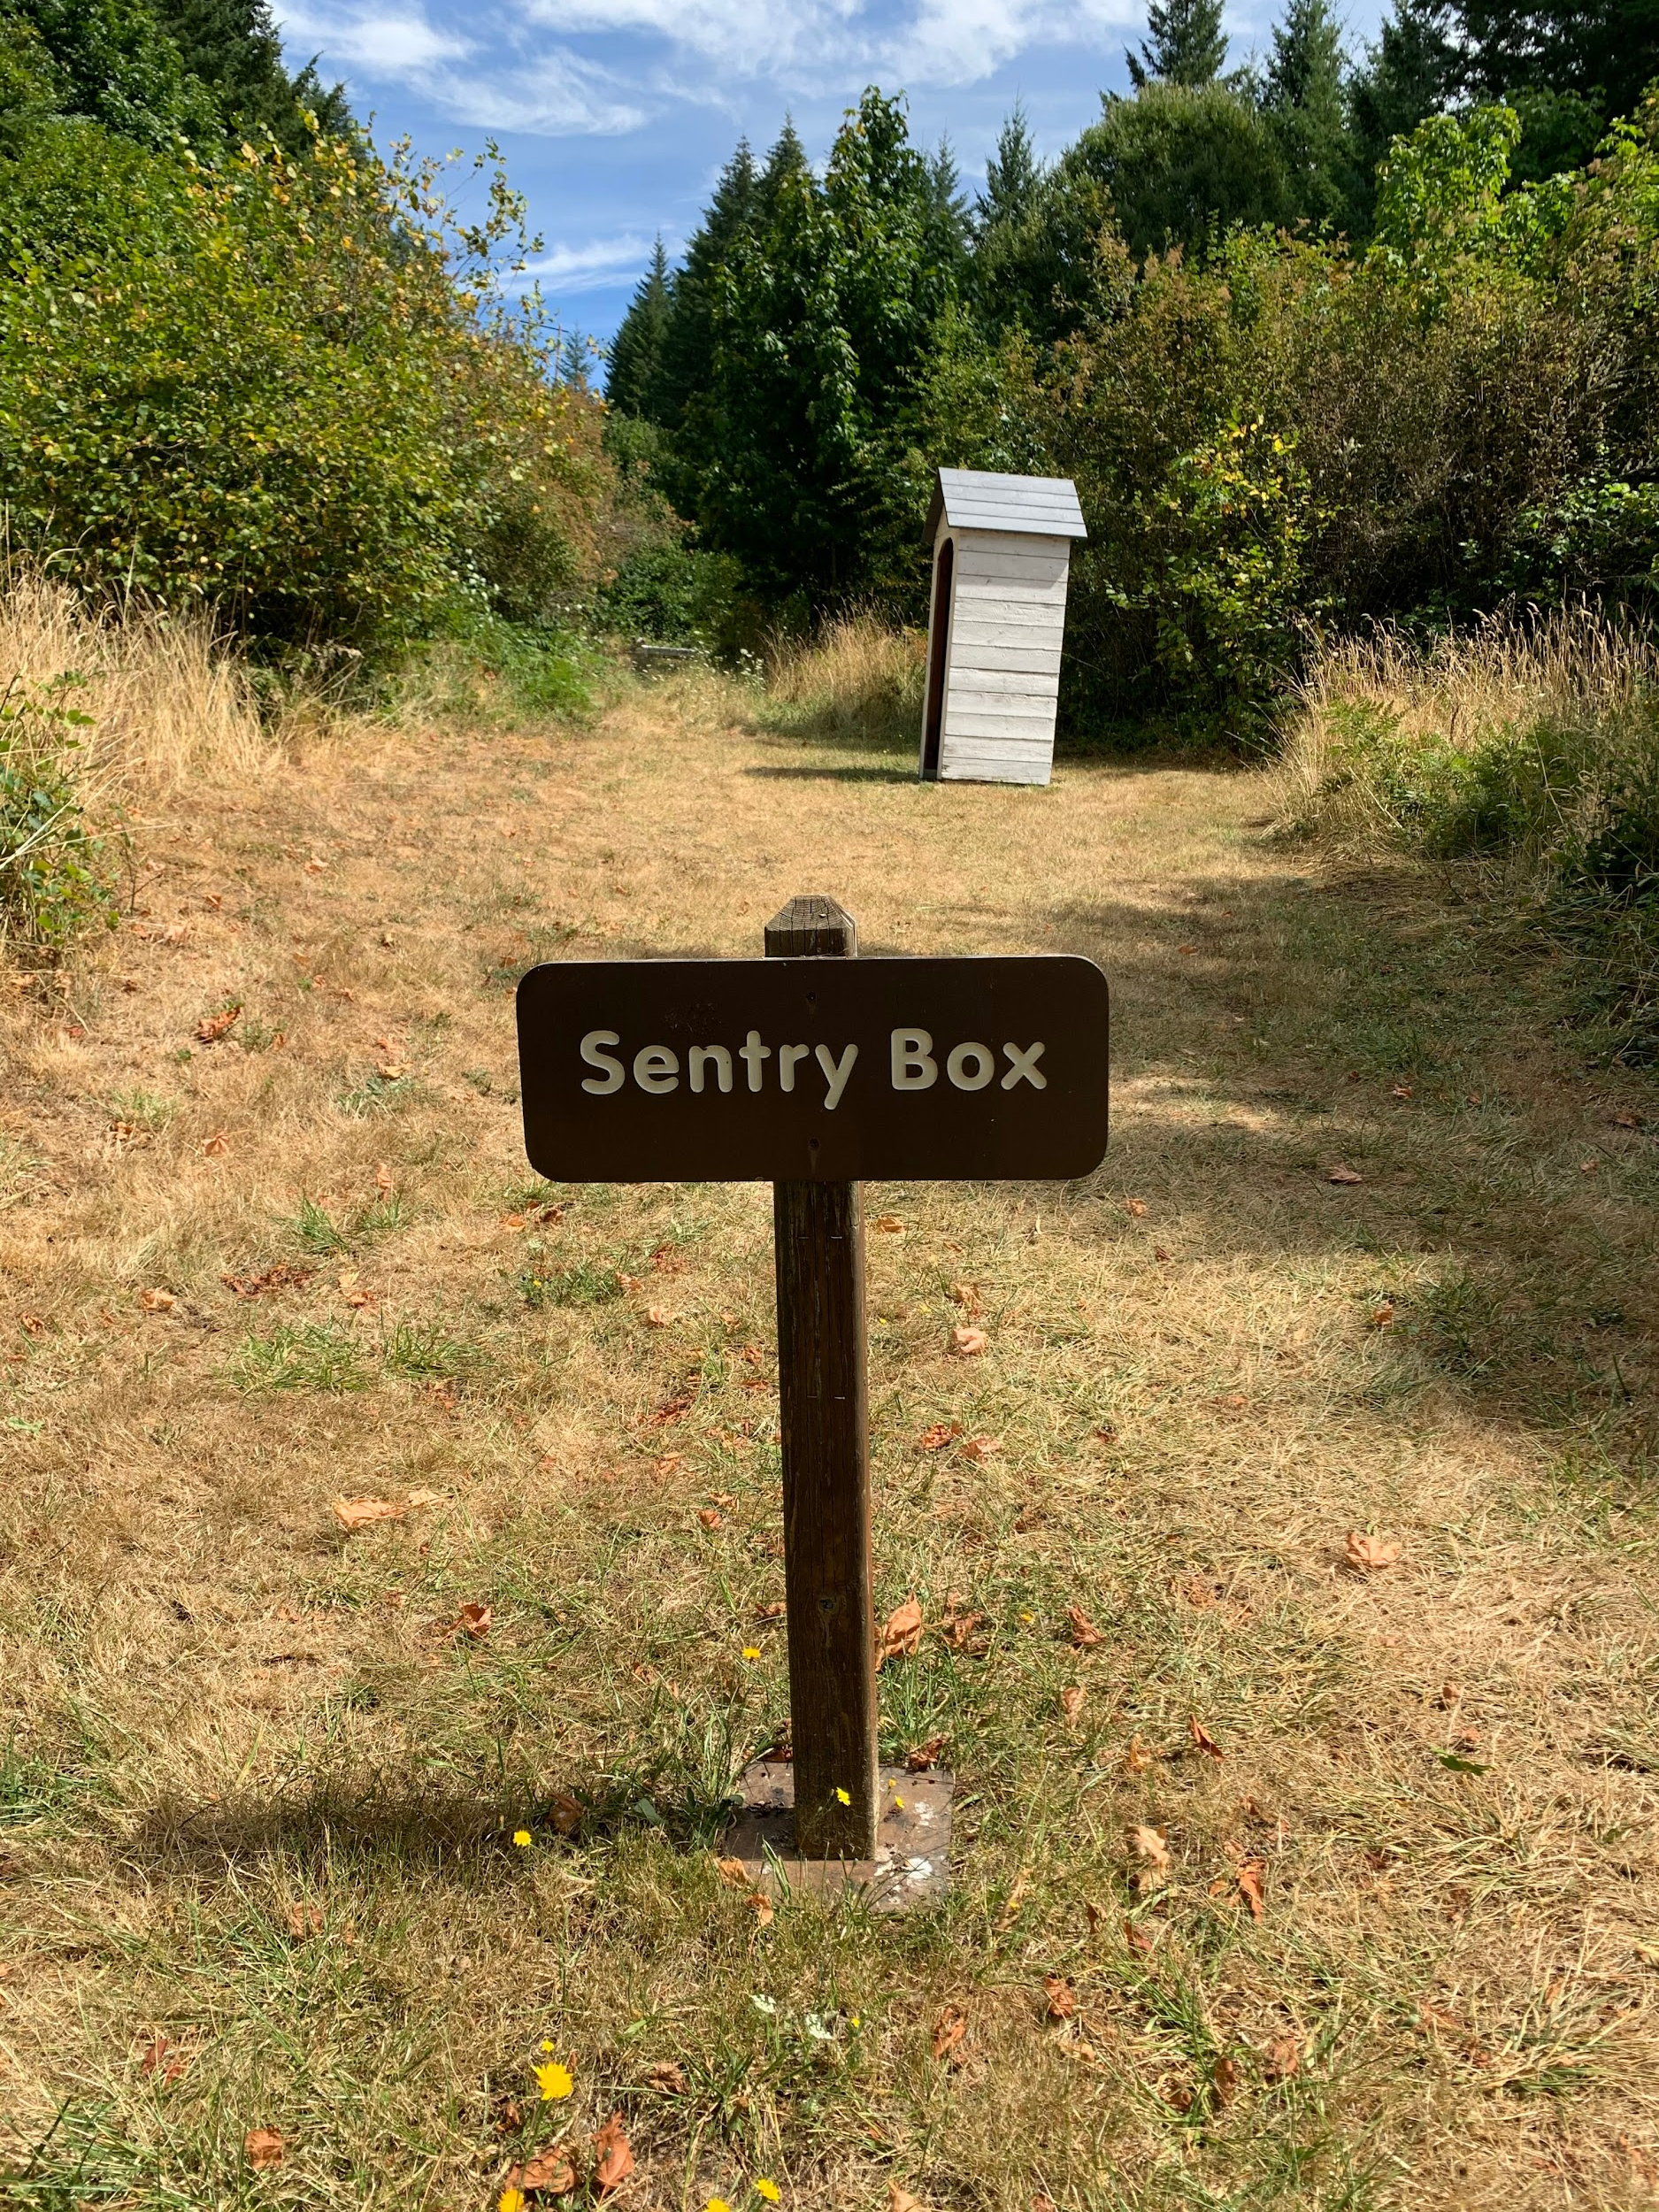
Notes:
Sentry Box -like TSA at airport – ID, pass, contraband
- 24/7 gate & fence
-chokepoint
-permission to leave or enter

Slide 9
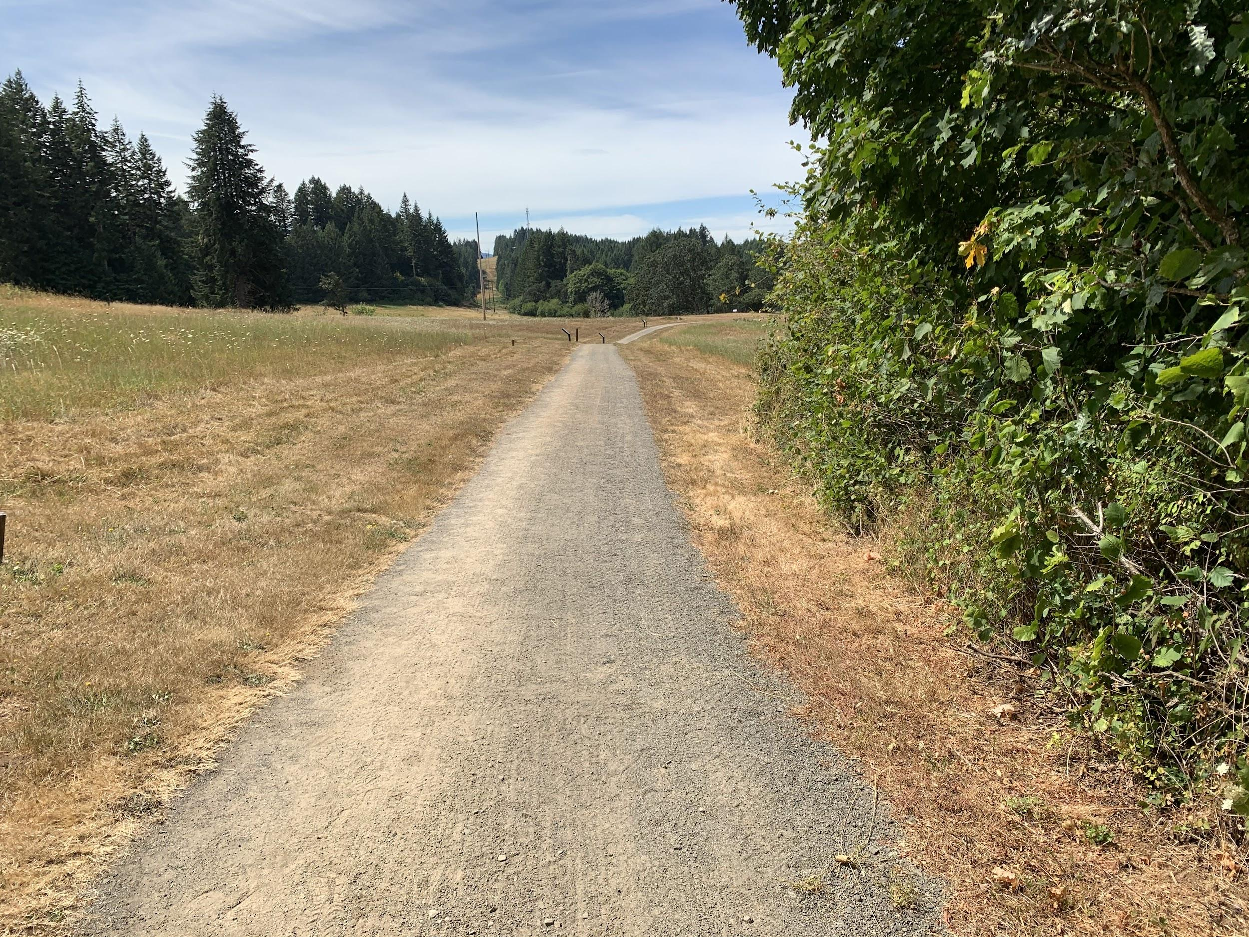
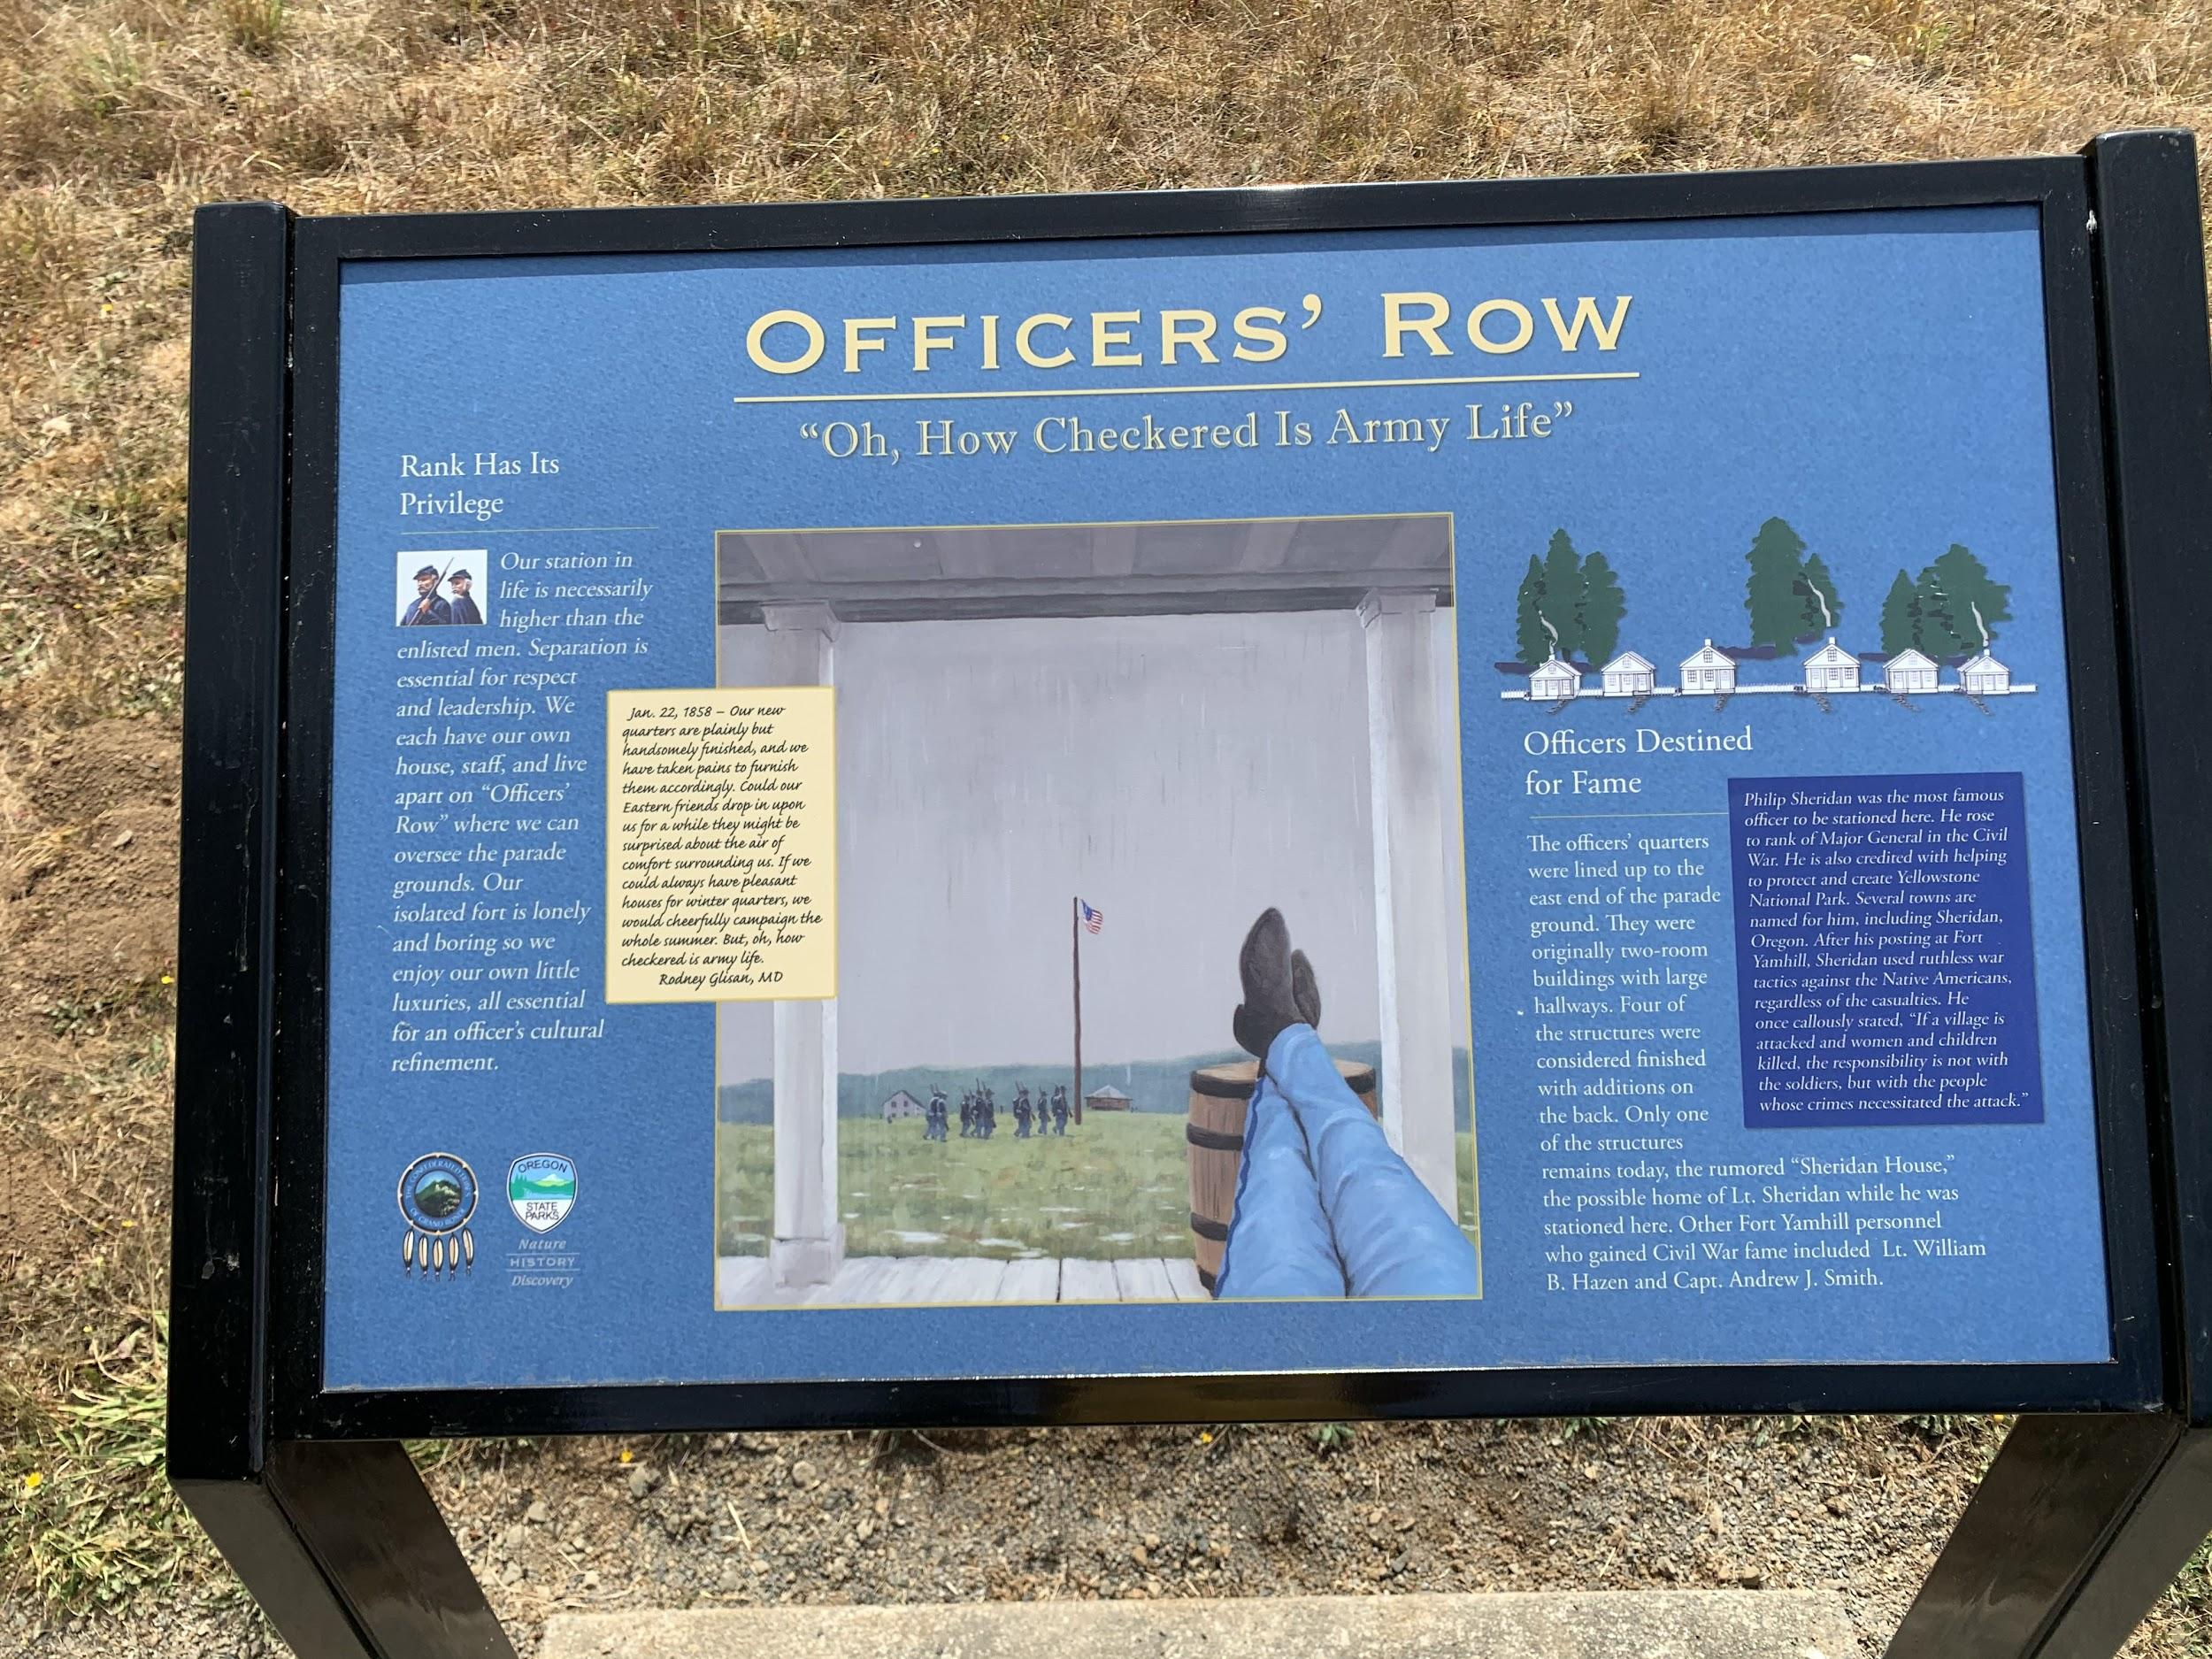
Notes:
Officers Row -ID location of house 1
-paint picture of symbolic fence
-commanding view of parade ground & reservation
-officers symbolically at the top of the hill= top authority

Slide 10
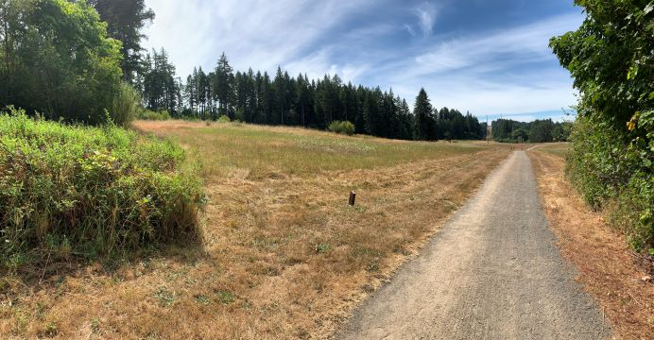

Slide 11
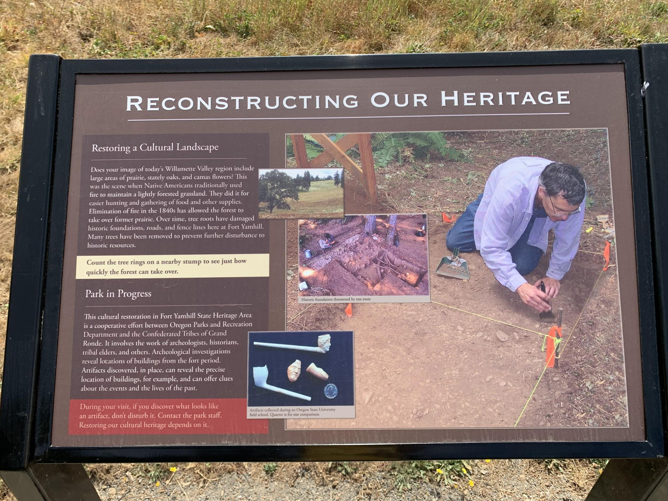
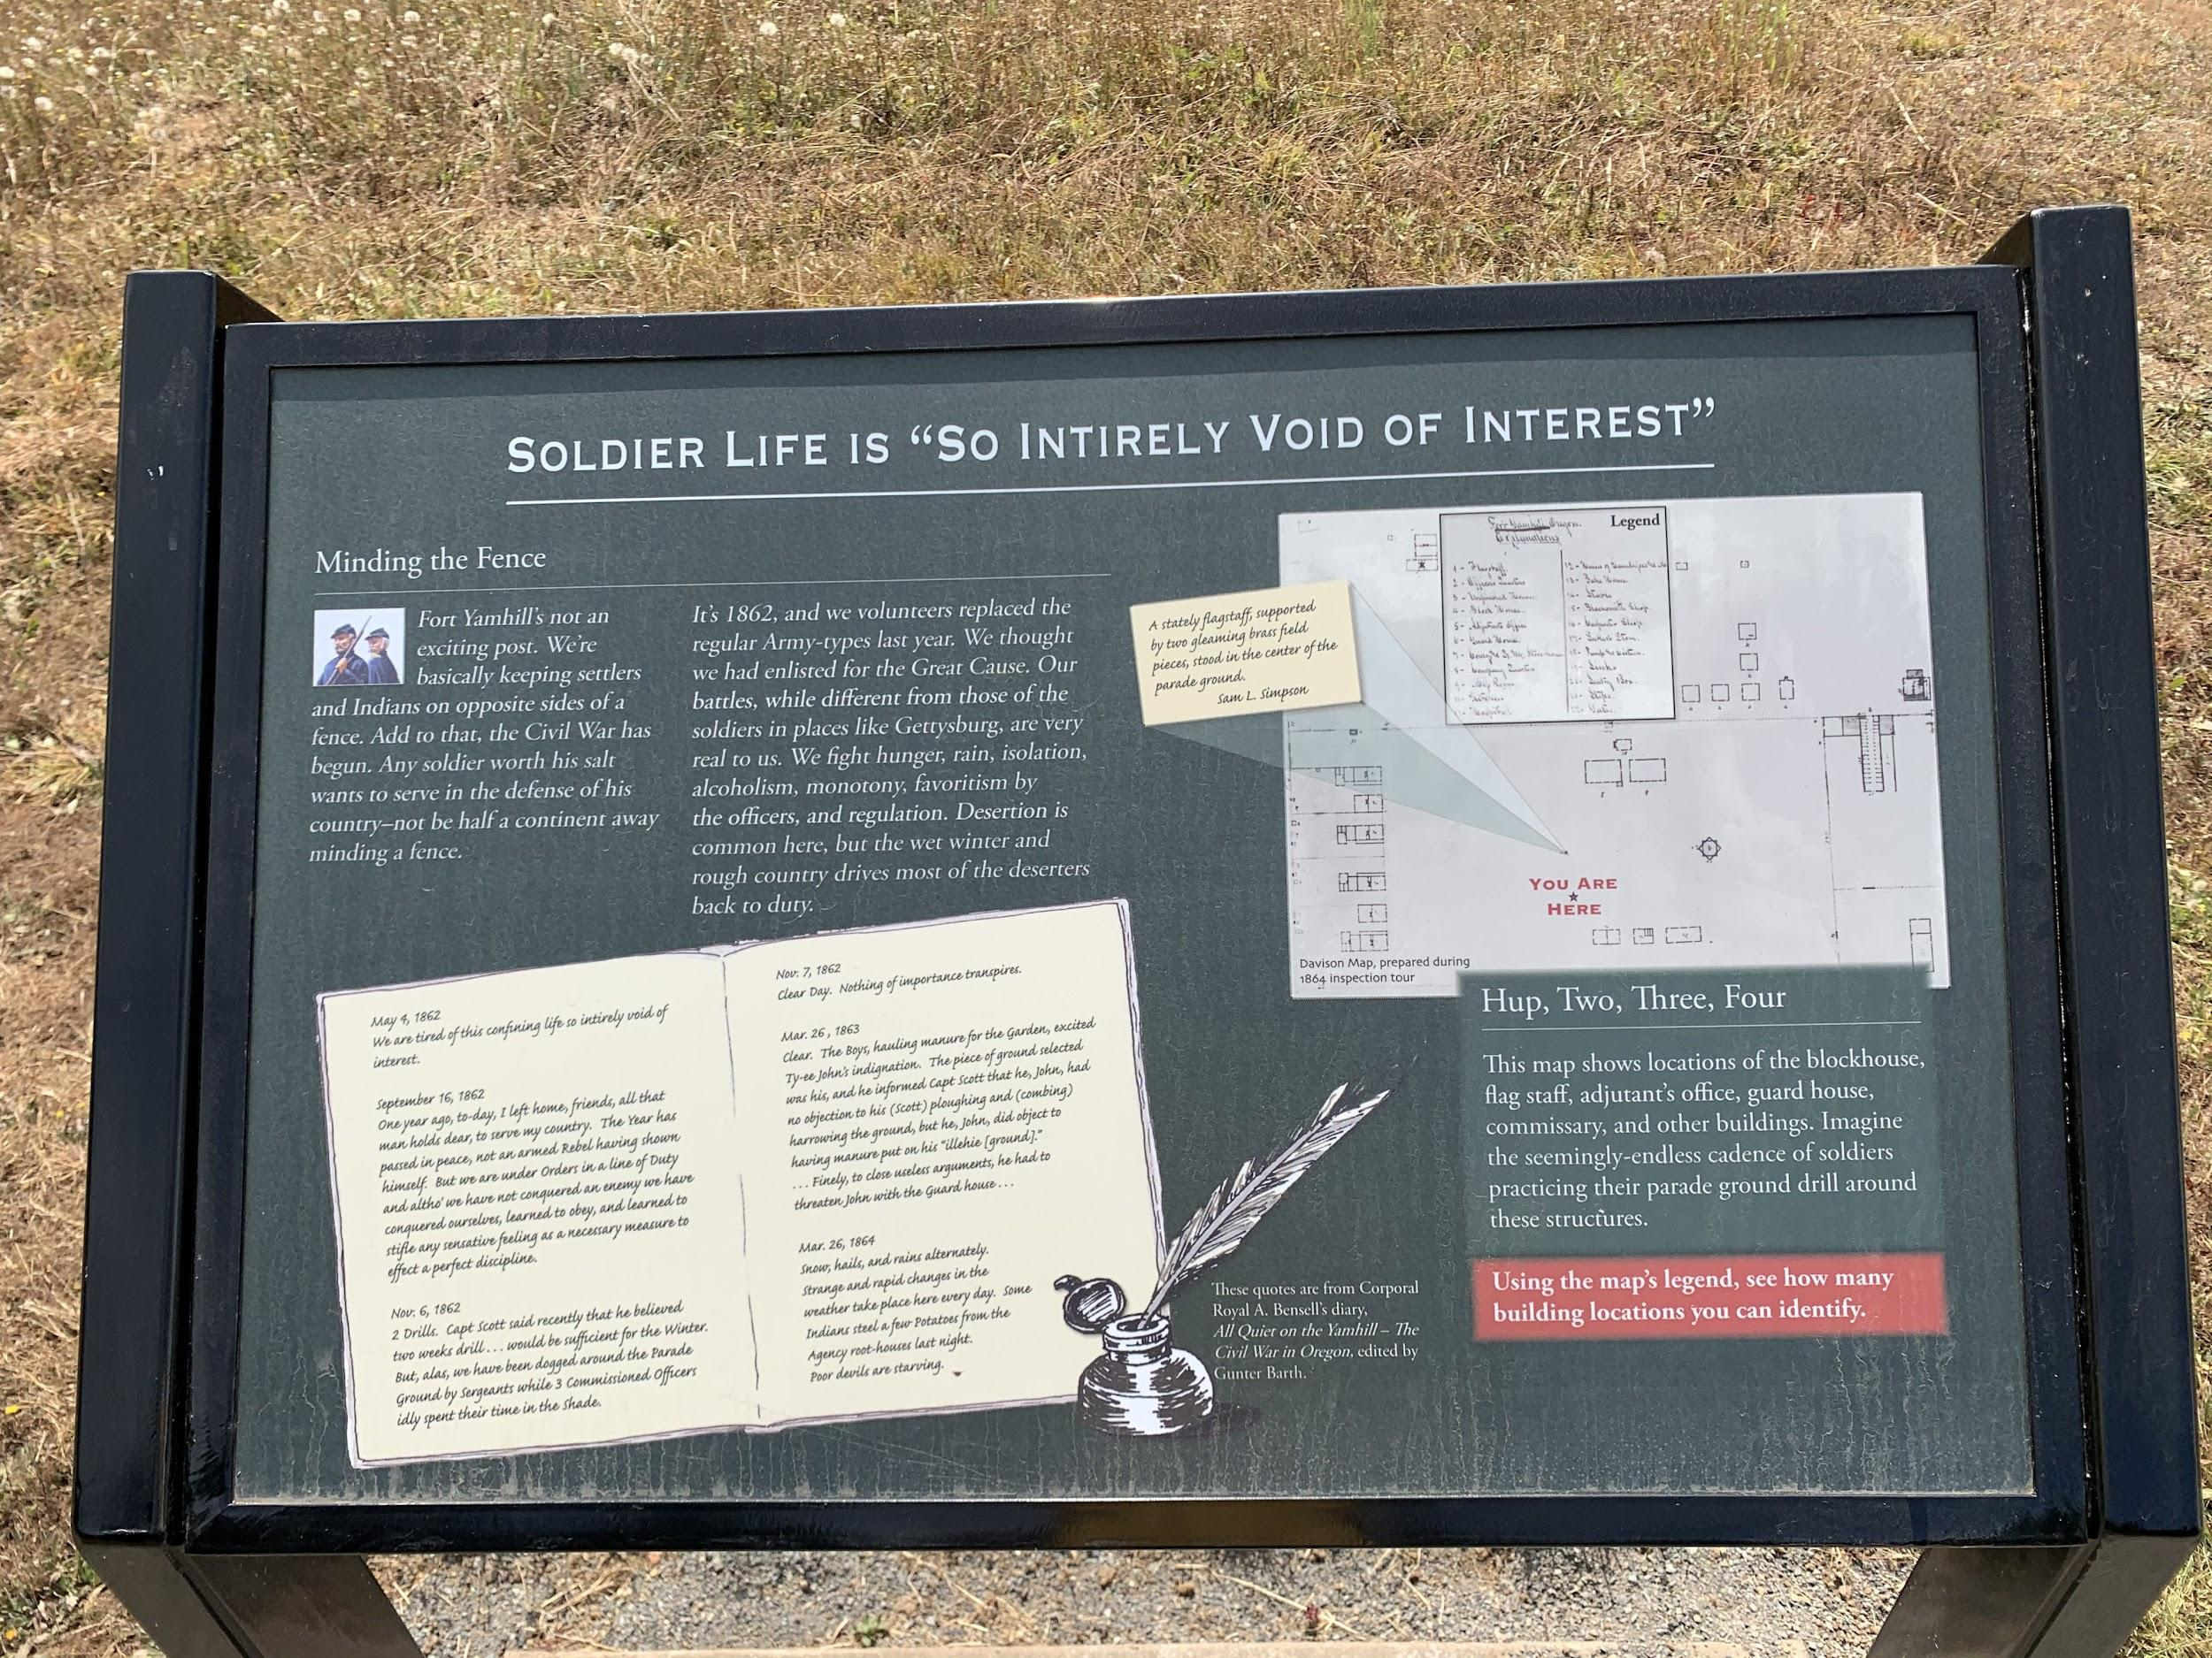

Slide 12
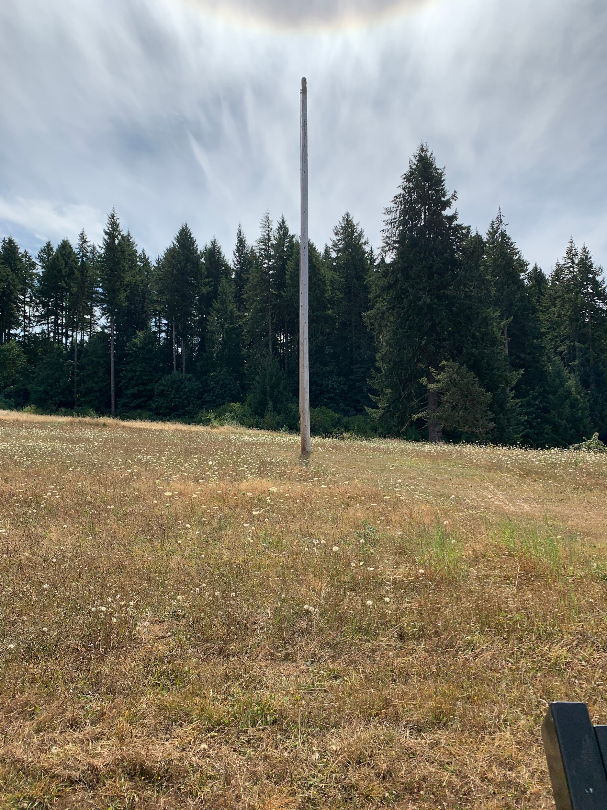
Notes:
Flag pole

Slide 13
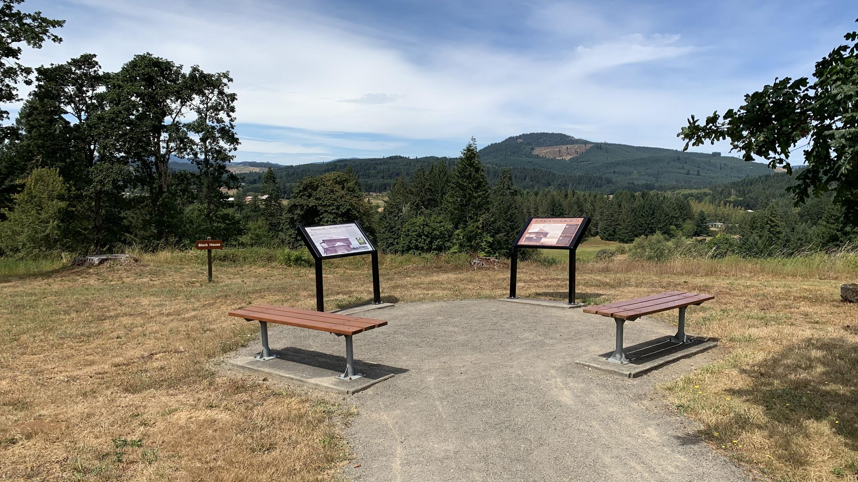
Notes:
Blockhouse -ID location of parade ground, flag & blockhouse
-use of blockhouse
-oak savannah & view to and from fort
-show of force to intimidate
-imagine being a Native American & looking up at the
fort everyday- reminder of loss

Slide 14
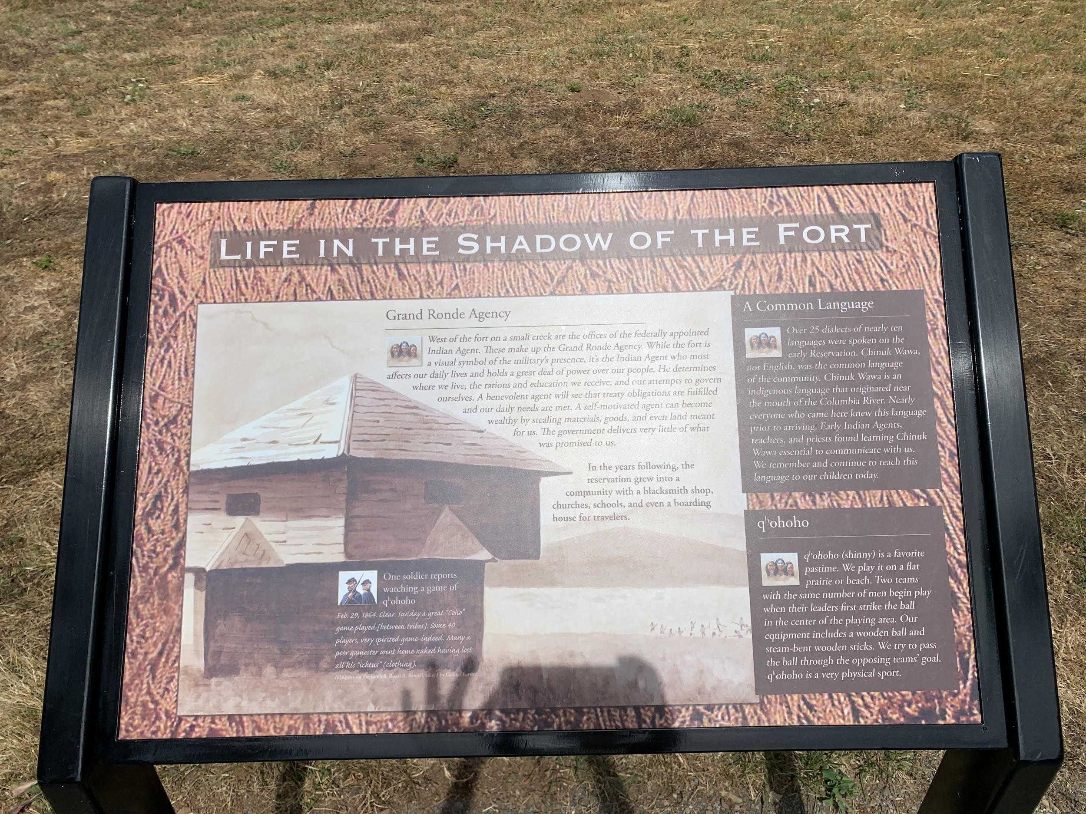
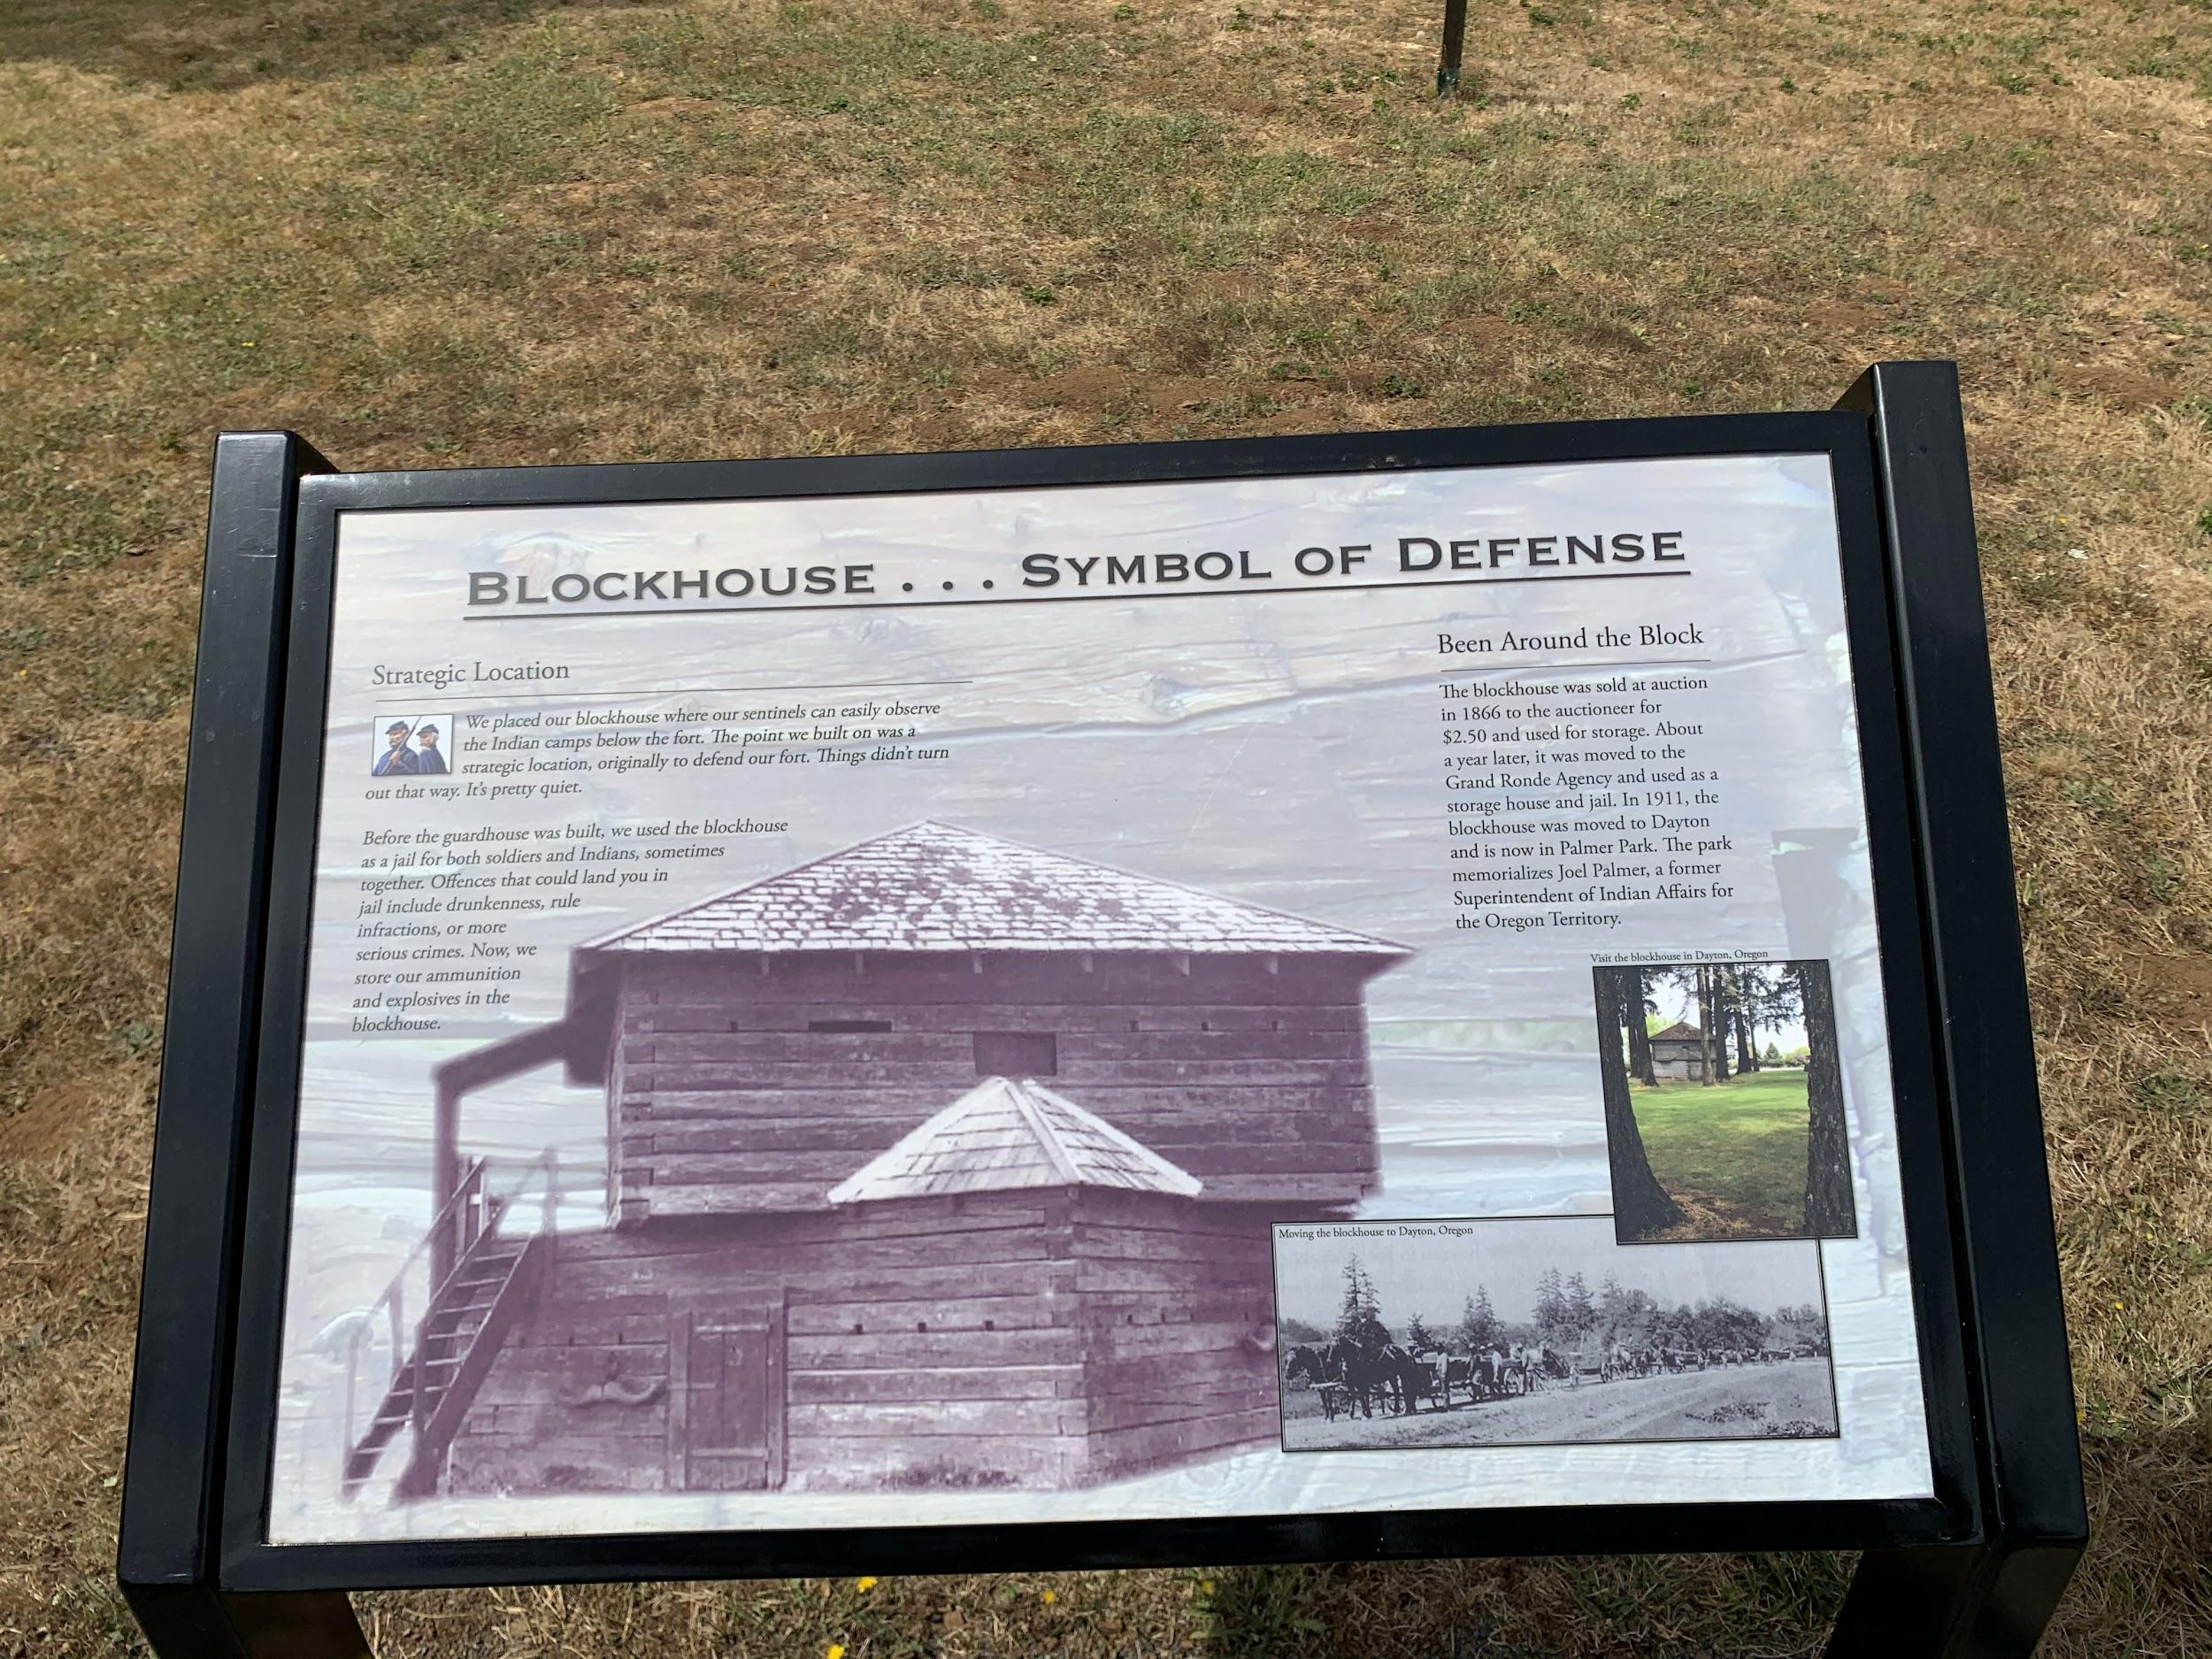

Slide 15
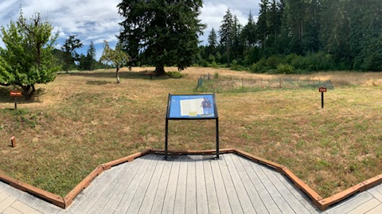
Notes:
Kitchen -OSU, definition: artifact/archeology
-show artifacts & foundation photos

Slide 16
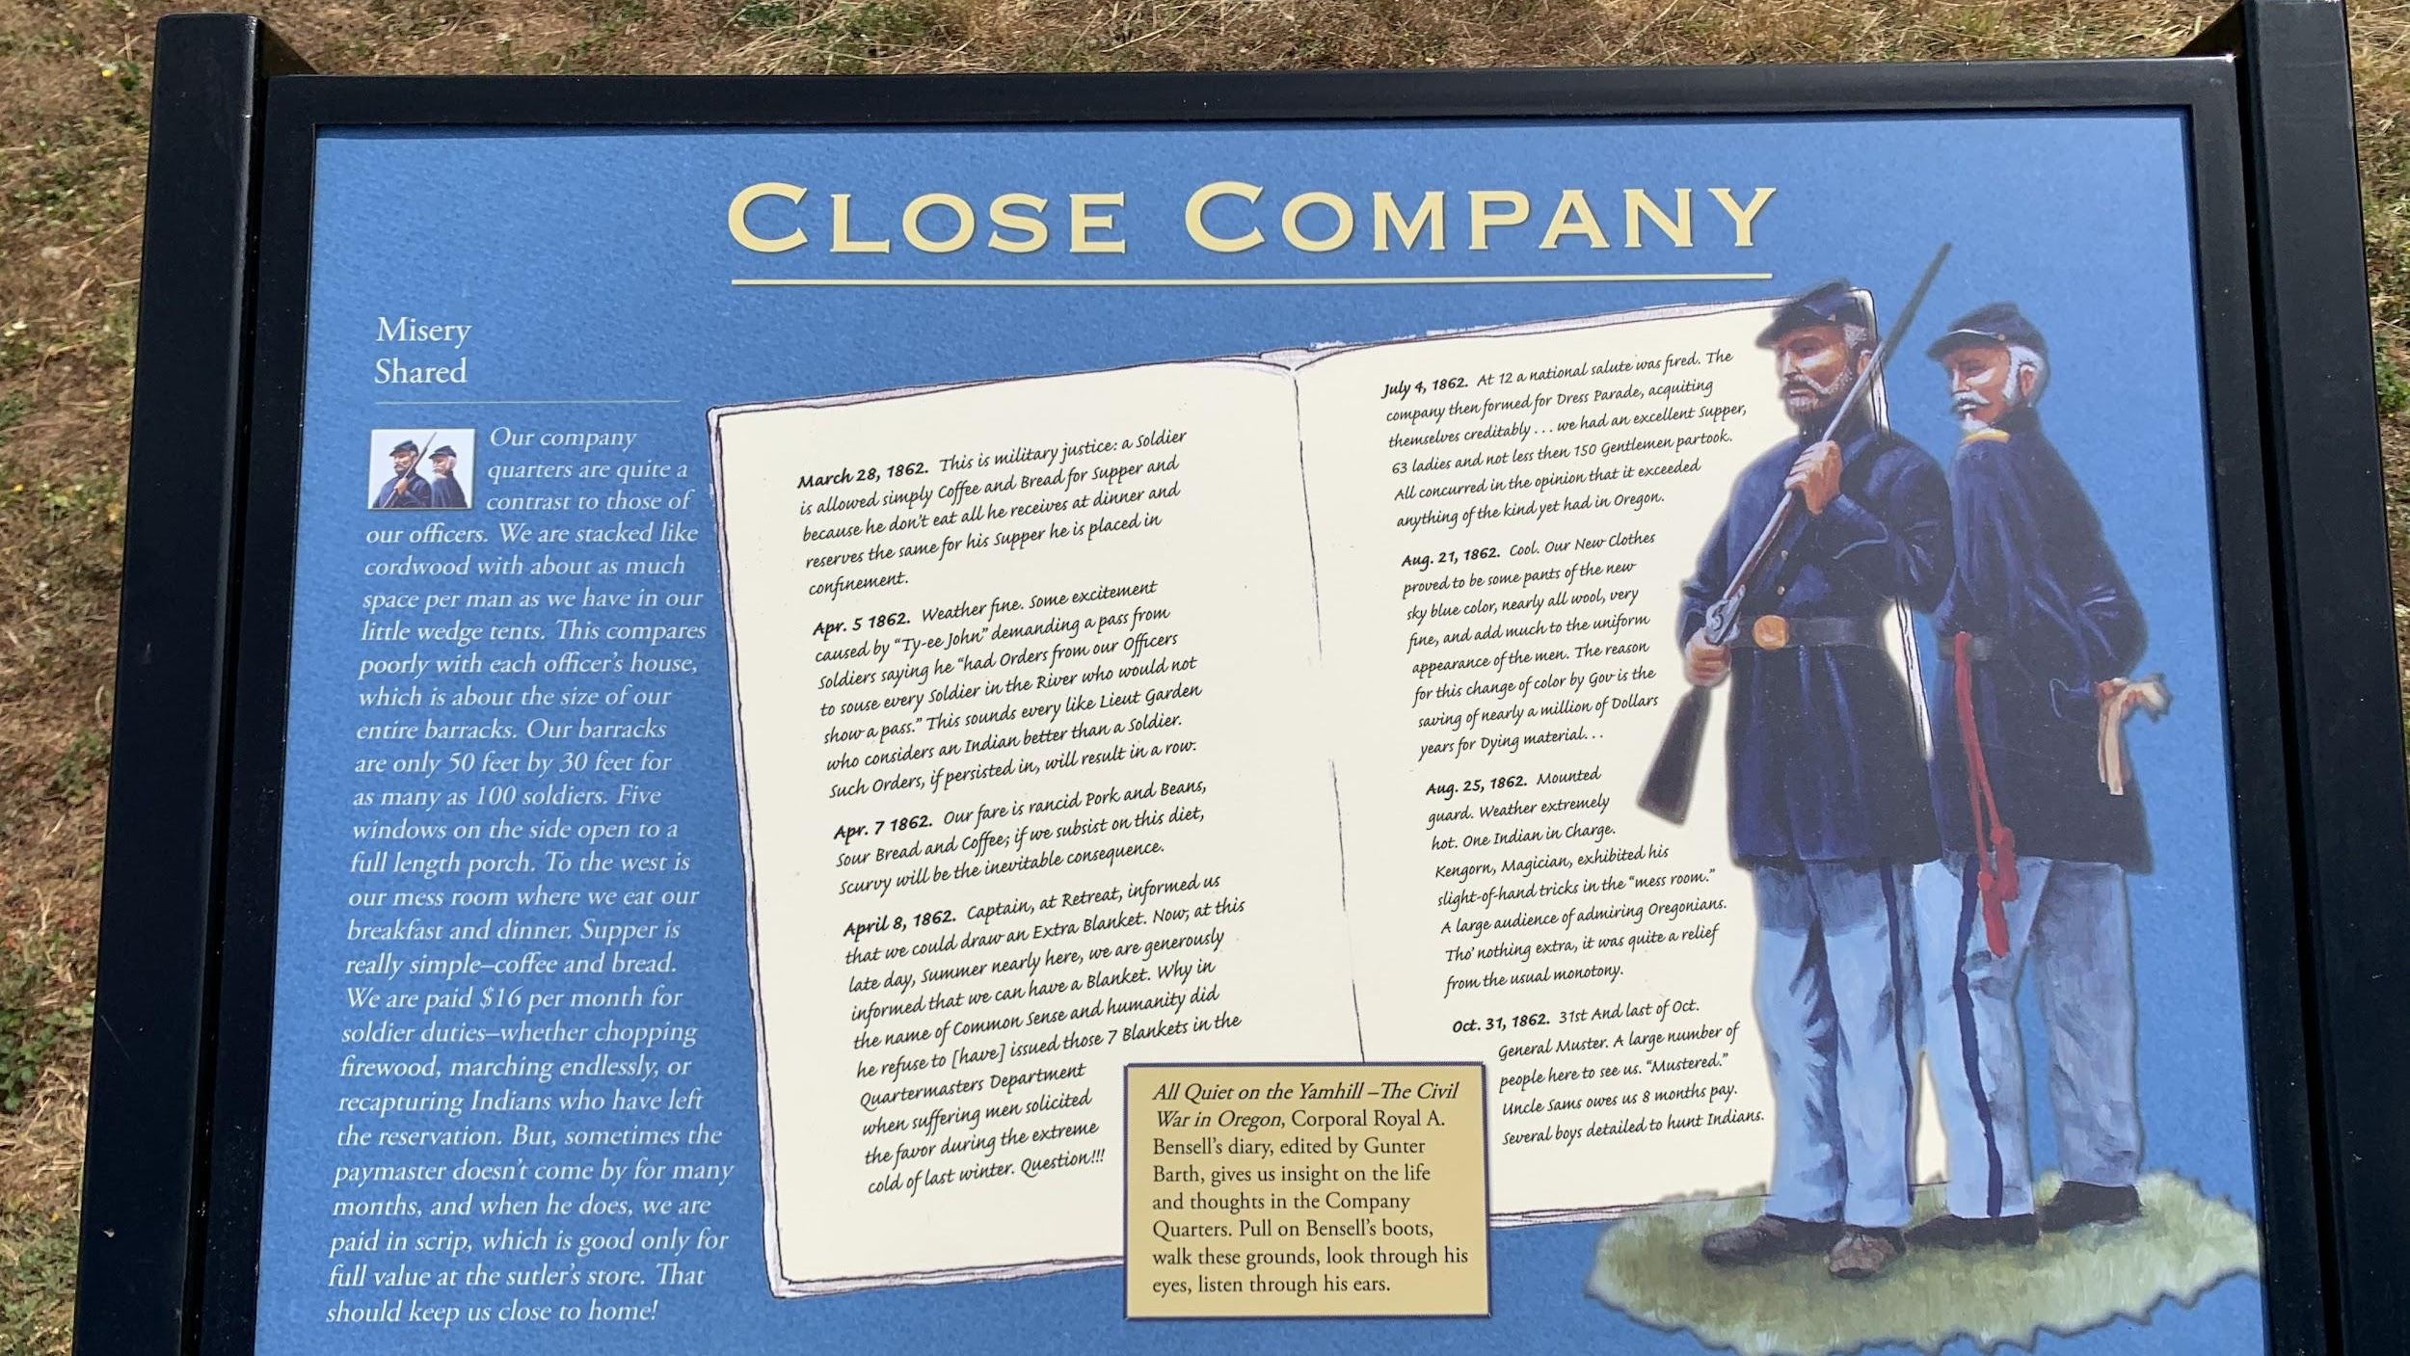

Slide 17
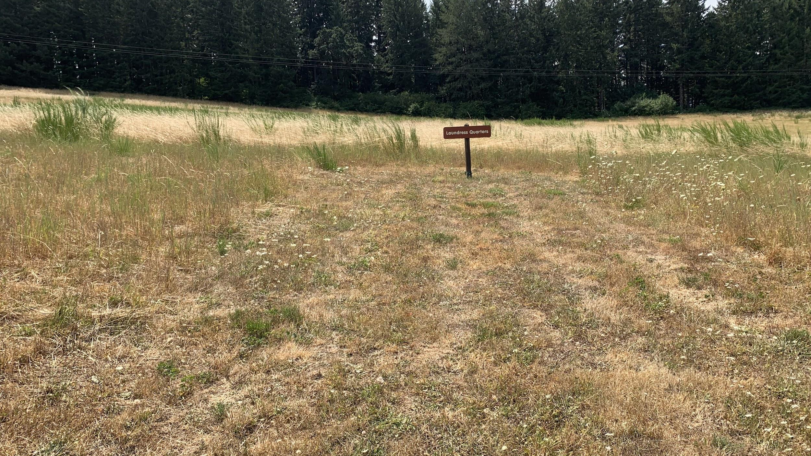
Notes:
Laundress Quarters

Slide 18
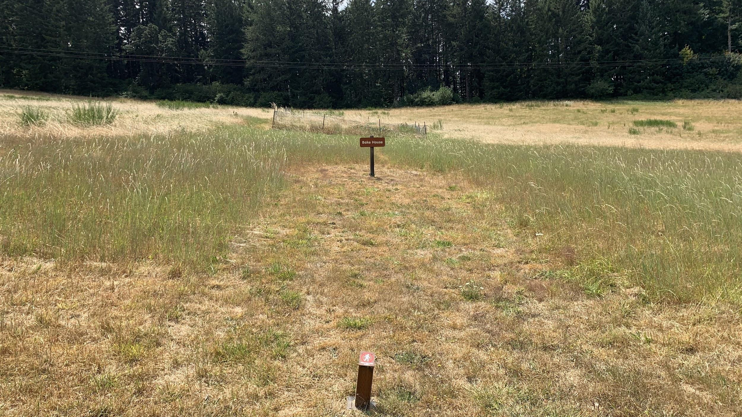
Notes:
Bake House

Slide 19
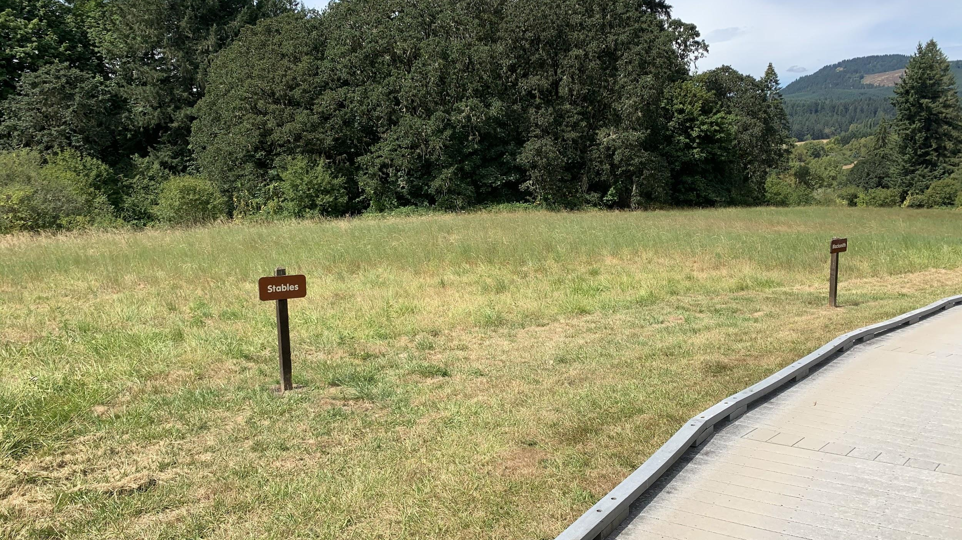
Notes:
Stables and Blacksmith

Slide 20
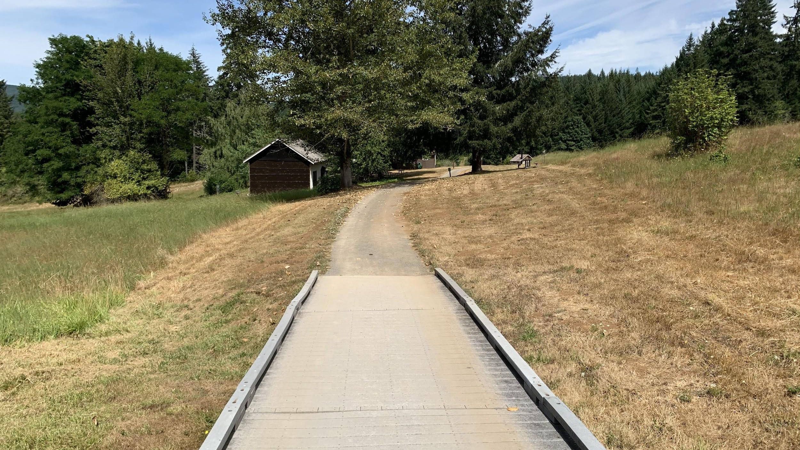

Slide 21
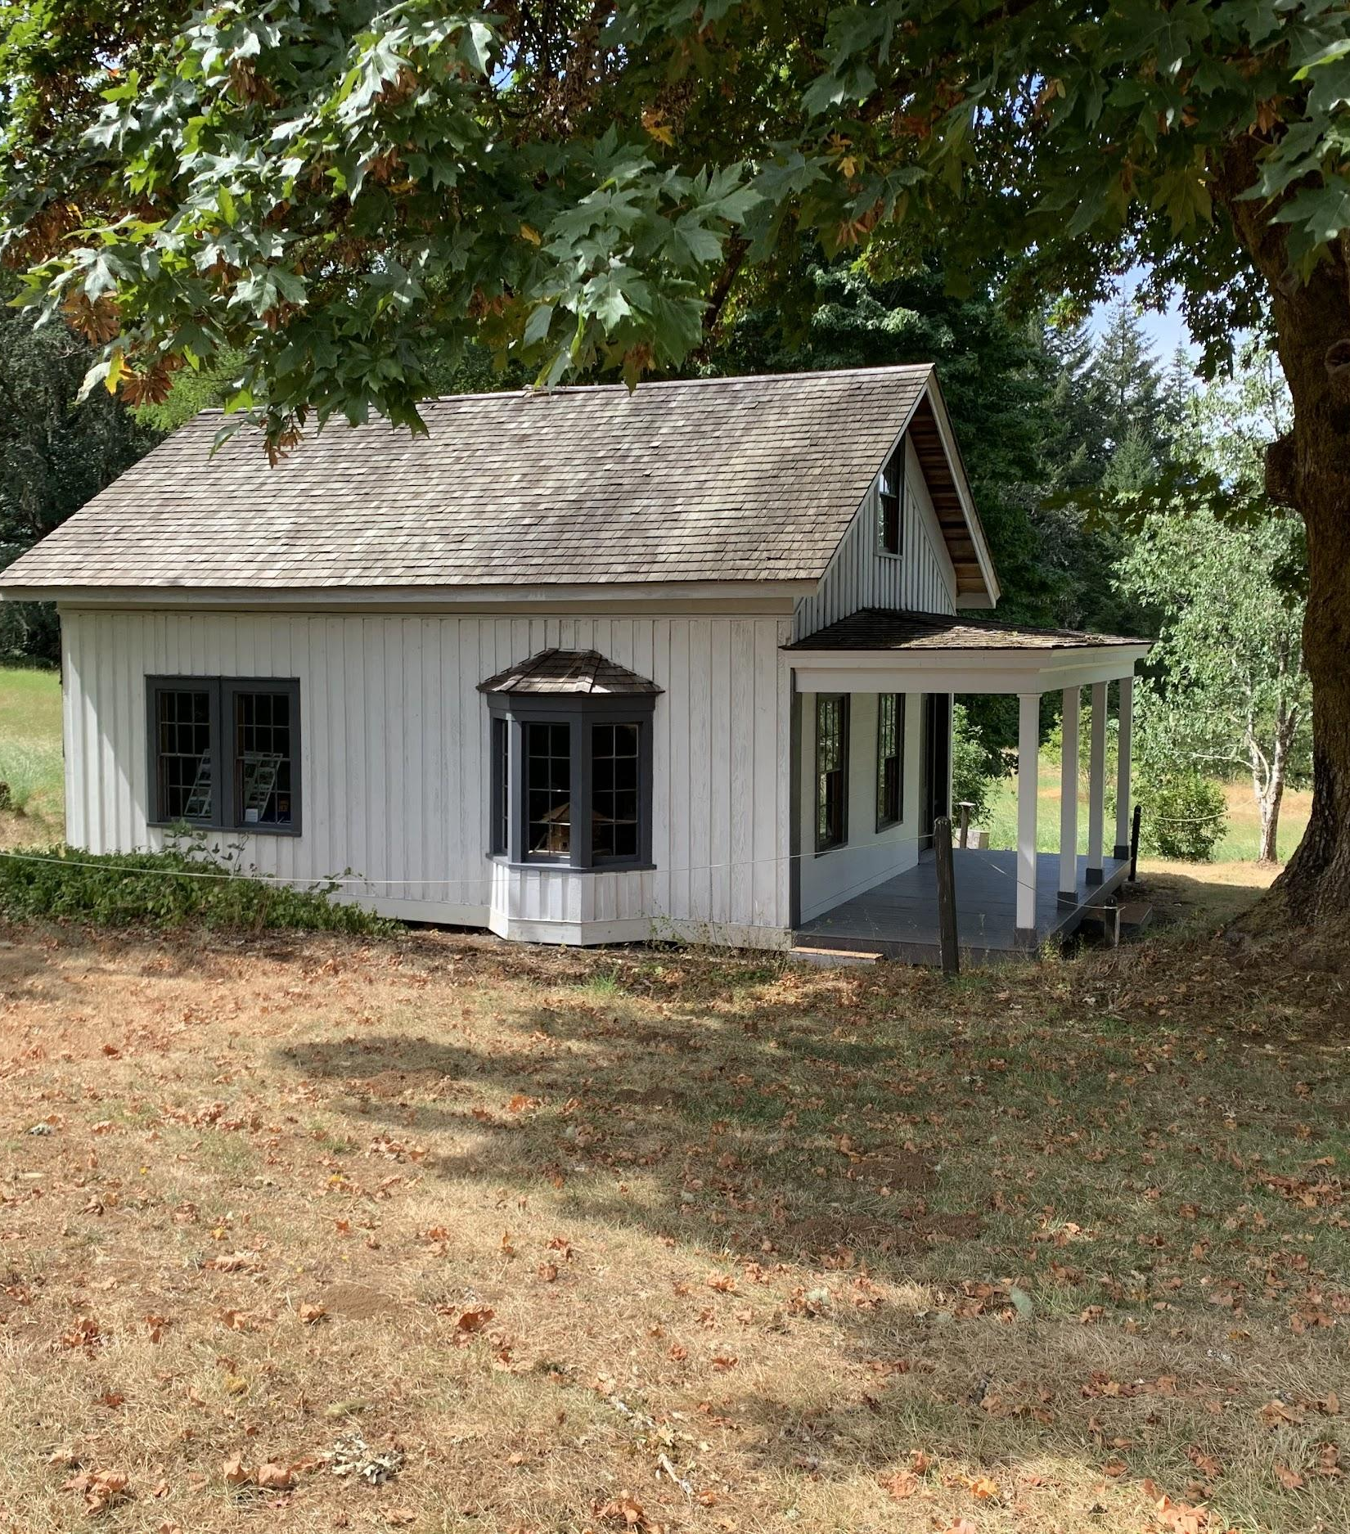
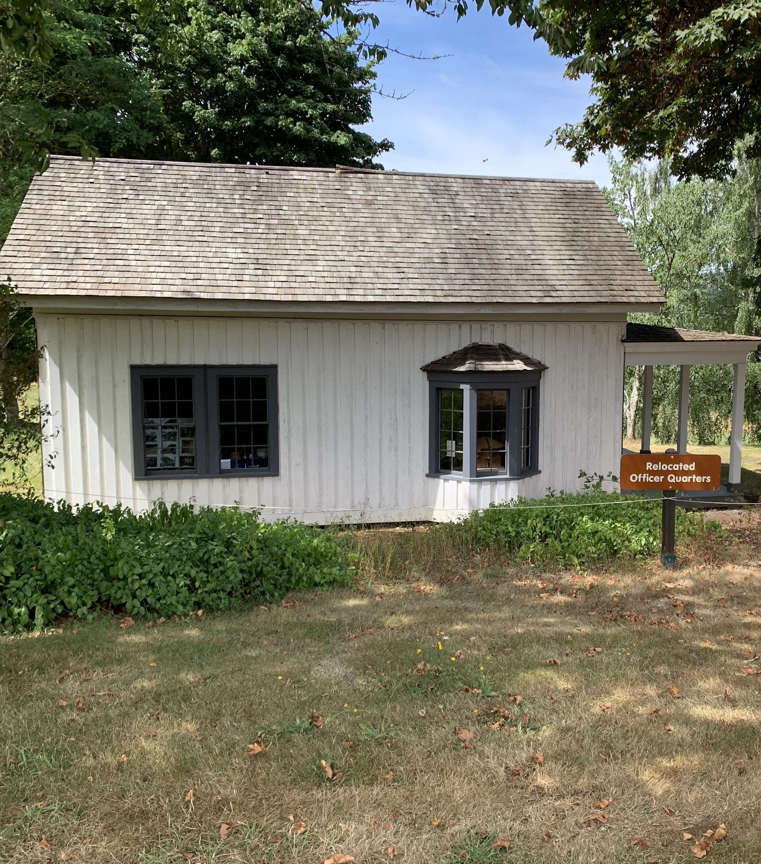
Notes:
Officer’s Quarters -one of the only buildings left from the fort
-relocated in 1874, originally at the top of hill
- 1 of 6, officer’s row, symbolic fence
- fancy two room house, 1 officer

Slide 22
