Slide 1

Plant Uses in the Pacific Northwest
The Confederated Tribes of Grand Ronde

Slide 2
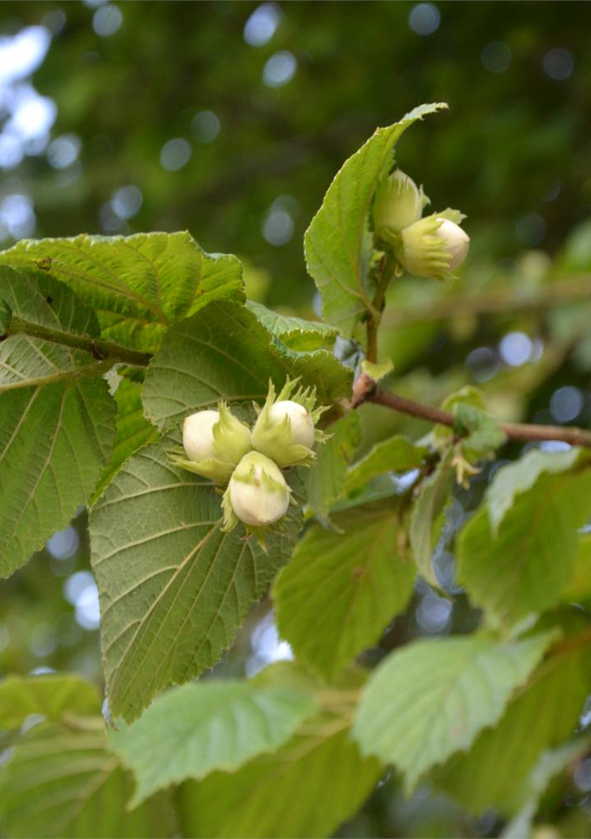
Hazel - taqwǝla-stik
Hazel is a shrub or a small tree
Most commonly used plant material for making baskets in Grand Ronde
The nuts from the tree are edible - hazelnuts

Slide 3
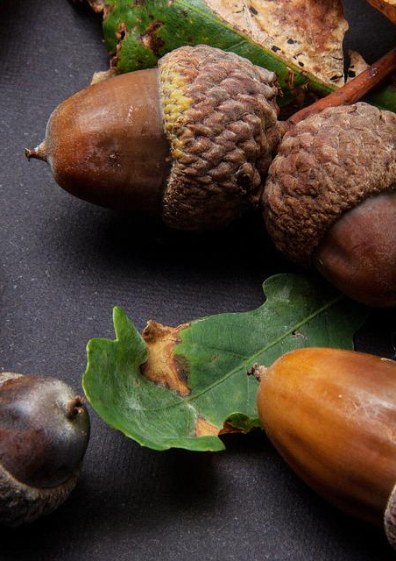
Acorn - k’anawi
Come from oak trees
Acorns are gathered, dried, shelled, leached with water and then ground into a powder. This powder is often used in soups.

Slide 4
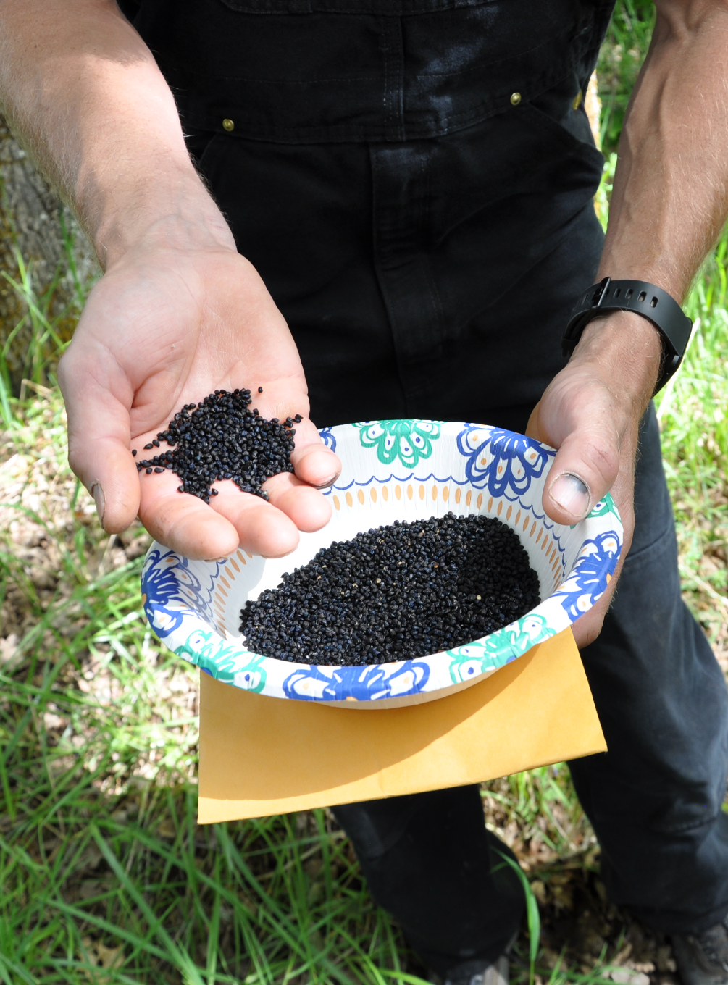
Tarweed - limulo-saplil
Tarweed is an annual plant that readily self-seeds. It's home to the moist areas of the Pacific Northwest and is abundant in wet meadows of the Willamette Valley and nearby habitats.
Tarweed seeds can be gathered from the Tarweed plant. They are grinded down and the oil they produce is used in foods.

Slide 5
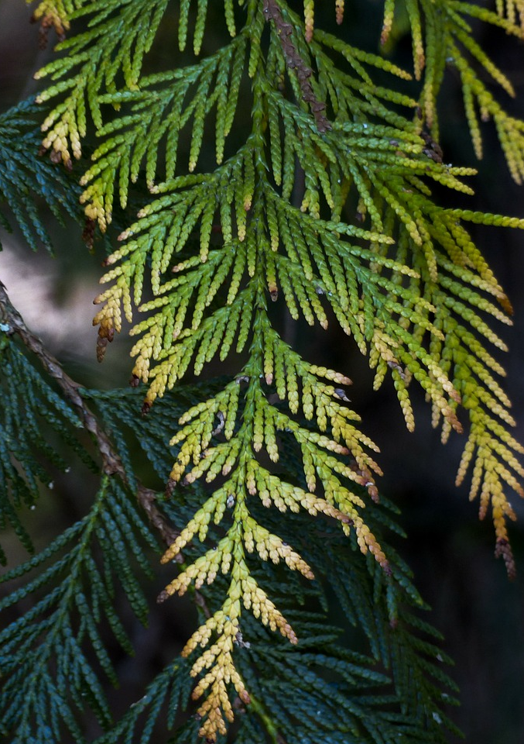
Cedar - khalakwati-stik●^{r}
Cedarwood is light, soft, resinous, and durable, even when in contact with soil or moisture.
Cedar is used for carving tools, canoes, and building structures such as plankhouses
Cedar roots are used for making watertight baskets because the roots have the ability to swell when water comes into contact with them
Cedar bark can be used for clothing

Slide 6
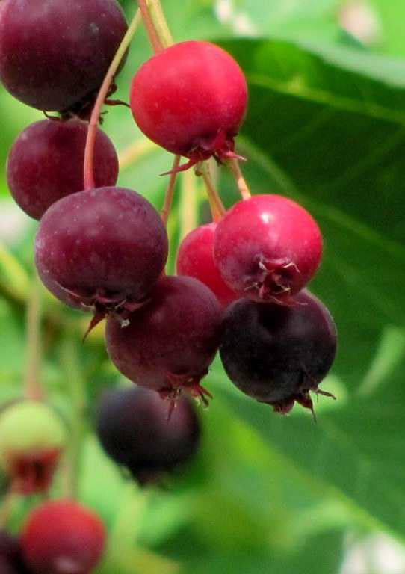
Berries - ulali
Includes: blackberries, huckleberries, salmonberries, service berries, Oregon grape, salal berries
Berries can be eaten right away but they can also be dried or made into jam so that they can be eaten in the winter.

Slide 7
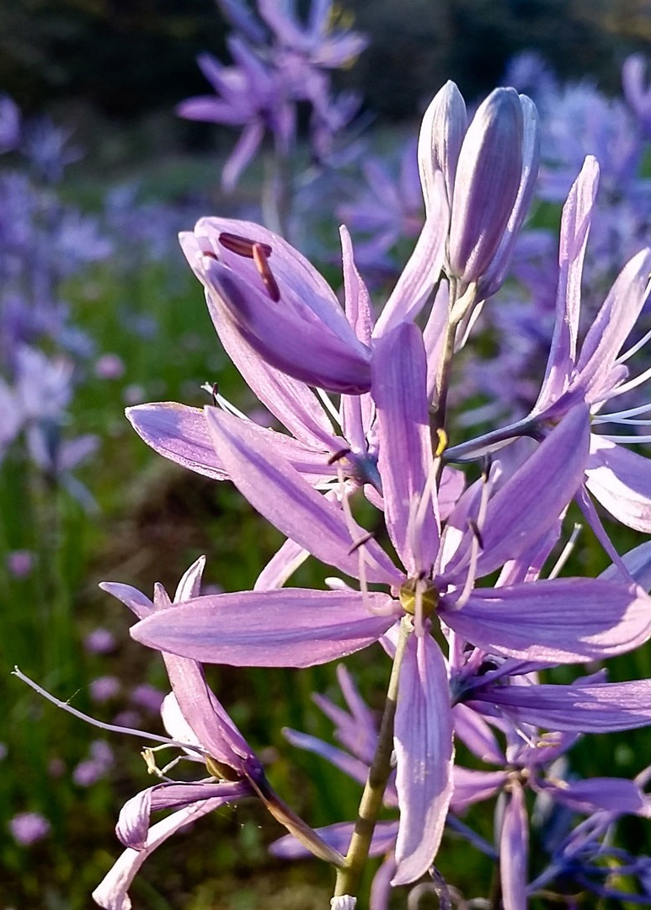
Camas - lakamas
One of the Native ancestors’ main food sources.
Camas bulbs are dug up in the summer and roasted for 3-5 days outdoors in an oven built in the ground.
The roasted camas is then made into cakes that can be eaten right away or stored.

Slide 8
Wapato - wapt^{h}u
“Wapato.” It’s also known as “Duck potato” or “arrowroot.” Explorer Meriwether Lewis dropped back one day from the rest of the party “to examine a root of which the natives had been digging great quantities in the bottoms along the river.”
The tubers can be eaten raw or cooked for 15 to 20 minutes. The taste is similar to potatoes and chestnuts, and they can be prepared in the same fashions: roasting, frying, boiling, and so on. They can also be sliced and dried to prepare a flour.
Wapato may have been an important food source historically but not today, according to Confederated Tribes of the Grand Ronde cultural educator Greg Archuleta. He said wapato is known to absorb metals and other pollutants.

