Slide 1

Rise of the Collectors
Grand Ronde Artifacts
Notes:
Rise of the Collectors is an exhibit on display at the Chachalu Museum in Grand Ronde. It features artifacts collected from the Grand Ronde Reservation in the mid 1800’s.

Slide 2
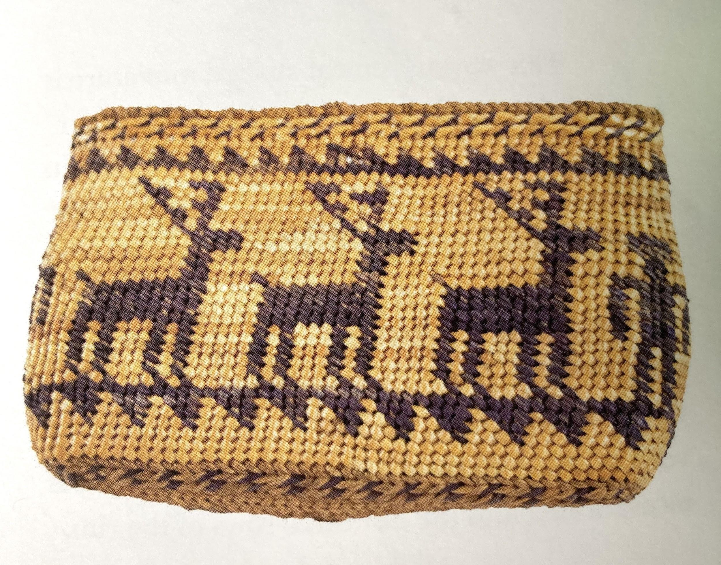
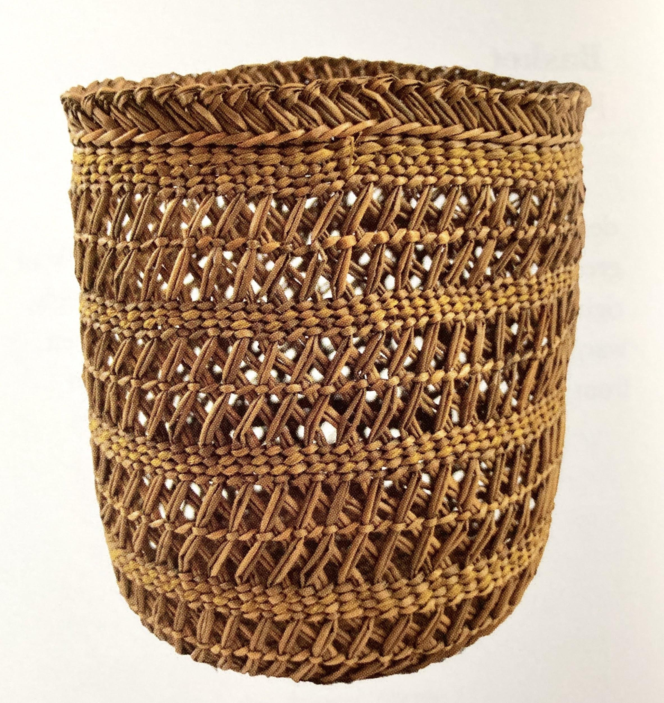
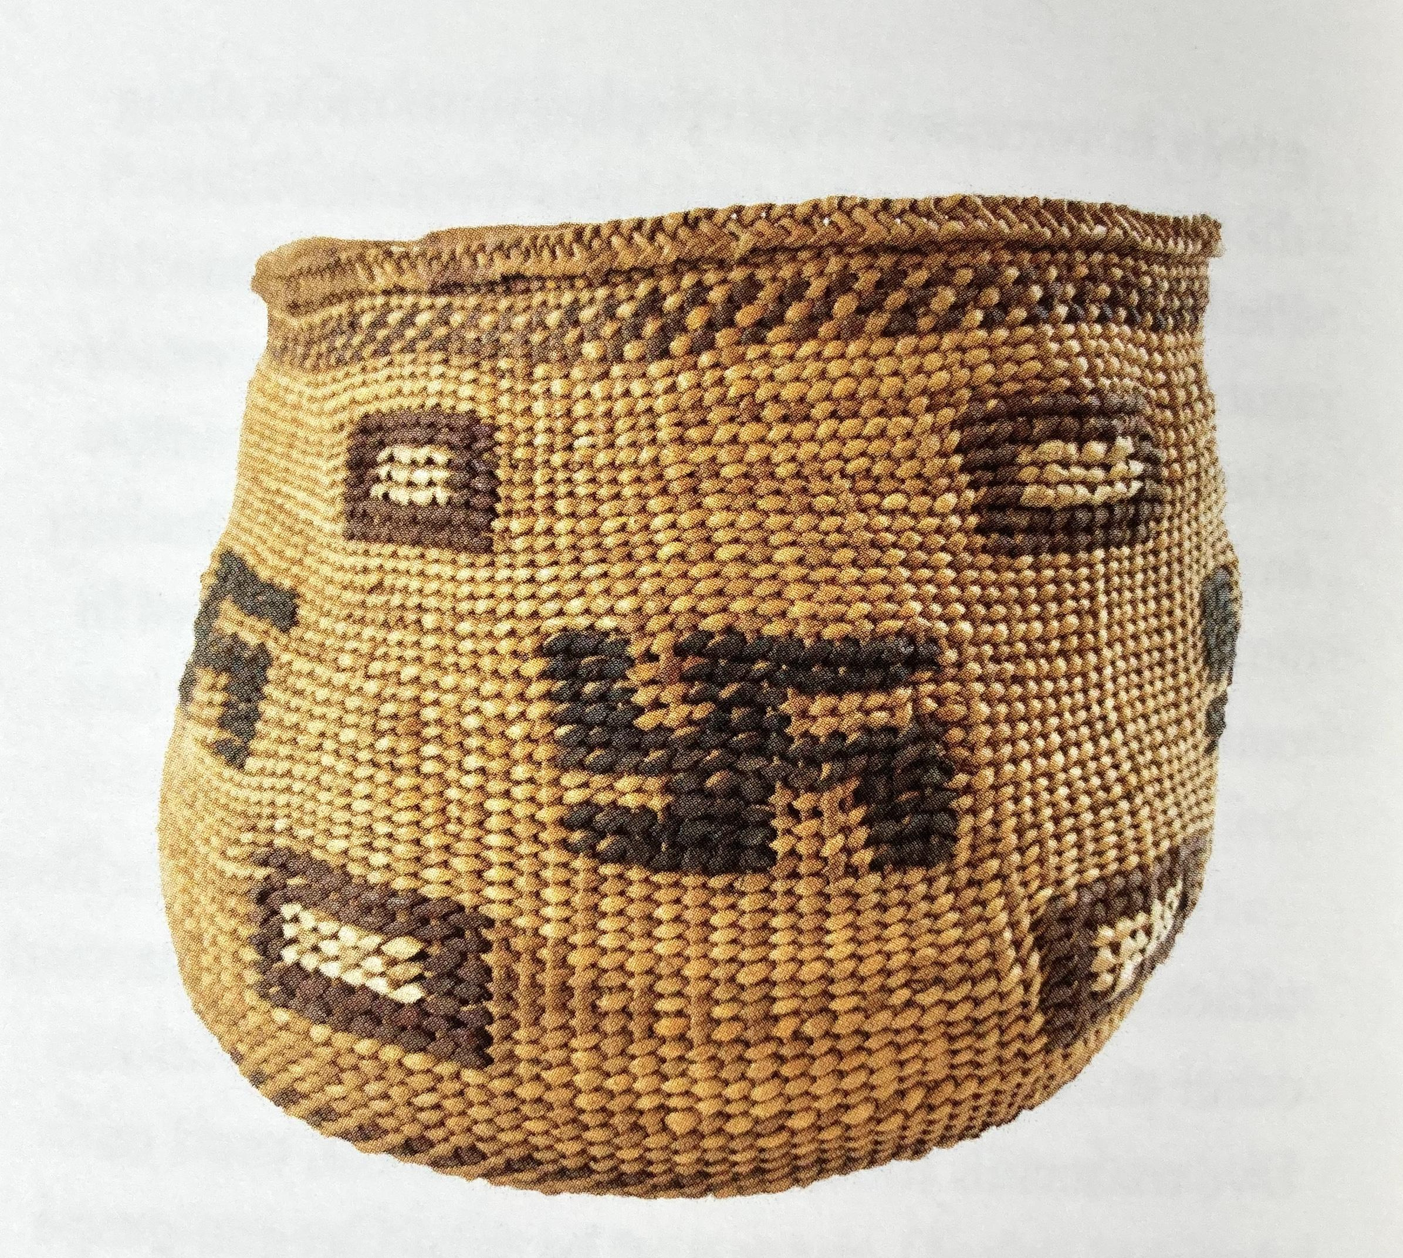
Basket Purse Basket B
Notes:
These artifacts were all collected on the Grand Ronde Reservation.
Basket Purse - This basket is 8 inches wide and 4 inches tall. It is made with sweet grass sedge and beargrass. It features a human figure and deer. By placing a human figure and animal figures on the same basket it highlights the close connection the Grand Ronde people had to their “First Foods”. qq
Basket B - This basket is made of juncus, a flowering plant. It is decorated with yellow raffia and faded purple or blue-dyced juncus. The basket was most likey used as a storage vessel.

Slide 3
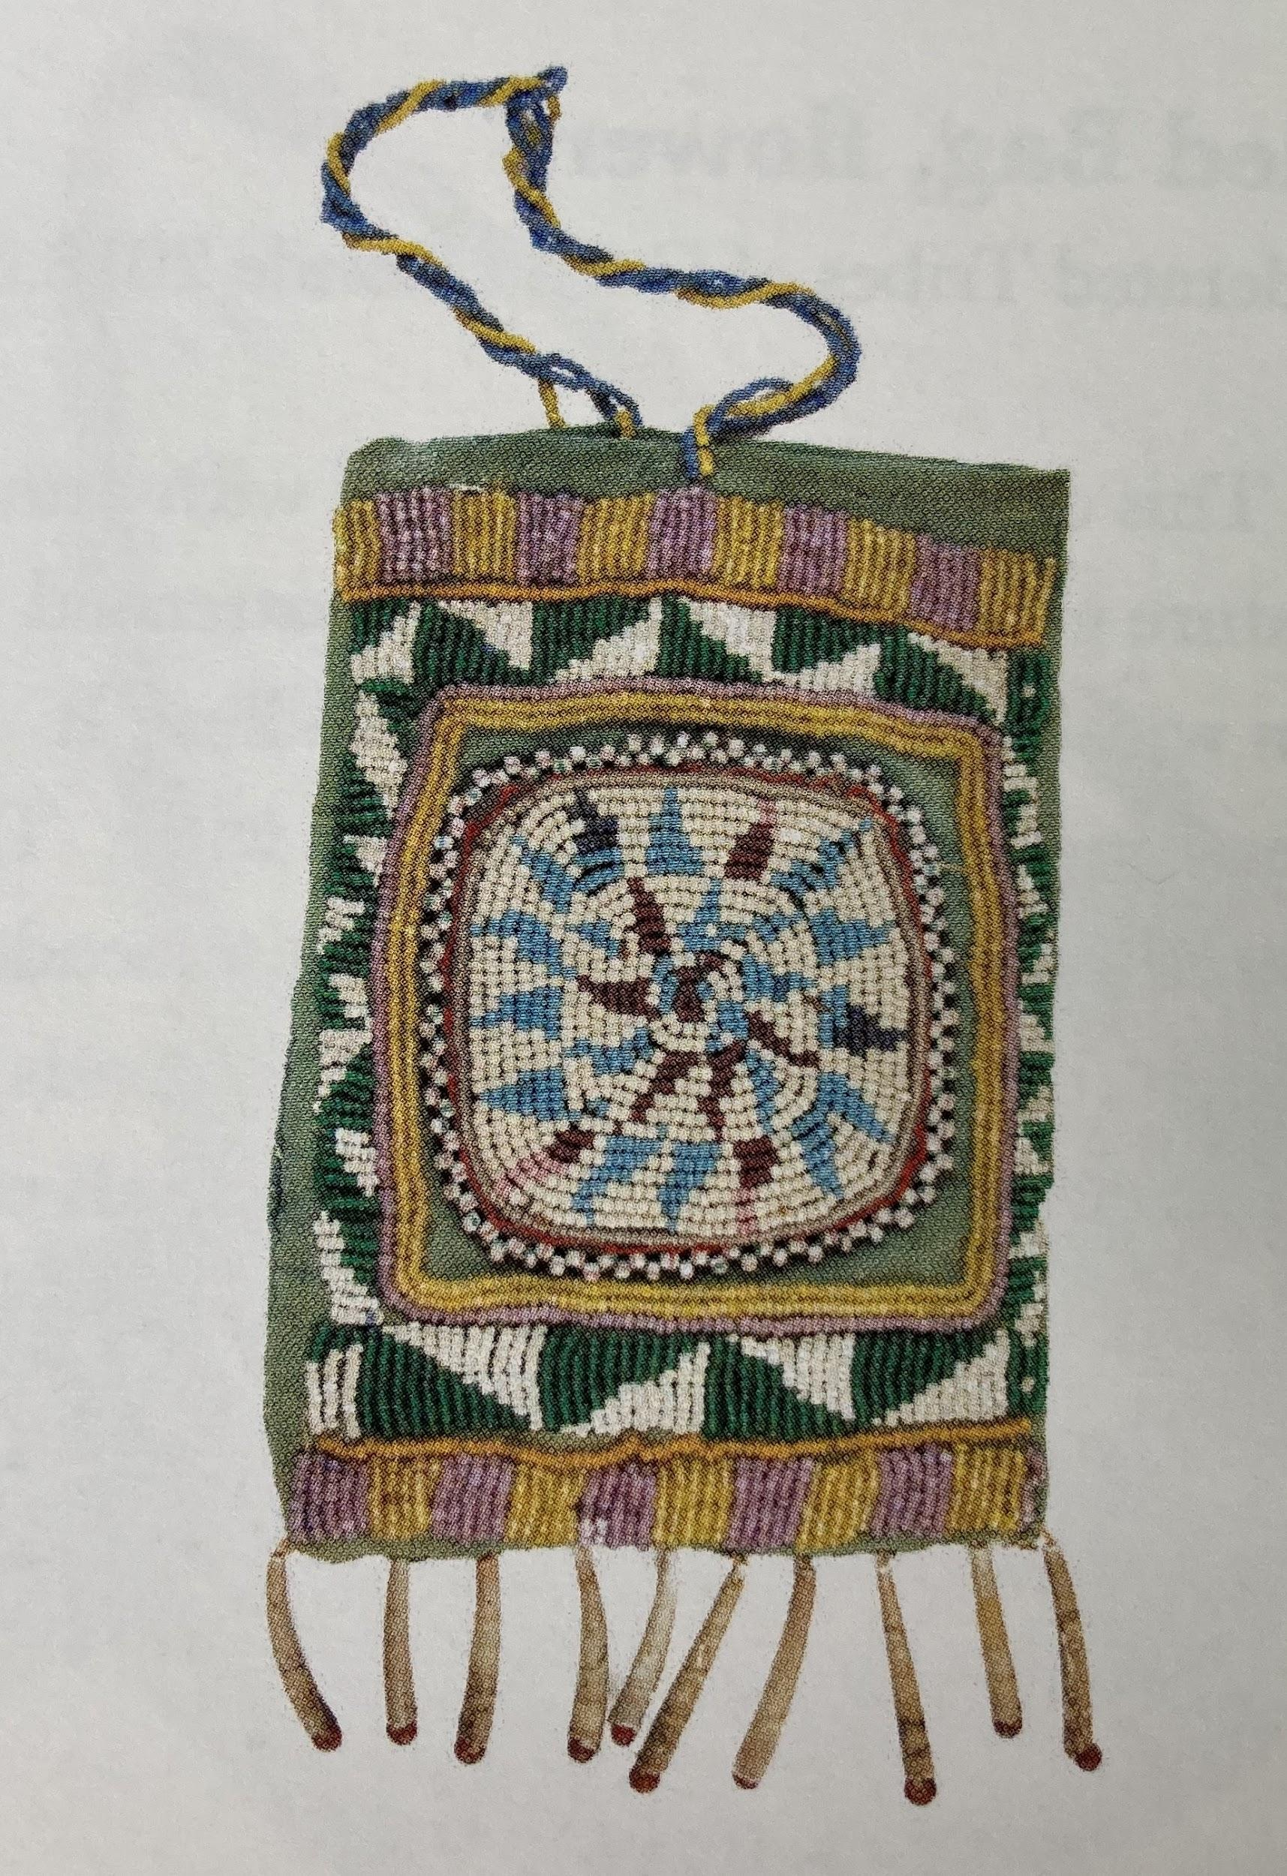
Basket A Beaded Bag
Notes:
Basket A: This is a large basket that was used for storage. It is made with juncus, beargrass and cedar bark. You will notice a swastika on the basket. Swastikas are a widely distributed, ancient design appearing in the Middle East, India, Southeast Asia and in native North American. The symbol means “well-being” or “good-fortune”.
Beaded Bag: The bag measure 5.5 inches high and 4 inches wide. It is made with dentalium shells and seed beads in various colors.

Slide 4
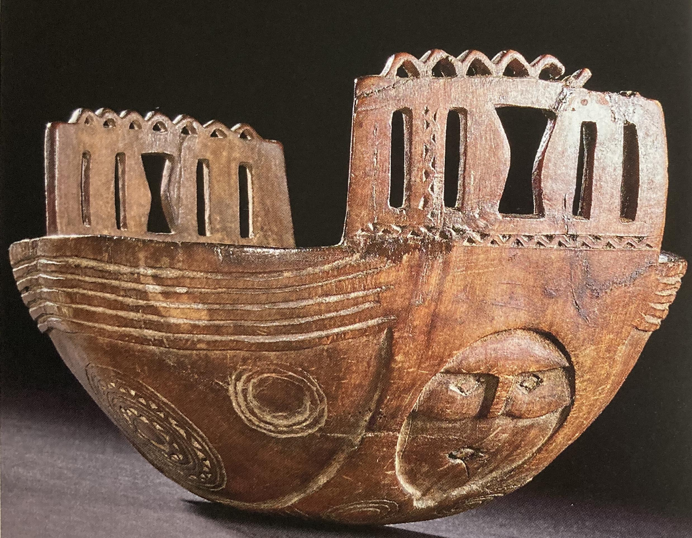
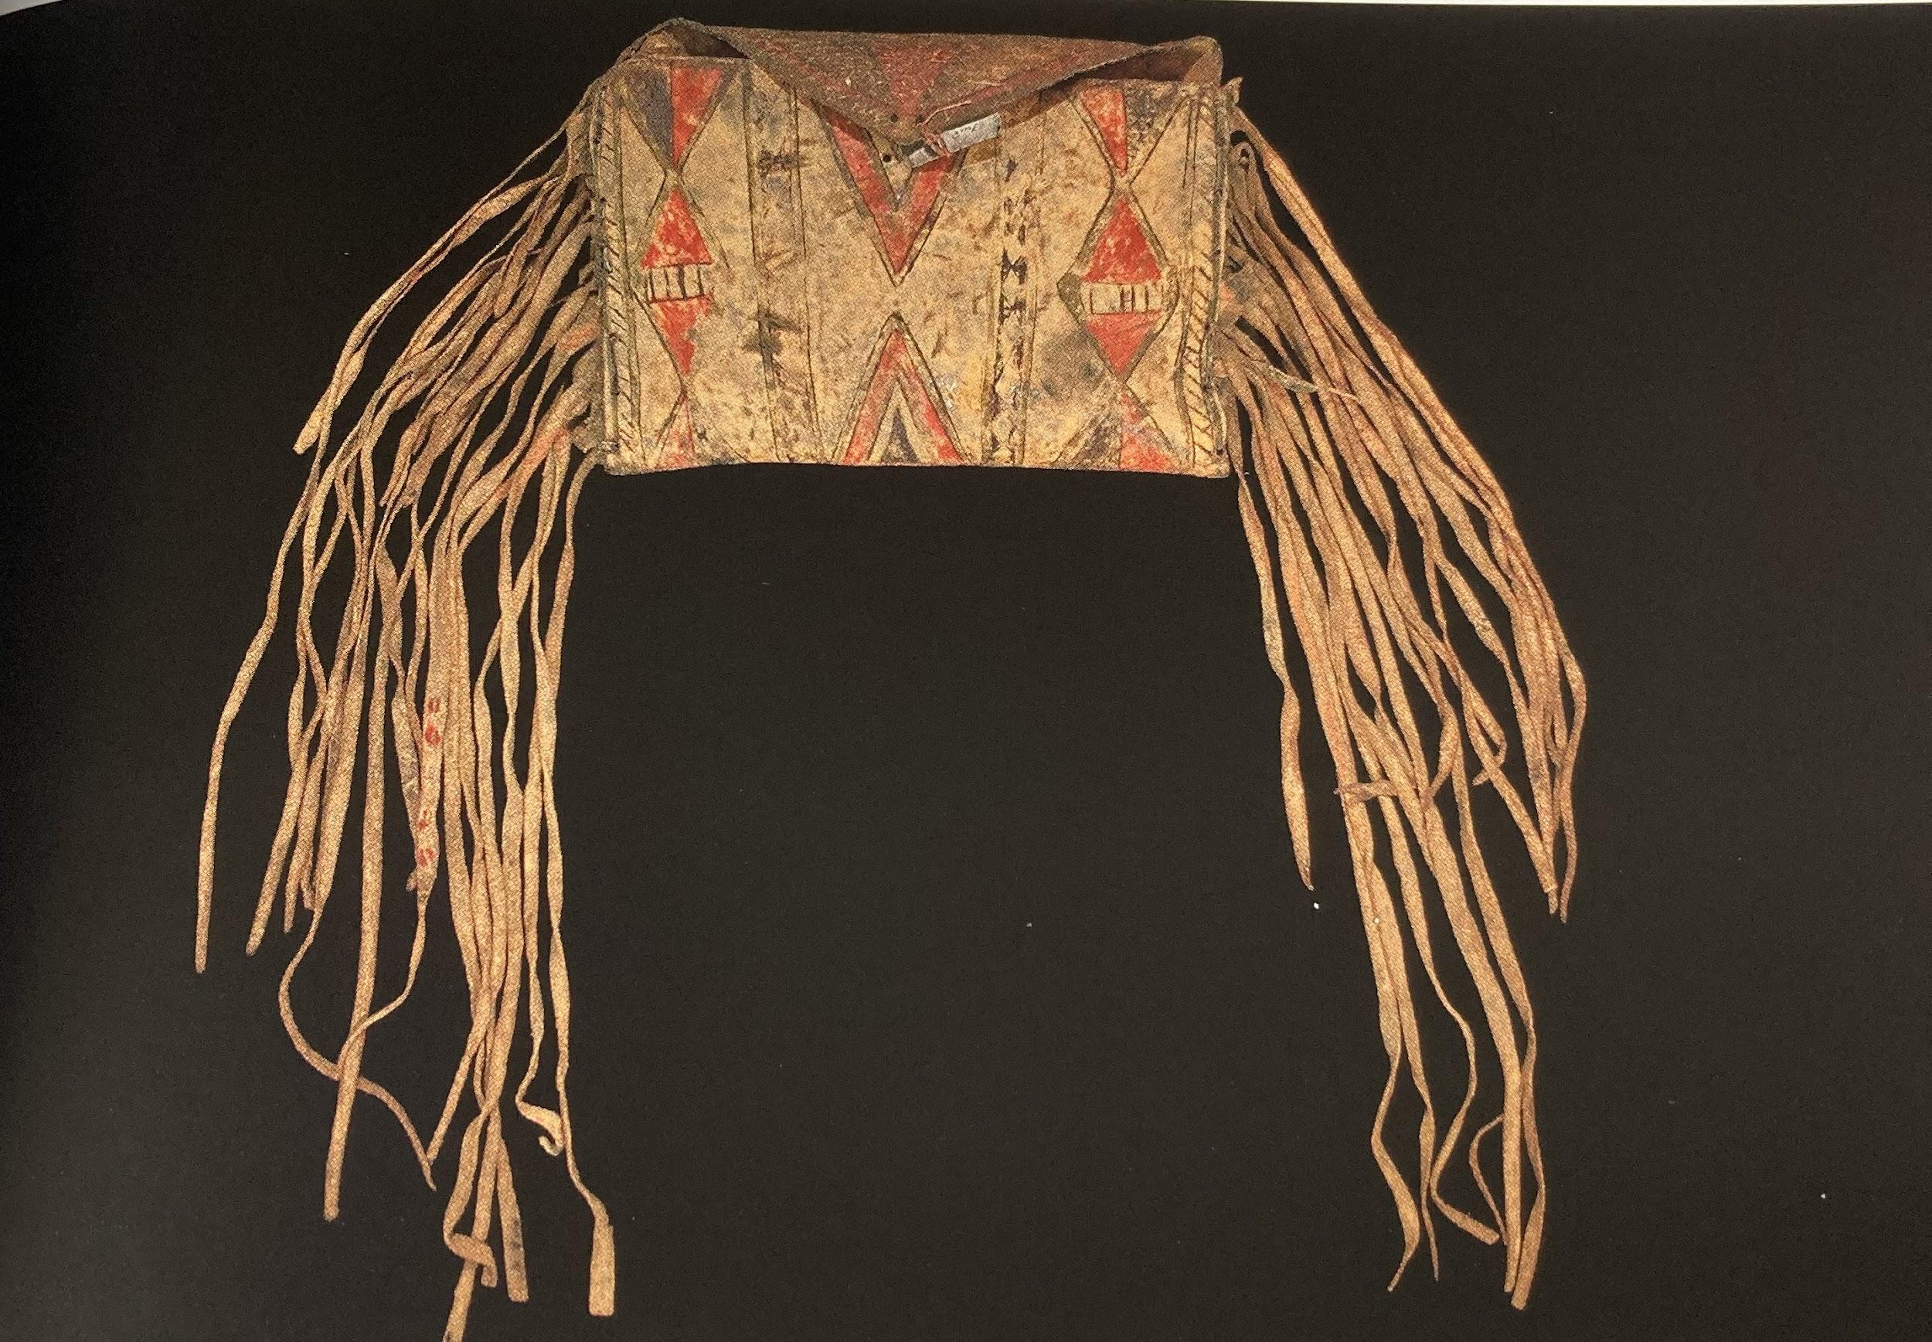
Horn Bowl Parfleche
Notes:
Horn Bowl: This bowl is made from the horn of the Mountain Bighorn Sheep. In order to carve the horn, it is softened and them carved or modeled into a particular shape. It is one of the most decorative items in the Summers Collection.
Parfleche (pahr-flesh): This is a storage bag that is made out of buffalo hide. The hide is painted with red, brown, black, green and yellow. It also has deer skin fringes on the sides of the bag. It is believed that this bag was made by a native living somewhere on the other side of the Cascade Mountains. It was brought to Grand Ronde after it was made.

