Slide 1
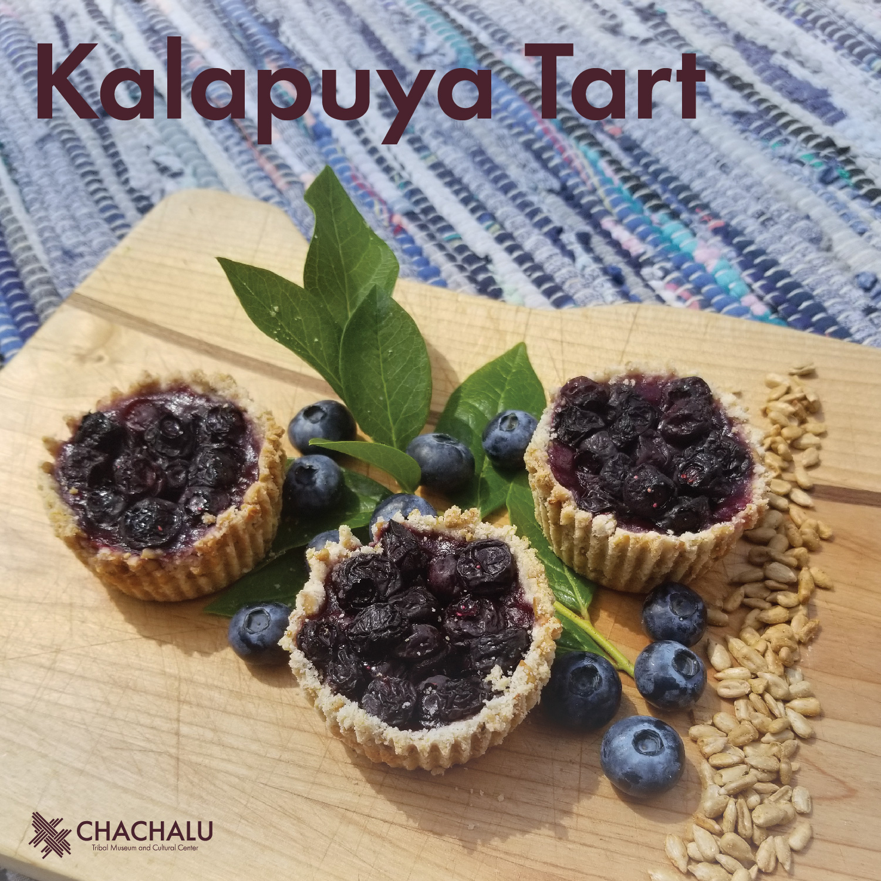
Notes:
Begin by introducing the food to the students (Kalapuya Tart)
Ask Students:
Does this look like any other food you have seen?
Have you ever eaten anything that looked like this?
Looking at the picture - can you guess what some of the ingredients may be?

Slide 2
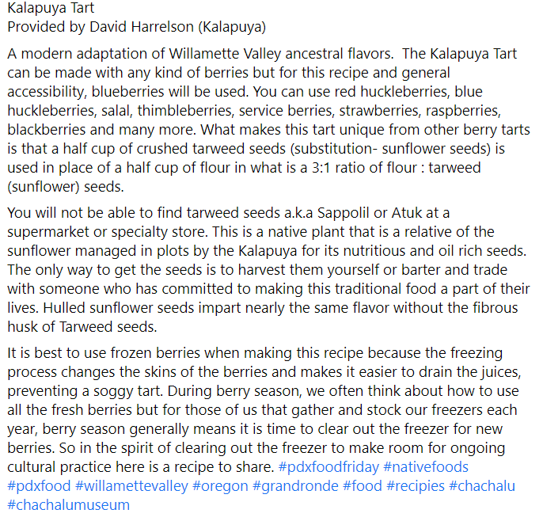
Notes:
Read the passage to students - written by the Grand Ronde Cultural Resources Department Manager David Harrelson
Discuss with Students:
What/Where is the Willamette Valley
Who are the Kalapuya (Native American peoples who are now apart of The Confederated Tribes of Grand Ronde)

Slide 3
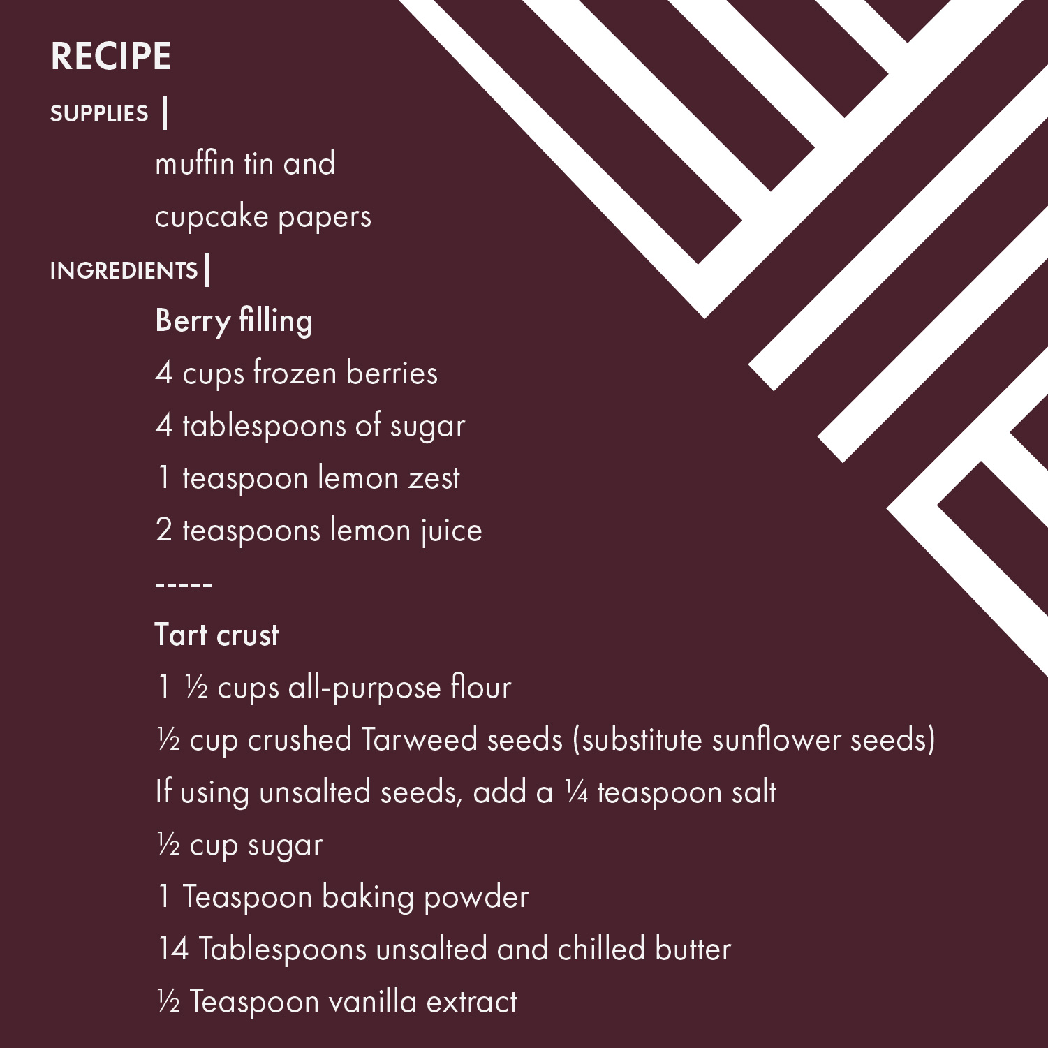
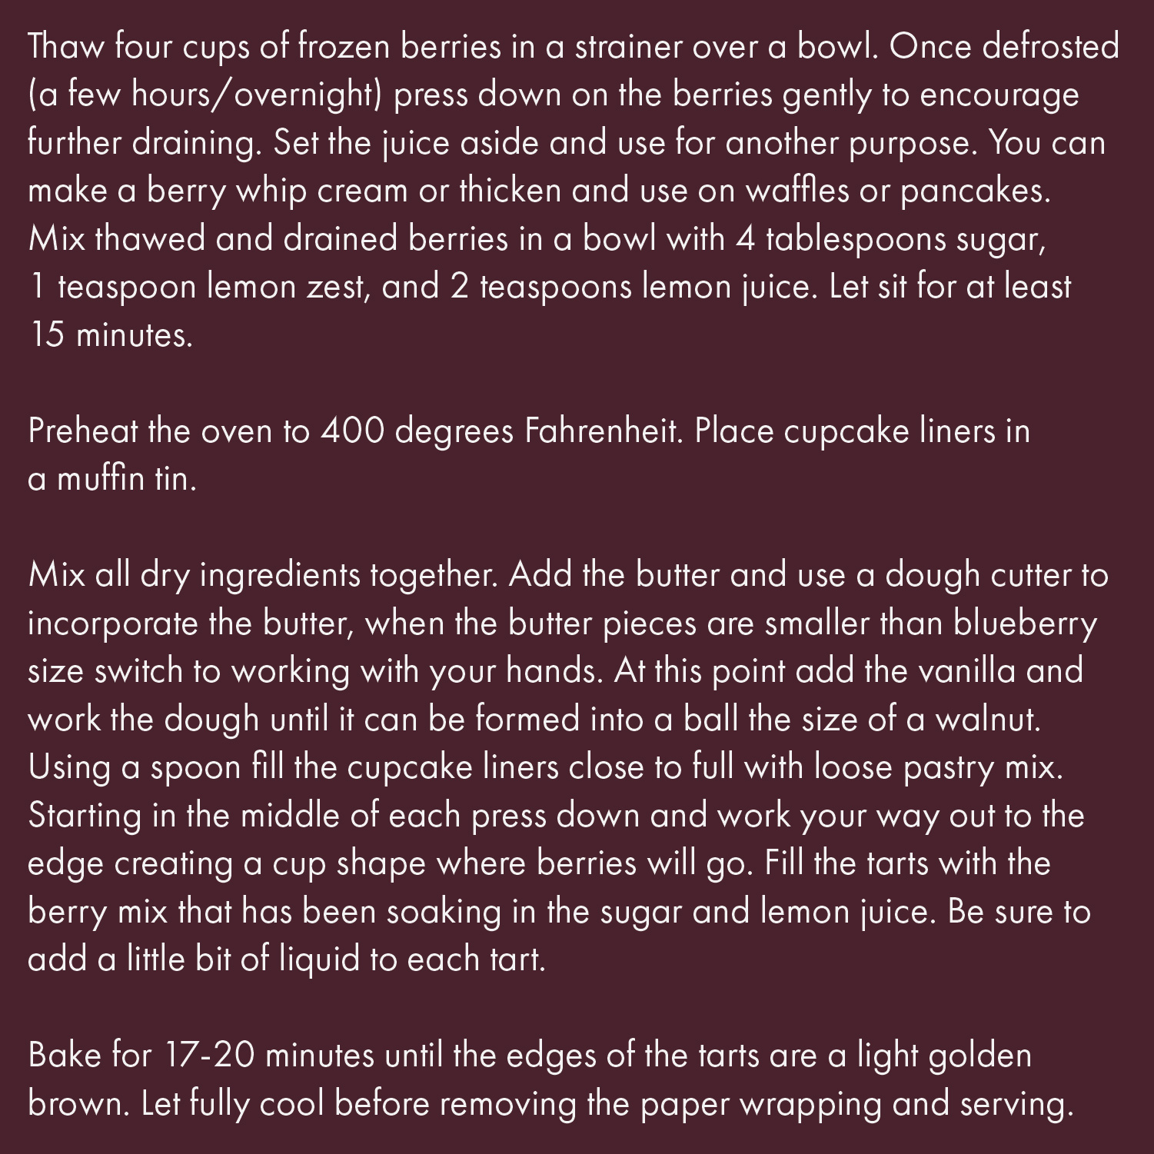
Notes:
Explain to Students:
What is a recipe?
Why is a recipe important when cooking?
In this recipe, it talks about using an oven to bake the tarts. Native American peoples did not always have ovens. What might they have used instead? (Fire)

Slide 4
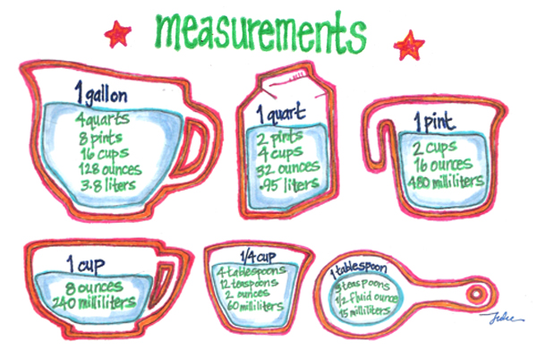
Notes:
Examples of Measurements for visual use
Image from https://chefjulieyoon.com/2011/09/measurements/

Slide 5

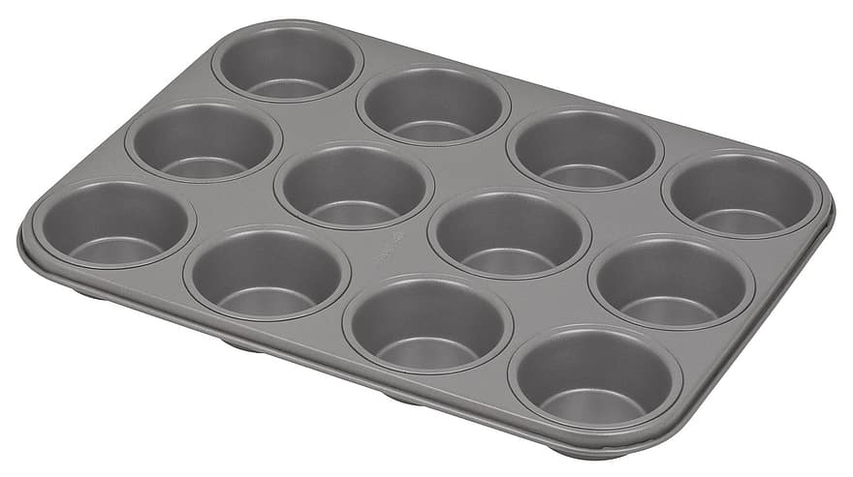
#1: If the Kalapuya Tart Recipe makes 12 tarts, how many times will we need to repeat the recipe to feed 24 people?

Slide 6
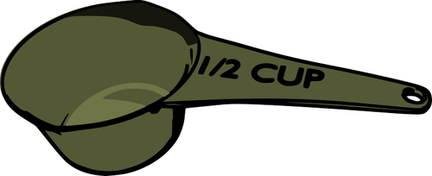
#2: If we repeat the Kalapuya Tart Recipe 2 times, how much flour will we need?
Remember: One recipe need 1 ½ cups of flour
1 recipe

Slide 7
#3: If the Kalapuya Tart Recipe is made 2 times, will 1 cup of sugar be enough?
Remember: One recipe needs ½ cup sugar

