Slide 1
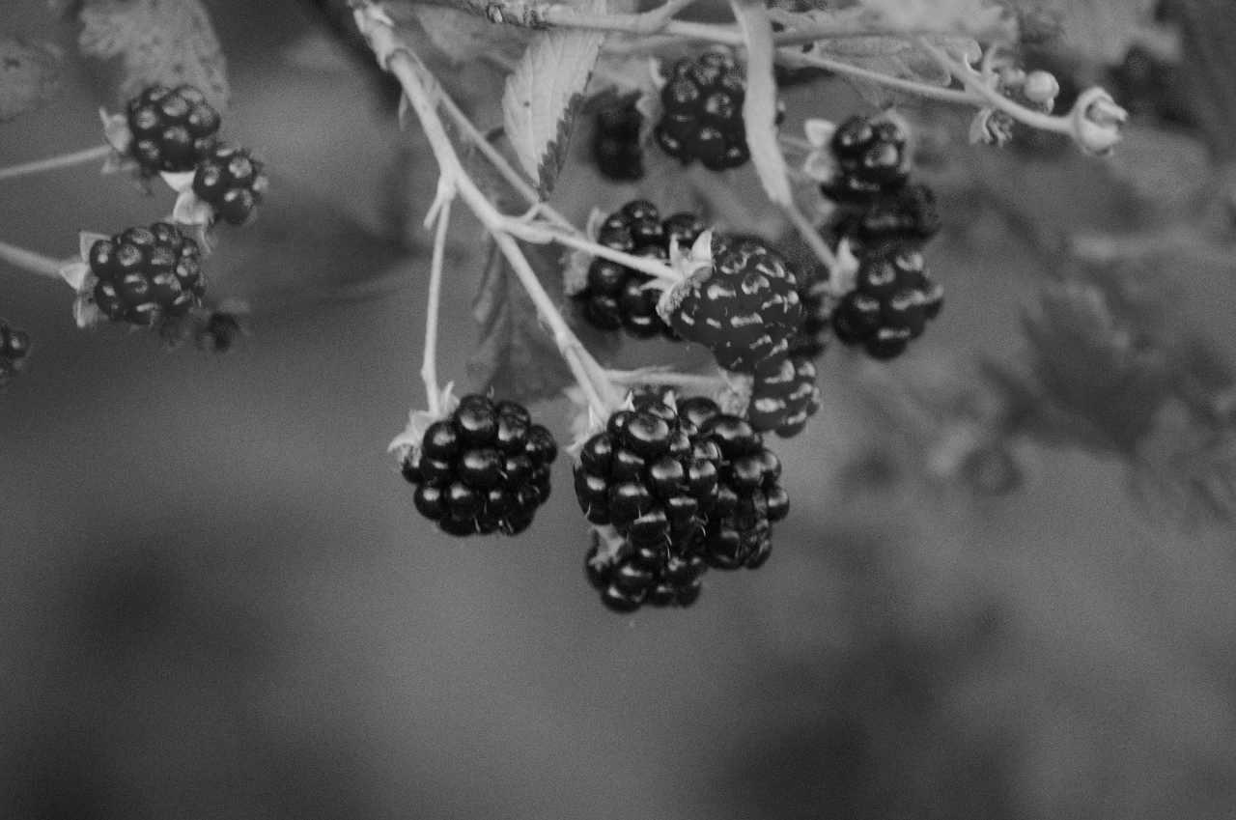
Berries
On the
Grand Ronde Reservation

Slide 2

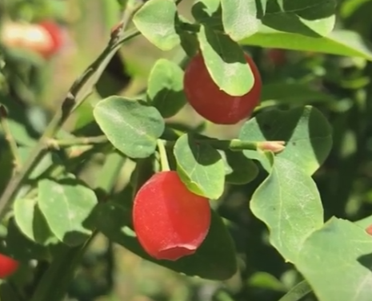
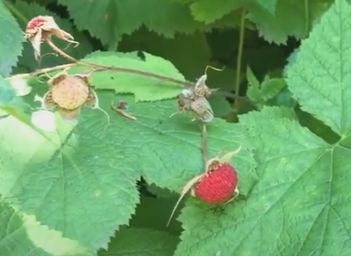
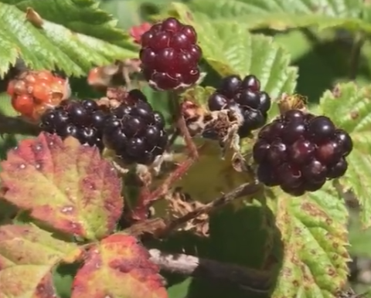
Notes:
Ask students if they recognize any of the berries on this page.
Have they seen these berries anywhere?
Have they eaten any of these berries?
Berry Identification:
Top Left: Red Huckleberry
Top Right: Salmonberry
Center: Blackberry
Explain to students that the people of the Confederated Tribes of Grand Ronde have eaten berries such as these since time immemorial. Many tribal members still eat these berries today!

Slide 3
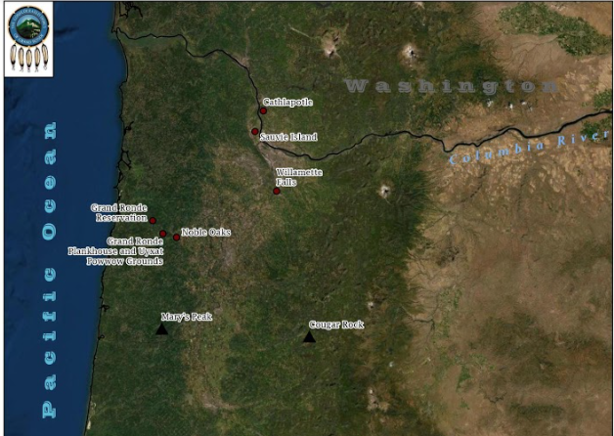
Notes:
Help students locate the Grand Ronde Reservation on the map.
Can students identity where they live on this map?
Explain to students that berries are a traditional food source for the people of the Grand Ronde Tribe and many types of berries grow on the Grand Ronde Reservation.
Have students share their thoughts on what they think a “traditional food” is.
Guide students to the idea that traditional foods are foods and dishes that are passed through generations.

Slide 4
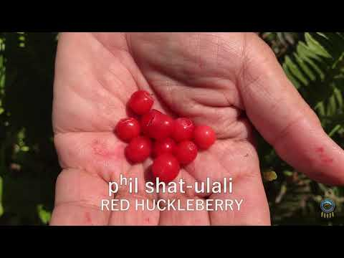
nsayka iliʔi: Reservation
Notes:
Explain to students that they will be watching a video about the berries found on the Grand Ronde Reservation.
Inform students that Greg Archuleta (the person talking about berries in the video) is a Grand Ronde Tribal Member.
The Native language being spoken in this video is chinuk wawa - the language of The Confederated Tribes of Grand Ronde
Watch the video about berries.
Have students focus on the type of berries found on the reservation and how they used the berries.

Slide 5
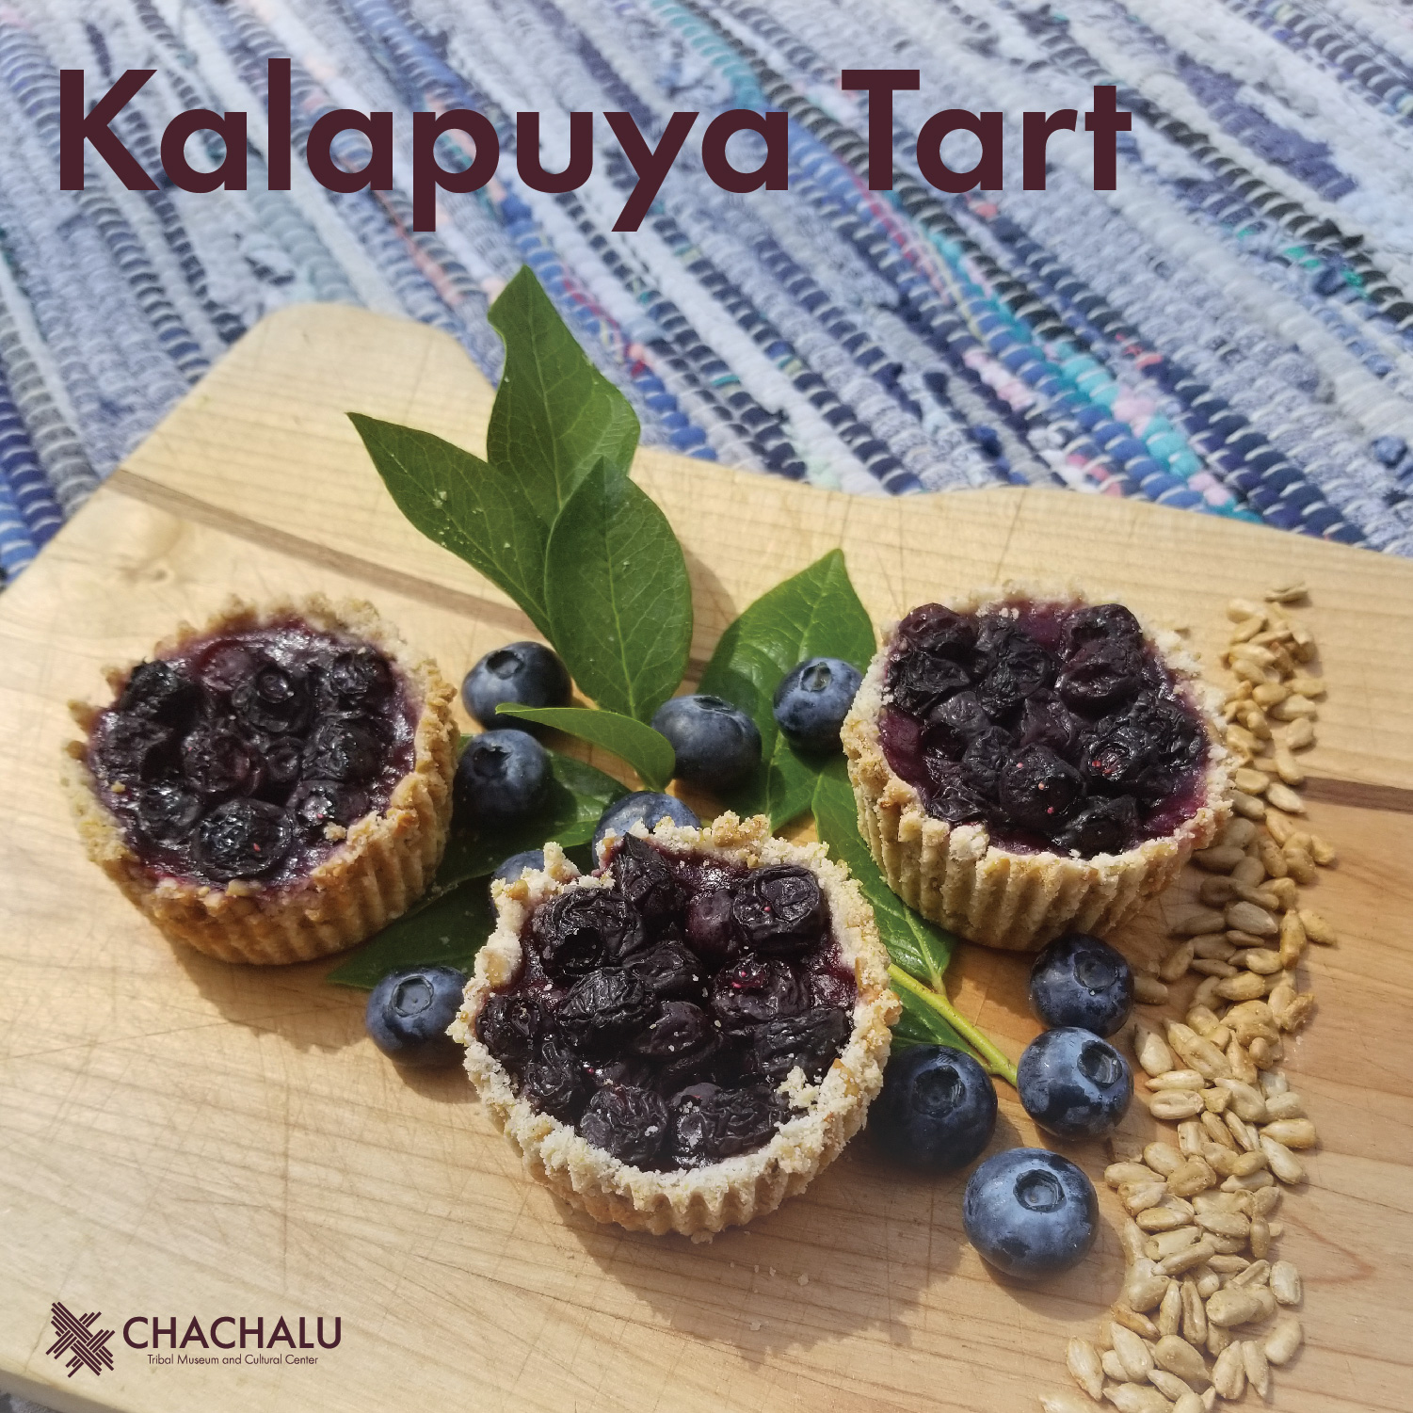

Slide 6
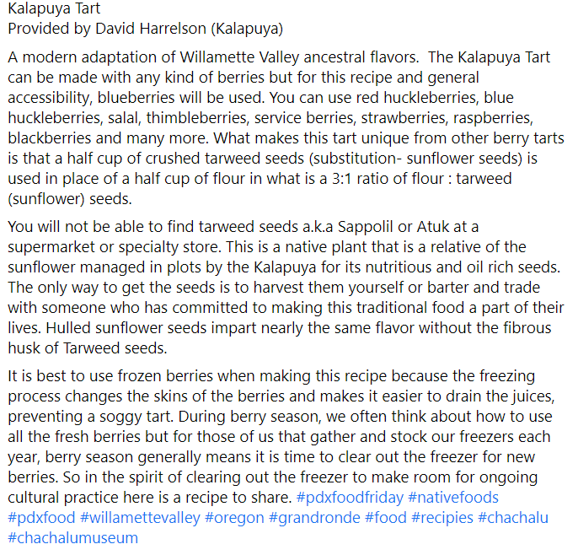

Slide 7
