Slide 1
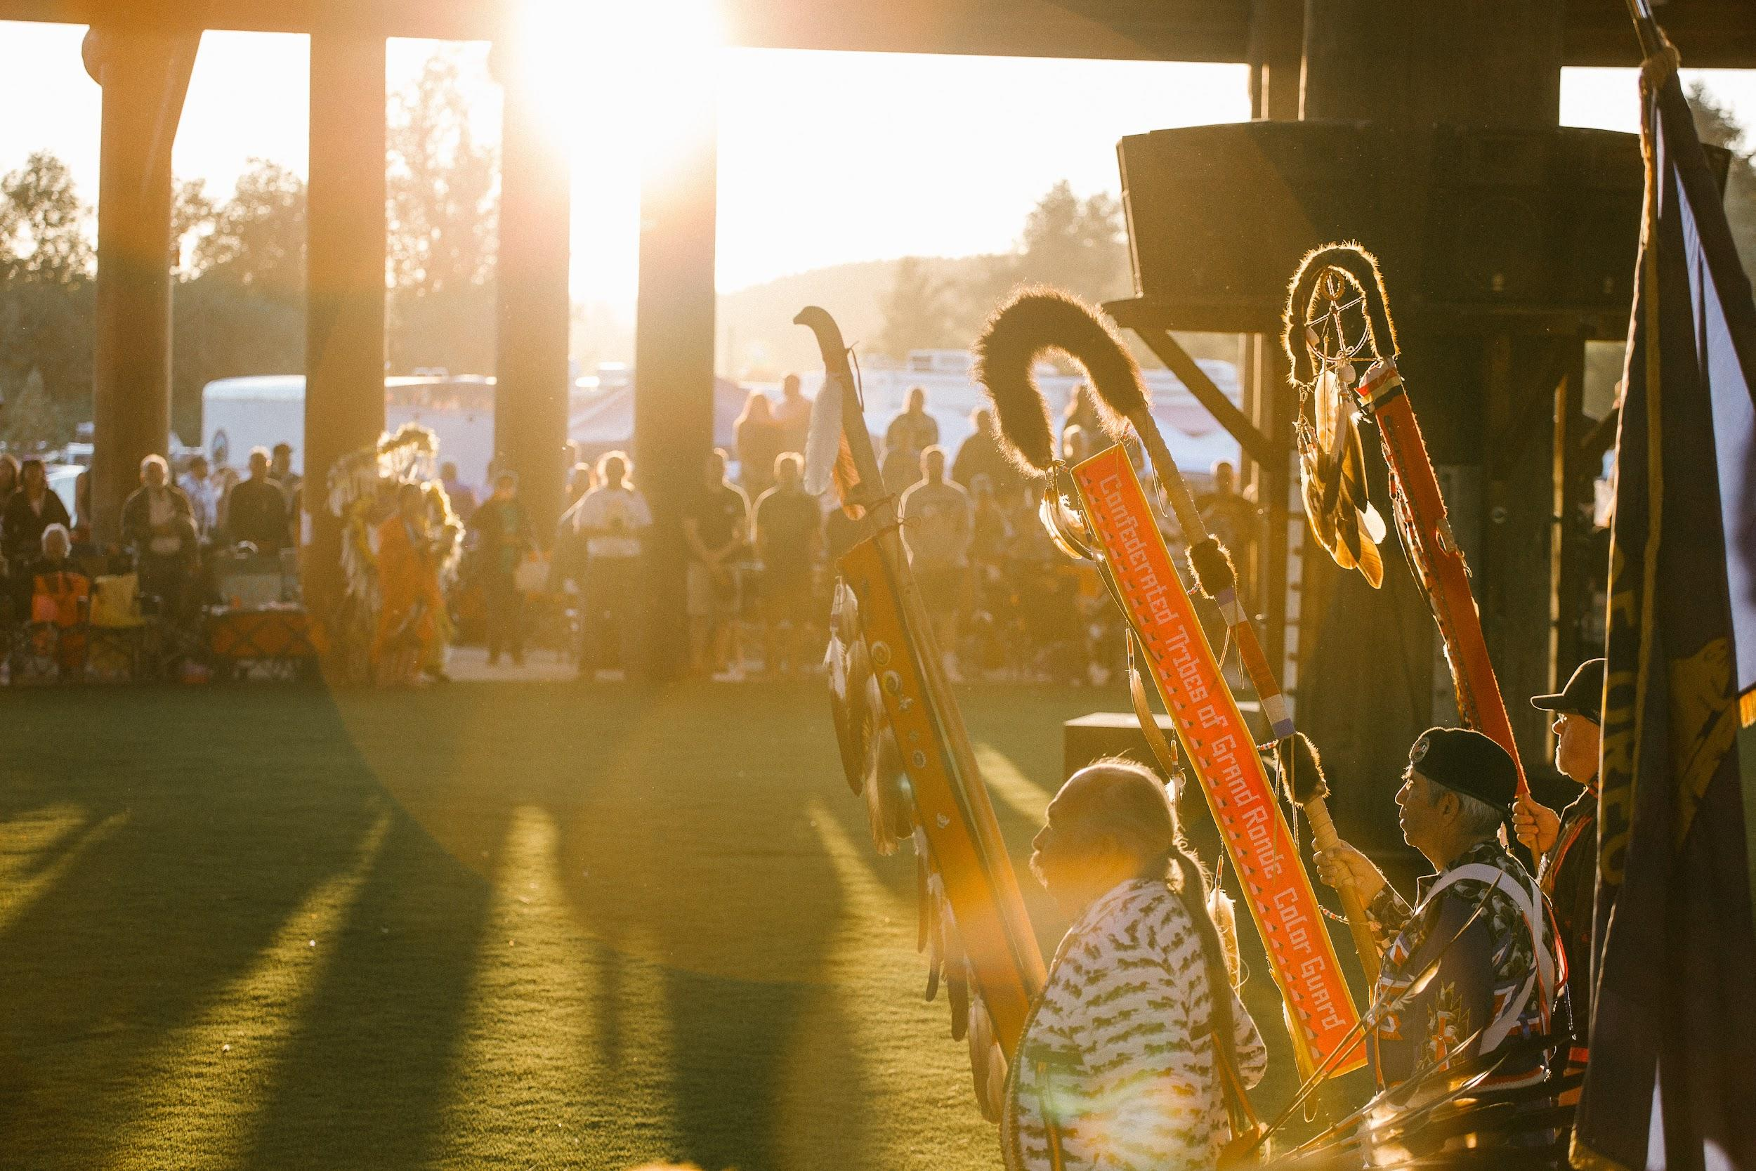
Grand Ronde
Powwows

Slide 2
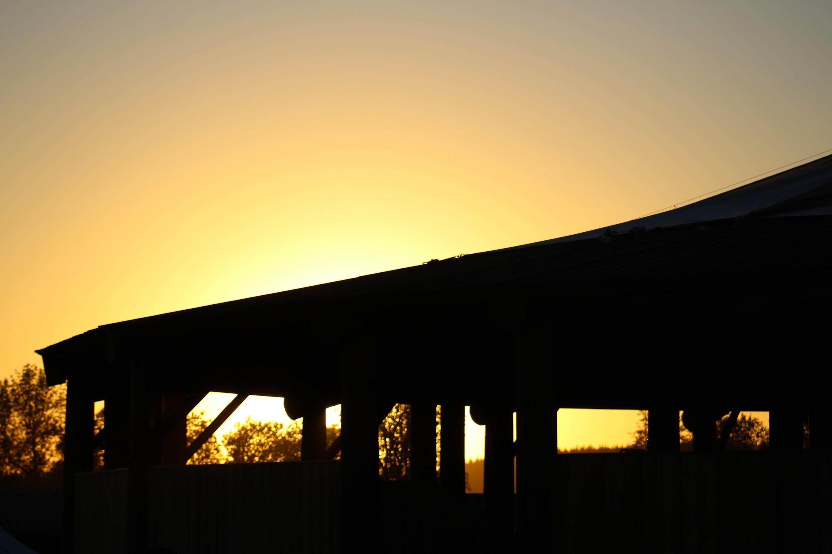
What is a powwow?
A Native American gathering where Native Peoples sing, dance, reconnect with old friends and celebrate their histories.

Slide 3
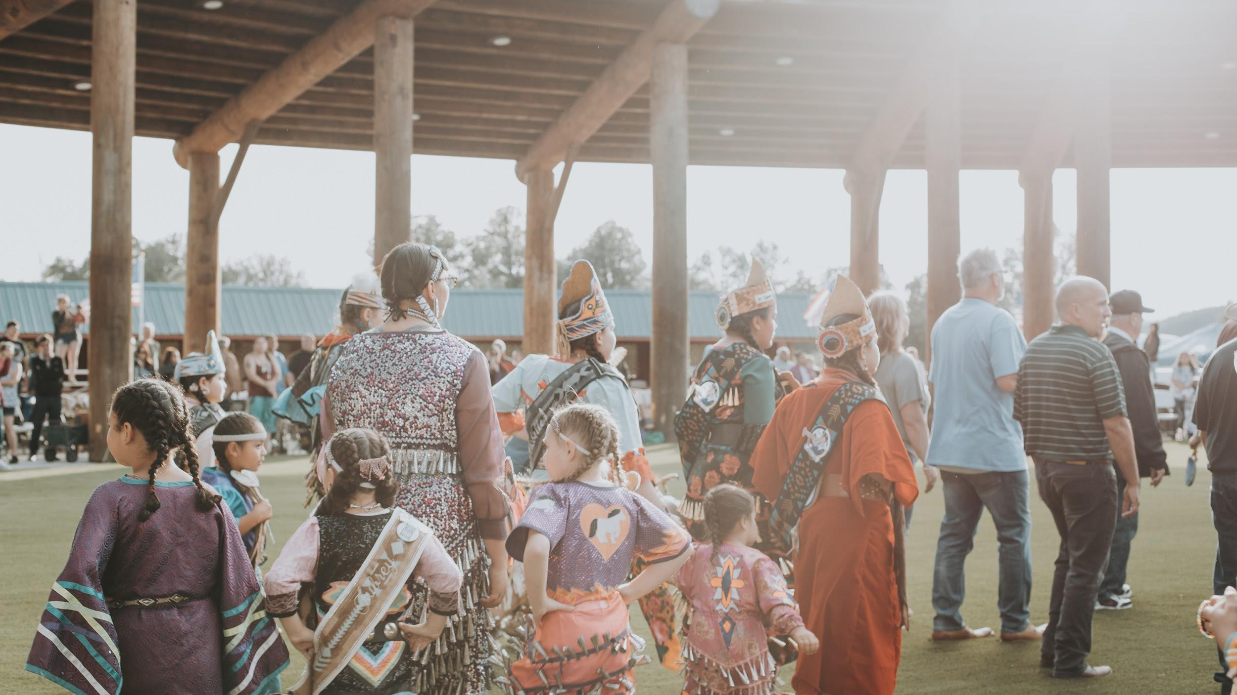
The Confederated Tribes
of Grand Ronde
CTGR holds at least two powwows each year
The Grand Ronde Veterans Powwow
  Honors the people who have been in the U.S. Military
The Grand Ronde Contest Powwow
  Holds competitions for dancers and drummers
Both powwows are vibrant, colorful and energetic events that everyone is welcome to attend!

Slide 4
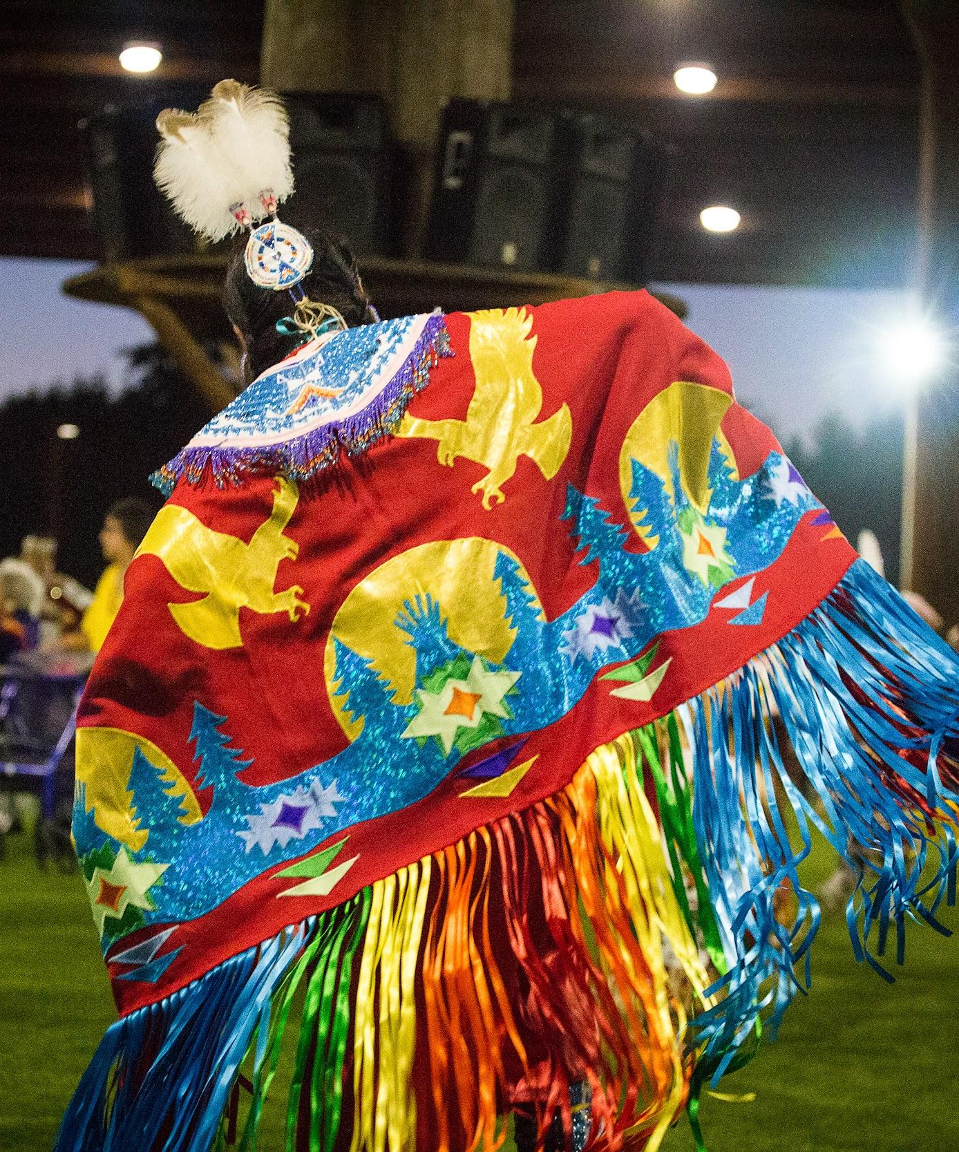
Regalia
At powwows, Native Peoples wear regalias. A regalia is a the traditional and often sacred clothing, accessories and artifacts worn or carried during various ceremonies. The designs on regalia have meaning and connection to the person’s culture and life.

Slide 5
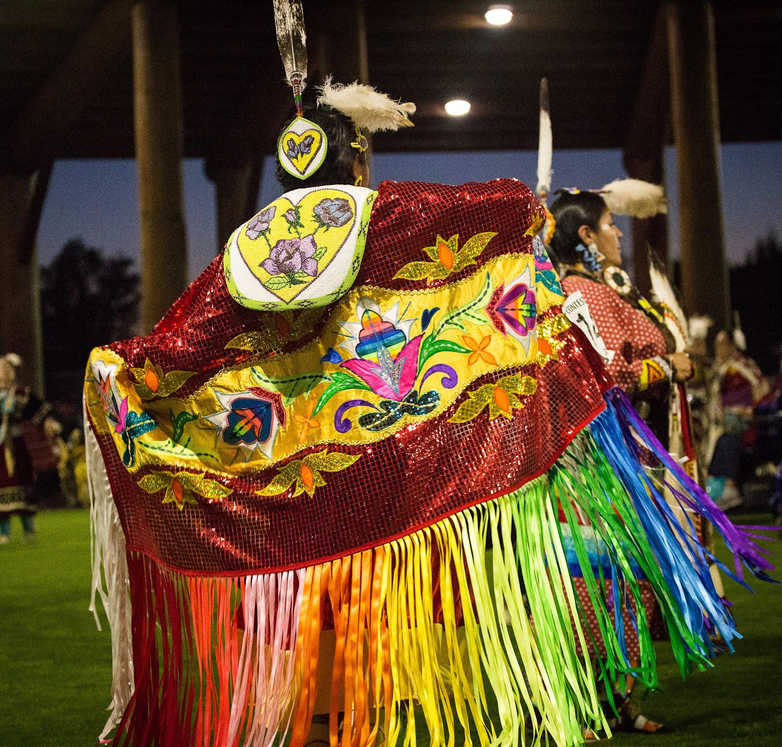
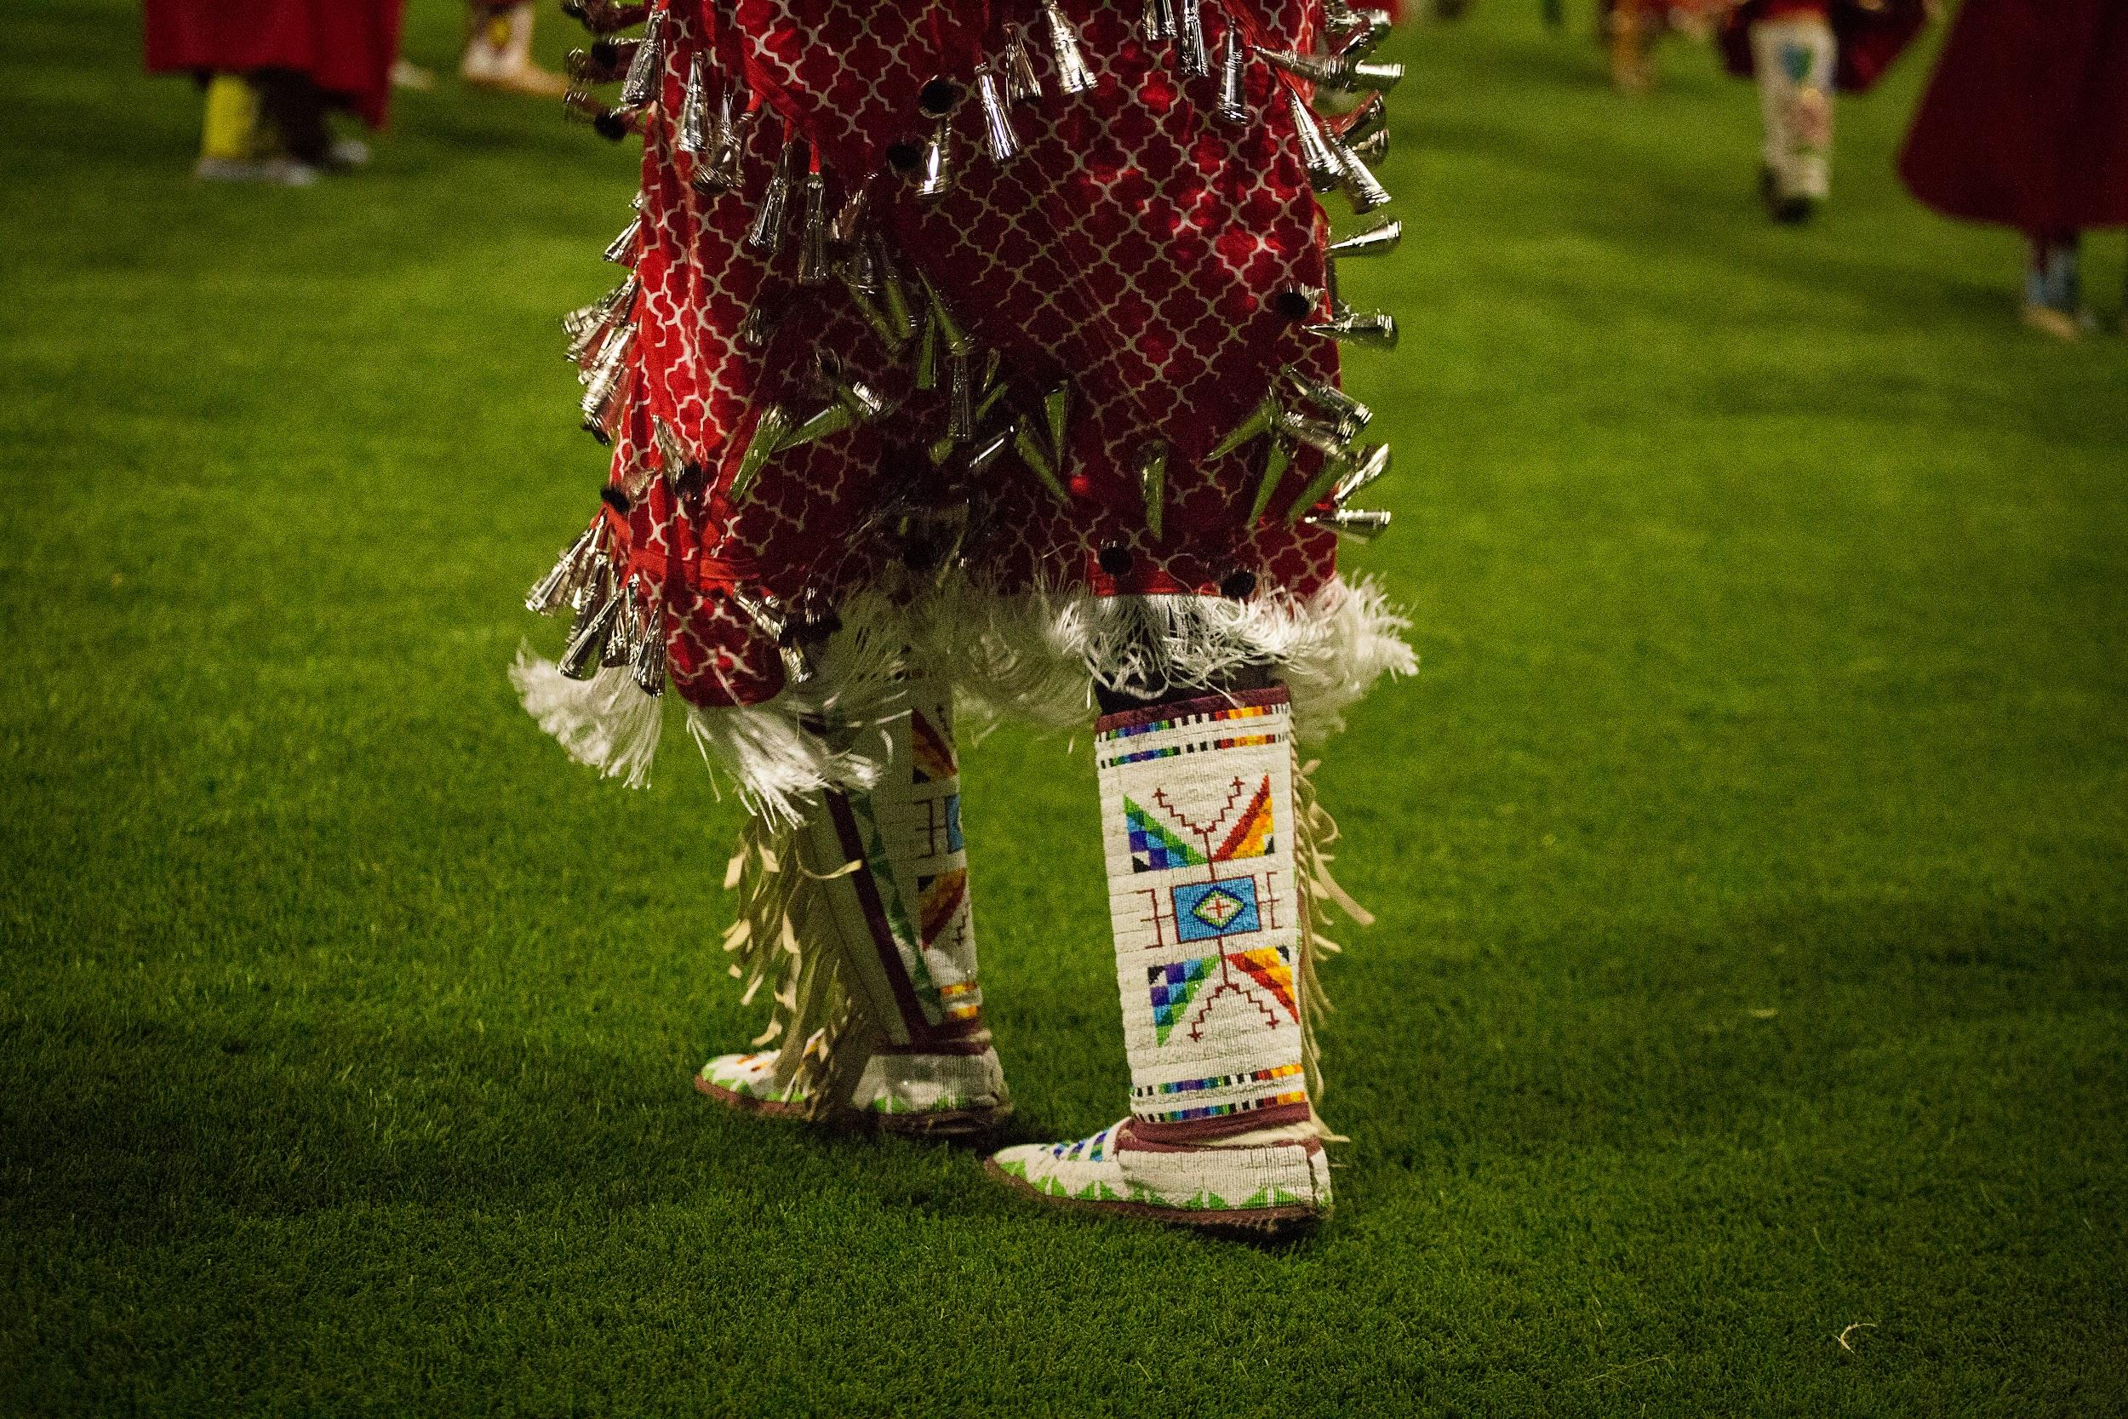
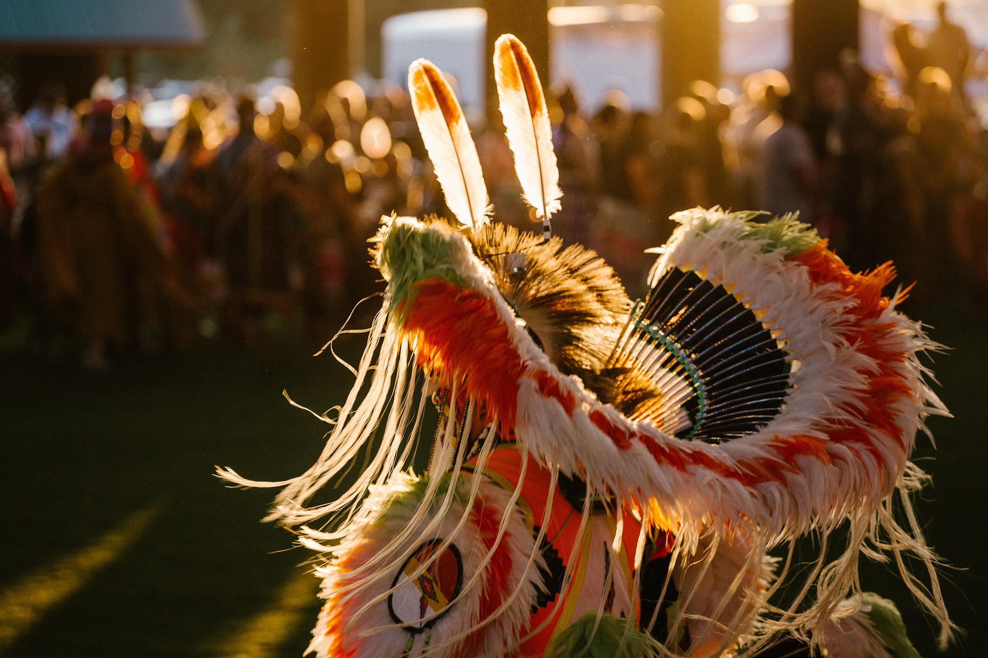
Notes:
Examples of different regalia pieces:
Fancy Shawl
Beaded Leather Moccasins
Bustle

Slide 6
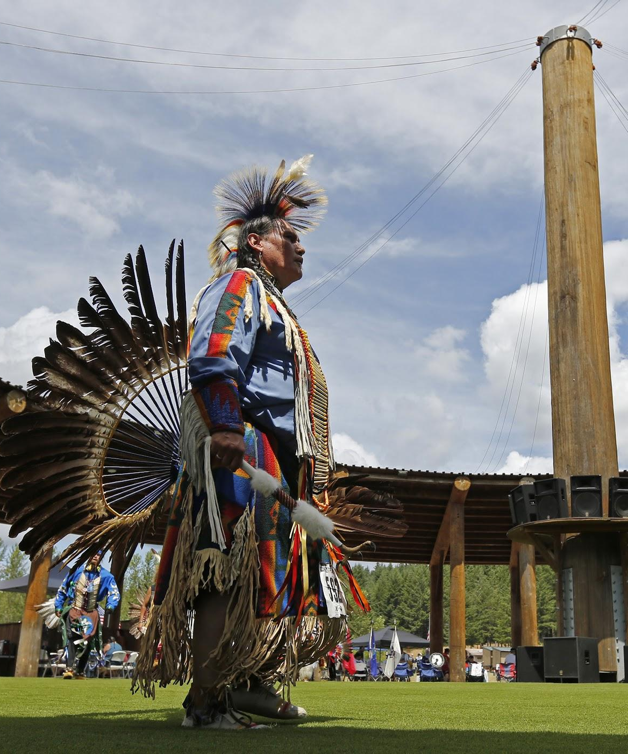
What is at a powwow?
Dancers
Drummers
Singers
Small shops (vendors)
Food tents/carts

Slide 7
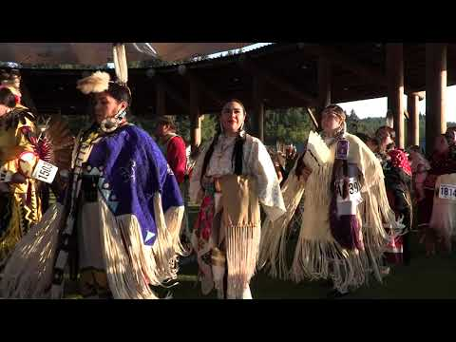
VISIT THE GRAND RONDE POWWOW

