Slide 1
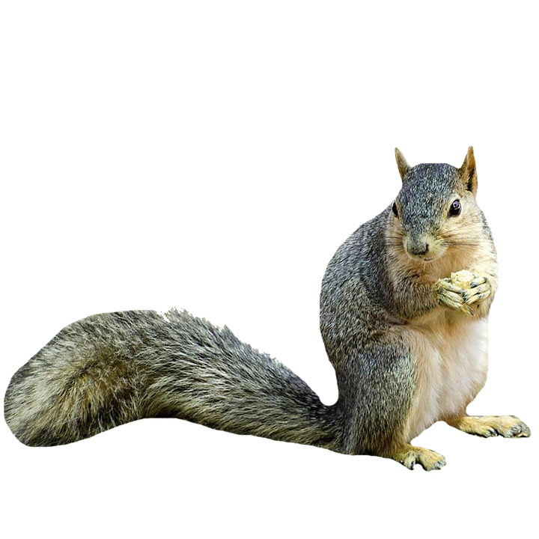
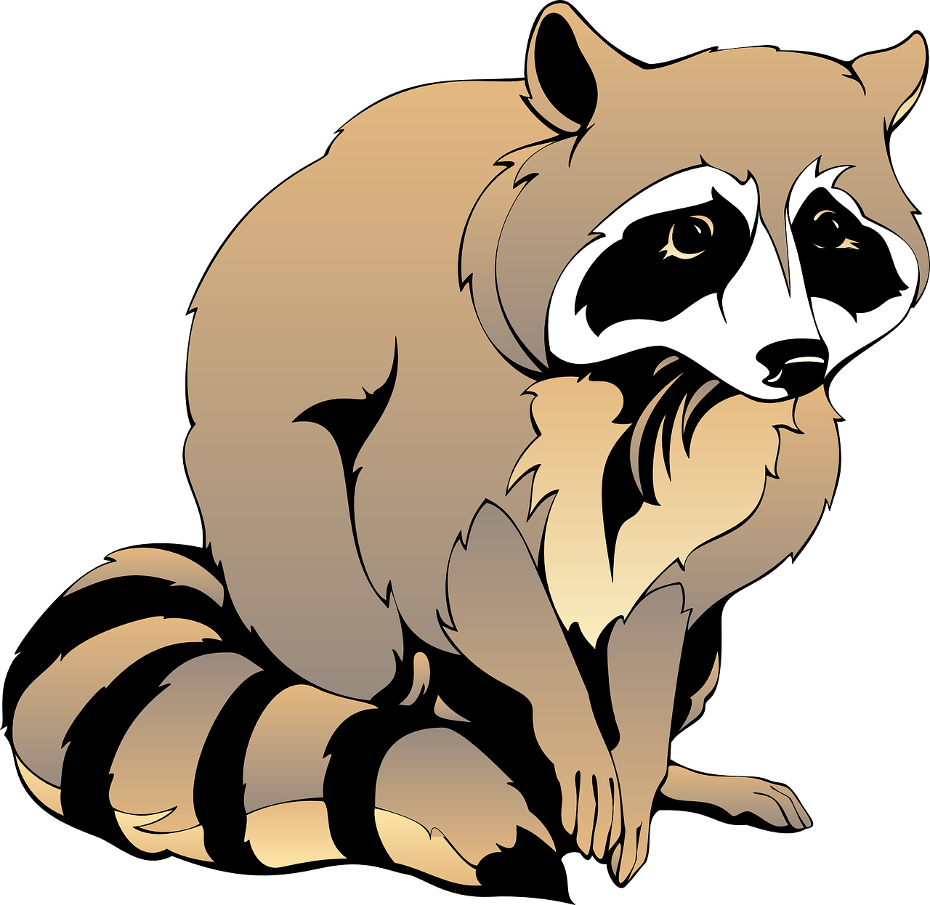
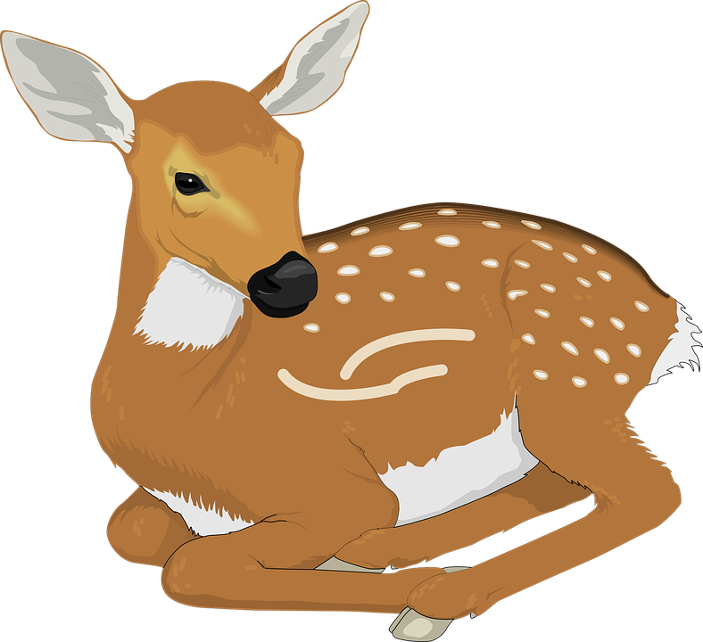
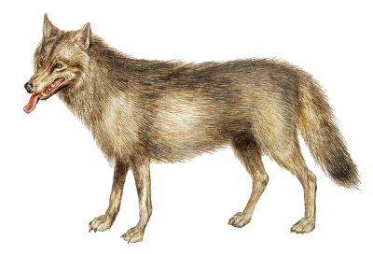
Animals on the
Grand Ronde Reservation

Slide 2
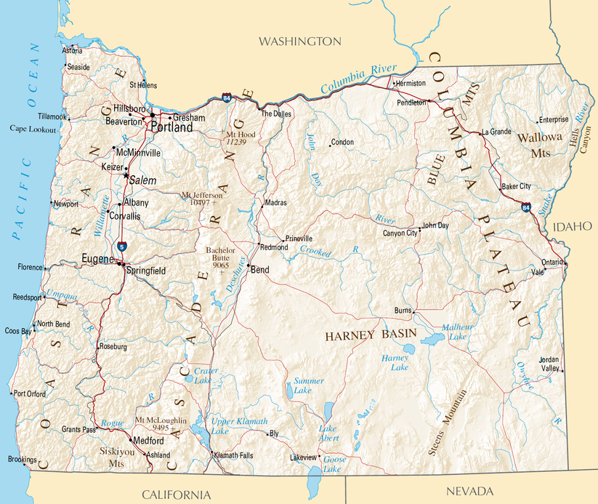
Notes:
The Grand Ronde Reservation is shown as a red square in this map.
Help students locate where they live relative to the Grand Ronde Reservation.

Slide 3
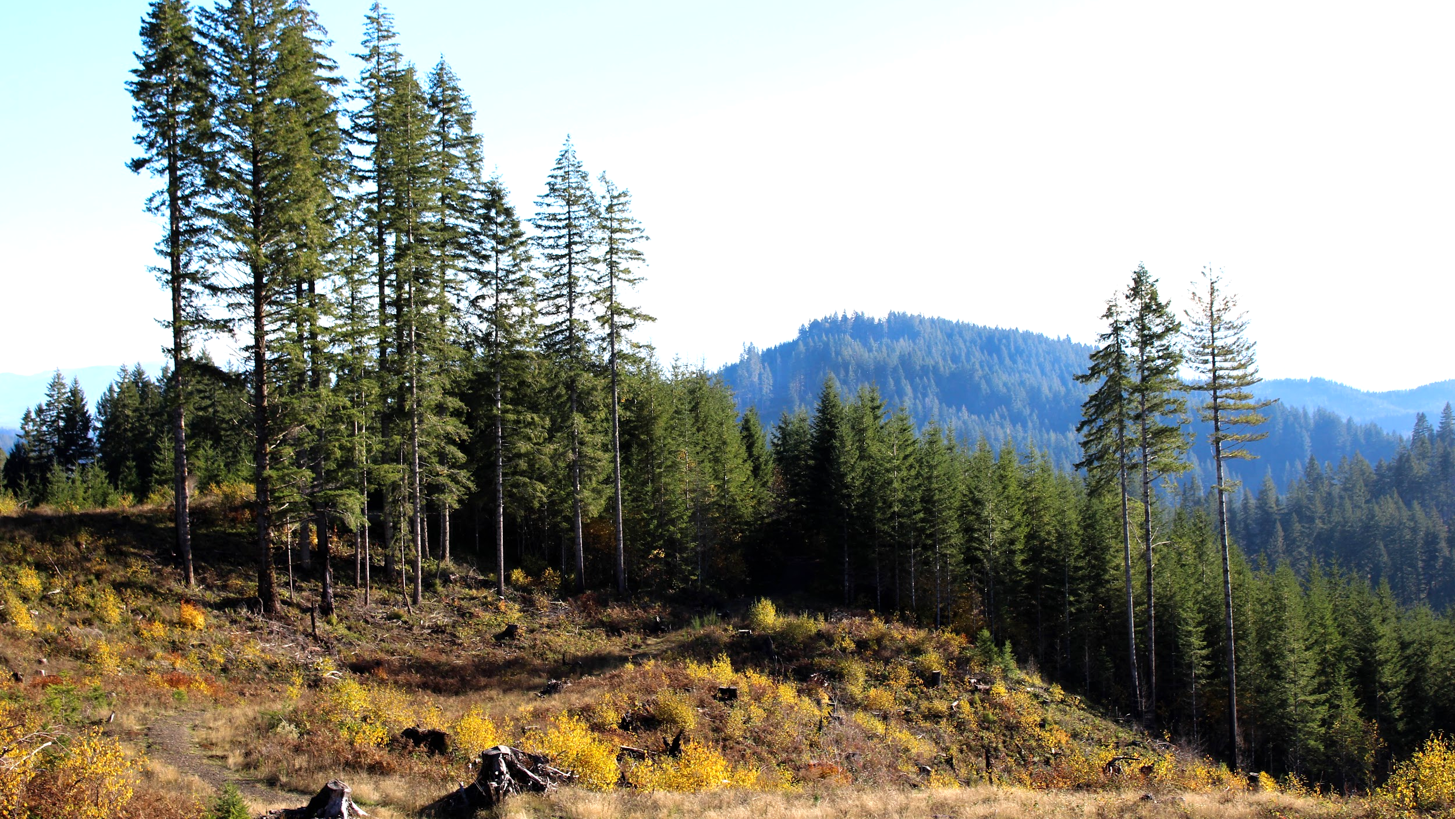
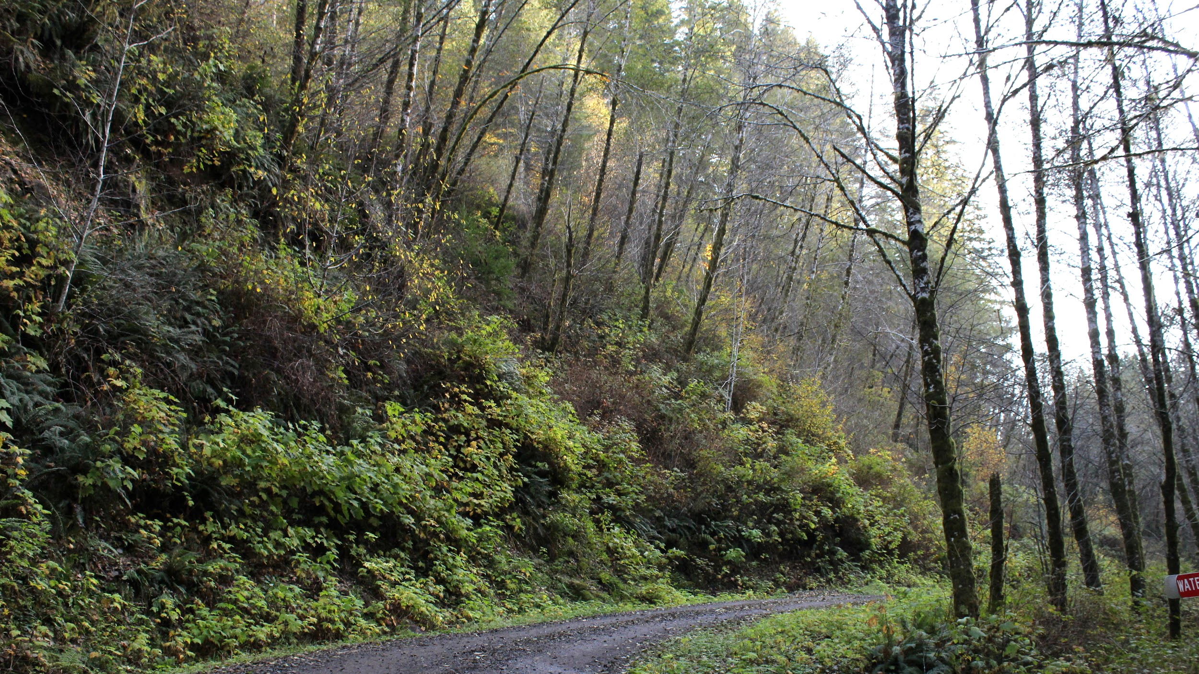
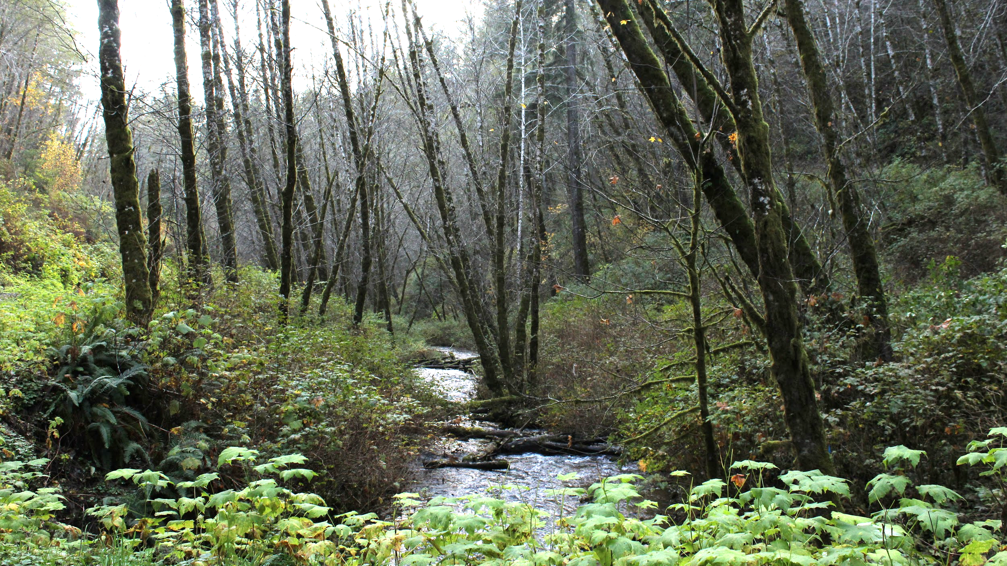
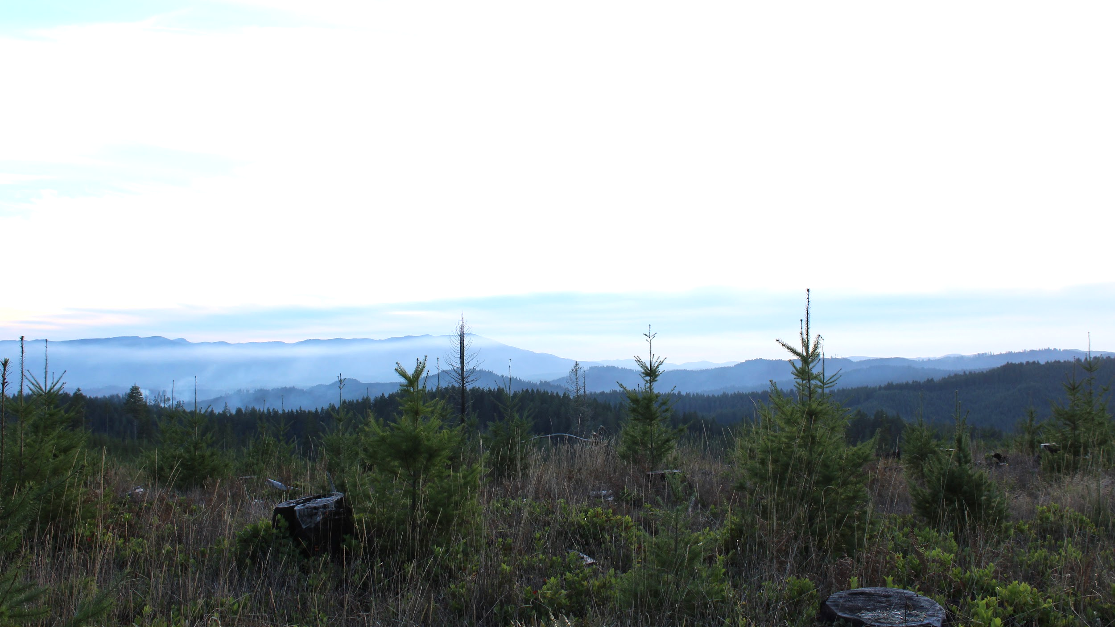
Notes:
Images from the Reservation:
These images are taken on the Grand Ronde Reservation in 2017.
Discuss the habitat seen in these images (trees, grasses, creeks, hills/mountains, etc.)
Have students predict what types of animals might live here.

Slide 4
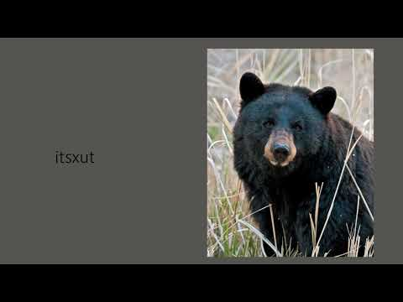
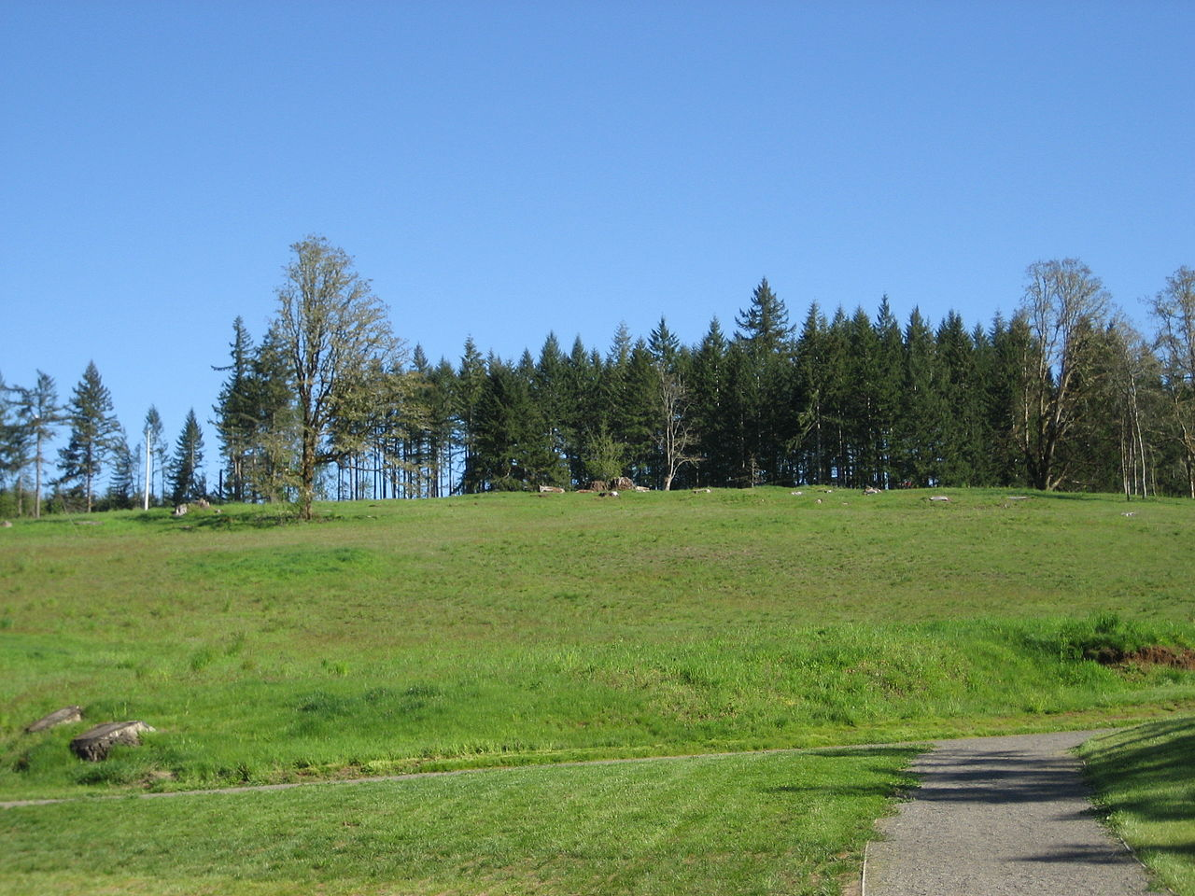
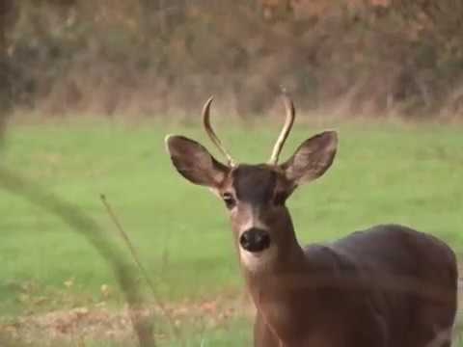
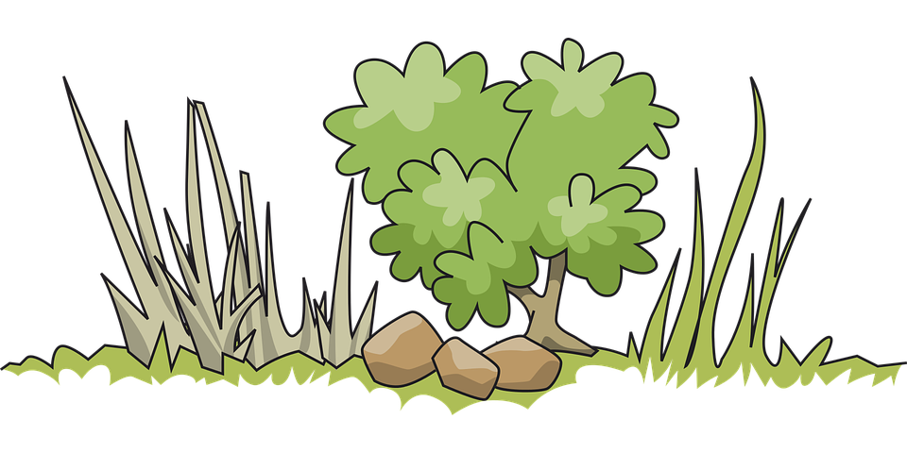
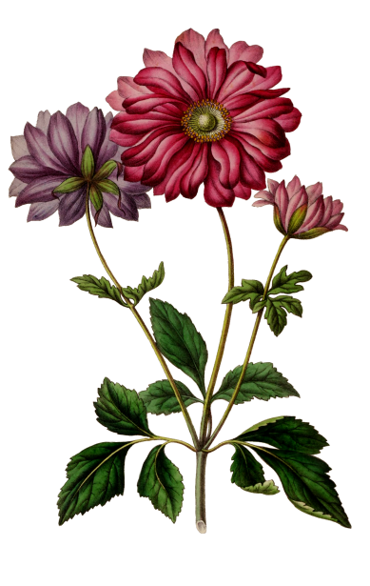

chinuk wawa - mawich
DEER
Notes:
DEER - mawich
Top Left: “deer” pronounced in chinuk wawa, the Native language of the Confederated Tribes of Grand Ronde
Middle Left: video of a blacktail deer - How do they move?
Middle Right: Blacktail deer diet - variety of grasses, forbs, lichens, shrubs, and trees
Bottom Left: Deer image
Bottom Right: Creek. Deer need water to go along with their food to survive
Background Image: Image of Fort Yamhill to display deer habitat. Deer often live on “edge” habitats where heavy timber meet meadows, clearings, shorelines, clearcuts, and brushy slopes. Image courtesy of Aboutmovies at English Wikipedia, CC BY-SA 3.0, https://commons.wikimedia.org/w/index.php?curid=4893298

Slide 5
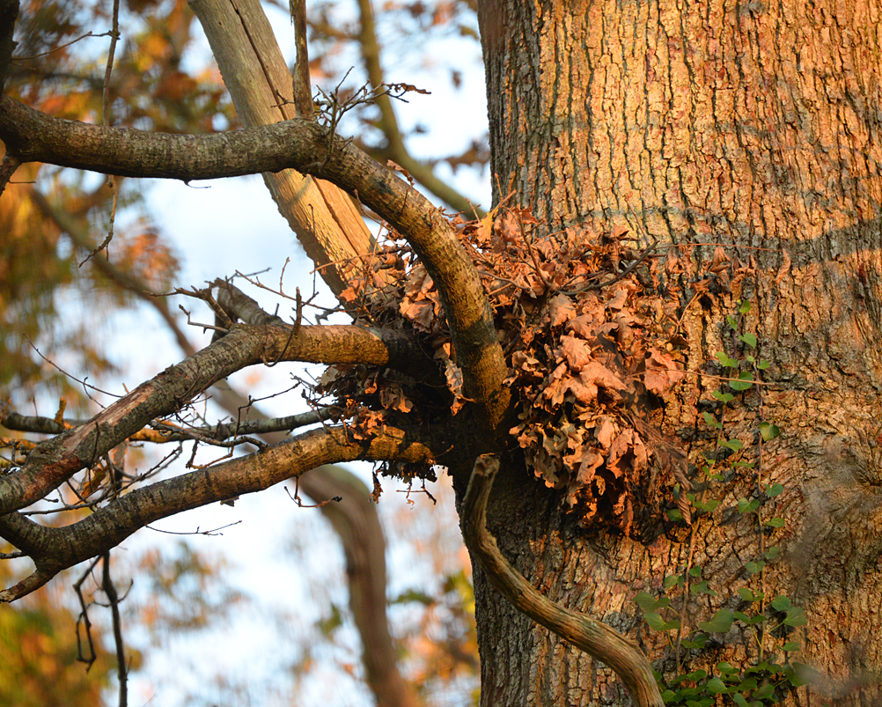
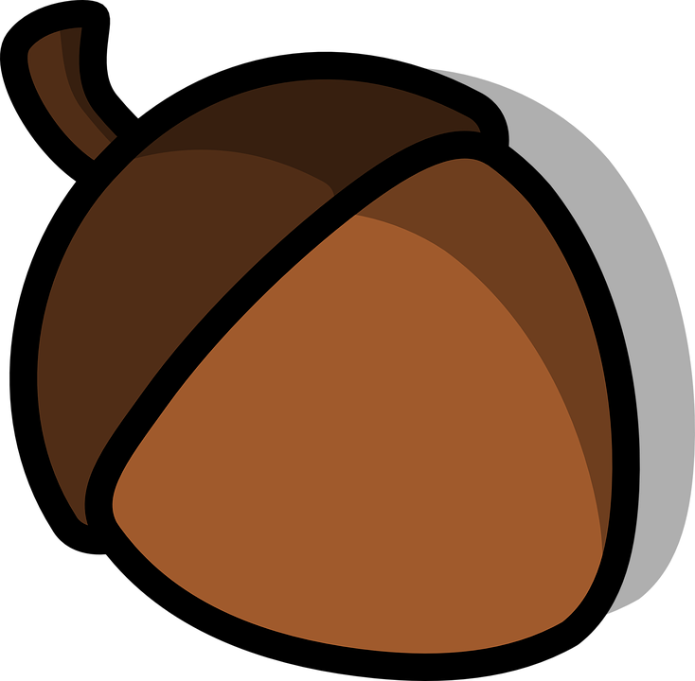
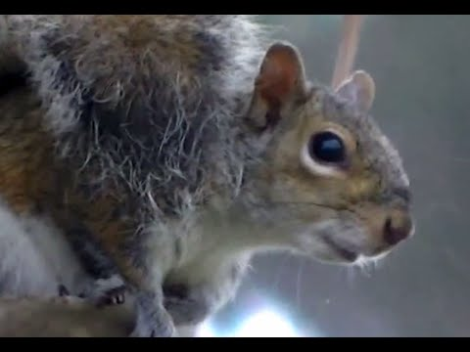

chinuk wawa - puypuy
SQUIRREL
Notes:
SQUIRREL - puypuy
Top Left: “squirrel” pronounced in chinuk wawa, the Native language of the Confederated Tribes of Grand Ronde
Center Left: video of a squirrel - How do they move? What sounds do they make?
Acorns and Seeds: Squirrel diet - fungi, seeds, nuts and fruits
Center - squirrel image
Additional Fact: To prepare for winter, squirrels will bury their food to save it for later
Background Image: Image courtesy of Marc Baldwin

Slide 6
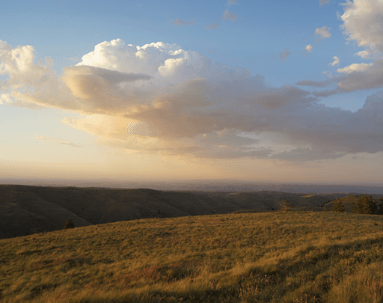
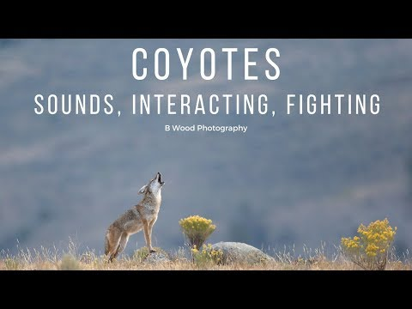
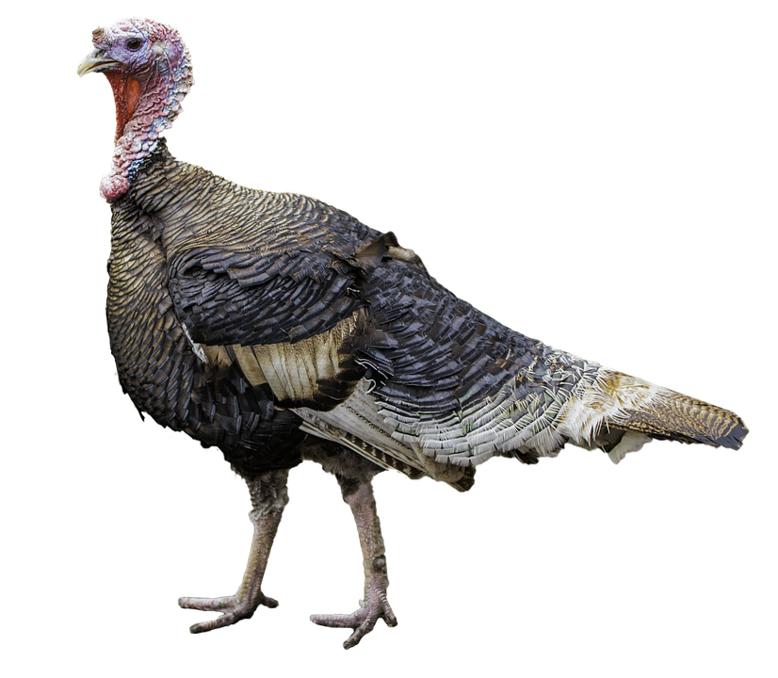
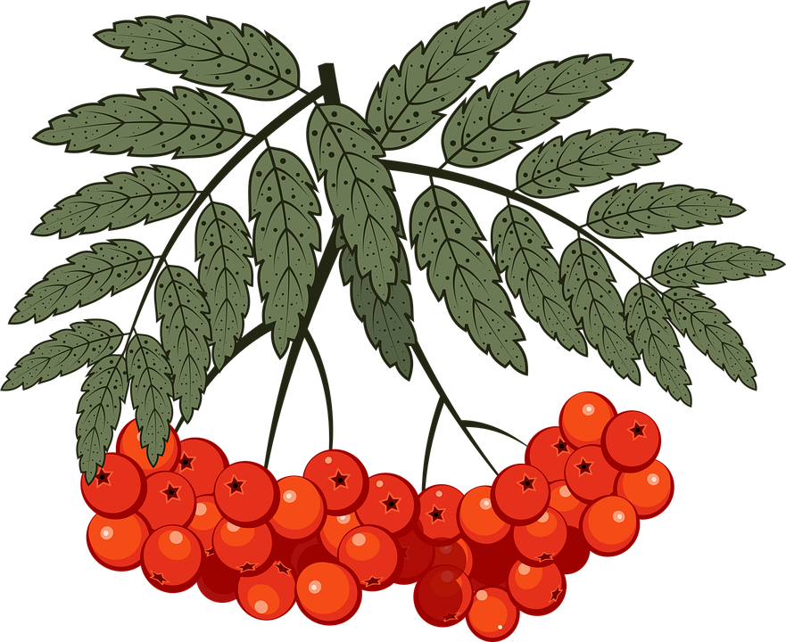
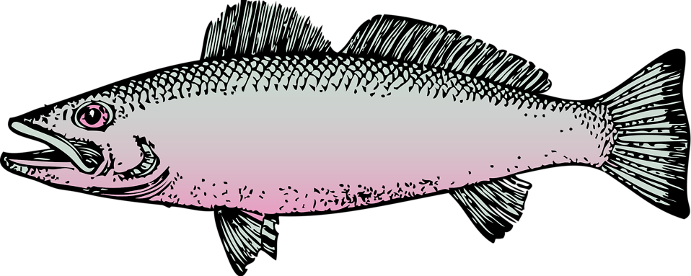
chinuk wawa - t’alapas
COYOTE
Notes:
SQUIRREL - t’alapas
Top Left: “coyote” pronounced in chinuk wawa, the Native language of the Confederated Tribes of Grand Ronde
Middle Left: video of coyote. How do they move? What sounds do they make?
Bottom Left: coyote diet - insects, amphibians, fish, small reptiles, birds, rodents, and larger mammals including white-tailed deer, elk, bighorn sheep, bison, and moose. Birds preyed upon by coyotes include thrashers, sparrows, and wild turkeys, variety of fruits and vegetables including peaches, blackberries, pears, blueberries, apples, carrots, cantaloupe, watermelon, and peanuts
Bottom Right - coyote image
Additional Fact: coyote can reach speeds of 40 miles per hour and can hunt in a pack or alone
Background Image: Coyotes can live in many different habitats but they prefer grasslands, prairies, and deserts. Image courtesy of Mark Darrach

Slide 7
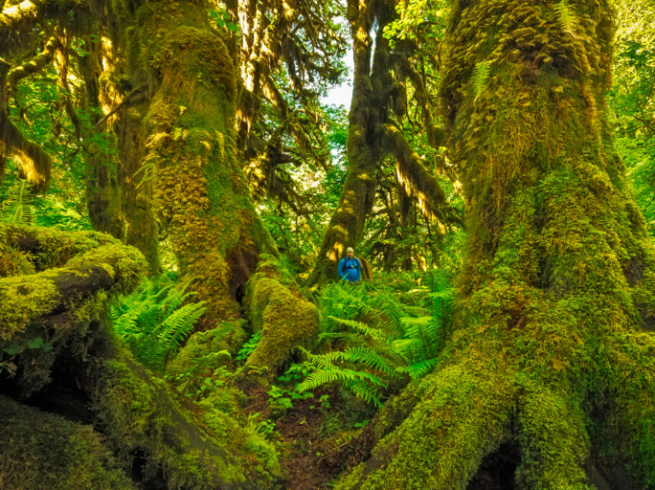
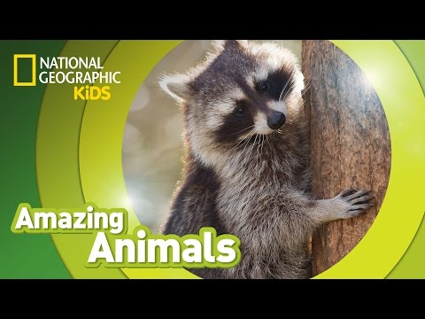
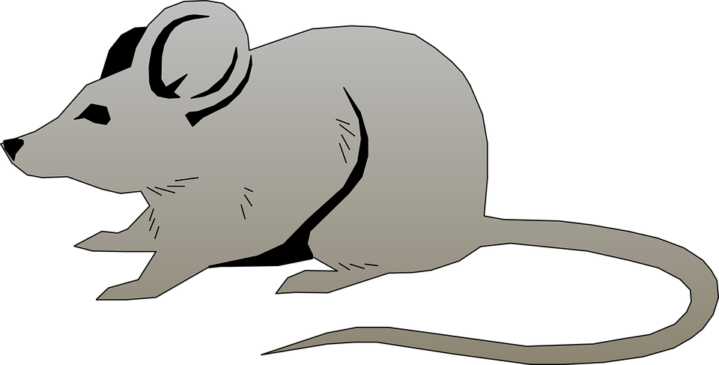
chinuk wawa - q’ǝlas
RACCOON
Notes:
RACCOON - q’ǝlas
Top Left Video: “raccoon” pronounced in chinuk wawa, the Native language of the Confederated Tribes of Grand Ronde
Middle Left Video: NatGeo Kids video on raccoons. Students can view the entire video or a small portion
Middle Left: raccoon diet - fruits, berries, nuts, fish, frogs, mussels, crayfish, insects, turtles, mice, rabbits, muskrats and bird eggs
Center: raccoon image
Additional Fact: raccoons are nocturnal, which means they are awake at night
Background Image: Raccoons prefer to live in moist woodland areas. However, they can also be found in farmlands, suburban, and urban areas. Raccoons prefer to build dens in trees, but may also use woodchuck burrows, caves, mines, deserted buildings, barns, garages, rain sewers, or houses.

