Slide 1

Legislative
Acts
Native American-related bills in the U.S. Congress

Slide 2
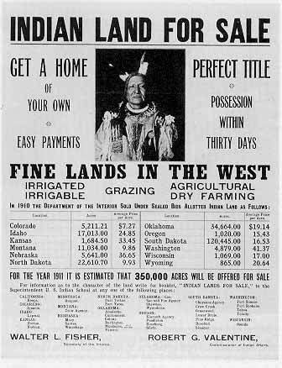
“To each head of family, one-quarter of a section;
To each single person over eighteen years of age, one-eighth of a section;
To each orphan child under eighteen years of age, one-eighth of a section; and
To each other single person under eighteen years now living, or who may be born prior to the date of the order of the President directing an allotment of the lands embraced in any reservation, one-sixteenth of a section”
The Dawes General Allotment Act
Notes:
Read the Act: https://www.ourdocuments.gov/doc.php?flash=false&doc=50&page=transcript

Slide 3
Dawes General Allotment Act
February 8, 1887
Named after Senator Henry L. Dawes of Massachusetts
Authorized the President of the United States to subdivide Native American tribal communal landholdings (reservations) into allotments for Native American heads of families and individuals (1)
The leftover land on the Reservation would be sold to settlers for a price of $1.10 an acre.
The act states that the allotments given to the Indians would be held in trust for 25 years (meaning that the U.S. Government would continue to hold ownership and “protect” the land) for 25 years After that time, the allotment would be discharged to the Native American. (2)
Within the Grand Ronde Reservation, 33,468 acres were allotted to 274 Native Americans.
This left 25,791 acres left over as “surplus” to be sold to settlers.
The money received from the surplus land sales was to go towards the funding of education and civilization of Indians (3)
Notes:
This was the first situation in history where Native Americans were forced into dividing and determining nuclear families. In the Native American culture, many families live communally and often house multiple generations within the same household. When the Dawes General Allotment Act was passed, Native families were forced to state who “belonged” within each family unit. Because the heads of families and certain individuals were granted pieces of land, it was essential that families were divided accordingly to reduce the amount of land lost.
This same rule did not apply for the White settlers who purchased the leftover land on the Reservation. Can you make an inference as to how the government felt towards the Native Americans versus the White settlers?
Possible Answer: The U.S. Government did not trust the Native Americans to own and manage their own land. They wanted to maintain control over the Native Americans, their resources, and their rights.
When the U.S. Government refers to the “civilization of Indians” what does that mean?
Possible Answer: Assimilation. The U.S. Government wanted the Native Americans to assimilate into White culture - live in traditional settler houses, wear settlers clothing, send their children to formal school, etc.

Slide 4
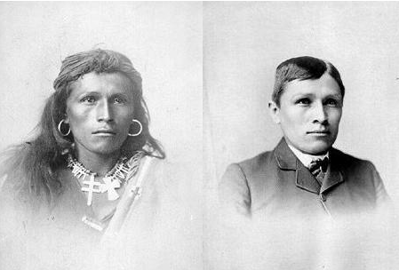
Stop & Think
“Kill the Indian, and Save the Man”
-Capt. Richard H. Pratt on the Education of Native Americans
Look at the quote and the image on this slide:
What do you think this quote means?

Slide 5
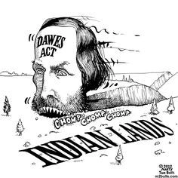
Stop & Think
Look at the image on this slide:
What message do you think the artist was trying to convey in this drawing?

Slide 6
Review Questions
In your own words, summarize this Act in 1-2 sentences.
What were the effects of this Act on Native American peoples?
What were two other events happening in U.S. history during this time?
Did these events have any impact on the passing of this Act? If so, explain why.

Slide 7
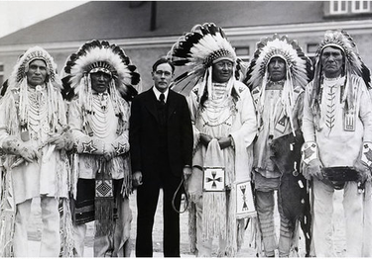
“Be it enacted by the Senate and House of Representatives of the United States of America in Congress assembled, That hereafter no land of any Indian reservation, created or set apart by treaty or agreement with the Indians, Act of Congress,
Executive order, purchase, or otherwise, shall be allotted in severalty to any Indian.”
Indian Reorganization Act
Notes:
Read the Act: https://www.govinfo.gov/content/pkg/COMPS-5299/pdf/COMPS-5299.pdf

Slide 8
Indian Reorganization Act
June 18, 1934
Often called the “Indian New Deal” and the “Wheeler-Howard Act”
Congress and the Executive Branch support Tribal Governments and Sovereignty
Goals:
  reverse the traditional goal of cultural assimilation
  strengthen, encourage and perpetuate the tribes and their historic Native American cultures
  conserve and develop Indian lands and resources
  extend to Indians the right to form business
  establish a credit system for Indians
  grant certain rights of home rule to Indians
  provide for vocational education for Indians
Negative Effect: The IRA forced Tribal governments to organize themselves under constitutions
  Essentially this says, “you need to look like “us” if we are going to work with you”
Notes:
Supplemental Resources:
The New Deal: Crash Course US History (https://youtu.be/6bMq9Ek6jnA) Students can view this video to understand more about how the IRA fit into Roosevelt’s New Deal
Rebuilding Indian Country (1934) (https://youtu.be/2h_PuVm-1DE) This video was first produced by the US Department of the Interior in 1934 and paints a picture of how Native Americans were viewed by society during this time period. Teachers may only chose to show parts of the video as it is lengthy and somewhat stagnant at times.

Slide 9
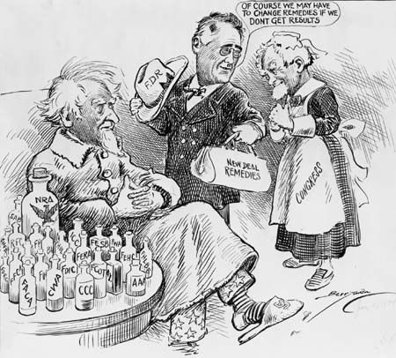
Stop & Think
Look at the image on this slide:
What message do you think the artist was trying to convey in this drawing?

Slide 10
Review Questions
In your own words, summarize this Act in 1-2 sentences.
What were the effects of this Act on Native American peoples?
What were two other events happening in U.S. history during this time?
Did these events have any impact on the passing of this Act? If so, explain why.

Slide 11
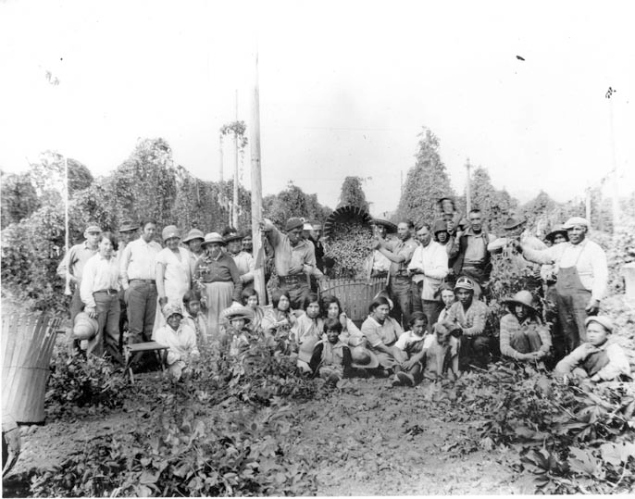
“the purpose of this Act is to provide for the termination of Federal supervision over the trust and restricted property of certain tribes and bands of Indians located in western Oregon and the individual members thereof, for the disposition of federally owned property acquired or withdrawn for the administration of the affairs of such Indians, and for a termination of Federal services furnished such Indians because of their status as Indians”
Western Oregon Indian Termination Act
Notes:
Read the Act: https://www.govinfo.gov/content/pkg/STATUTE-68/pdf/STATUTE-68-Pg724.pdf#page=5

Slide 12
Western Oregon Indian Termination Act
August 1954
Also called Public Law 588, signed by President Eisenhower
Called for the termination of federal supervision over the trust and restricted property of numerous Native American bands and small tribes
Oral accounts from Grand Ronde Elders stated that the Tribe did not give consent for termination.
61 tribes in Western Oregon were terminated, more than the total tribes terminated under all other individual acts
The Termination Act terminated the tribes’ federal recognition status, stripping their identity as a sovereign nation.
The tribes lost all their treaty rights and land.
The Termination Act removed all obligations that had been negotiated through treaties between the United States Government and the tribes
Notes:
For more information relating to the effects of the Termination Act on Grand Ronde Tribal Members, see the High School U.S. History Lesson Presentation Termination

Slide 13
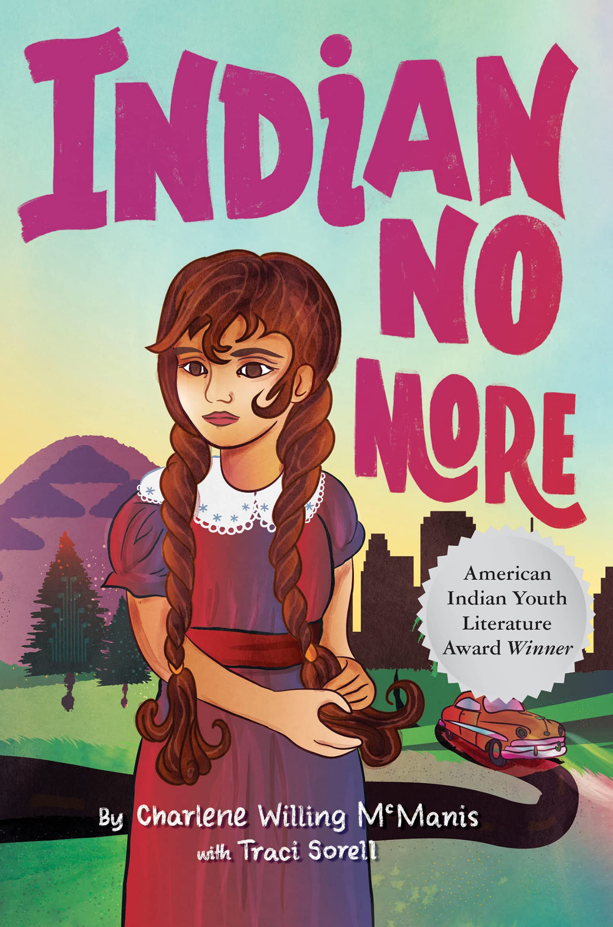
Stop & Think
The image on this slide is the cover of a young adult novel written about a young tribal girl’s experience during the Termination Era.
Based on the title and the artwork, what do you predict the story discusses?

Slide 14
Review Questions
In your own words, summarize this Act in 1-2 sentences.
What were the effects of this Act on Native American peoples?
What were two other events happening in U.S. history during this time?
Did these events have any impact on the passing of this Act? If so, explain why.

Slide 15
That in order to help adult Indians who reside on or near Indian reservations to obtain reasonable and satisfactory employment…
The Indian Relocation Act
Notes:
Read the Act: https://www.govinfo.gov/content/pkg/STATUTE-70/pdf/STATUTE-70-Pg986.pdf

Slide 16
The Indian Relocation Act
August 3, 1956
Public Law 959 or the Adult Vocational Training Program
Intended to:
  encourage Native Americans in the United States to leave Indian reservations and their traditional lands
  assimilate into the general population in urban areas
  weaken community and tribal ties
offered to pay moving expenses and provide some vocational training for those who were willing to move from the reservations to certain government-designated cities
Types of assistance offered included:
  relocation transportation and transportation of household goods
  subsistence per diem for both the time of relocation and up to four weeks after arrival
  medical insurance for workers and their dependents
  grants to purchase work clothing, household goods and furniture
However, not all who accepted these offers actually received these benefits once they arrived in the cities, leading to some cases of poverty, culture shock, joblessness and homelessness among this population in the new, urban environment

Slide 17
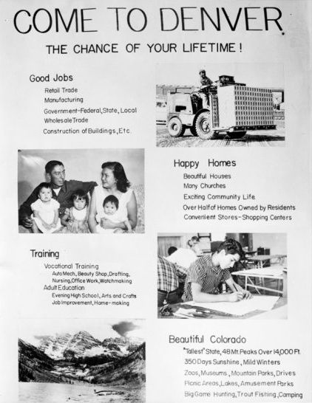
Stop & Think
Take a look at the flyer on this slide. It was used to entice Native Americans to move to Colorado during the Indian Relocation Act.
What tactics were used to motivate the Tribal Members to move?

Slide 18
Review Questions
In your own words, summarize this Act in 1-2 sentences.
What were the effects of this Act on Native American peoples?
What were two other events happening in U.S. history during this time?
Did these events have any impact on the passing of this Act? If so, explain why.

Slide 19
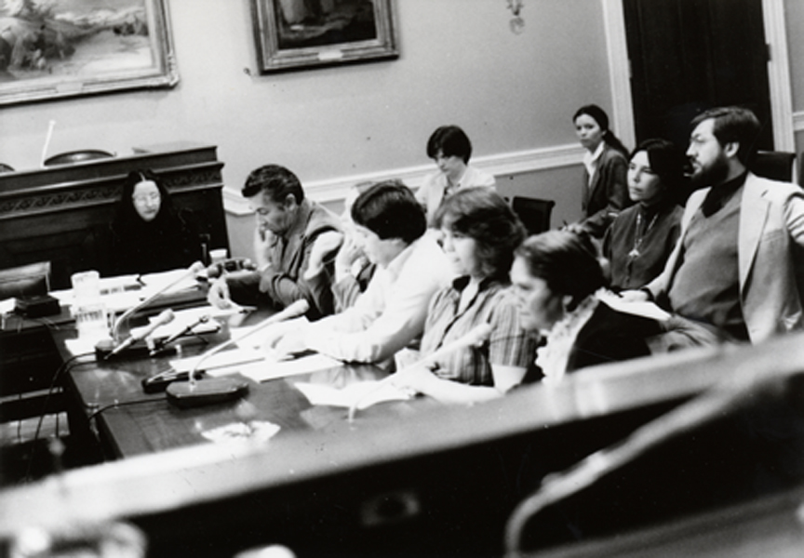
“The Confederated Tribes of the Grand Ronde Community of Oregon shall be considered as one tribal unit for purposes of Federal recognition and eligibility for Federal benefits…”
The Grand Ronde Restoration Act
Notes:
Read the Act: https://www.govtrack.us/congress/bills/98/hr3885/text

Slide 20
The Grand Ronde Restoration Act
November 22, 1983
President Ronald Reagan signed the bill into law on November 22, 1983.
Marvin Kimsey, Jackie Whistler, Kathryn Harrison, Frank Harrison, and Karen Harrison travelled to Washington D.C. to testify in front of the House of Representatives
When they testified, they focused on the issue of justice. They explained their desire to become part of Indian Nation once again.
Despite oppositional pressure from the regional fishing and hunting lobbies, Congress passed the Grand Ronde Restoration Act (25 U.S.C. 713 et seq.)
Once federal recognition was regained, tribes were able to fight for and buy pieces of their traditional lands, lobby for treaty rights, and make decisions that would best support their memberships.
Notes:
For more information relating to the effects of the Restoration Act on Grand Ronde Tribal Members, see the High School U.S. History Lesson Presentation Restoration
Students can also view the Grand Ronde Restoration Video, found at the end of this slideshow

Slide 21

Stop & Think
The building shown in the image on this slide is the Grand Ronde Health and Wellness Center which opened in 1997.
How does this building contrast the stereotypes that often exist surrounding Native Americans?

Slide 22
Review Questions
In your own words, summarize this Act in 1-2 sentences.
What were the effects of this Act on Native American peoples?
What were two other events happening in U.S. history during this time?
Did these events have any impact on the passing of this Act? If so, explain why.

Slide 23
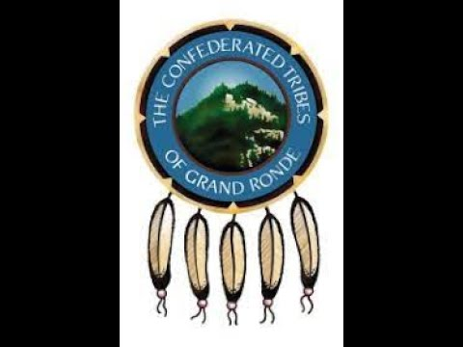
Notes:
Grand Ronde Restoration Video

