Slide 1
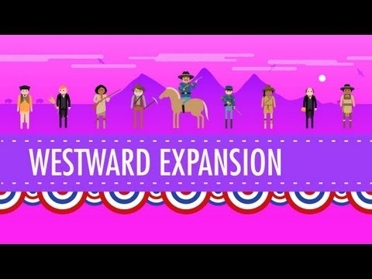

Slide 2
Federal Indian Policy
in the
United States
Exploring the relationship between Tribal Nations and the U.S. Federal Government

Slide 3
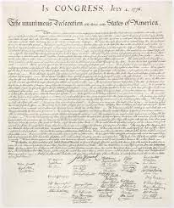
1774-1789: The Confederation Period
April 1775 - “shot heard around the world”
July 1776 - Declaration of Independence
“that all men are created equal, that they are endowed by their Creator with certain unalienable Rights, that among these are Life, Liberty and the pursuit of Happiness.”
“He has excited domestic insurrections amongst us, and has endeavored to bring on the inhabitants of our frontiers, the merciless Indian savages whose known rule of warfare, is an undistinguished destruction of all ages, sexes, and conditions.”
November 1777 - Continental Congress adopted Articles of Confederation
March 1781 - Articles ratified by 13 states
Problem: The Articles of Confederation did not give Congress the power to manage and deal with the Native Nations that were already here.
Creates the Question: Who has power over who? Do the Tribes control themselves and their actions or does the newly formed Federal Government?
Notes:
April 1775 - start of Revolutionary War
July 1776 - Declaration of Independence
Opening words for Declaration of Independence: “that all men are created equal, that they are endowed by their Creator with certain unalienable Rights, that among these are Life, Liberty and the pursuit of Happiness.”
Closing words for Declaration of Independence: “He has excited domestic insurrections amongst us, and has endeavored to bring on the inhabitants of our frontiers, the merciless Indian savages whose known rule of warfare, is an undistinguished destruction of all ages, sexes, and conditions.”
Q: What does this immediately do to and show about the relationship between the colonists and the Native American tribes?
Nov. 1777 - Continental Congress adopted Articles of Confederation
March 1781 - Articles ratified by 13 states
Problem: The Articles of Confederation did not give Congress the power to manage and deal with the Native Nations that were already here
Creates the Question: Who has power over who? Do the Tribes control themselves and their actions or does the newly formed Federal Government?

Slide 4
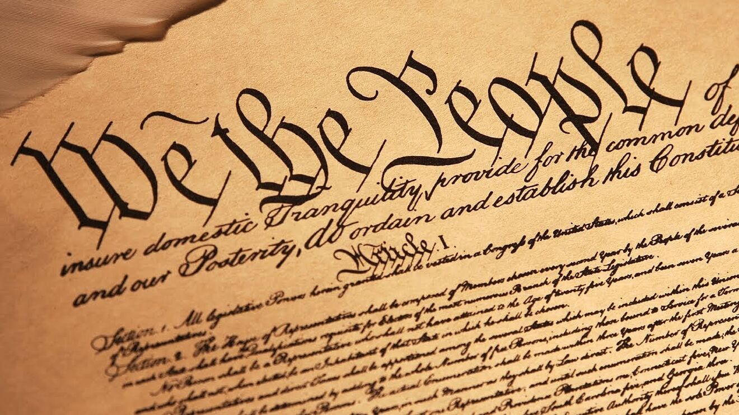
1774-1789: The Confederation Period
May 1787 - U.S. Constitution signed
Designated who had power over “Indian Affairs”
The Commerce Clause refers to Article 1, Section 8, Clause 3 of the U.S. Constitution, which gives Congress the power “to regulate commerce with foreign nations, and among the several states, and with the Indian tribes”
Question: What about this language is so important?
June 1788 - U.S. Constitution Ratified
Notes:
May 1787 - U.S. Constitution signed
Designated who had power over “Indian Affairs”
The Commerce Clause refers to Article 1, Section 8, Clause 3 of the U.S. Constitution, which gives Congress the power “to regulate commerce with foreign nations, and among the several states, and with the Indian tribes.
Question: What about this language is so important?
ANSWER: This language is the basis for sovereignty as it places Tribes on the same level as foreign nations and states. They are not a “group” or “race” of people. This is the difference between Native Americans and other races.
June 1788 - U.S. Constitution Ratified

Slide 5
Comprehend & Reflect
1. In the beginning of the Declaration of Independence it states, “that all men are created equal, that they are endowed by their Creator with certain unalienable Rights, that among these are Life, Liberty and the pursuit of Happiness.” Did this apply to the Native Americans that were already living on the land? Explain your answer.
2. What did the Articles of Confederation not give Congress the power to do?
request money from the states
regulate armed forces
manage and deal with Native Nations
declare war
3. What document designated who had power over “Indian Affairs”?
The Declaration of Independence
The Articles of Confederation
The Trade & Intercourse Act
The United States Constitution

Slide 6
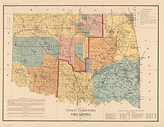
1789-1825: Trade & Intercourse Era
Congress established the Department of War with responsibilities over Indian Affairs
Q: What does this immediately do to and show about the relationship between the new federal government and the Native American tribes? How does the government view the Tribes?
1790 - Congress enacts the Trade & Intercourse Act
Congress recognized that they must purchase the property from Native Americans to reduce conflicts and continue U.S. Expansion as orderly and fairly as possible
U.S. Policies created to:
Define “Indian” Territory
Protect “Indian Country”
Regulate traders’ dealings with Tribal Nations by controlling the pioneers and settlers who were trying to take Native lands
Notes:
Congress established the Department of War with responsibilities over Indian Affairs
Q: What does this immediately do to and show about the relationship between the new federal government and the Native American tribes? How does the government view the Tribes?
A: As a threat and in some cases an enemy. Demonstrates a contentious and violent relationship
1790 - Congress enacts the Trade & Intercourse Act
Congress recognized that they must purchase the property from Native Americans to reduce conflicts
U.S. Policies created to:
Define “Indian” Territory
Protect “Indian Country”
Regulate Traders’ dealings with Tribal Nations by controlling the pioneers and settlers who were trying to take Native lands

Slide 7
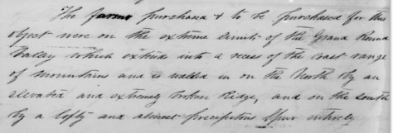
1789-1825: Trade & Intercourse Era
- Purchasing Lands -
As a result of the Trade & Intercourse Act:
Indigenous Nations would be treated as foreign nations and lands would be purchased through treaties, although at a low cost
* treaty: a legally binding agreement between sovereign nations
390 treaties would be negotiated between the United States and Native Nations before 1871
Sounds great, right?
Q: What could possibly go wrong?
Notes:
As a result of the Trade & Intercourse Act:
Indigenous Nations would be treated as foreign nations and lands would be purchased through treaties
* treaty: a legally binding agreement between nations
390 treaties would be negotiated between the United States and Native Nations before 1871
Sounds great, right?
Q: What could possibly go wrong? (Have students predict what they think will happen next)

Slide 8
Comprehend & Reflect
1. The 1790 Trade & Intercourse Act demonstrated that Congress recognized that they must _______________________ the land from Native Americans to reduce conflicts and continue U.S. expansion as orderly and fairly as possible.
2. Explain why the United States Federal Government was legally able to create treaties with Native Nations.

Slide 9
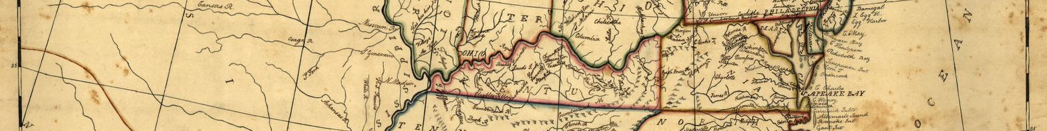
1825-1850: Removal Era
Mid-1820’s - The U.S. Government began openly discussing the forceful move of all Tribal Nations west in order to give the U.S. more room to grow
1830 - The Removal Act was passed under Andrew Jackson’s presidency
The government began to relocate Tribal Nations to “Indian Territory”
Ultimate Goal: Move all Native Nations past the Mississippi River and into Oklahoma, resulted in the Cherokee Trail of Tears
Promised to have this land forever and that the Federal Government would protect that promise
Notes:
Mid-1820’s - The U.S. Government began openly discussing the forceful move of all Tribal Nations west in order to give the U.S. more room to grow
1830 - The Removal Act was passed under Andrew Jackson’s presidency
The government began to relocate Tribal Nations to “Indian Territory”
Ultimate Goal: Move all Native Nations past the Mississippi River and into Oklahoma, resulted in the Cherokee Trail of Tears (loss of approx. ¼ of population)
Promised to have this land forever and that the Federal Government would protect that promise
Additional Resource:
This Land - podcast: https://crooked.com/podcast-series/this-land/

Slide 10
Comprehend & Reflect
1. What was the ultimate goal of the 1830 Removal Act?
move all Native Nations past the Mississippi River and into Oklahoma
move all Native Nations past the Snake River and into Idaho
remove the treaty rights that had been previously established
2. Who was the United States President at the time the Removal Act was passed?

Slide 11
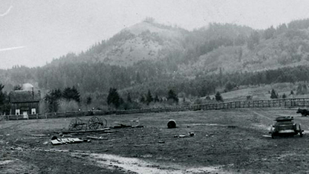
1850-1887: Reservation Era
The Gold Rush & the Oregon Trail
Leads to a flood of United States citizens across the county
Creates conflict within the “frontier” among pioneers/settlers and Native tribes
Pioneers/Settlers began to stake claim to land and claim ownership, which is an extremely uncommon concept to Native Peoples
Q: How could this clash of cultures create issues?
Nearly 300 Reservations formed
Often advertised as a “safe space” for Native Peoples
They were poorly managed and promised services were not being provided
President Grant moved Indian Affairs from the Department of the Interior to the Military
Treaty making ended in 1871 due to a power struggle between the Senate and the House over control of Indian Affairs
Management of the Reservations moves into control of religious denominations
Notes:
The Gold Rush & the Oregon Trail
Leads to a flood of United States citizens across the county
Creates conflict within the “frontier” among pioneers/settlers and Native tribes
Pioneers/Settlers began to stake claim to land and claim ownership, which is an extremely uncommon concept to Native Peoples
Q: How could this clash of cultures create issues?
Nearly 300 Reservations formed
Often advertised as a “safe space” for Native Peoples
They were poorly managed and promised services were not being provided
President Grant moved Indian Affairs from the Department of the Interior to the Military (appearance of Forts near the Reservations)
Treaty making ended in 1871 due to a power struggle between the Senate and the House over control of Indian Affairs
Management of the Reservations moves into control of religious denominations (Ask students: What type of influence could this possibly have on Native peoples?)

Slide 12
Comprehend & Reflect
1. What two historic events led to the increase in settlers moving west?
the Civil War and the Dred Scott Decision
the Gold Rush and the Oregon Trail
the Fugative Slave Act and the Great Chicago Fire
the defeat of Lieutenant Colonel Custer and the division of the U.S. into time zones
2. How were Reservations advertised to Native Peoples? Were they everything that had been promised?
3. Who controlled the Indian Reservations after the end of treaty making in 1871?

Slide 13
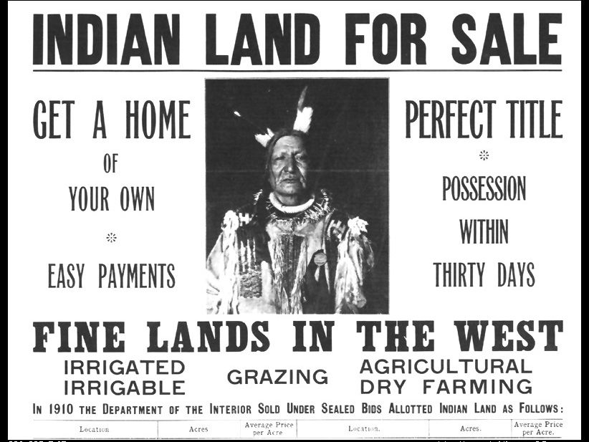
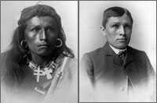
1887-1934: Allotment & Assimilation Era
1887 - Dawes General Allotment Act was passed
The United States Government could not uphold the promises that have been made (healthcare, housing, education, etc.”)
Goal #1: Assimilate into American Society and “civilize Indians”
Goal #2: Break up the Tribal Nations’ ownership of land
  Opening the land to the sold to settlers
  Eliminates the need to uphold the promises within treaties
“Kill the Indian, and Save the Man”
-Capt. Richard H. Pratt on the Education of Native Americans
Q: How would this affect the identity of Native Peoples?
Notes:
1887 - General Allotment Act was passed
The United States Government could not uphold the promises that have been made (healthcare, housing, education, etc.”)
Goal #1: Assimilate into American Society and “civilize Indians”
Goal #2: Break up the Tribal Nations’ ownership of land
Opening the land to the sold to settlers
Eliminates the need to uphold the promises within treaties
“Kill the Indian, and Save the Man”
-Capt. Richard H. Pratt on the Education of Native Americans
What is the meaning of this quote?
How does this quote make you feel?
Q: How would this affect the identity of Native Peoples?

Slide 14
Comprehend & Reflect
1. What were the two goals of the Dawes General Allotment Act?
2. Look at the quote below. How does this quote make you feel?
“Kill the Indian, and Save the Man”
-Capt. Richard H. Pratt on the Education of Native Americans

Slide 15
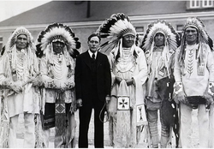
1934-1940s: Indian Reorganization Era
Roosevelt’s New Deal: The Indian Reorganization Act (IRA) was passed
Congress and the Executive Branch support Tribal Governments and Sovereignty
The IRA forced Tribal governments to organize themselves under constitutions (you need to look like “us” if we are going to work with you)
Q: How could this affect the cultural structures and practices that had been in place for thousands of years?
John Collier in a 1934 meeting with South Dakota Blackfoot Indian chiefs to discuss the Indian Reorganization Act (IRA)
Notes:
Roosevelt’s New Deal: The Indian Reorganization Act (IRA) was passed
Congress and the Executive Branch support Tribal Governments and Sovereignty
The IRA forced Tribal governments to organize themselves under constitutions (you need to look like “us” if we are going to work with you)
Q: How could this affect the cultural structures and practices that had been in place for thousands of years?

Slide 16
Comprehend & Reflect
1. The Indian Reorganization Act forced Tribal governments to organize themselves under __________________________________________
2. What was the purpose of this forced organization?

Slide 17
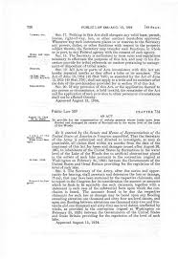
1940-1961: Termination Era
The United States Government terminates the legal relationship with 109 Tribal Nations
Results
loss of Federal benefits
loss of 1.3 million acres of Tribal land
relocation of many Tribal Nations’ people from reservations to cities
Notes:
The United States Government terminates the legal relationship with 109 Tribal Nations
Results
loss of Federal benefits (housing, healthcare, etc.)
loss of 1.3 million acres of Tribal land (sold)
relocation of many Tribal Nations’ people from reservations to cities (promise of jobs, intent to terminate every aspects of Native lives and their relationships with each other)
loss of trust in the United States government
loss of identity and culture
Additional Resources:
4th Grade Grand Ronde Termination Presentation (https://docs.google.com/presentation/d/1xDTqV1f_nutTwca8X6ArG7OBv_IcRfHSXj3JuWDiL-w/edit?usp=sharing)
The Grand Ronde Termination Act (https://drive.google.com/file/d/1Ydcg22bwmF9gS-DGSkvLvxG2W1iSBpk8/view?usp=sharing)

Slide 18
Comprehend & Reflect
1. What were the results of the termination of legal status for the Native Nations? (circle all that apply)
loss of federal benefits
loss of 1.3 million acres of Tribal land
loss of trust in the United States government
loss of identity and culture
relocation of many Tribal Nations’ people from reservations to cities

Slide 19
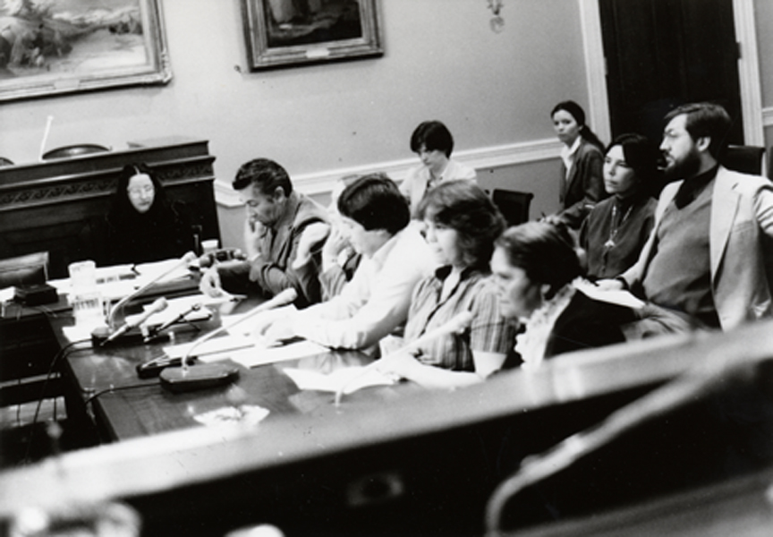
1961-PRESENT: Self-Determination Era
Kennedy Administration: Refused to undertake new actions to terminate more Tribal Nations
1970s & 1980s: Tribal Nations are restored
Indian Self-Determination and Education Assistance Act of 1975
Instituted fundamental changes
Tribes are allowed to run their own government
Contract their own services
Govern their own people
Kathryn, Karen, and Frank Harrison, seated in the front row, testify for Congressional restoration of the Grand Ronde tribe.
Notes:
Kennedy Administration: Refused to undertake new actions to terminate more Tribal Nations
1970s & 1980s: Tribal Nations are restored, The Confederated Tribes of Grand Ronde was restored in 1983
Indian Self-Determination and Education Assistance Act of 1975
Instituted fundamental changes
Tribes are allowed to run their own government
Contract their own services
Govern their own people
Q: What could come next?
Q: Trends in history hint at what?
Additional Resource:
4th Grade Grand Ronde Restoration Presentation (https://docs.google.com/presentation/d/1WwP6sfWIsG6NaEjkf0QWkJ1AoE_2KhdPOmUExAFG6o8/edit?usp=sharing)

Slide 20
Comprehend & Reflect
1. What presidential administration refused to undertake any new actions to terminate more Tribal Nations?
Jefferson
Kennedy
Grant
Bush
Jackson
2. In what year was the Confederated Tribes of Grand Ronde restored?

Slide 21


After everything you have learned, how would you summarize the relationship between the United States Federal Government and Tribal Nations in one word or sentence?

