Slide 1
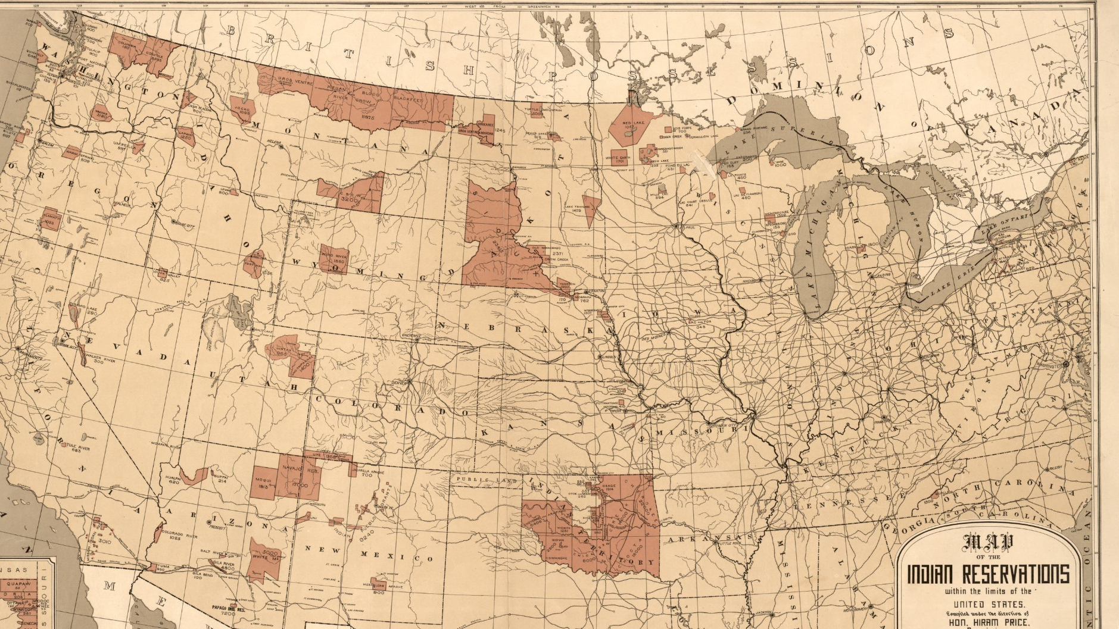
The Demise of Indian Land
Grand Ronde Tribal History

Slide 2
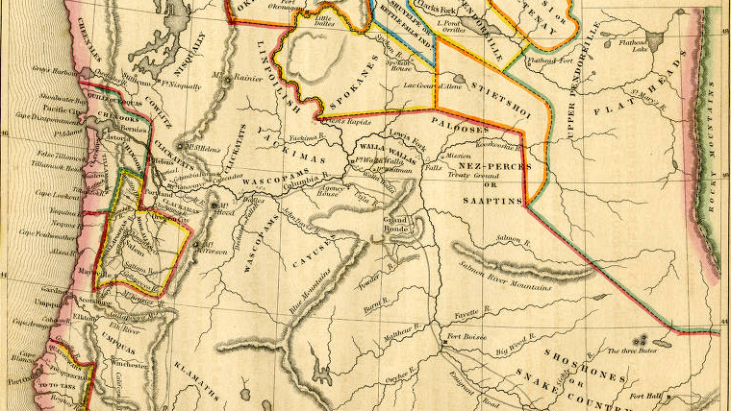
From the Beginning
Before being removed to the Grand Ronde Reservation, the ancestors of the Confederated Tribes of Grand Ronde inhabited Oregon’s inland valleys and part of the coast since time immemorial.
According to oral traditions, this was at least 14,500 years in time
According to archaeological records, this was at least 14,300 years in time

Slide 3
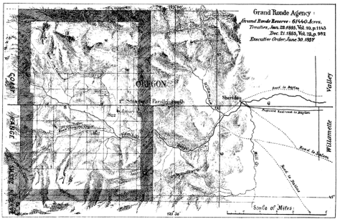
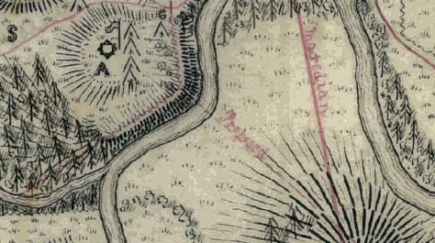
Both before and after moving tribes/bands to the Grand Ronde Reservation, there were several legislative acts passed that had a significant impact on the tribes in Oregon and the land they occupied.
These acts slowly took away land from the tribes and eventually forced them from their homelands to the Reservation. Other acts impacted the tribes’ land ownership even after they were moved to the Reservation.
So, where did it all begin?

Slide 4
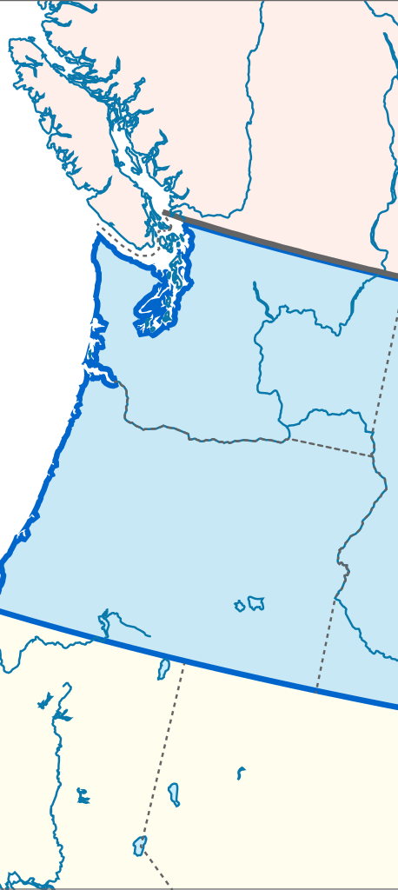
The First Organic Law of 1843
In 1843, “American and French-Canadian settlers formed the Oregon Provisional Government and established territorial laws and policies regarding Indians” (Lewis, 2009) **
The policy towards “Indians” stated:
“Of utmost good faith shall always be observed towards the Indians, their land and property shall never be taken away from them without their consent and in their property, rights and liberty they shall never be disturbed unless it be in just and lawful laws, authorized by the representatives of the peoples” ***
Notes:
*Do you think any Native Americans sat on this government?
*Why do you think they were excluded from this process?
*What language in this paragraph supports Native Americans, their rights, and their freedom?
*What language in this paragraph gives the settlers the ability to make changes to this policy? (UNLESS)
*What the paragraph refers to “authorized by the representatives of the peoples” do you think they included representation of Native American peoples?

Slide 5
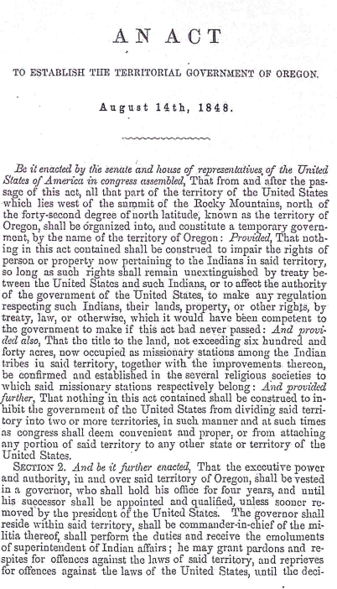
The Organic Law of 1848
The Organic Law of 1848 established the Oregon Territory
Now that Oregon had boundary lines, this act laid the groundwork for Indian land titles, the recognition of Indian land, and the beginning of treaties between tribes and the United States government.

Slide 6
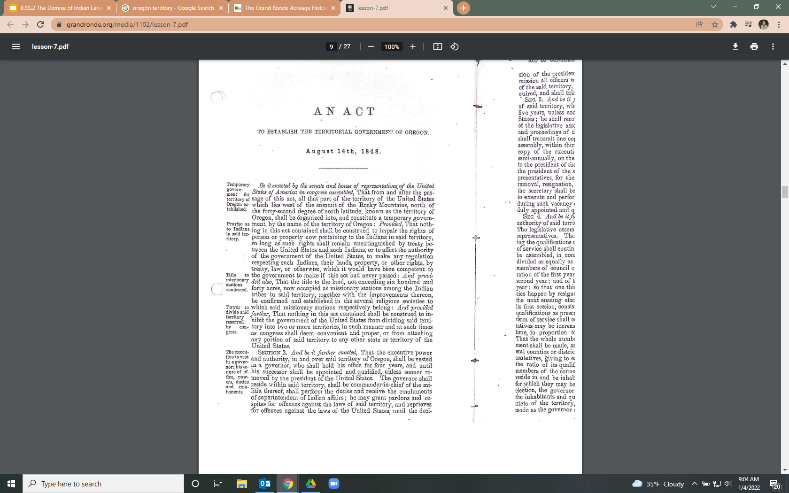
The Organic Act of 1848
The first paragraph of the act states,
“... nothing in this act contained shall be construed to impair the rights of person or property now pertaining to the Indians in said territory, so long as such rights shall remain unextinguished by treaty between the United States and such Indians”
“...or to affect the authority of the government for the United States, to make any regulation respecting such Indians, their lands, their property, or other rights, by the government to make if this act had never passed.”**
Notes:
*What language in this paragraph supports Native Americans, their rights, and their freedom?
*What language in this paragraph gives the settlers the ability to make changes to this policy?

Slide 7

What does this mean?
The United States government must respect the Native Americans’ lands, rights, and property within the Oregon Territory. A treaty may not take away the rights of the Native Americans or their lands and property.
UNLESS…..
The United States Government makes a treaty or asserts authority over these rights and lands.

Slide 8
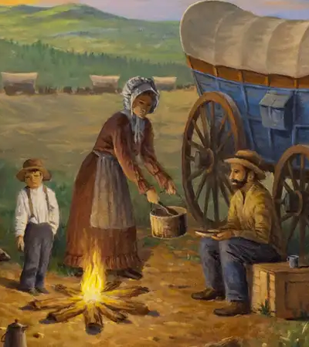
Results of the Organic Act
By 1849, more than 10,000 settlers moved to Indian Country on the Oregon Trail and began competing against one another for land which drove the Native Americans out of their homelands.
Due to the overpopulation on the East coast and the failing economy, Congress passed a new act…

Slide 9
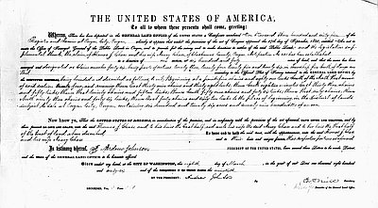
The Donation Land Claim Act of 1850
This act granted every single White male settler or American half-breed Indian who was a citizen of the United States, 320 acres of land and every married White male settler or American half-breed Indian who was a citizen of the United States, 640 acres of land*
Incoming settlers who arrived within one year of this act were given 160 acres of land or if the man was married, 320 acres of land.
Hundreds of thousands of acres were taken from the Native American tribes and given to the settlers. The Donation Land Claim Act of 1850 benefited settlers greatly, while displacing the Native Americans.
Notes:
*The language used in this section is taken from the official Act document, including the term “half-breed”. What does the usage of this term tell us about the views of Native Americans during this time? Is it still appropriate to use this terminology today? (NO)

Slide 10
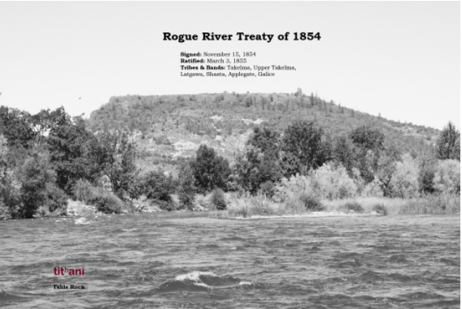
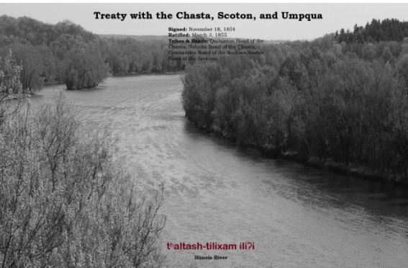
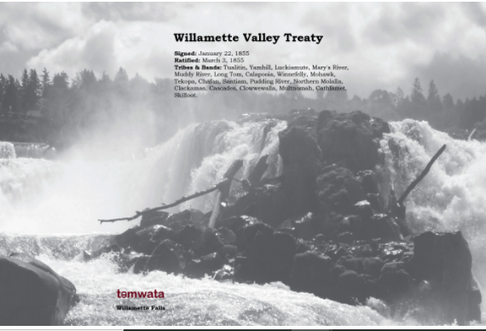

What Happened Next?
Because tribes are recognized as sovereign nations, the United States Government made treaties with the Oregon tribes regarding the land.*
The Confederated Tribes of Grand Ronde has 7 ratified treaties:
Treaty with the Umpqua-Cow Creek Band 1853
Treaty with the Rogue River 1853
Treaty with the Rogue River 1854
Treaty with the Chasta 1854
Treaty with the Umpqua and Kalapuya 1854
Treaty with the Kalapuya etc. 1855
Treaty with the Molala 1855
Notes:
*Teachers may need to review the definition of sovereignty with students

Slide 11
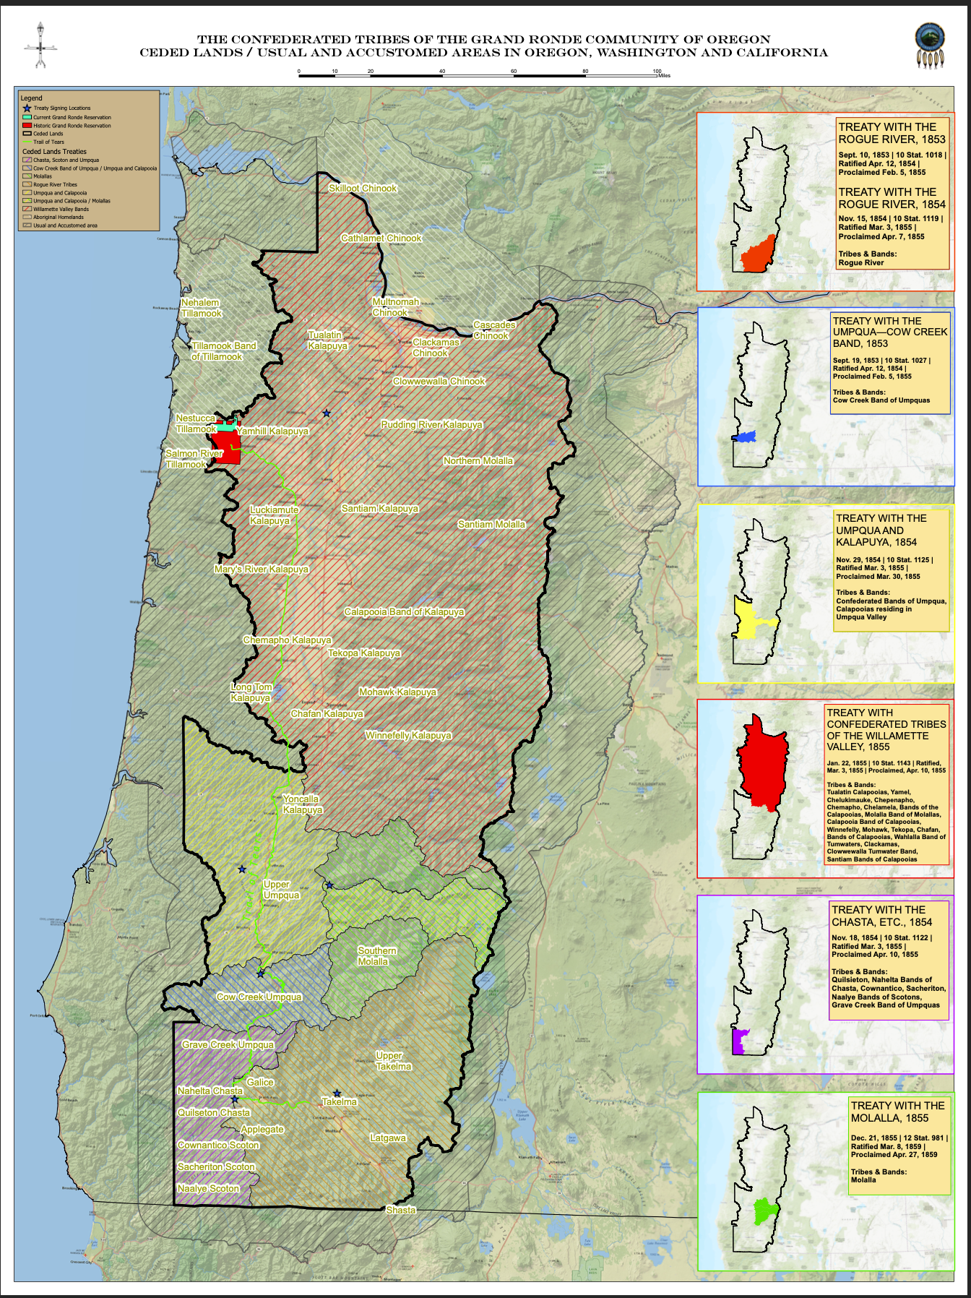
This map shows outlines of the land covered by each treaty.
Note: The land for the Treaty with the Umpqua and Kalapuya of 1854 overlaps with the land of the Treaty with the Molala of 1855.
Notes:
*A larger image of this map can be found attached to this lesson

Slide 12

Establishing the Reservation 1855-1857
The Grand Ronde Reservation began by treaty arrangements in 1853 and 1855, and was established by Executive Order on June 30, 1857. The Reservation was created in order to fulfill treaty obligations stated in the Willamette Valley Treaty (also known as Treaty with the Kalapuya etc.) in 1855.
The original Reservation contained more than 60,000 acres.
Native peoples from tribes and bands all over Oregon Territory were marched from their homelands to the Grand Ronde Reservation, where they were told they must make a new home and a new life.**
Notes:
*How do you think the Native Americans felt about being removed from their homelands?
*What complications could occur from the gathering and merging of multiple tribes/bands?

Slide 13
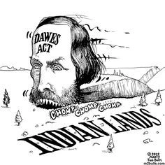
The Dawes Act of 1887
The Dawes Act of 1887 (also known as the General Allotment Act) split up the Reservation land and gave portions of it to the Native Americans living there.
“To each head of family, one-quarter of a section;
To each single person over eighteen years of age, one-eighth of a section;
To each orphan child under eighteen years of age, one-eighth of a section; and
To each other single person under eighteen years now living, or who may be born prior to the date of the order of the President directing an allotment of the lands embraced in any reservation, one-sixteenth of a section”
Notes:
*Look at the image on this slide: What message do you think the artist was trying to convey in this drawing?

Slide 14
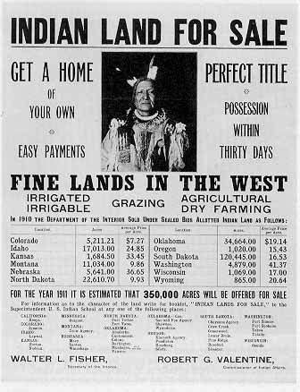
The Dawes Act of 1887
The leftover land on the Reservation would be sold to settlers for a price of $1.10 an acre.
The act states that the allotments given to the Indians would be held in trust for 25 years (meaning that the U.S. Government would continue to hold ownership and “protect” the land) for 25 years After that time, the allotment would be discharged to the Native American.*
Notes:
*This same rule did not apply for the White settlers who purchased the leftover land on the Reservation. Can you make an inference as to how the government felt towards the Native Americans versus the White settlers?
Possible Answer: The U.S. Government did not trust the Native Americans to own and manage their own land. They wanted to maintain control over the Native Americans, their resources, and their rights.

Slide 15
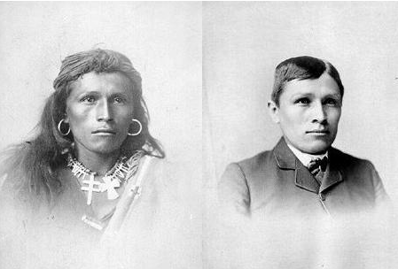
The Dawes Act of 1887
Within the Grand Ronde Reservation, 33,468 acres were allotted to 274 Native Americans.
This left 25,791 acres left over as “surplus” to be sold to settlers.
The money received from the surplus land sales was to go towards the funding of education and civilization of Indians*
“Kill the Indian, and Save the Man”*
-Capt. Richard H. Pratt on the Education of Native Americans
Notes:
*When the U.S. Government refers to the “civilization of Indians” what does that mean?
Possible Answer: Assimilation. The U.S. Government wanted the Native Americans to assimilate into White culture - live in traditional settler houses, wear settlers clothing, send their children to formal school, etc.
*Look at the quote and the image on this slide: What do you think this quote means?

