Slide 1
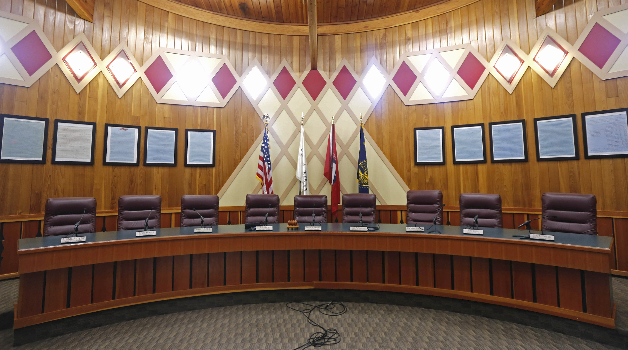
The Confederated Tribes of Grand Ronde
--------
Government

Slide 2

Vocabulary
Constitution: A plan which is developed and written for a government that represents the rights and responsibilities of the government to the people
Sovereignty: the act of having independent power, political, social and economic, or being free
Democratic Government (Democracy): Democracy is a form of government that allows the people to choose leadership. The primary goal is to govern through fair representation and prevent abuses of power.
Tribal Council: At Grand Ronde a nine member governing and decision making body elected by the Tribal membership, the General Council, responsible for upholding the tribal constitution. Tribal Council members serve three year terms. They may choose to run for re-election at the end of each three year term. The Tribal Council has a Chair, Vice Chair, and Secretary.
General Council: Enrolled members of the Confederated Tribes of Grand Ronde Community of Oregon who are eighteen (18) years of age or older

Slide 3
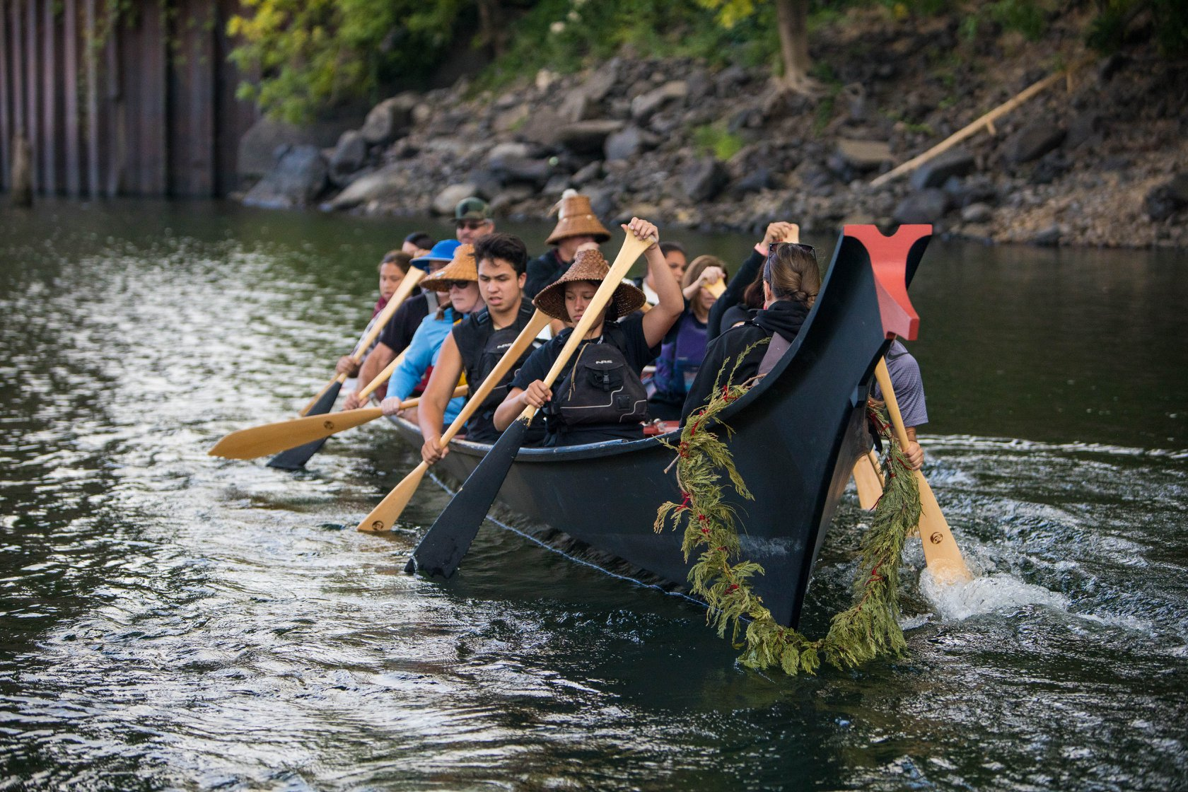
After Restoration
After the Confederated Tribes of Grand Ronde was restored on November 22, 1983 they had to decide as a people how they were going to operate (or run) their Tribe.
They wanted to make sure they, as a people, had control over their own property, people, and rights.
Grand Ronde Tribal members paddling Grand Ronde’s canoe, Stank’iya

Slide 4
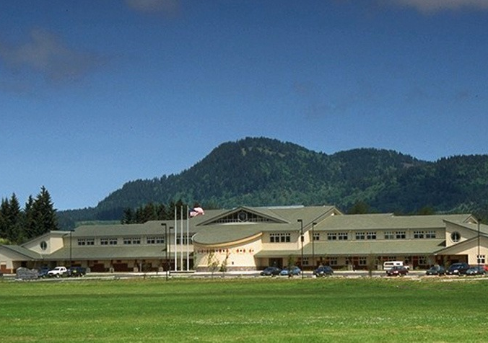
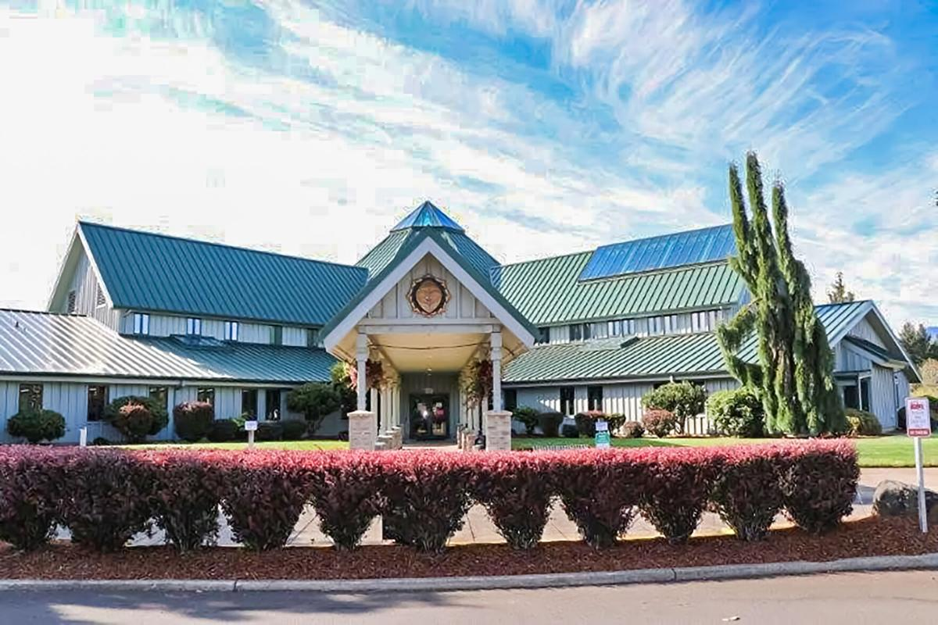
Sovereign Nation
Sovereign Nations have the right to:
Form their own government
Determine membership or citizenship
Make and enforce laws
Regulate trade within borders
Govern the conduct of members and non-members on tribal lands
Form alliances with other nations
Notes:
Vocabulary Definition:
Sovereignty- the act of having independent power, political, social and economic, or being free
Images:
(Top) Grand Ronde Governance Building- https://www.hge1.com/confederated-tribes-of-grand-ronde/
(Bottom) Grand Ronde Health and Wellness Center- https://www.polkio.com/news/casino-tries-not-to-gamble-with-people-s-health/article_ba7718d0-fd2d-11ea-b2ba-67215be27a75.html

Slide 5
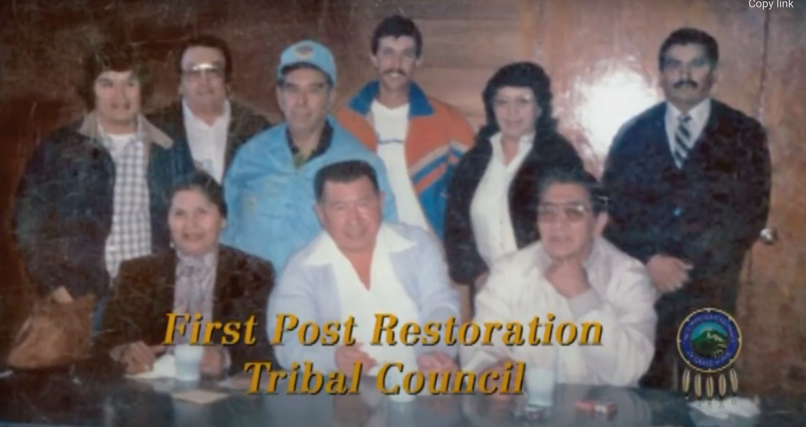
Form their Own Government
The Confederated Tribes of Grand Ronde has a democratic government - the General Council votes for who will be on Tribal Council
Tribal Council
Gives power to multiple people, not just one person
These are people elected by the Tribal General Council to govern the Confederated Tribes of Grand Ronde.
A total of 9 members are on Tribal Council.
Elections are held each year and members of Tribal Council hold 3 year terms.
Tribal Council is responsible for upholding the Grand Ronde constitution.
The Tribal Council also has a Chair, Vice Chair, and Secretary
First Post Recreation Tribal Council: Kathryn Harrison, Dean Mercier, Candy Robertson, Frank Harrison, Daryl Mercier, Mark Mercier, Russ Leno, Merle Leno, & Henry Petite
Notes:
Ask students what they think a Chair member may do? Vice Chair? Secretary?
Chair – spokesperson for Tribal Council & Tribe & runs tribal meetings
Vice Chair has similar roles in the absence of a Chair
Secretary typically reads minutes & resolutions created by Tribal Council
Current Tribal Council: https://www.grandronde.org/government/

Slide 6
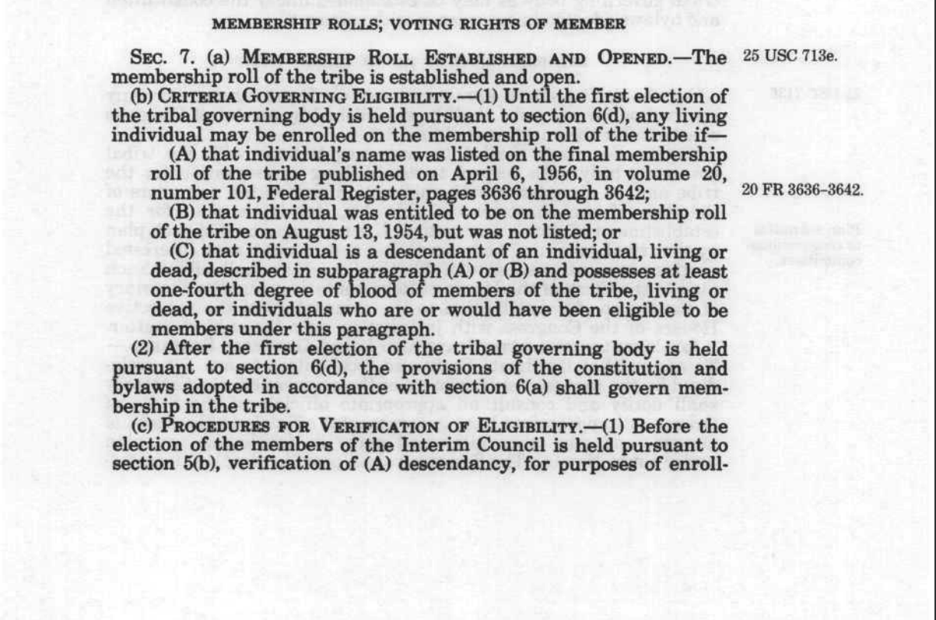
Determine Membership or Citizenship
Native Americans are U.S. citizens and are entitled to the same legal rights and protections under the U.S. Federal Constitution that all other U.S. citizens enjoy but Native Americans may also be members of self-governing tribes and also have legal rights and protections under the Tribal Government Constitution.
Membership Requirements for CTGR:
Person cannot be enrolled in another recognized tribe, band or community
Person’s name appears on the official tribal membership roll prepared under the Grand Ronde Restoration Act or is a descent from any person who was named on this roll
Person possess one-sixteenth (1 / 16) or more degree Indian blood quantum of The Confederated Tribes of Grand Ronde

Slide 7
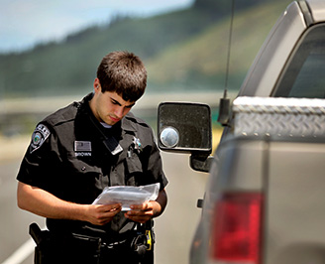
Make and Enforce Laws
Writing a Constitution: A written set of guidelines for a government
May include:
Laws
Rules
Elections
Roles & Responsibilities of elected officials
Tribal Court:
Includes a Chief Judge
Limited Power: no criminal hearings
Tribal Police:
“The mission of the Confederated Tribes of Grand Ronde Tribal Police Department is to uphold the constitutional sovereignty and customs of the Confederated Tribes of Grand Ronde; to protect life and property, and to promote and preserve peace within the Grand Ronde Community.”
Notes:
Explore The Confederated Tribes of Grand Ronde Constitution:
https://narf.org/nill/constitutions/confederated_grand_ronde/index.html
Please explore the link below to learn more about The Confederated Tribe of Grand Ronde’s Government: https://www.grandronde.org/government/
Powers of Tribal Court: enforcement of the Indian Child Welfare Act of 1978 and the American Indian Religious Freedom Act of 1978, as well as the power to review and overturn tribal legislative and executive actions for violation of this Constitution or the Indian Civil Rights Act of 1968

Slide 8
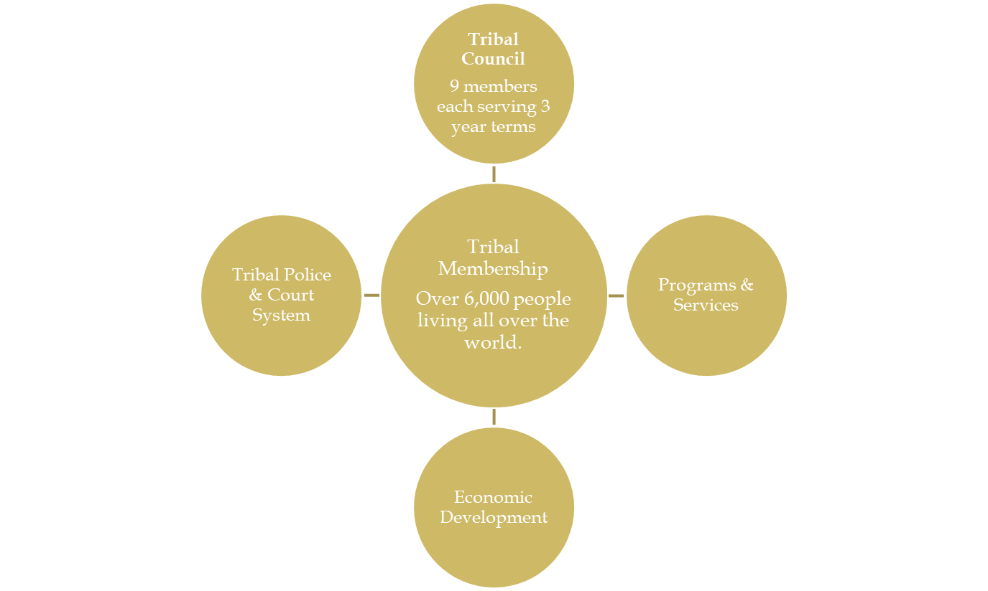
Elected by the membership and governs & leadership to the Tribe.
The Tribe has its own police officers and tribal court system.
Programs include Education, Health, Housing, and many others.
The Tribe has several different ways to fund its governmental functions (timber sales and casino revenue)
Notes:
Tribal Membership – currently over 6,000 members are enrolled within Grand Ronde tribe. Although many of these members live in Oregon, there are members located throughout the US. Members 18 years or older can vote during a Tribal Council election.
Tribal Council – consists of 9 members & each member serves 3 year terms (they can be reelected for unlimited amount of terms). Elections are held every year as members serve alternate terms (rotating so that every year 3 members are up for elections).
Tribal Policy & Court System – provides a service of safety & equity at the Tribe.
Programs & Services – offered to the membership and include education, health care, housing, social services, natural resources, and many others. Some of these programs can also be accessed by community members or tribal spouses.
Economic Development – tribes earn their living through a variety of ways – engaging in a variety of economic opportunities including timber sales, casino, federal grants and funding, and other small and large commercial businesses. Some, but not all Tribes, have overcome their social and economical means to adapt to the larger society.
The Tribe has its own police officers and tribal court syste

Slide 9
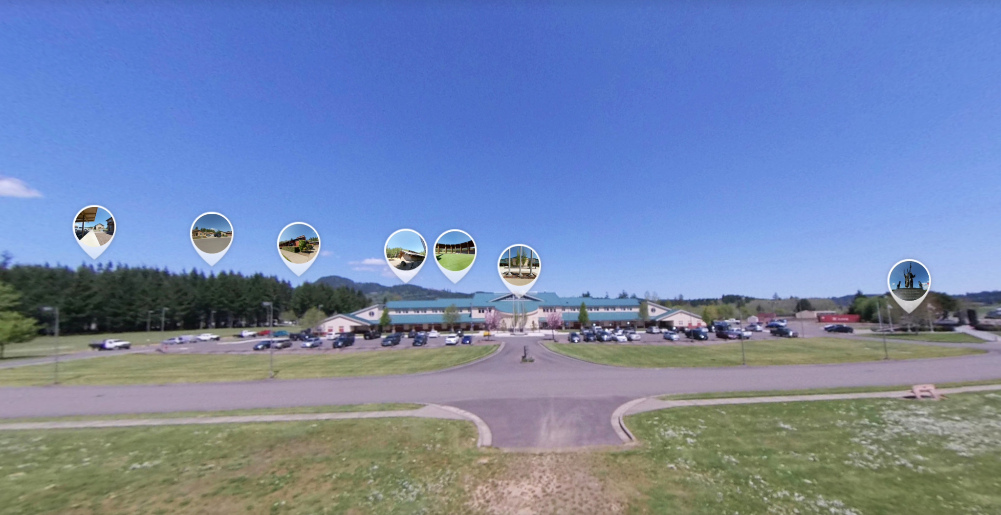
Explore the CTGR Campus
https://roundme.com/tour/433498/view/1480429/

