Slide 1
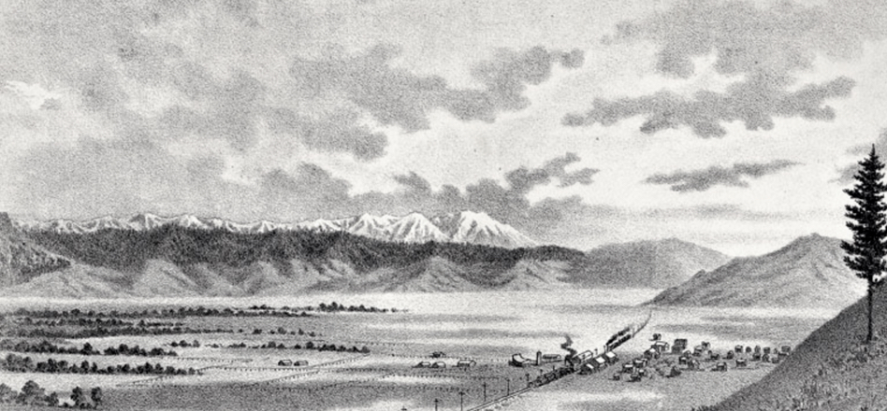
Grand Ronde
Trail of Tears
The Removal and Relocation of Oregon Tribes

Slide 2

Vocabulary
Remove (munk-ɬaq): the action of taking away or abolishing something unwanted
Relocation: the action of moving to a new place and establishing one's home or business there
Reservation: land held for special use, in this case a place for Indians
Notes:
Chinuk Words:
remove - munk-ɬaq

Slide 3
The Removal of Tribes (1855-1857)
More than 30 Tribes and Bands were gathered from Western Oregon, Southwestern Washington, and Northern California were removed and relocated to the Grand Ronde Indian Reservation - creating what we know as “The Confederated Tribes of Grand Ronde”
The most memorable of these relocations is what the Tribal community today calls “Grand Ronde’s Trail of Tears.”
The Rogue River and Chasta Tribes were the first to be removed (ɬaq) from their aboriginal lands. They were joined by members of other Tribes and bands as the march passed other tribal homelands.
George H. Ambrose was the Indian agent charged with carrying out the march. His journals have been published to share this story.
Notes:
Chinuk Words:
removed - ɬaq

Slide 4
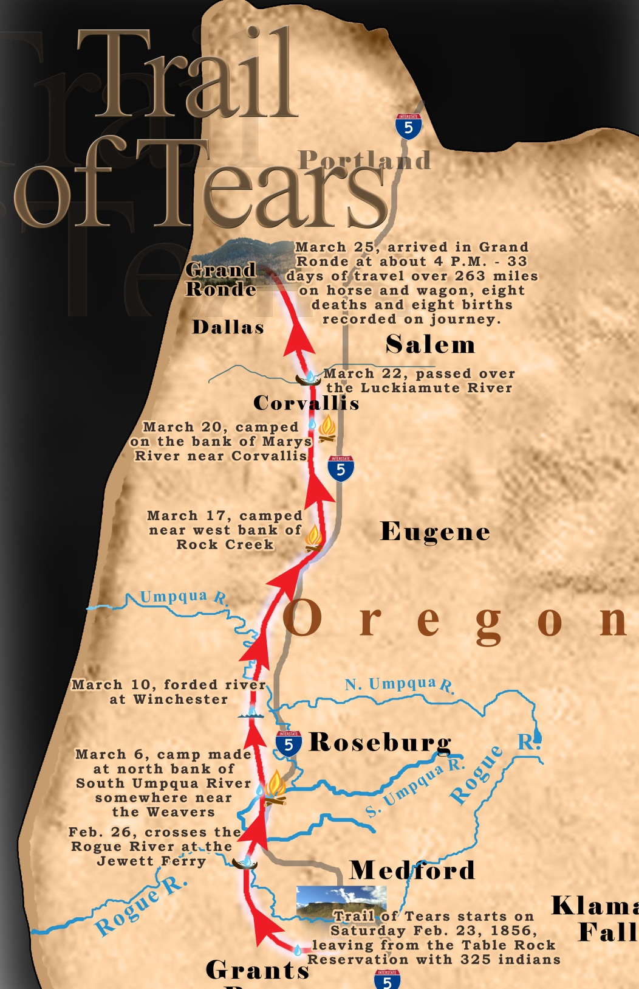
Timeline:
February 23, 1856: 325 Native Americans left the Table Rock Reservation.
March 25, 1856: Arrived at the Grand Ronde Reservation around 4PM.
33 days (sans)
263 miles
8 deaths (chaku-hilu)
8 births (t’ɬap-tǝnas)
Notes:
Chinuk Words:
days (sans)
to die (chaku-hilu)
birth (t’ɬap-tǝnas)

Slide 5
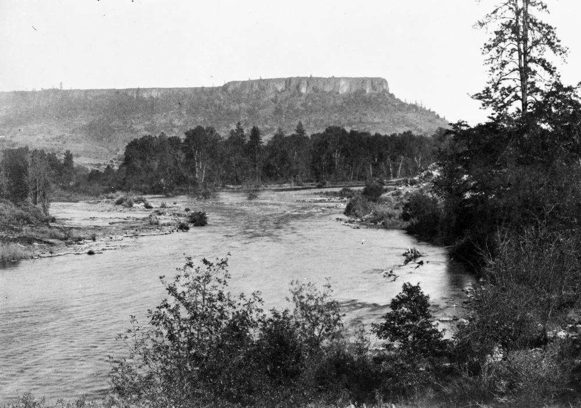
Grand Ronde’s Trail of Tears
Native people were gathered up near Ft. Lane, at the base of Table Rock (near present day Medford) and forced to march during the wintertime (k^{h}ul-iliʔi) months beginning February 23 through March 25, 1856, to the Grand Ronde (shawash-iliʔi) Indian Reservation.
During this march, 8 people died and 8 babies were born. The military officers supervising the march were able to state that “they had arrived with the number of people they had left with.”
Notes:
Chinuk Words:
Grand Ronde - shawash-iliʔi
wintertime - k^{h}ul-iliʔi
Background Image: Table Rock

Slide 6

Explore Ambrose’s Journal Entries
Visit the website: https://www.grandronde.org/history-culture/
OR
Scan the QR Code on this page
Scroll down to “Our Land”
Use the slider to read journal entries from dates along the trail

Slide 7
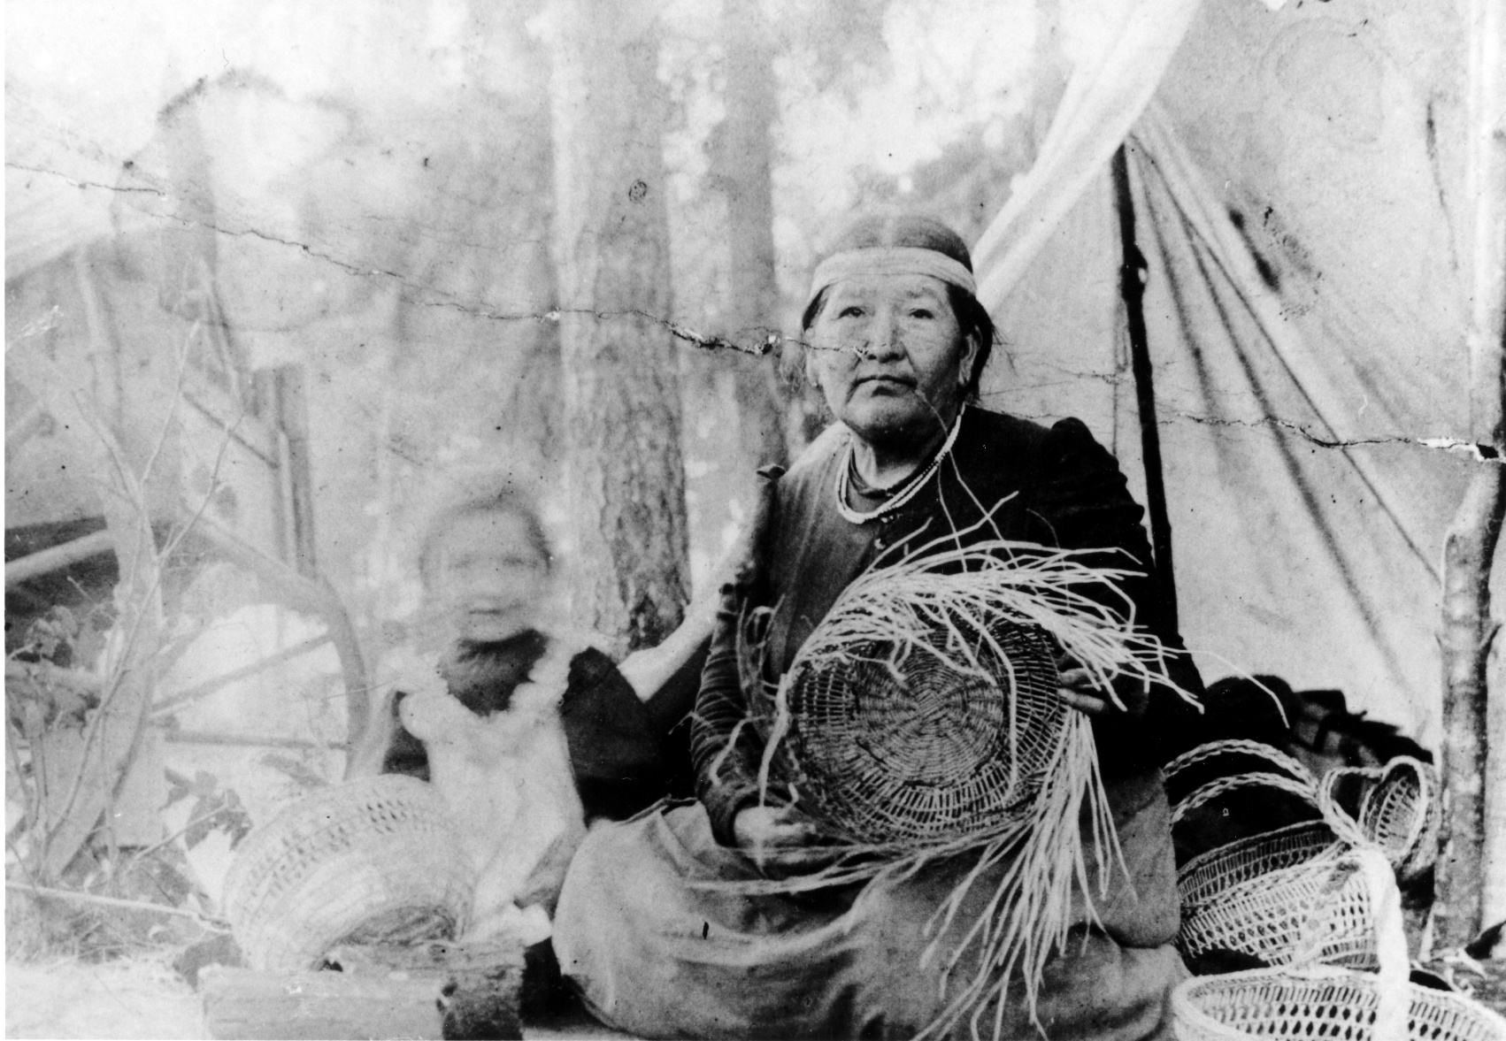
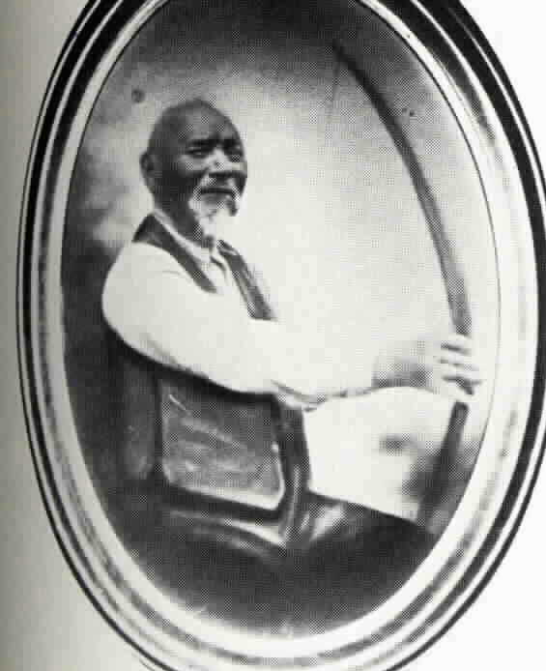
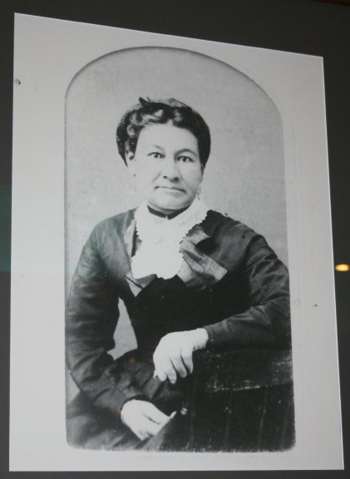
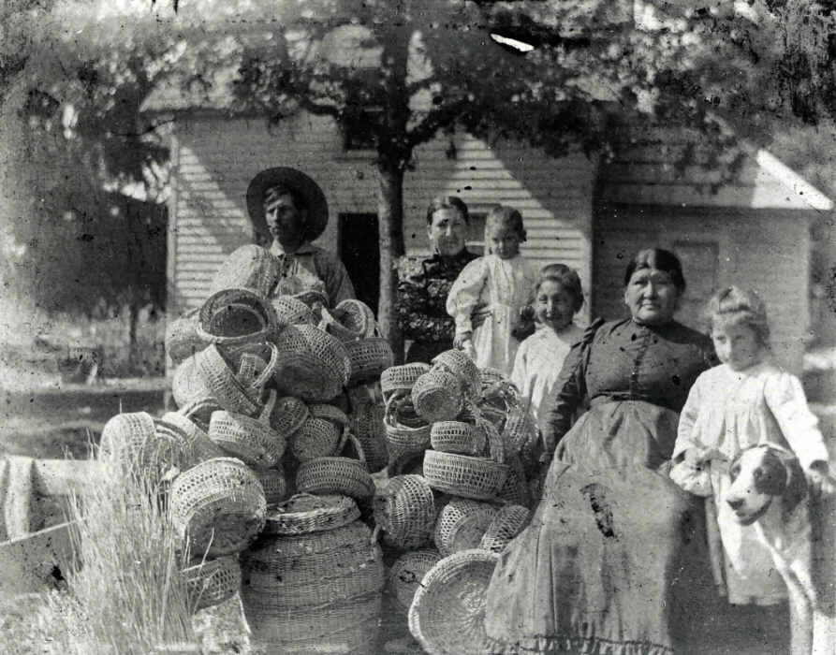
Faces of the Trail
Notes:
Faces of the Trail:
Men, Women, & Children traveled the 33 days by foot or horse/wagon.
Some of these individuals include:
Gertrude Mercier and Martha Jane Sands (top left image)
The Hudson Family (bottom left image)
Solomon Riggs (center)
Jenny Riggs (right image)

Slide 8
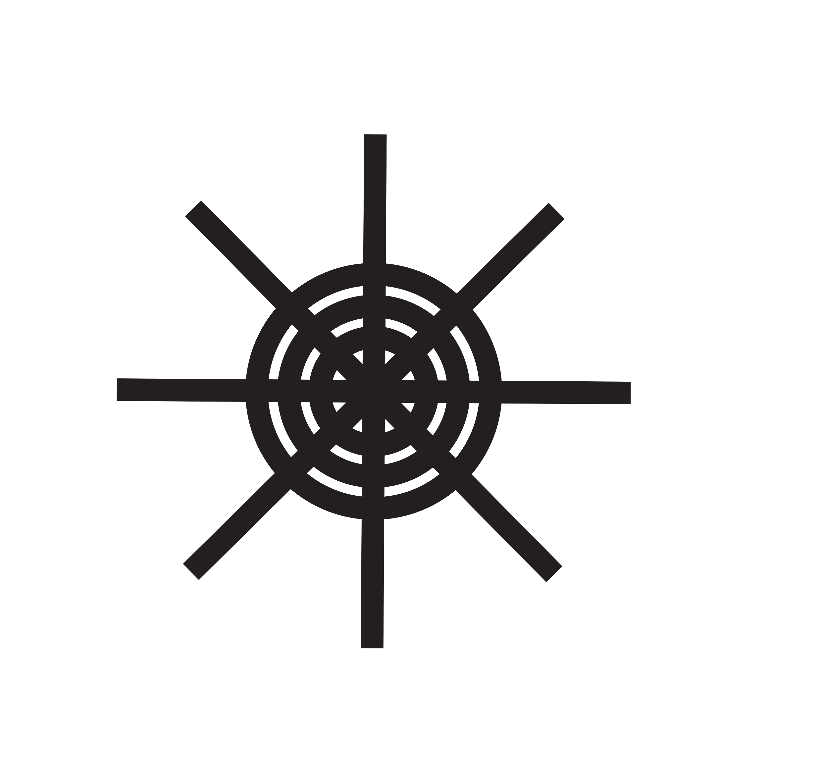
Think & Discuss
What would it be like to be taken from your home permanently and forced to go to a reservation?
How would you feel?
What are some things you would be most worried about?
What do you think this quote means?
“Left behind were the bones of parents, grandparents, and ancestors, ages-old villages and fisheries, and a way of life well-tuned to the rhythms of a beautiful land.”
Notes:
ADD SPEAKER NOTES

Slide 9
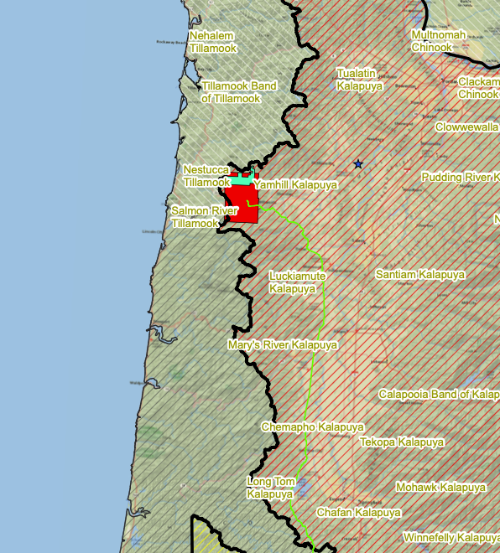
The Grand Ronde Reservation
The Reservation was begun by treaty arrangements in 1854 and 1855 and established by Executive Order on June 30, 1857.
The original Reservation contained more than 60,000 acres (red box on map)
The Reservation was located on the eastern side of the coast range on the headwaters of the South Yamhill River, about 60 miles southwest of Portland and about 25 miles from the ocean.

Slide 10
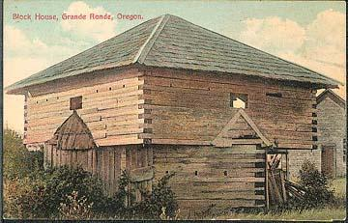
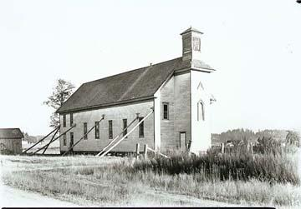
Early Reservation
Fort Yamhill was established and manned by the U.S. Army.
The soldiers were responsible for keeping Indians on the Reservation and white settlers off the Reservation.
The area of this fort is now an Oregon State Park

Slide 11
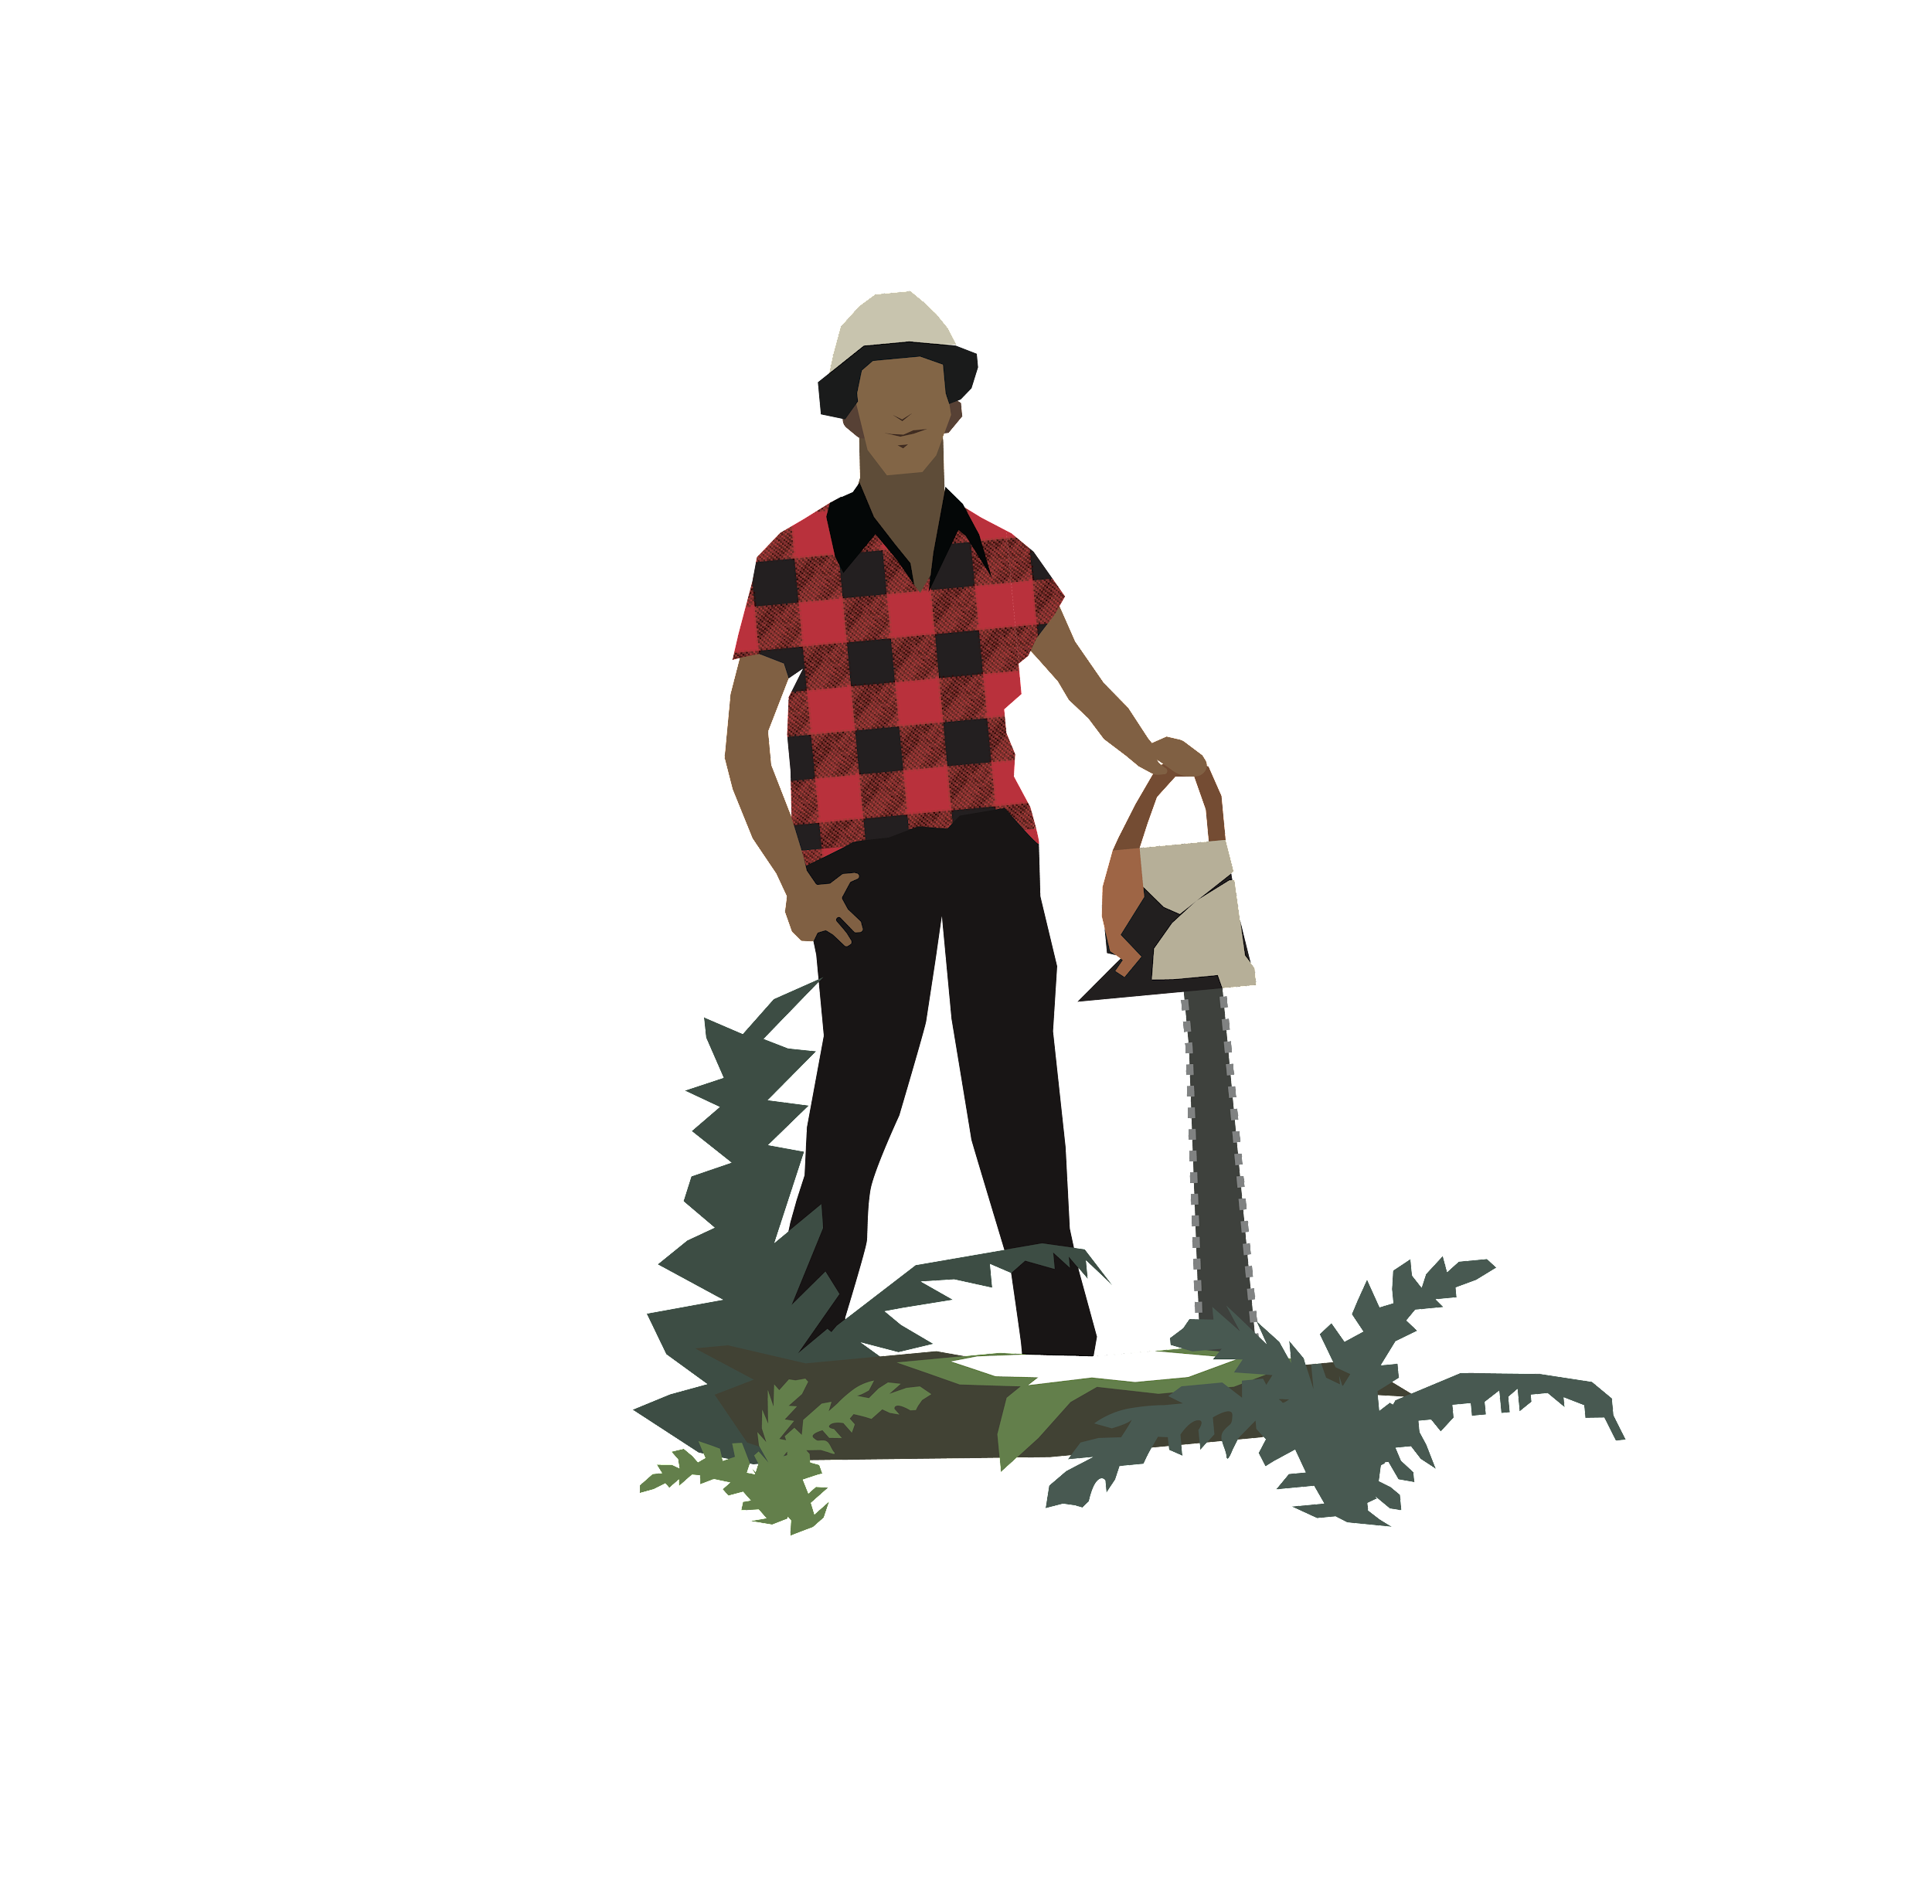
Life on the Reservation
There were few jobs at the Reservation and in almost every job, Native Americans were paid ½ wages.
Many people left the Reservation to work in agriculture or to find jobs in other areas.
Many men worked in logging.
Others worked in hops and bean fields or in canneries.

Slide 12
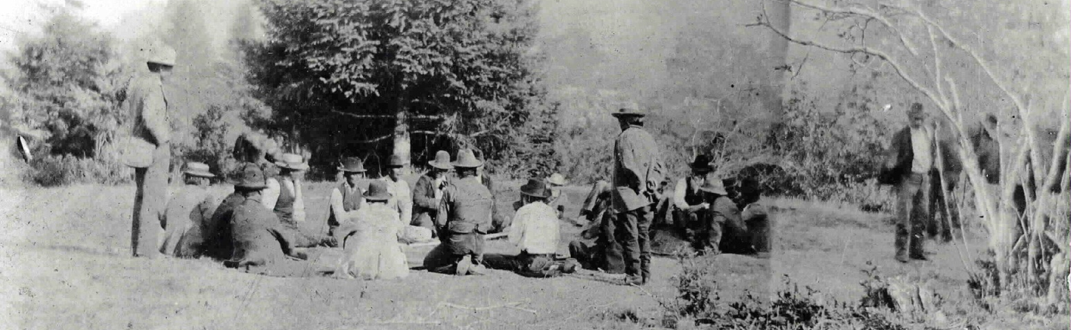
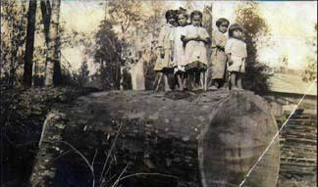
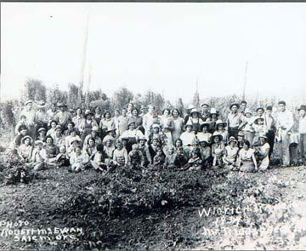
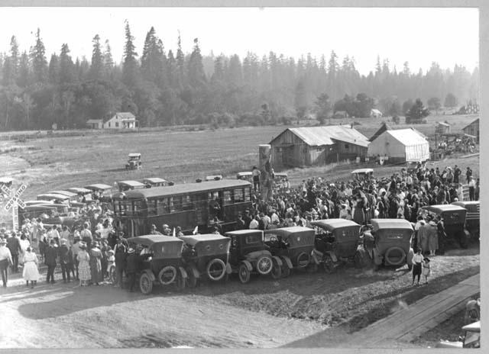
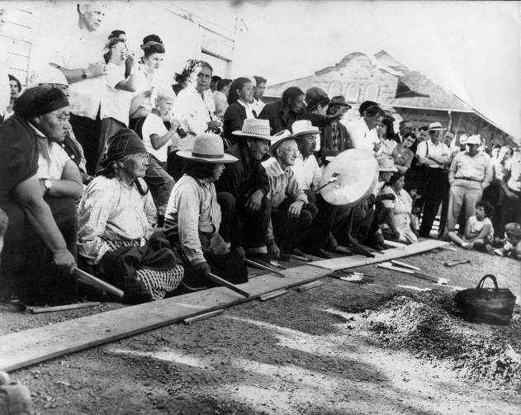
Lifestyle Changes
Tribal members adapted to the changing times.
They were not allowed to participate or show any piece of their culture
Many inter-tribal marriages took place (marriages between members of separate tribes/bands)
Tribal people now have relations at nearly all Reservations in Oregon.

