Slide 1
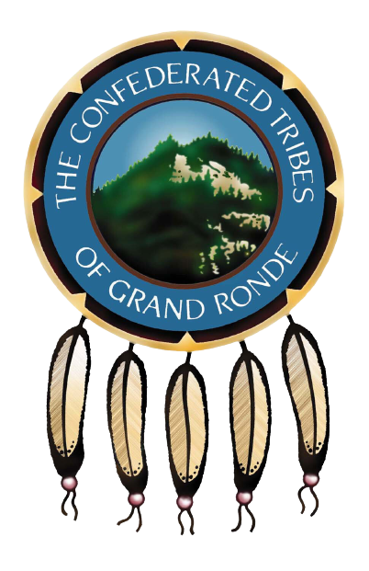
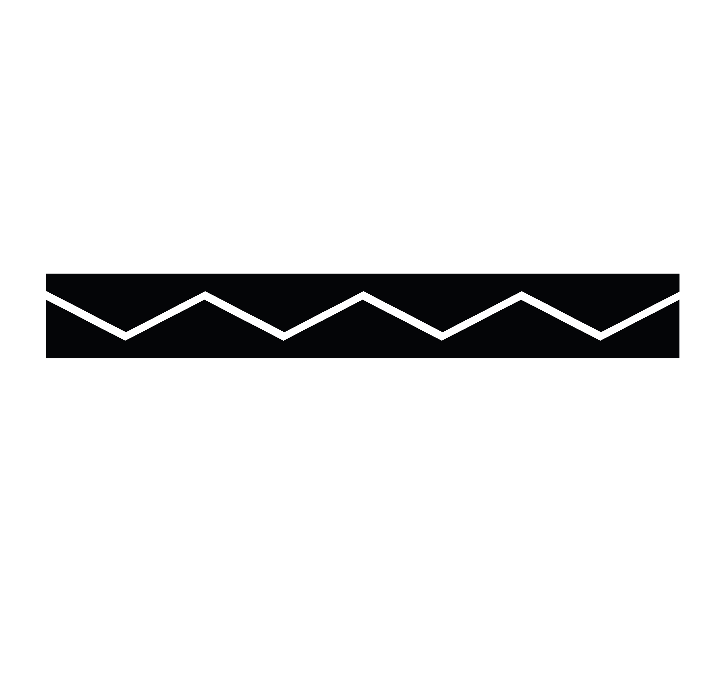
The 5 Principal Tribes
EXPLORING THE GRAND RONDE (shawash-iliʔi) TRIBAL LOGO AND THE 5 TRIBES IT STANDS TO REPRESENT
Notes:
Chinuk Words:
Grand Ronde- shawash-iliʔi

Slide 2
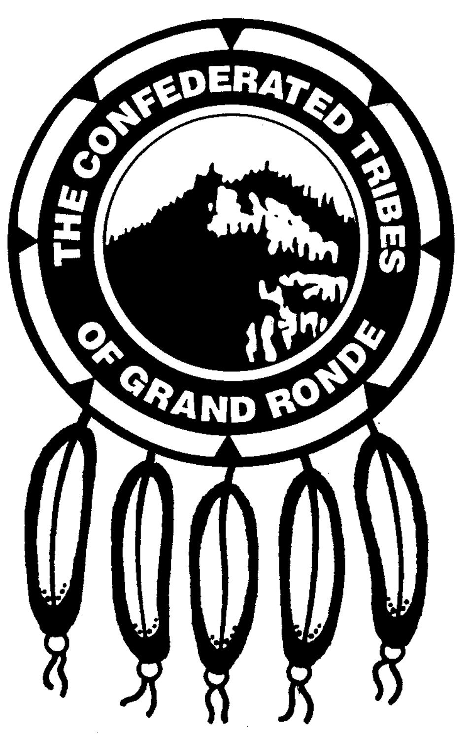
The Confederated Tribes of Grand Ronde Tribal Logo
Logo: a graphic representation or symbol of a company/organization name
The CTGR Tribal Logo was designed by Grand Ronde Tribal Member, Roy Harrison – son of Tribal leader and past Tribal Council member Kathryn Harrison

Slide 3

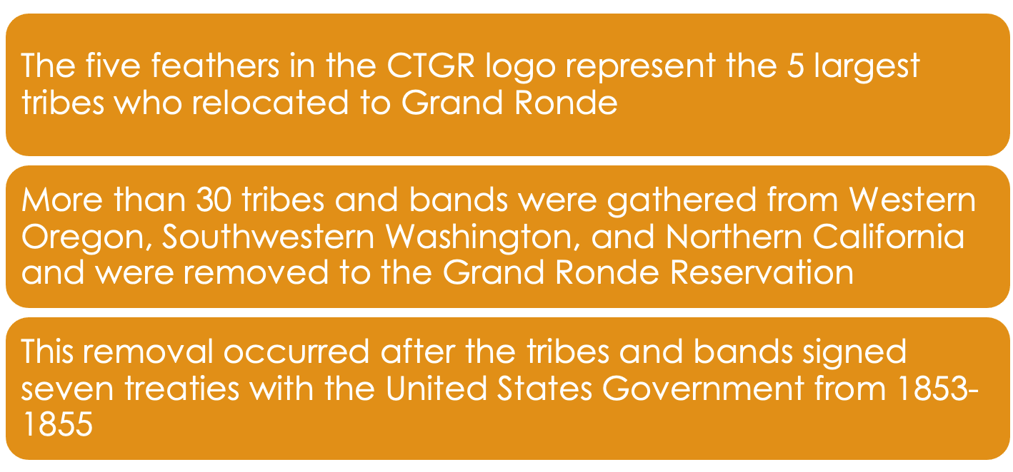
The Five Feathers
(qwinǝm) (kǝlǝkǝlǝ-tipsu)
Notes:
Chinuk Words:
five (qwinǝm)
feathers (kǝlǝkǝlǝ-tipsu)

Slide 4
The 5 Largest Tribes
Molalla - molala
Kalapuya - k’alap^{h}uya
Umpqua - ampkwa
Chasta Costa - chasti
Rogue River - inatay-tilixam
Notes:
Chinuk Words:
Molalla (molala)
Kalapuya (k’alaphuya)
Umpqua (ampkwa)
Chasta Costa (chasti)
Rogue River (inatay-tilixam)
Additional:
Tribes-people (tilixam)

Slide 5
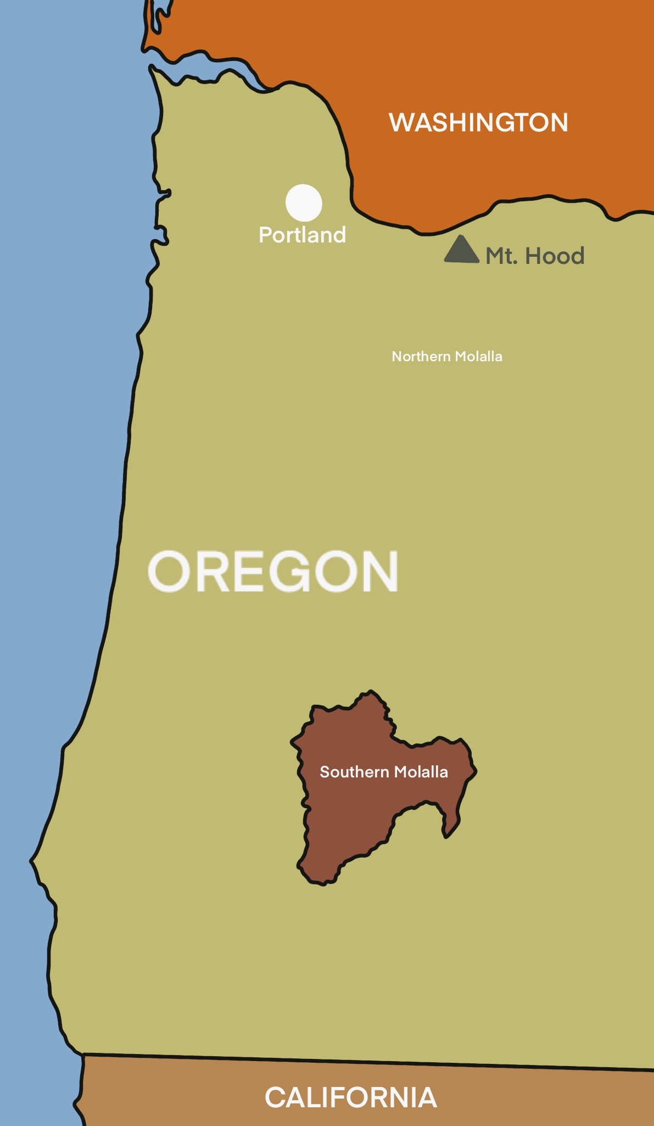

Molalla
mow-laa-luh
Notes:
Click orange hyperlink to hear pronunciation

Slide 6
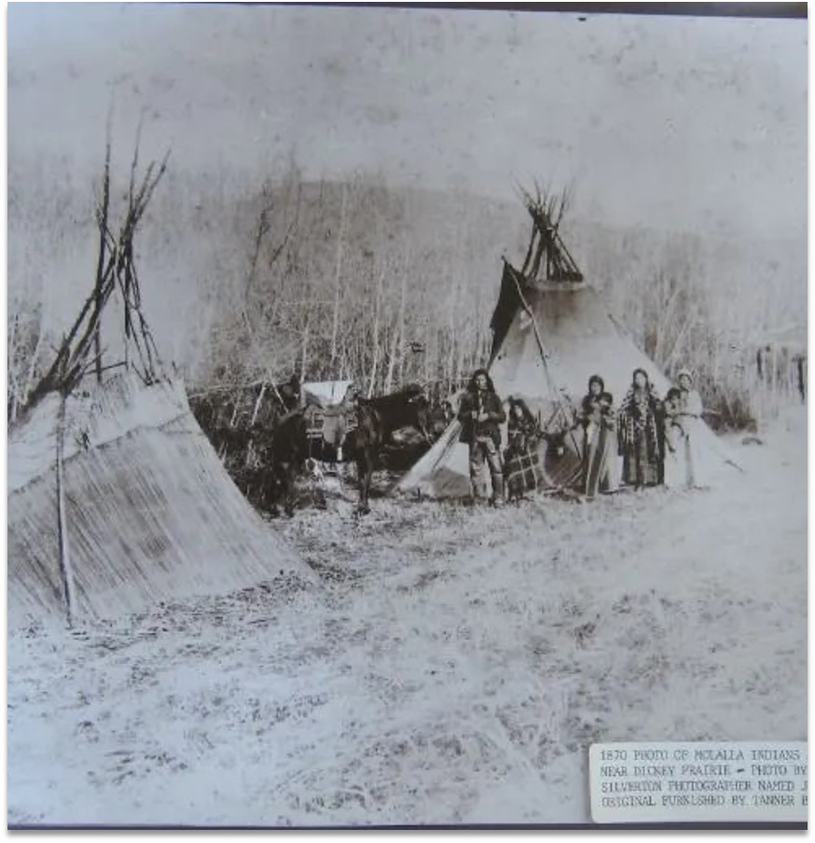
The Northern Molallas
Birthplace: The Northern Cascades in Oregon, near Mt. Hood
In the winter, the Northern Molalla had villages (t^{h}awn) from Mt. Hood to present-day Oregon City and just east of Salem to the foot of Mt. Jefferson
Housing: homes made from mud, cedar, and hemlock
Travel: used dugout canoes (kǝnim) and horses (k^{h}iyutǝn) (early 1800s)
Notes:
Chinuk Words:
village (t^{h}awn)
canoe (kǝnim)
horse (k^{h}iyutǝn)

Slide 7
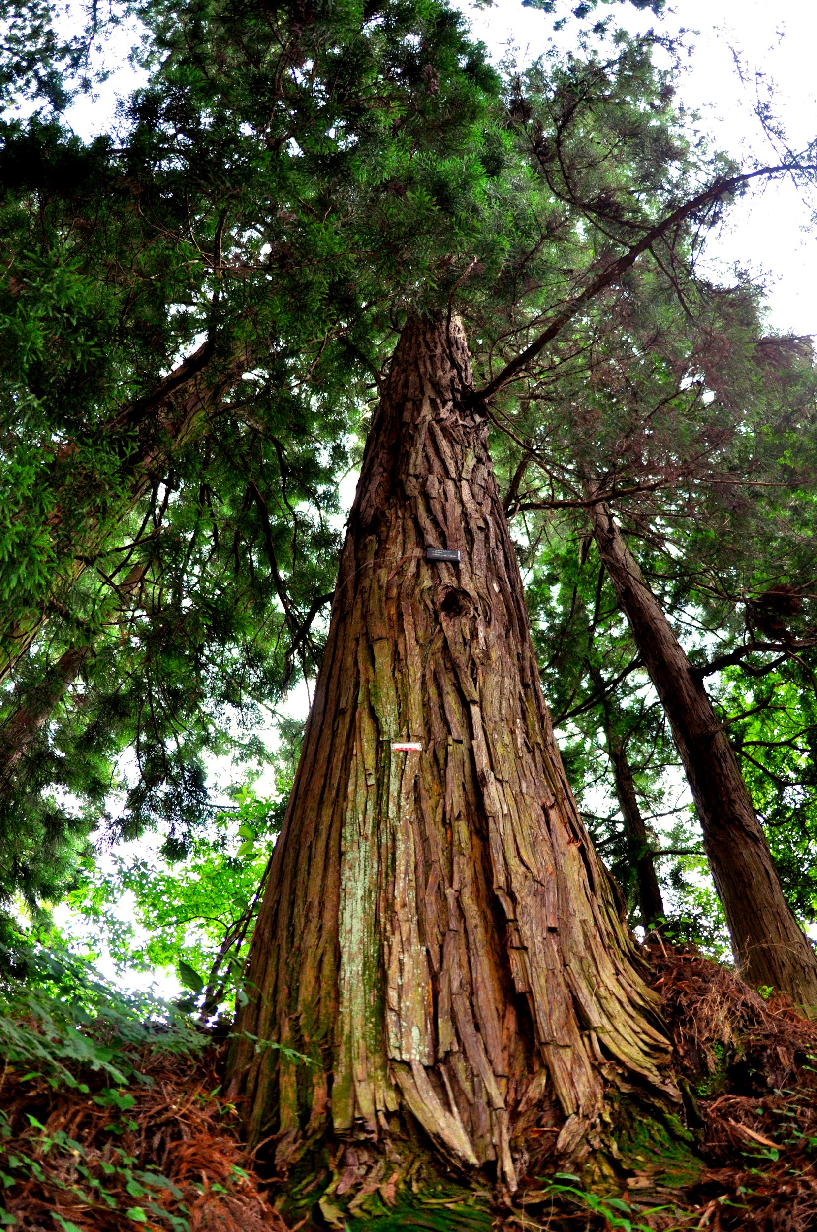
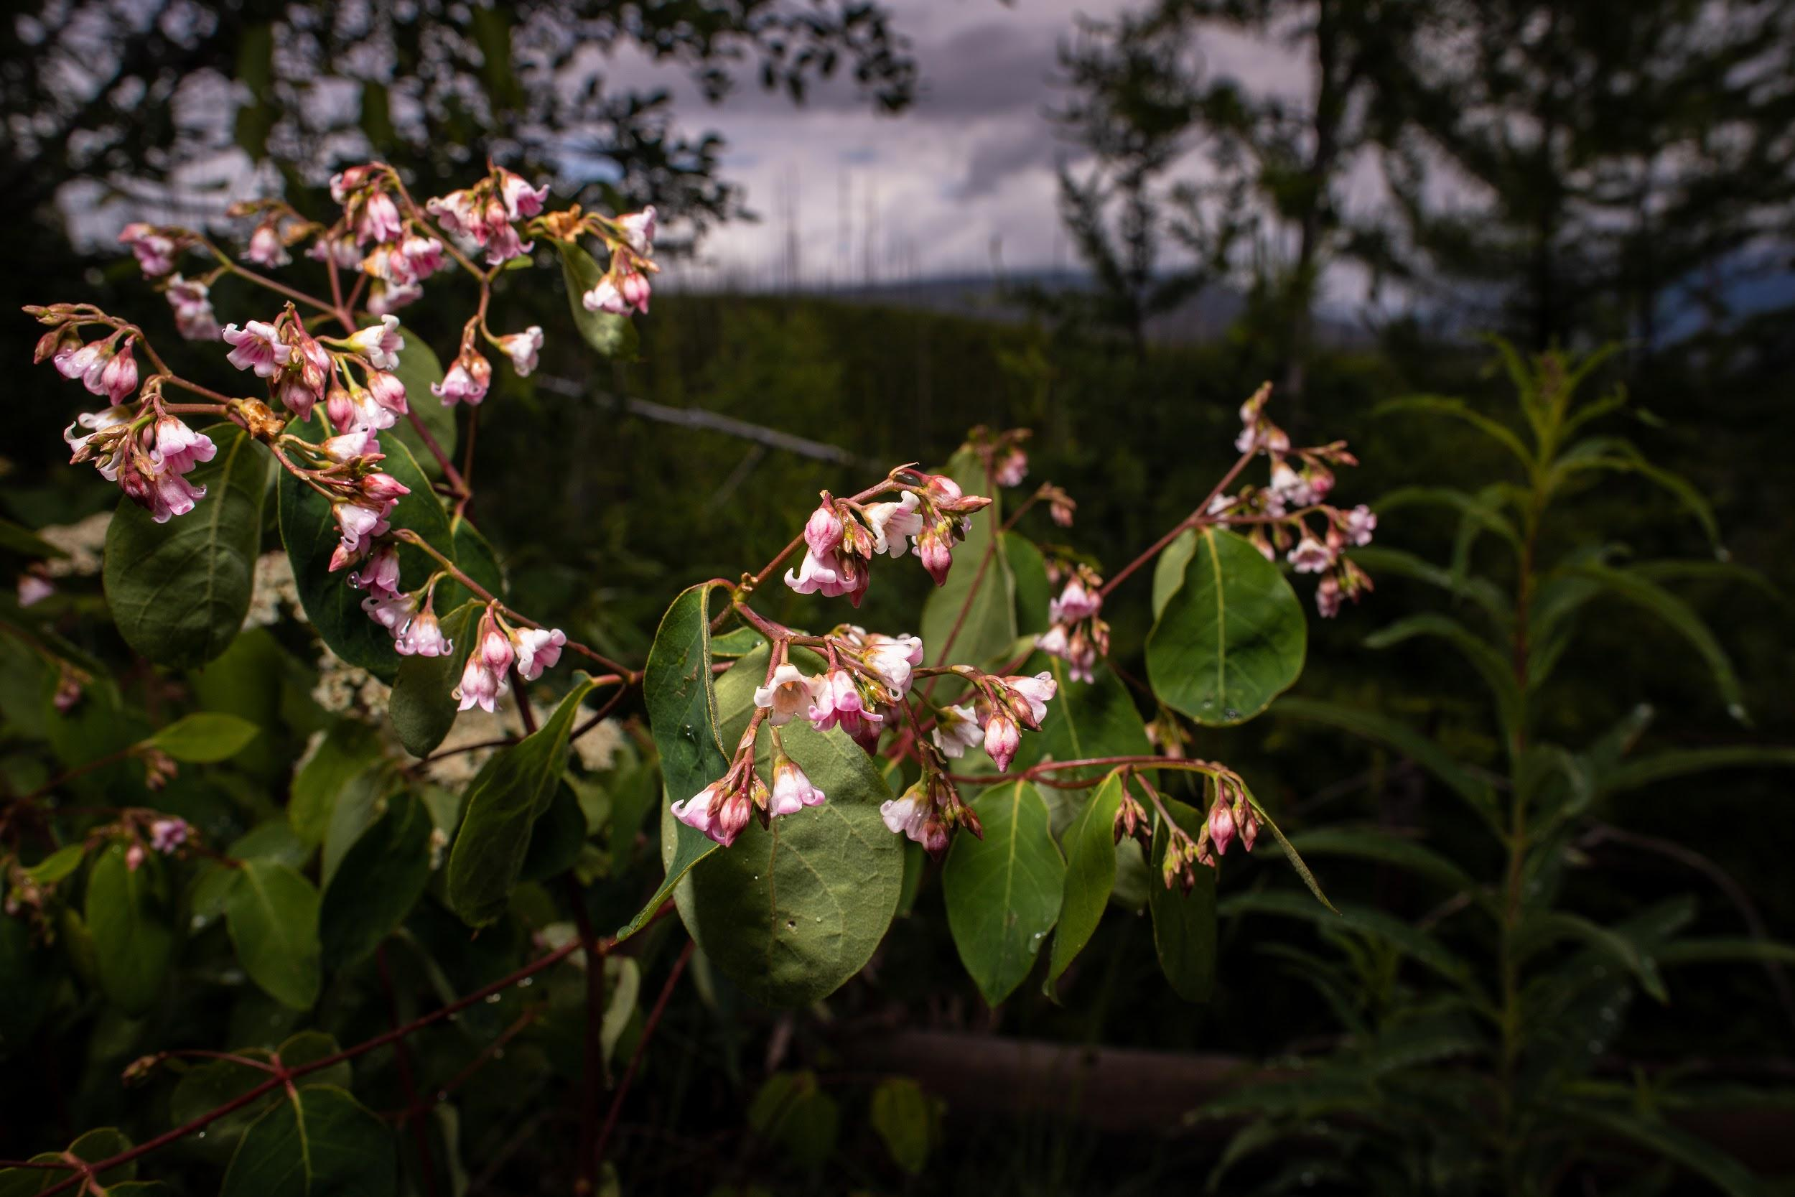
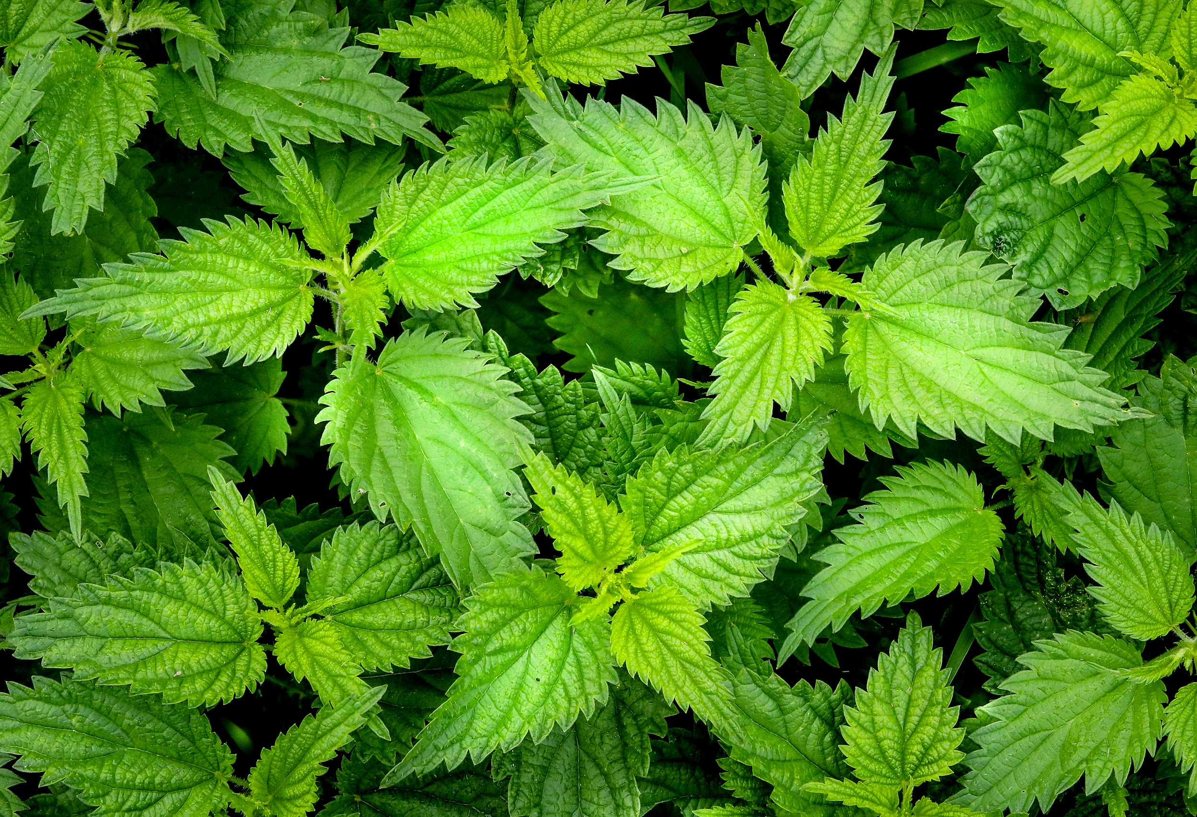
The Southern Molallas
Cedar
Dogbane
Part of the tribes and bands of the Umpqua Basin
Estimated at 500 in number
Hunting & Gathering:
Larger game animals (elk - mulak, deer - mawich, bear - itsx̣ut)
Masters of the bow & arrow
Created handmade rope traps to catch deer along the trails. Ropes were traditionally made from cedar, dogbane, or stinging nettles
Stinging Nettles
Notes:
Chinuk Words:
elk (mulak)
deer (mawich)
bear (itsx̣ut)

Slide 8
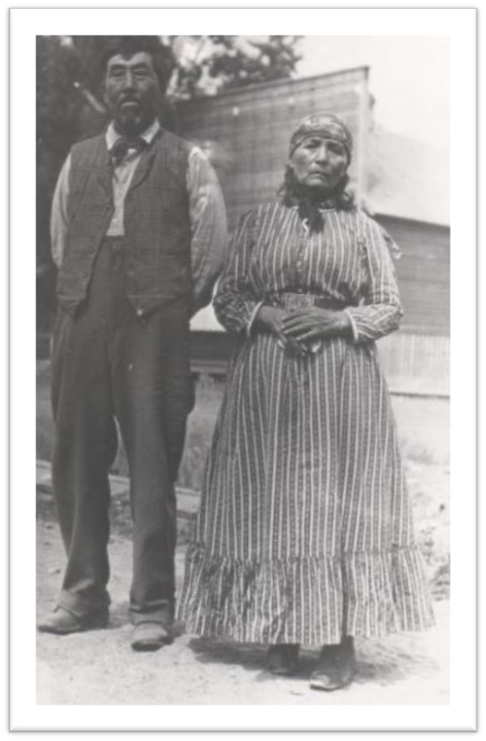
Important Individuals
Molalla Kate
Known for her baskets (upqwǝna) , stringing bead necklaces, baking bread, and many other skills
Was thought to be an Native American doctor
Sister to Henry Yelkis
Henry Yelkis
A Molalla Chief who signed the Willamette Valley Treaty in 1855.
Lived most of his life at Dickey Prairie
Notes:
Chinuk Words:
basket (upqwǝna)

Slide 9
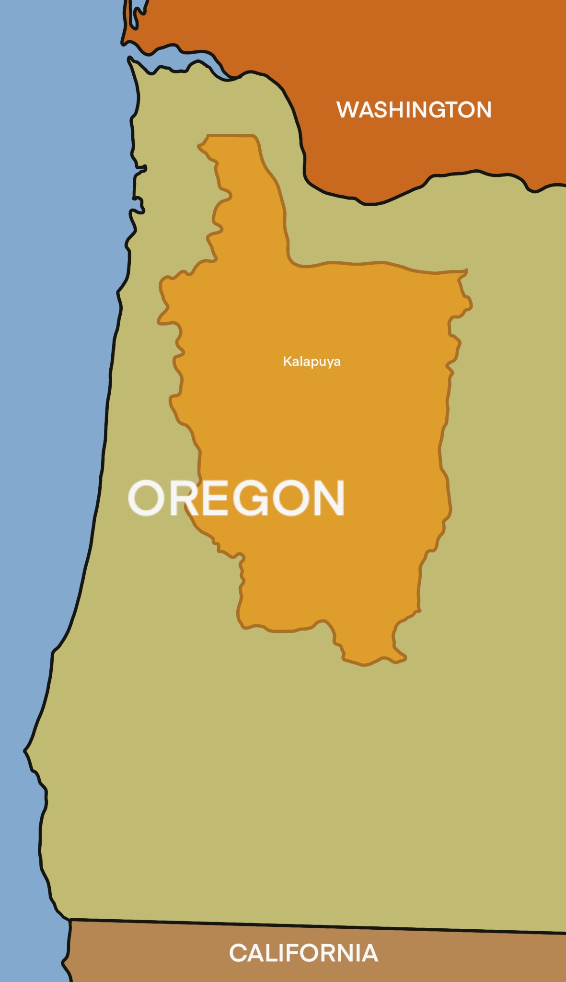
Kalapuya
cal-uh-poo-yuh
Notes:
Click orange hyperlink to hear pronunciation

Slide 10
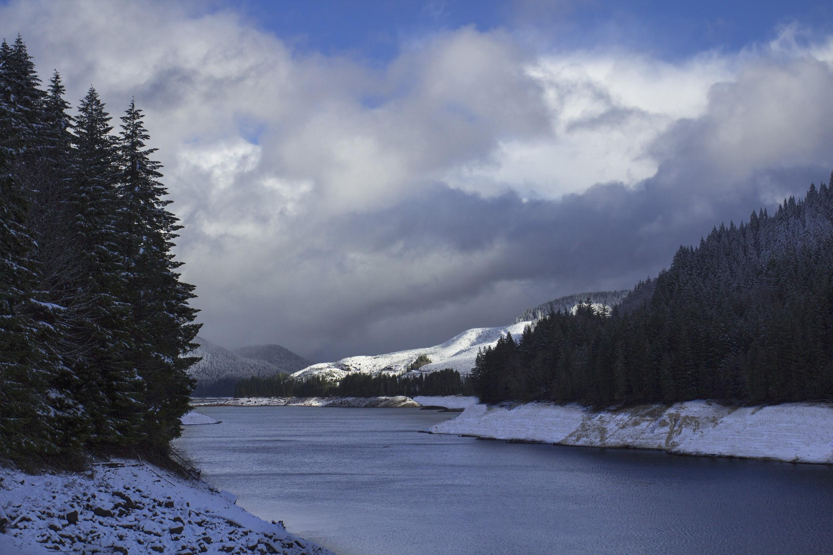
Kalapuya
Location: Covered much of the Willamette Valley – lived in permanent homes during the winter and traveled throughout the warmer months
Estimated 20,000 in number (population)
Travel: The Kalapuya traveled to harvest, hunt, fish, and trade with their neighboring tribes/bands (especially the Molalla)

Slide 11
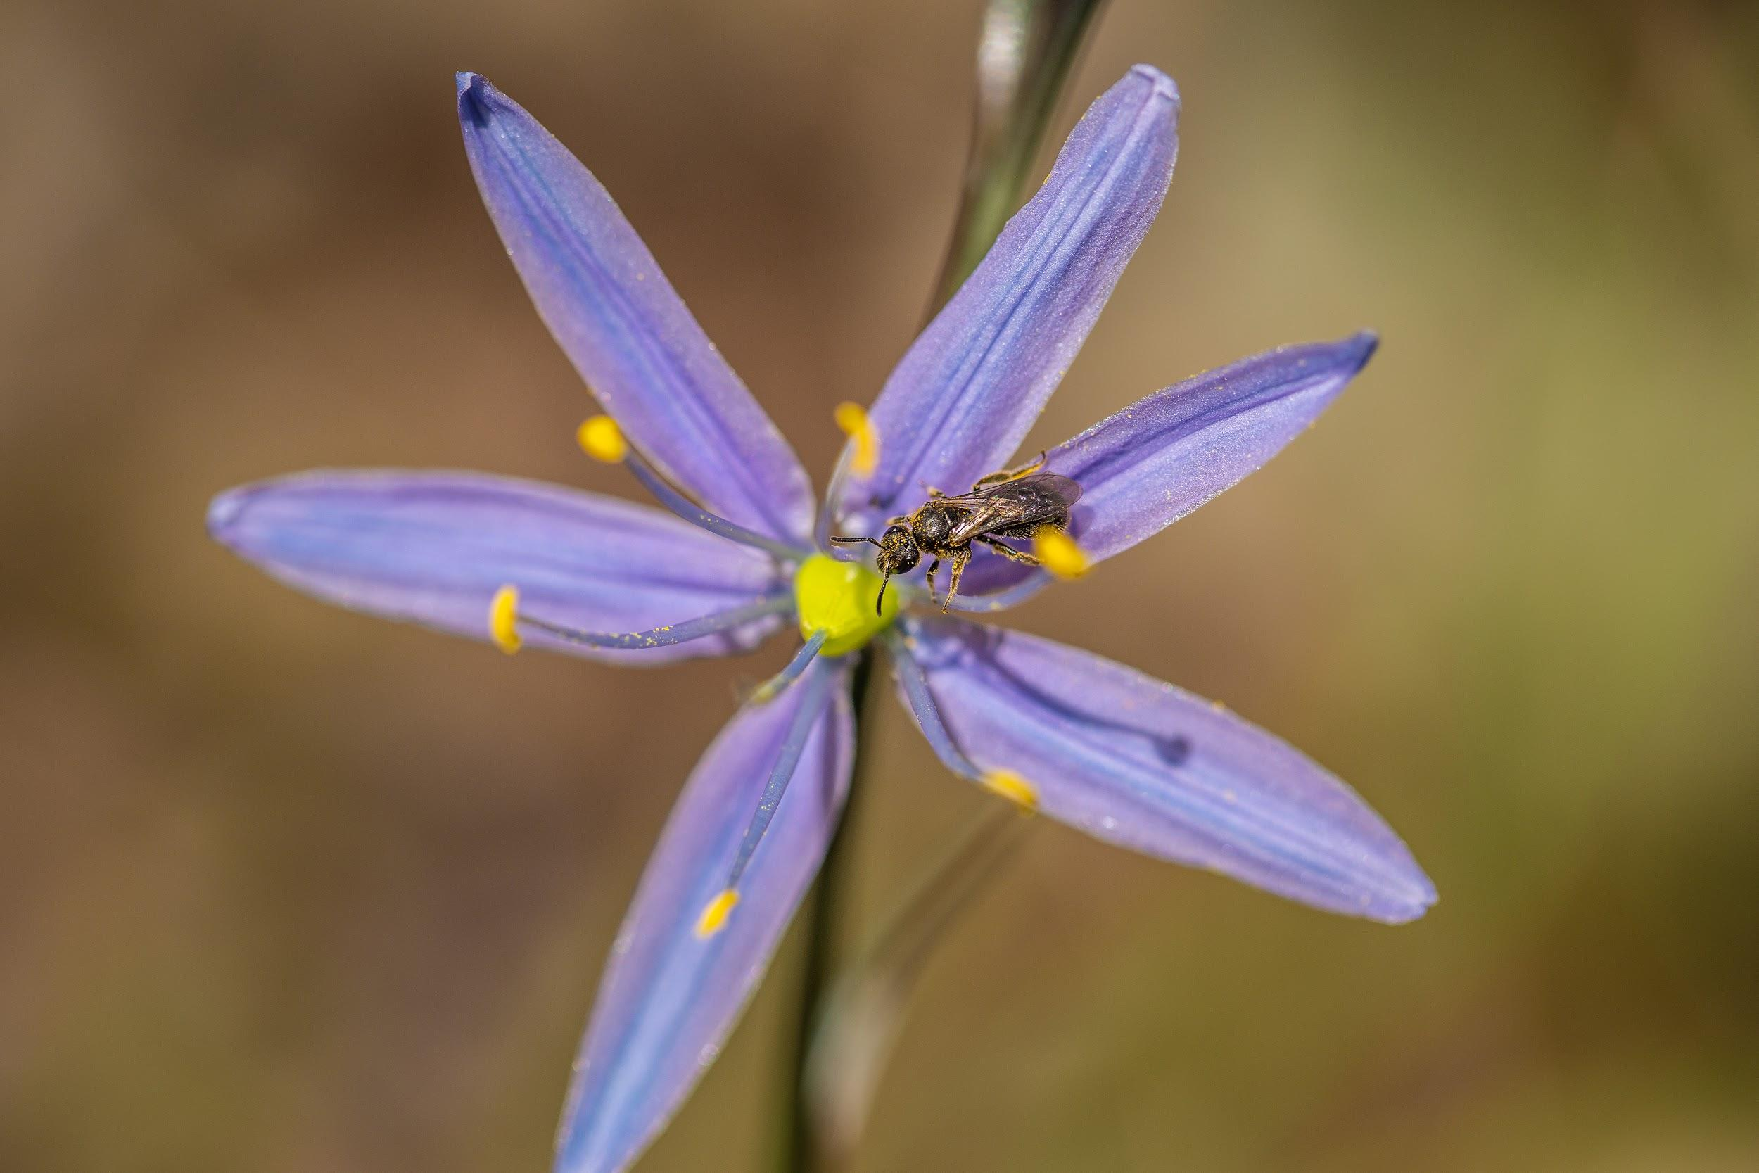
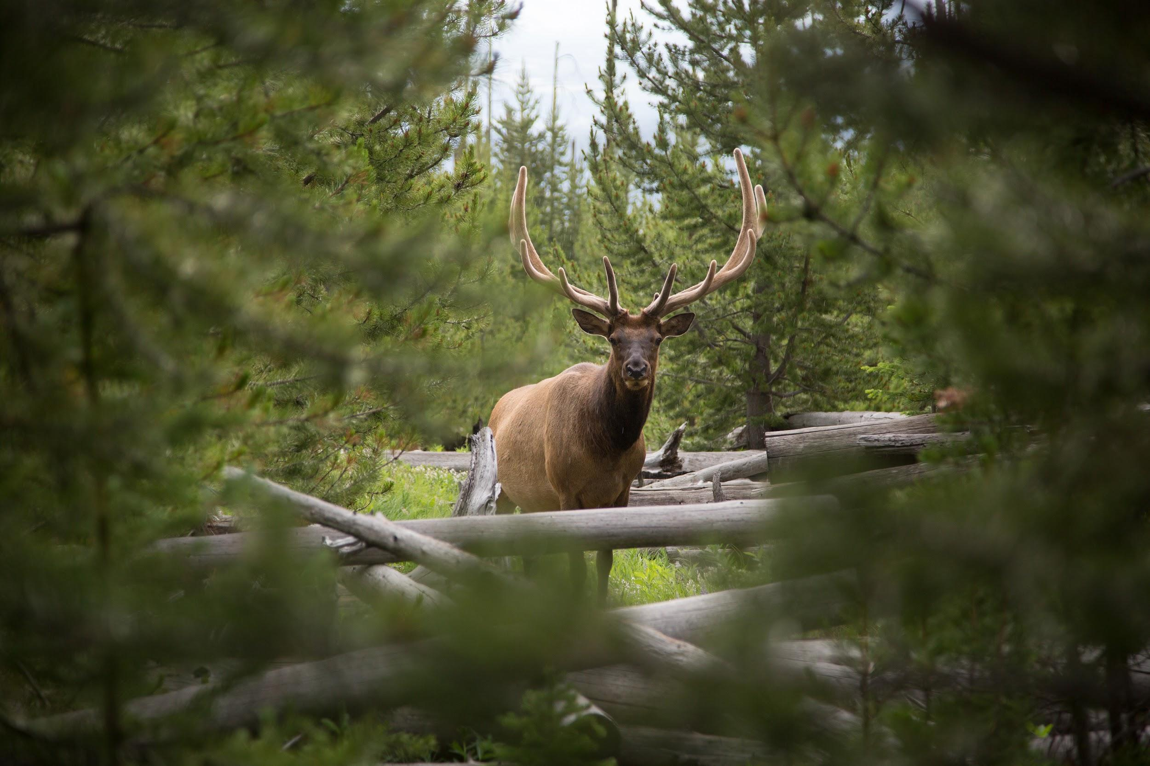
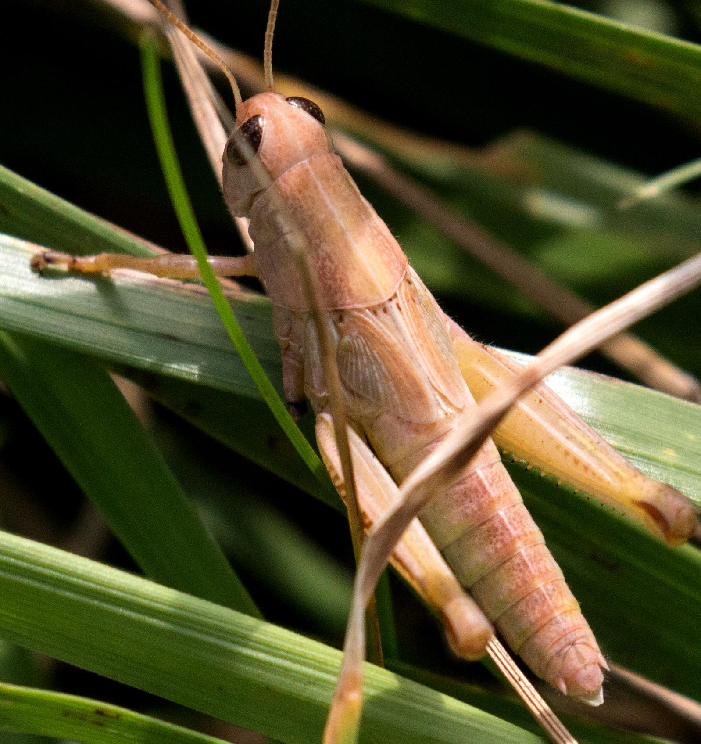
A Hunting and Gathering Culture
Camas
Elk
Known for their harvesting method of fire to burn (paya). The Kalapuya would burn to make open pastures which helped create a better habitat for elk (mulak), deer (mawich), camas roots (lakamas), tarweed seeds (limulo-saplil●^{r}), and hazelnuts (taqwǝla).
When the land was burned, it often burned the grasshoppers (tɬak^{h}ǝtɬak) that lived there. The women gathered up the grasshoppers for eating. Very little went to waste in the Tribe.
Grasshopper
Notes:
to burn (paya)
elk (mulak)
deer (mawich)
camas roots (lakamas)
tarweed seeds (limulo-saplil●^{r})
hazelnuts (taqwǝla)
grasshopper (tɬakhǝtɬak)

Slide 12
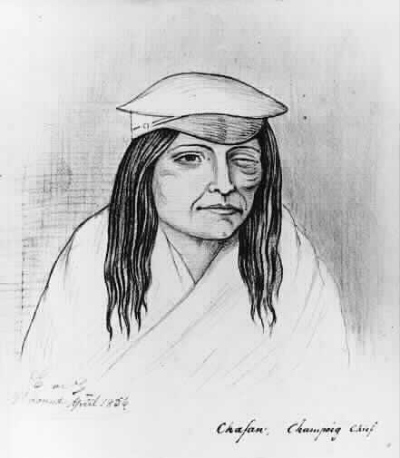
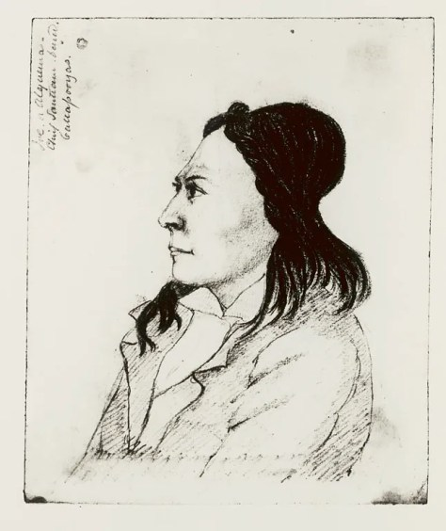
Important Individuals
Chief Chafan
Chief Alquema
(Joseph Hutchins)
Tekopa band of the Santiam Tribe of Kalapuya
Worked to minimize the trauma of the relocation to the reservation
Chief Chafan
Champoeg (sham-poo-eg) band of Kalapuya
Chief Alquema – Joseph Hutchins

Slide 13
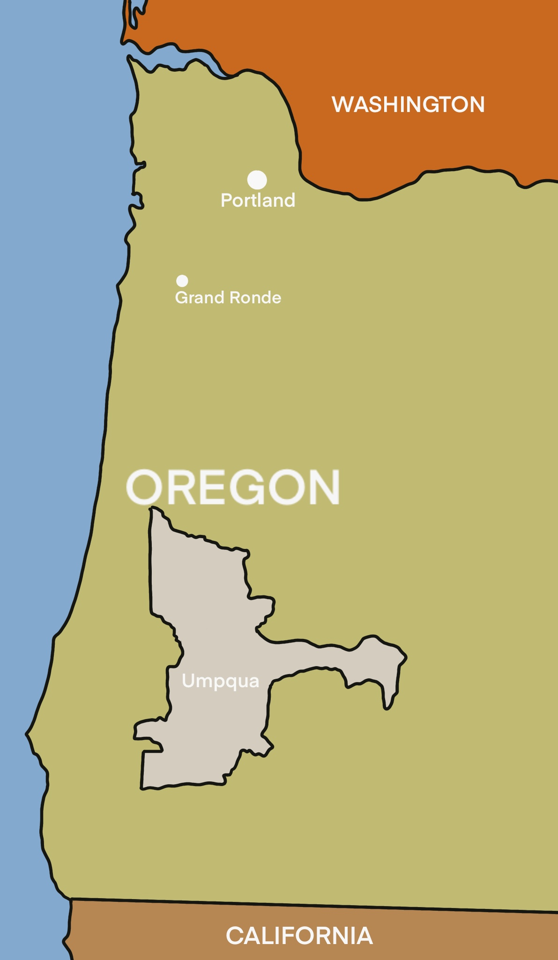
Umpqua
uhmp-kwuh
Notes:
Click orange hyperlink to hear pronunciation

Slide 14

Umpqua
Once numbered ~3,200 people
Location: Southwest Oregon in the Umpqua Valley, near Roseburg territory.
They were seasonal gatherers – migrated to different part of Southwest Oregon valley at different times of the year depending on local custom and available resources.
Like the Kalapuya - they would burn (paya) prairies during the fall, which kept the area rich in wild blackberries (ɬik^{h}ǝmuks) and other plant foods. It would also attract game animals.
Notes:
Chinuk Words:
burn (paya)
blackberries (ɬikhǝmuks)

Slide 15
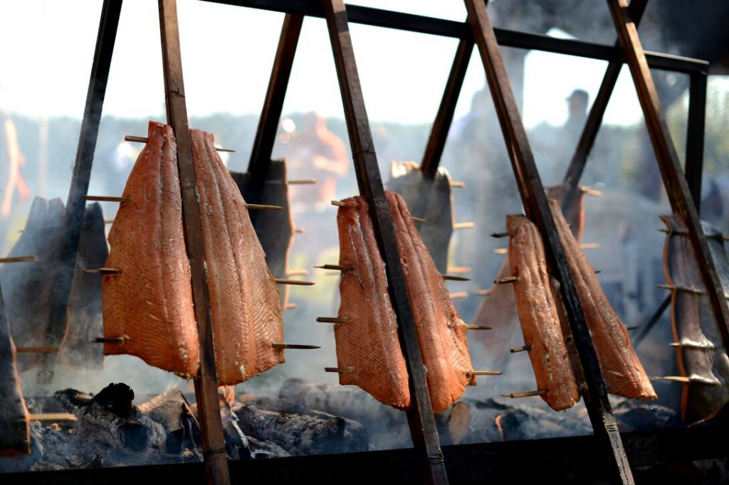
Hunting & Gathering
Umpqua hunters used yew wood bows, as well as snared and pitfall traps, to catch smaller game.
Camas roots (lakamas) and acorns (k’anawis) were also part of the Umpqua diet.
Each spring the Umpqua Band would follow migrating Chinook salmon (samǝn) upriver to areas such as Narrow Falls, Rock Creek, and high mountain plateaus.
Dried and smoked fish, as well as fish head soup, were some of the traditional Umpqua delicacies.
They believed in living harmoniously with their environment.
Smoking Salmon. Photo Credit: Tim Chacon
Notes:
Chinuk Words:
camas roots (lakamas)
acorns (k’anawis)
salmon (samǝn)

Slide 16
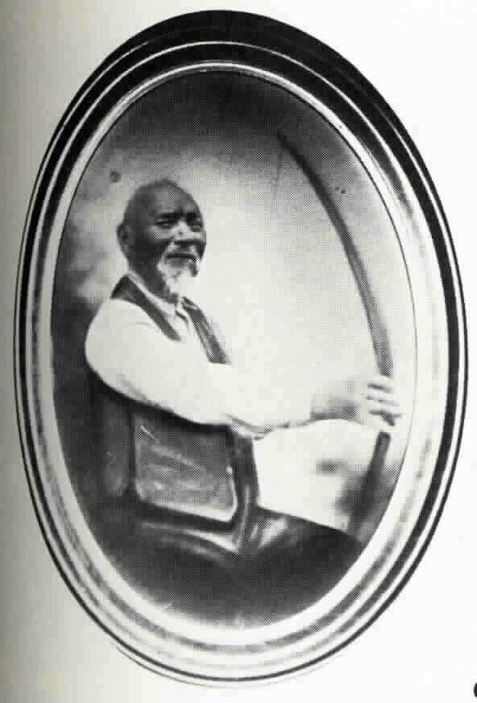
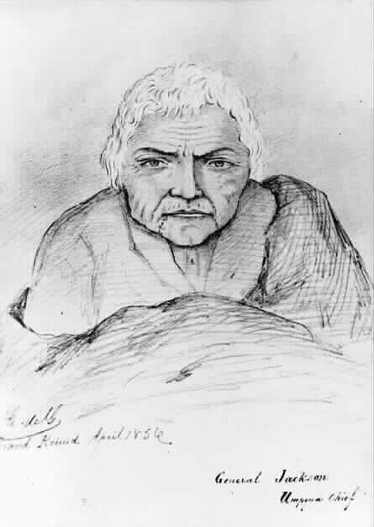
Important Individuals
Chief General Jackson
Also known as Tas-yah
Signed the Treaty with the Umpqua & Kalapuya in 1854
Chief Solomon Riggs
One of the richest Umpqua, his father was also chief
Solomon Riggs was not his real (Indian” name – he took the name of his White employer after being relocated to the Reservation
He was one of the oldest males on the reservation
Chief General Jackson
Chief Solomon Riggs

Slide 17
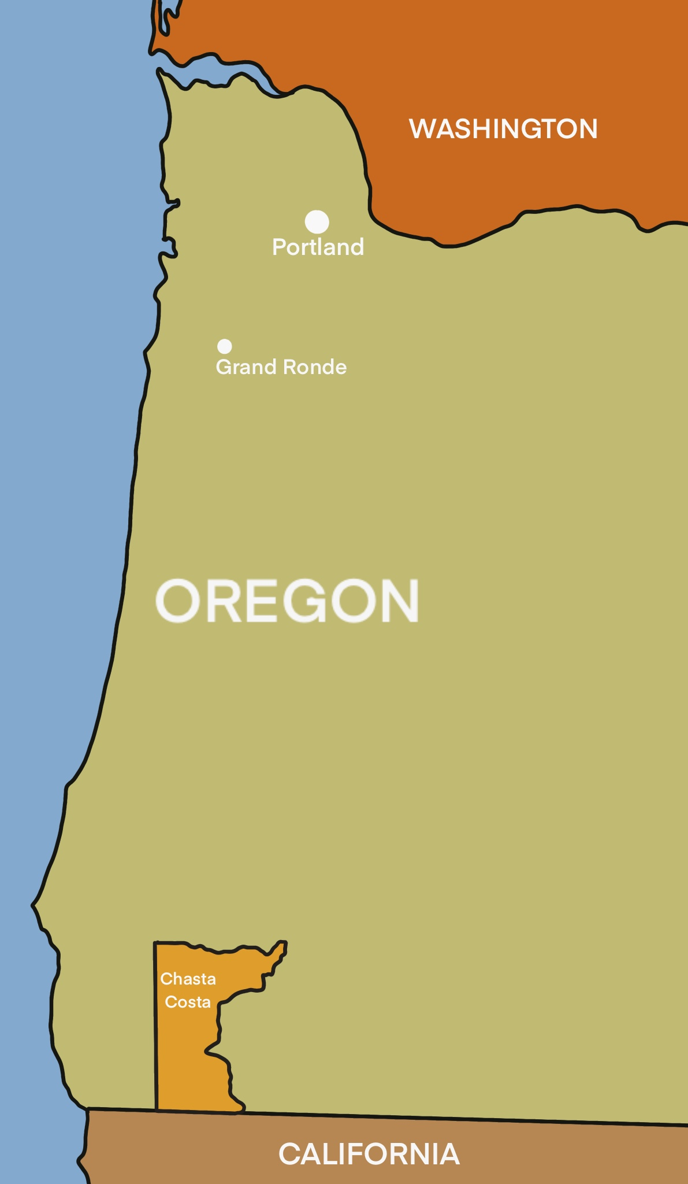
Chasta Costa
(ch-ahstah)
Notes:
Click orange hyperlink to hear pronunciation

Slide 18
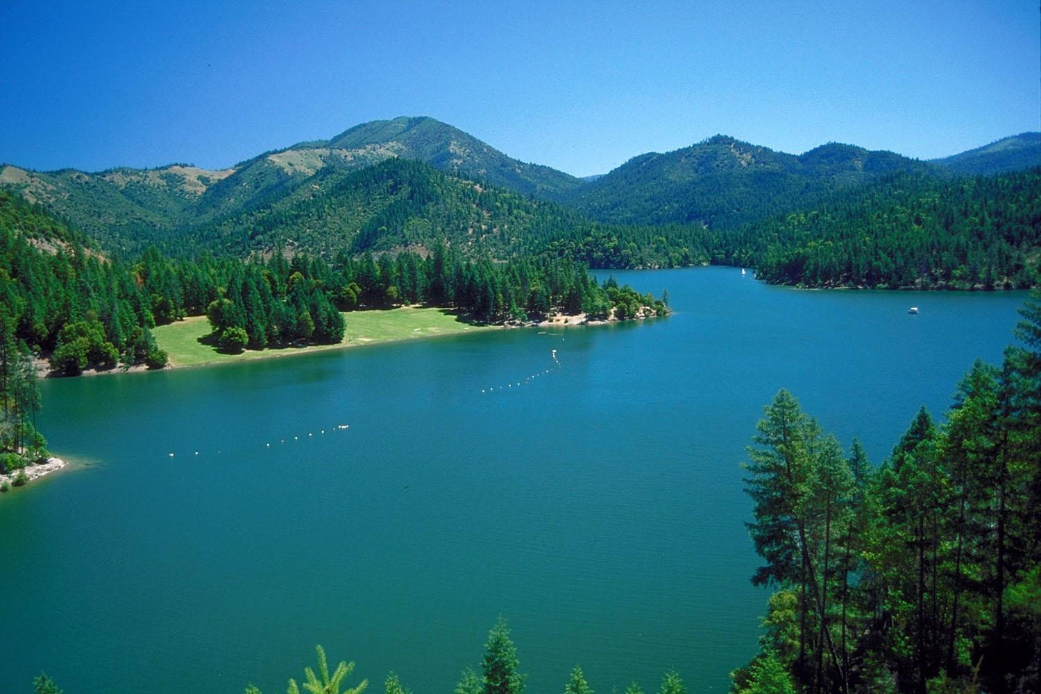

Chasta Costa
Location: The middle of Rogue River, one mile below the mouth of Applegate Creek to the headwaters of Jump‐Off‐Jo Creek; their boundary went to the summit of the main ridge of the Siskiyou Mountains.
Athabascan (ath-uh-bas-kuh n) ‐speaking Tribe
Chasta Costa were related to Takelma (Indian Tribes near the Rogue Valley) by marriage

Slide 19
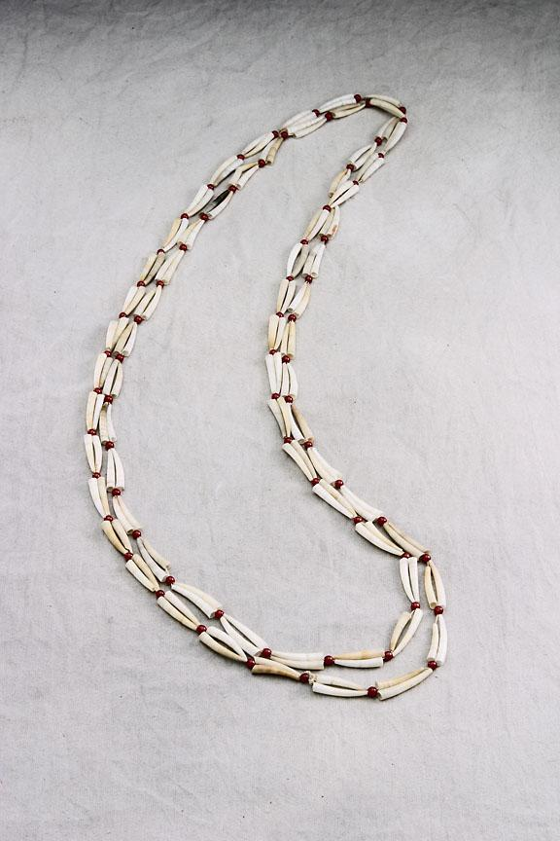

Traditional Lifeways
Chasta Costas moved around from the coast to the mountains and valley to find what they needed to survive. They fished and hunted for food in each of these areas.
They also participated in gathering. An example is the gathering of roots (kakwa-tsiltsil), berries (ulali), nuts (taqwǝla), and acorns (k’anawi)
They had naming ceremonies – an event in which an infant, youth, or adult is given a name or names
Engaged in warfare, primarily for status and acquiring slaves
Strings of dentalium shells (kupkup) were used as money, along with the other tribes in the Pacific Northwest
Notes:
Chinuk Words:
roots (kakwa-tsiltsil)
berries (ulali)
nuts (taqwǝla)
acorns (k’anawi)
dentalium shells (kupkup)

Slide 20
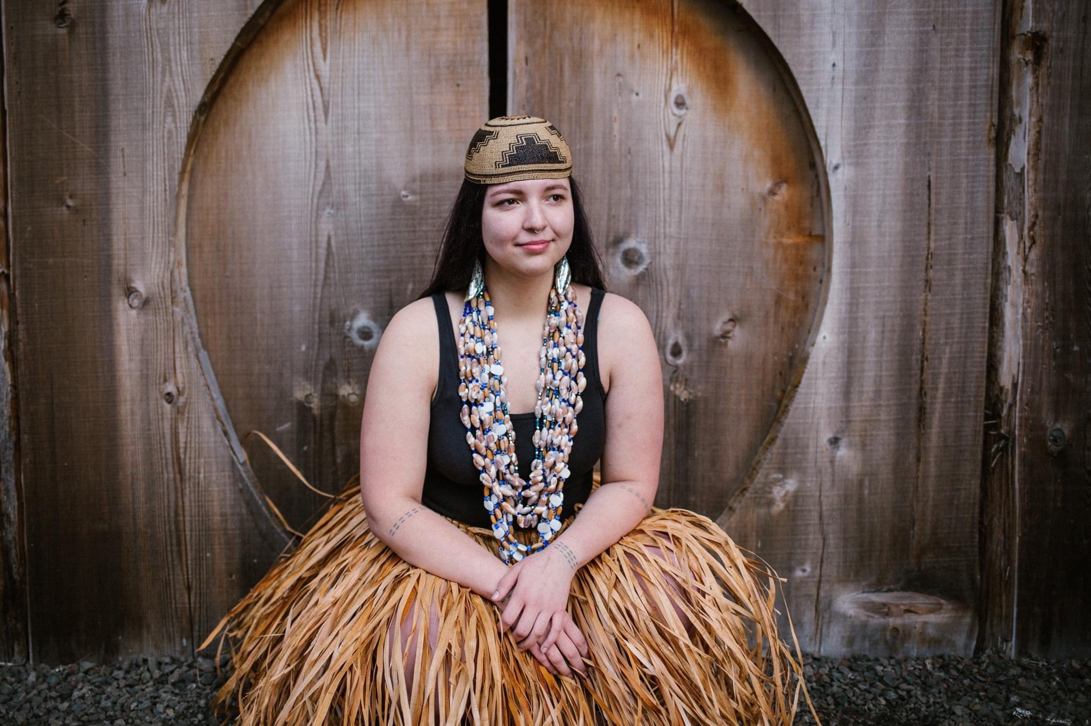
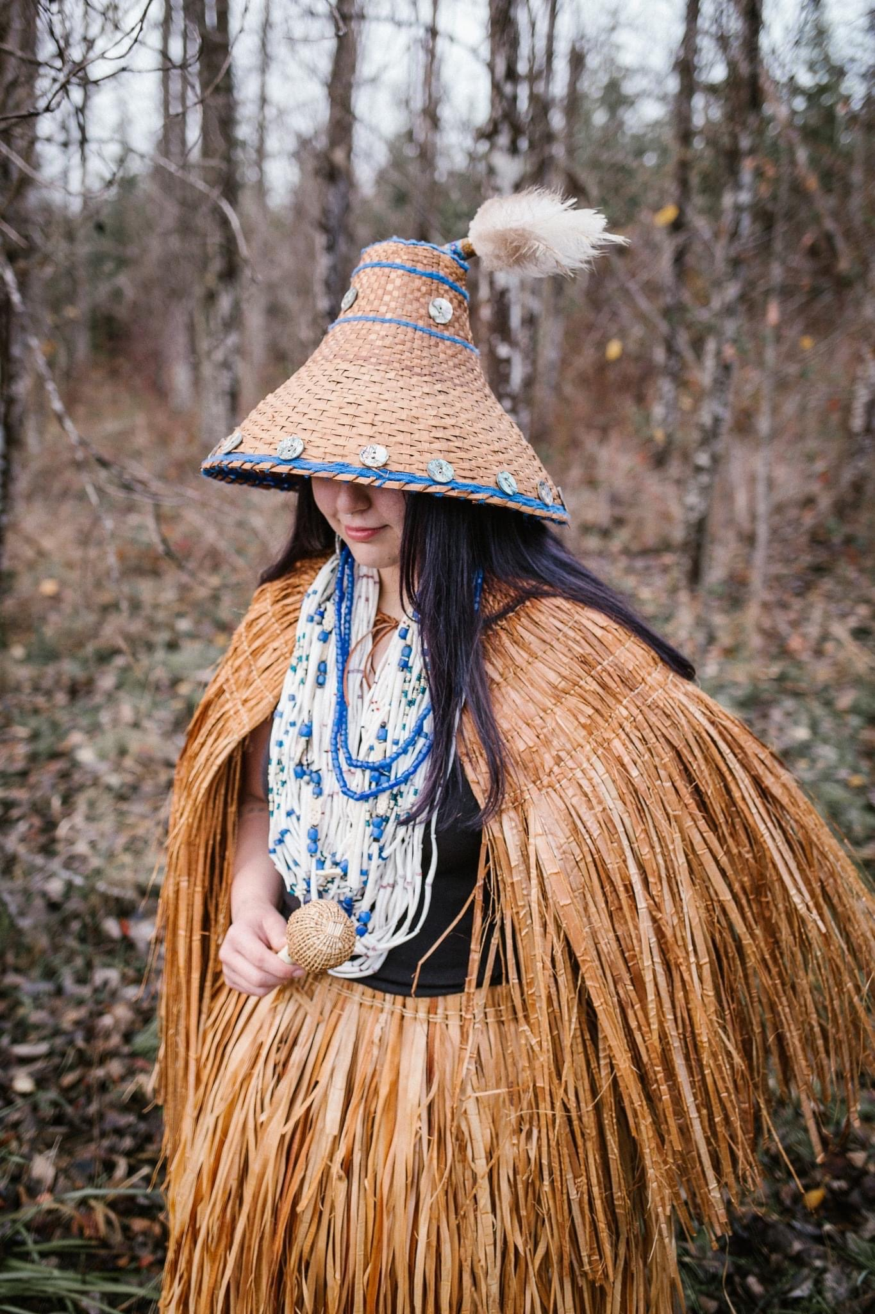
Art Forms
Forms of Dance (tanis): Line dancing, Nedash, Feather dancing
Rich tradition in basket making.
Basket hats were common attire for women.
Notes:
Chinuk Words:
dance (tanis)

Slide 21
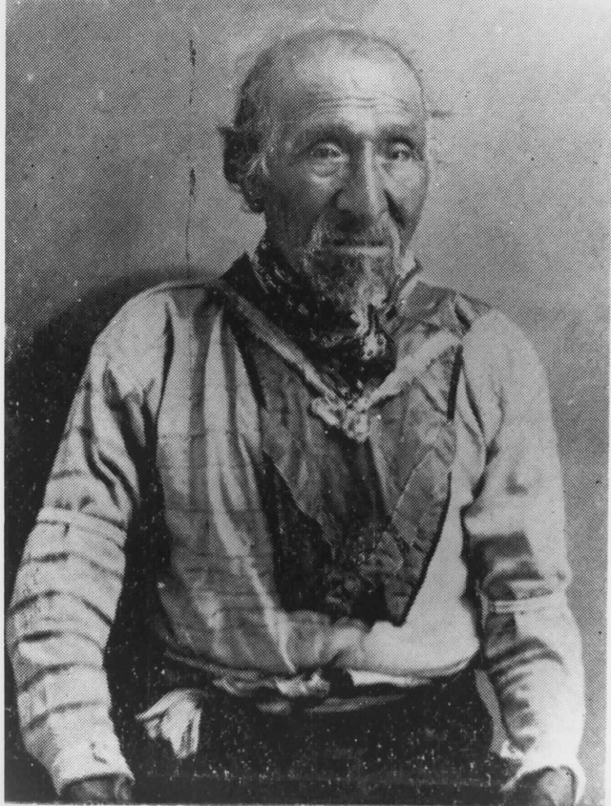
Important Individual
Tecumtum – “Elk Killer”
Also known as Chief John, Old John, and Tyee John, John Chamberlin
Takelma warrior and leader
Chief of the Etch-ka-taw-wah band of Athabaskan Indians
Extremely active in the fights against settlers and the sovereign rights of tribes

Slide 22
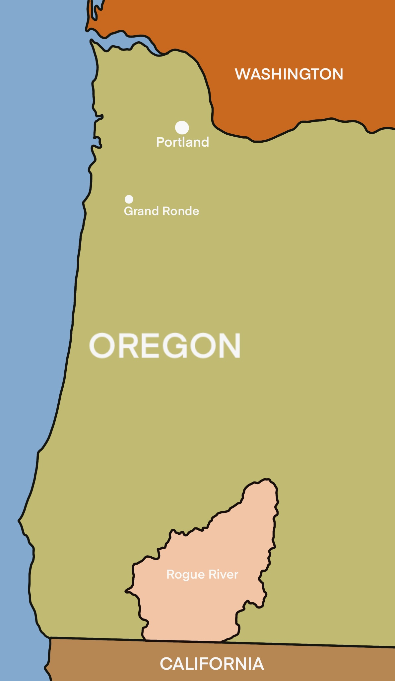
Rogue River
(rowg ri-vr)
Notes:
Click orange hyperlink to hear pronunciation

Slide 23
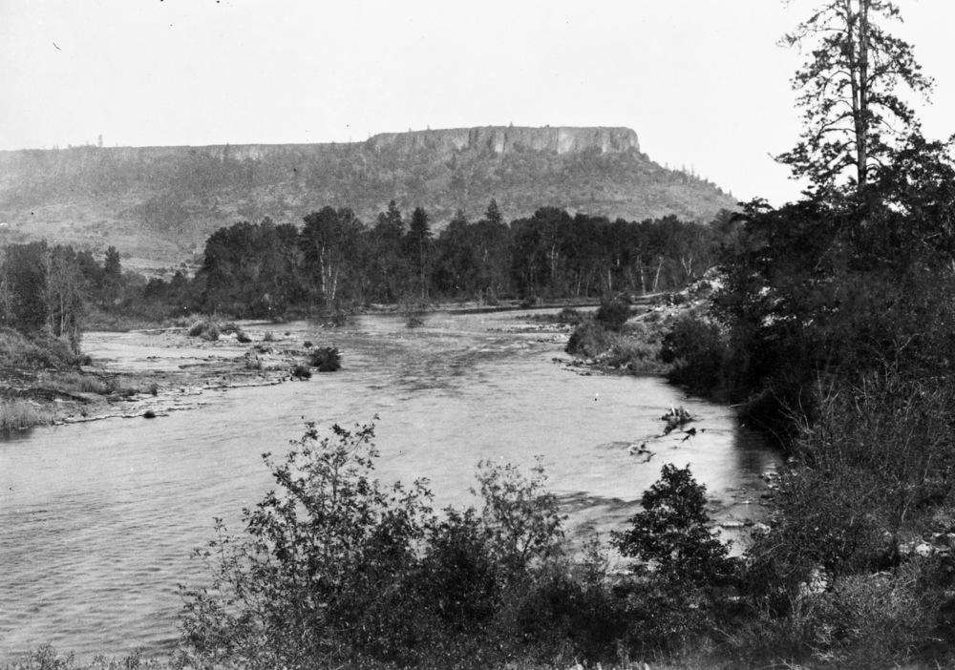
Rogue River - Takelma -
“Rogue River” – A general name for the Takelma, Athbaskan, and Shasta people
Location: They occupied the rugged interior around Table Rocks and the Cascades, in the area of present-day Jacksonville.
Other Takelma communities clustered around the northern banks of the Rogue River centered in the Siskiyou National Forest; Cow Creek near Canyonville; and within the southwestern valley towards California.
Independent bands typically ranged from 80-100 members

Slide 24
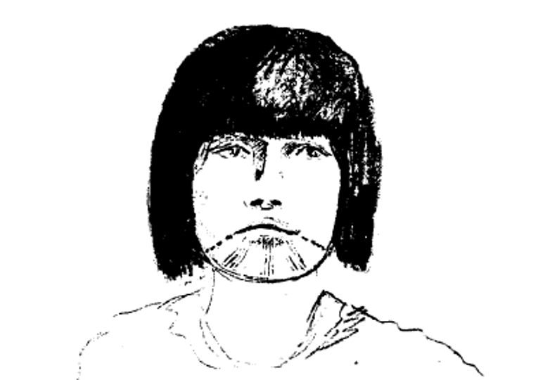
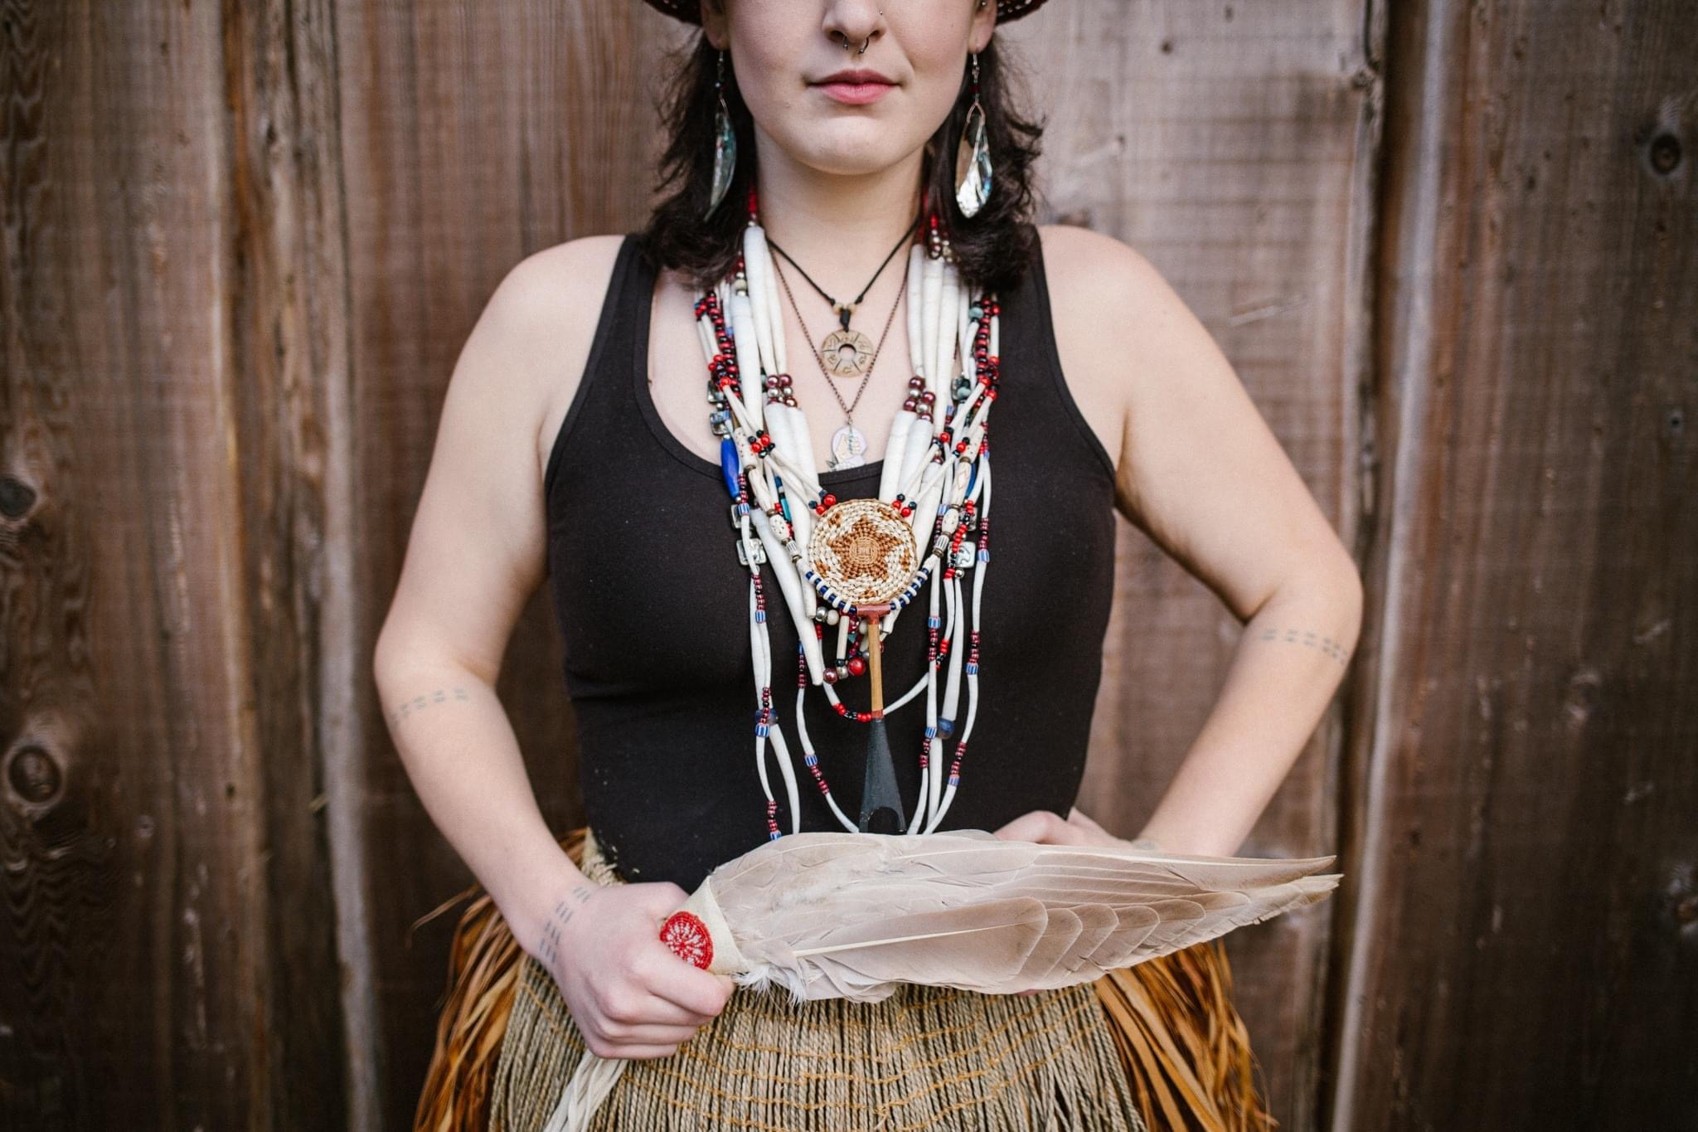
Fashion
Takelma culture put a high value on wealth and beauty
They had pride in the abundance of dentalium shells (kupkup)
Takelma men wore buckskin shirts and pants or leggings, and hats made of bear skin or deer scalp. Deerskin blankets were also occasionally worn.
Knee-length buckskin dresses with white grass tassels and Chasta-made basket hats were worn by the women.
Facial charcoal tattoos in the form of three downward stripes on the chin were common for the women. Men used tattoo markings on their left arms to measure dentalium and display wealth.
Notes:
Chinuk Words:
dentalium shells (kupkup)

Slide 25
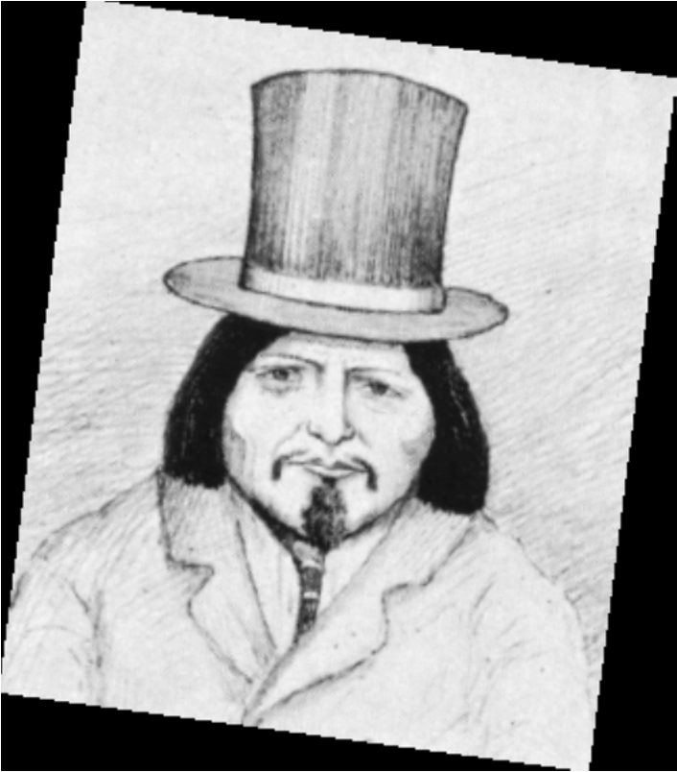
Important Individuals: Chief Brothers
Chief Toquahear – also known as “Sam”
Chief of a Rogue River Takelma
Chief Apserkahar – also known as Tyee Jo, Joapserkahar, Chief Jo, and Horse Rider
Chief of a Rogue River Takelma
Best known for his peacemaking efforts
Believed to be called “Jo” after requesting to be named after Joseph Lane, (the Superintendent of Indian Affairs) whom he respected
Both brothers were involved in treaty councils and treaty signing at Table Rock

