Slide 1
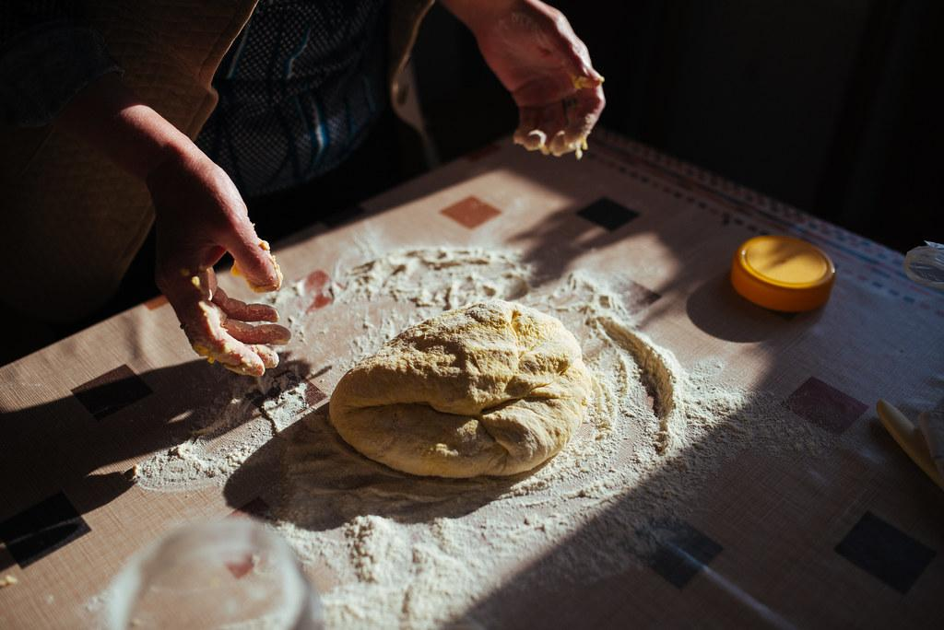
Fry Bread

Slide 2

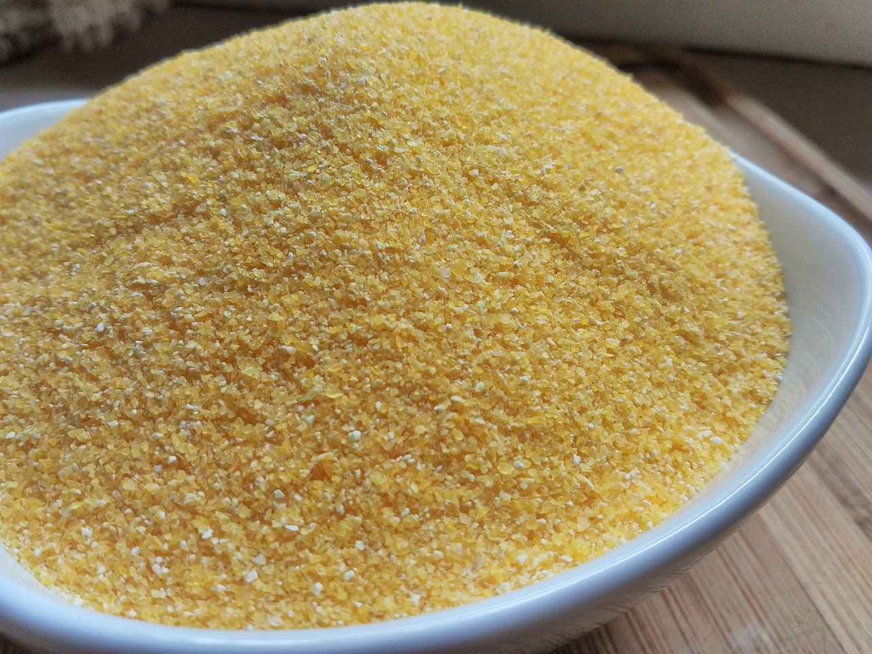
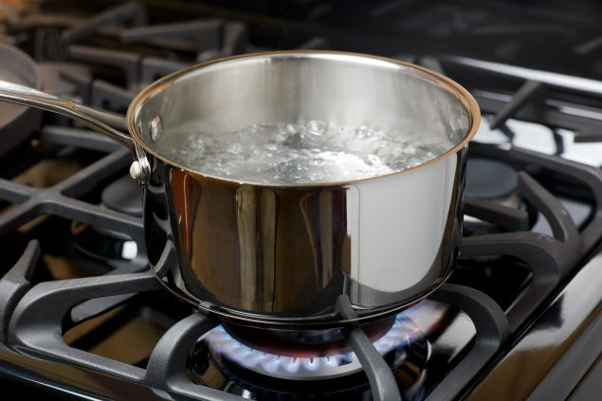
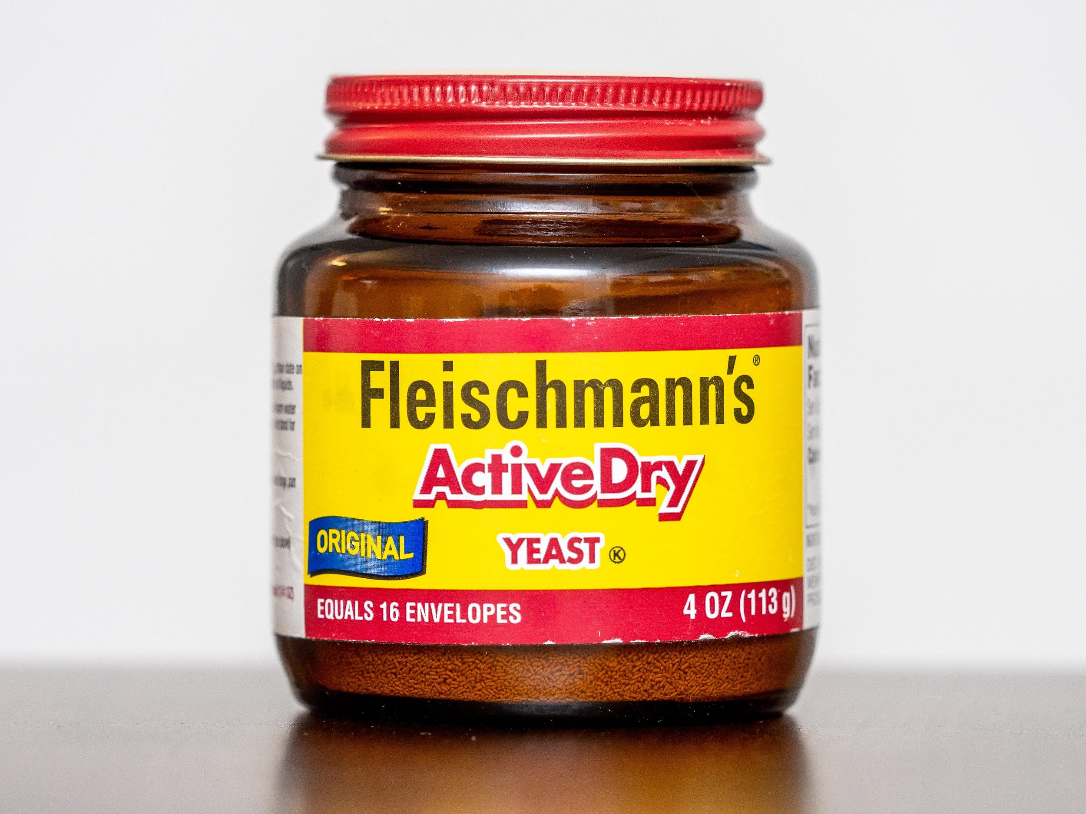

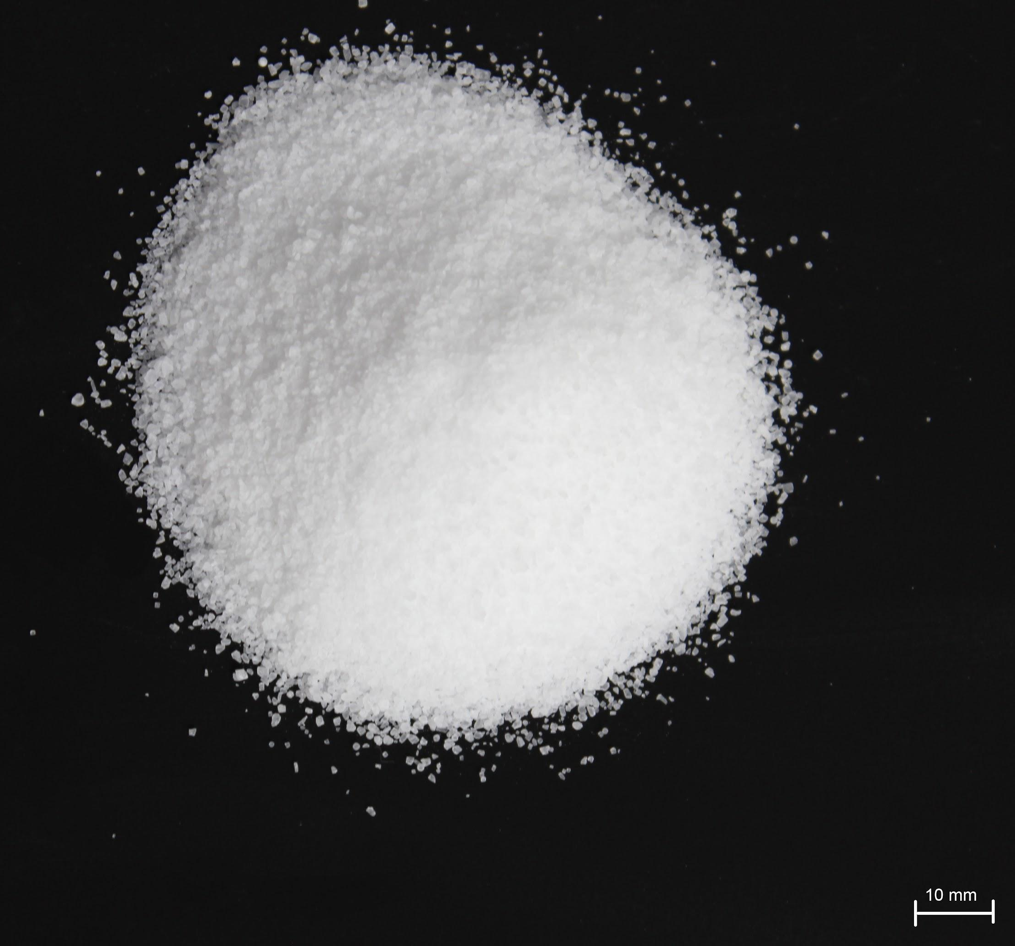
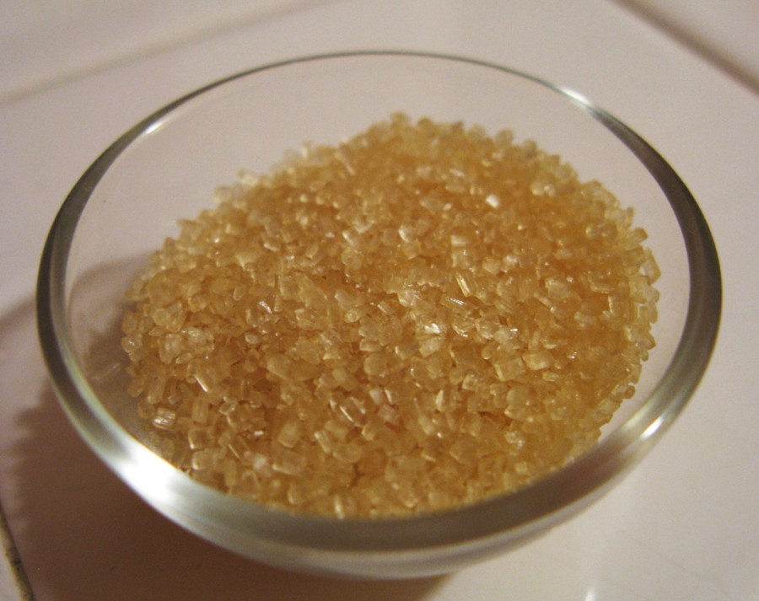
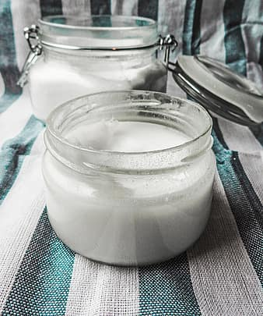
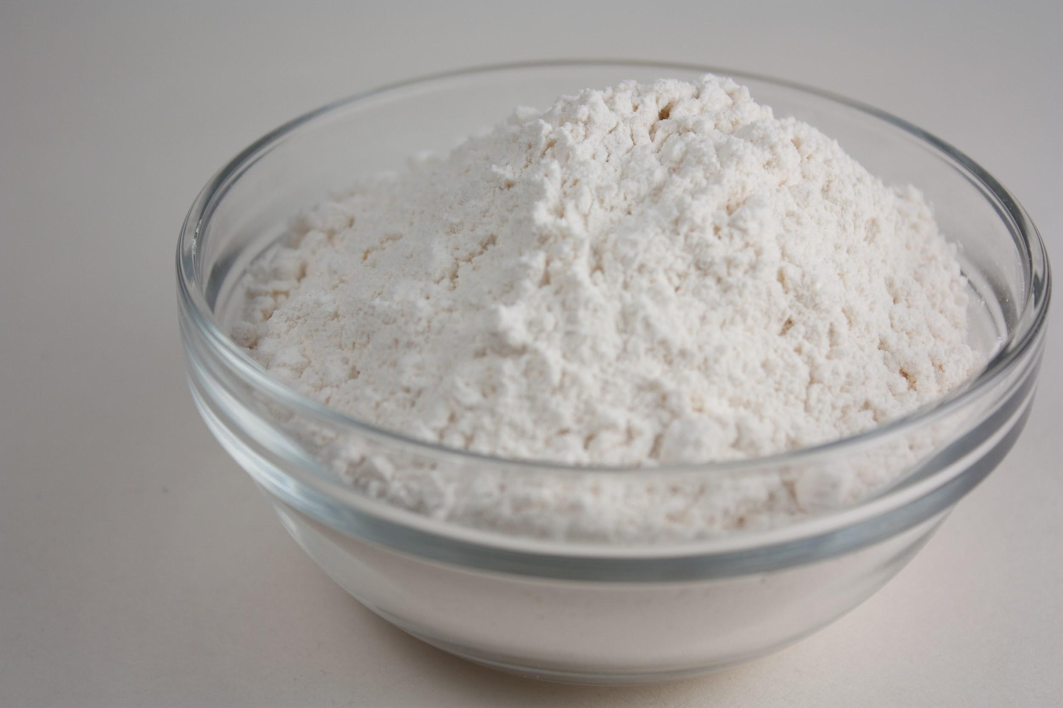
Recipe
1 pint boiling water
1 cup cornmeal
1 ½ cup cold water
½ oz. dry or instant yeast
1 cup raw sugar
1 tsp. sea salt
3 ½ cups flour
32 oz. unrefined coconut oil
C = cup tsp = teaspoon oz = ounce
Notes:
Full Recipe - including directions - can be found in the book Fry Bread: A Native American Family Story by Kevin Noble Maillard

Slide 3
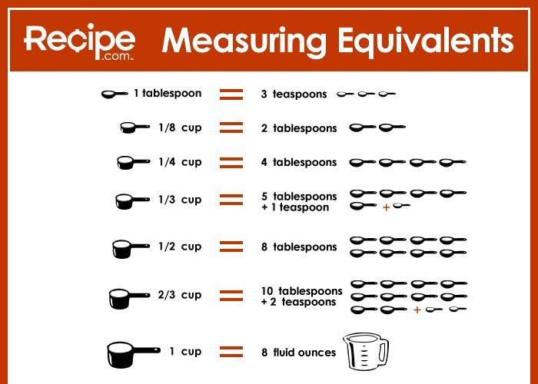
Measurement Conversions
Cups, Teaspoons, & Tablespoons

Slide 4
Converting the Recipe
To make the recipe easier, we are going to “convert” the recipe to cups, teaspoons, and tablespoons.
1 pint boiling water
1 cup cornmeal
1 ½ cup cold water
½ oz. dry or instant yeast
1 cup raw sugar
1 tsp. sea salt
3 ½ cups flour
32 oz. unrefined coconut oil
1 pint = ________ cups boiling water
1 cup cornmeal
1 ½ cup cold water
½ oz. = _______ tsp. dry or instant yeast
1 cup raw sugar
1 tsp. sea salt
3 ½ cups flour
32 oz. = _____ cups unrefined coconut oil

