Slide 1

Connecting Cultures

Slide 2

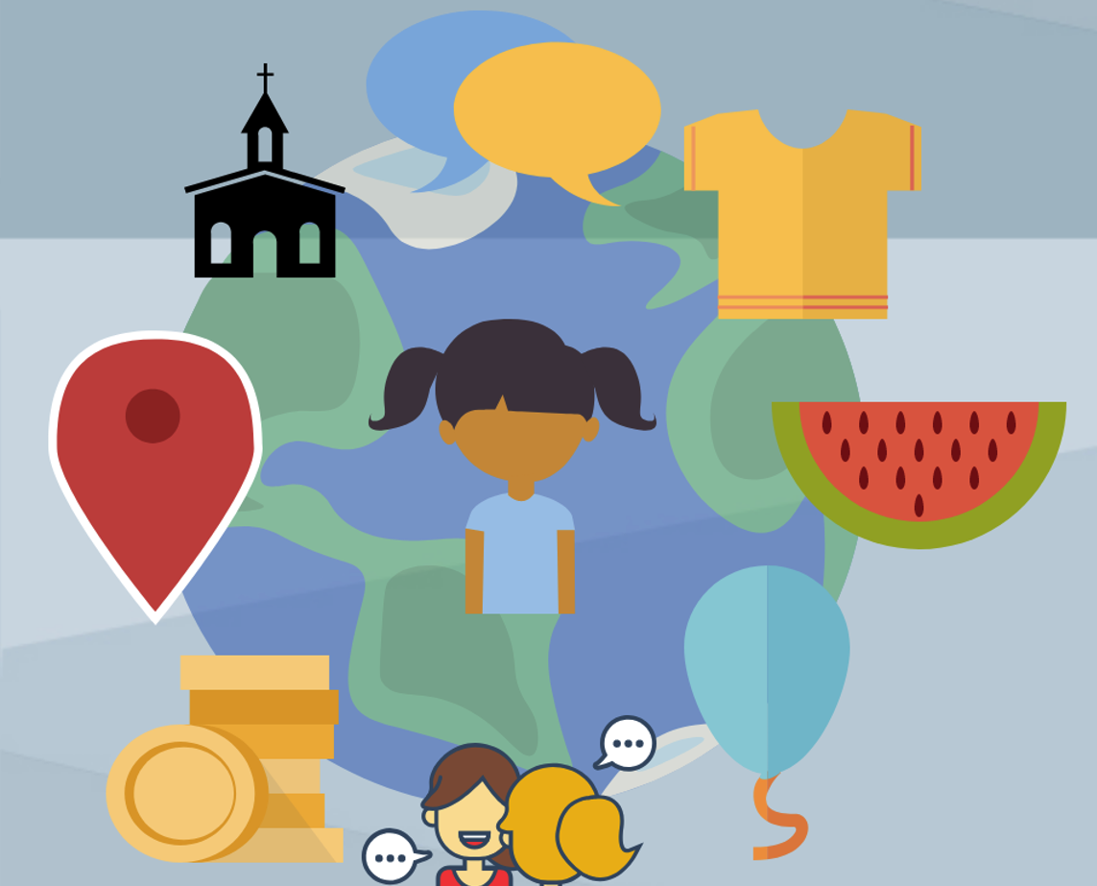
What is culture?
'way of life' for groups of people
A culture is passed on to the next generation by learning
Culture is seen in people's writing (t’sǝm-pipa), religion (p^{h}liye●^{r}), music (tintin), clothes (ikt^{h}as), food (mǝk^{h}mǝk) and in what they do
Culture can be tied to race, religion, location, and age
Notes:
Chinuk Words:
writing (t’sǝm-pipa)
religion (phliye●^{r})
music (tintin)
clothes (ikt^{h}as)
food (mǝkhmǝk)
Sources:
Culture Facts for Kids

Slide 3
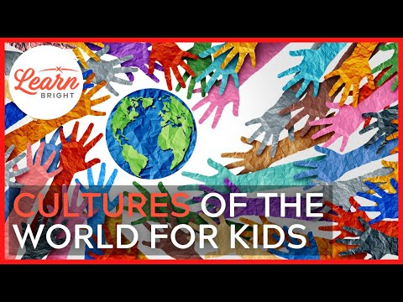
Notes:
Video Link: https://www.youtube.com/watch?v=RwSYrsjTiW4

Slide 4
Native American Culture
Although Native Americans are often thought of as one group, different Tribes have different cultures depending on their location (place - iliʔi) and the traditions that have been passed down through generations.
These traditions and cultural practices have been passed down since time immemorial through oral stories and examples from elders.
There have been many instances in United States history where Native Americans have been told they can no longer practice their cultures.
Notes:
Chinuk Words:
place (iliʔi)
Time Immemorial: time extending beyond the reach of memory, record, or tradition, indefinitely ancient, "ancient beyond memory or record". In law, it means that a property or benefit has been enjoyed for so long that its owner does not have to prove how they came to own it.

Slide 5
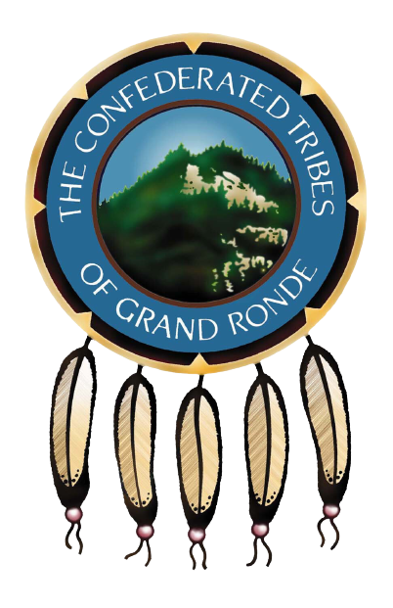
The Confederated Tribes of Grand Ronde
Key Pieces of Grand Ronde Culture:
Celebrations
*First Fish Ceremony
*Indigenous Peoples Day
*Restoration
Music
*Drum
*Flute
Clothes
*Beaded Necklaces
*Use of leather, furs
*Native patterns/designs
Cooking/Food
*First Foods - Elk, deer, berries, nuts, etc
*Recipes passed down through family

Slide 6
What are pieces of your culture?
Celebrations/Holidays (lep^{h}et●^{r}):
Music (tintin):
Clothes (ikt^{h}as):
Cooking/Food (mǝk^{h}mǝk):

Slide 7
Using a Venn Diagram
Details About the Character in the Book
Details About You
Similarities

