Slide 1

Write a Journal Entry

Slide 2
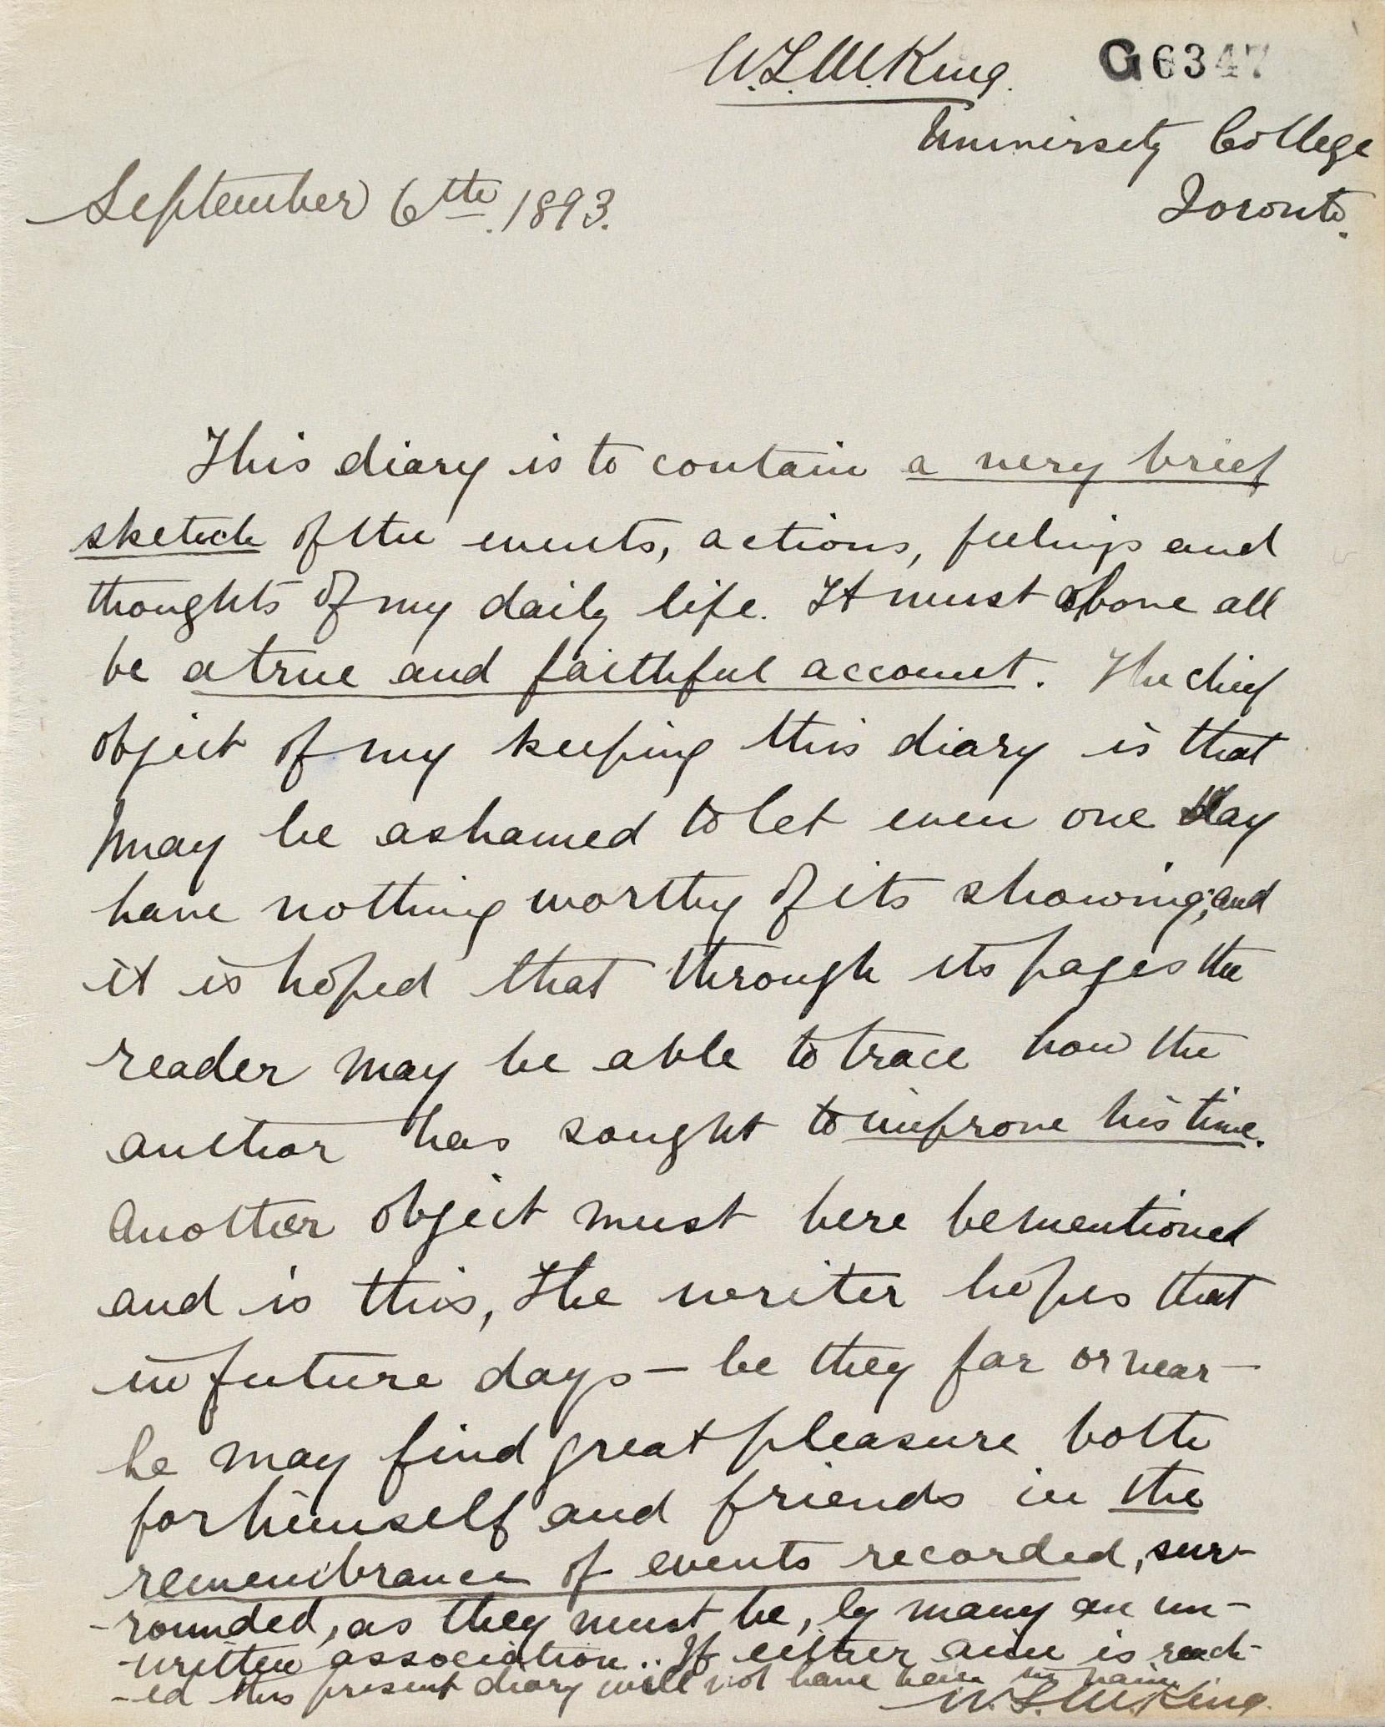

Have you ever written in a journal or diary before?
What types of things do you usually write (t’sǝm) about in a journal or diary?
Notes:
Chinuk Words:
T’sǝm - write

Slide 3

Historical Background
Famous Journal Writer:
Anne Frank
Journal entries have been used for hundreds of years to keep records for history. Writers often include important details:
Setting
Events
Emotions
It is because of these journal entries that we know so much about the people of the past.

Slide 4
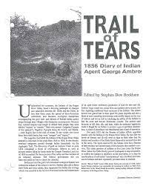
Historical Background
On February 23, 1856, Indian Agent George Ambrose began moving 325 "Indian Refugees" from the Table Rock Reservation in Southern Oregon to the Grand Ronde (shawash-iliʔi) Reservation in the Willamette Valley. Known as the Rogue River Trail of Tears, this journey required the Natives to leave their homelands and travel, on foot, north. The Rogue River, or Grand Ronde, Trail of Tears would take 33 days and cover 263 miles.
Agent Ambrose kept a journal during the removal. We will review one of his entries as a glimpse into that time in history.
Notes:
Chinuk Words:
shawash-iliʔi - Grand Ronde
Ask students if they believe any Native Americans on this trail kept a journal/diary (They did not).
Explain that Native Americans typically only kept records orally, by telling stories.
Ask students: What problems could this cause for historians when they are piecing together times in history? (i.e. one-sided perspective of events since records are not easily accessible due to being oral).

Slide 5
Review a Journal Entry
What did he include?
What could he add?
"February 23rd Saturday”
The weather still continues to be pleasant. It was found necessary to have more teams than at first contemplated. I accordingly proceeded to Jacksonville for that purpose, and also to provide some articles, such as clothing and blankets to add to the comfort of the Indians, although the weather is sett [sic] down as pleasant. It certainly would be regarded as such, especially at this season of the year, however the nights are quite frosty and the morning’s cool, sufficiently so, to render it necessary that they should be provided with Tents, Blankets, shoes & such necessaries as would tend to promote their comfort while on the journey which being procured the day was spent in distributing the articles among them. Also two additional teams were secured to convey the sick, aged, and infirm. Our teams now number eight with I fear will not be sufficient. Thirty four Indians are disabled from traveling by reason of Sickness aside from the aged and infirm, who will as a matter of course, have to be hauled."
Notes:
Teacher should use two colors for this slide:
One color to highlight the components that were included
One color to write/add components that need to be added

Slide 6

Directions - Write (munk-t’sǝm) Your Own Journal Entry
Create a journal entry as if you are a character in the book.
The main character
A family member of the main character
A friend of the main character
Your journal entry should include:
The date (Make sure it is historically accurate!)
A description of who you are
Details about the setting (Where are you? What is the weather like?)
Information about the day or event you are writing about. Include lots of details!
Information about how you feel about the day/event (Are you mad/sad/happy/tired?)
Notes:
Chinuk Words:
munk-t’sǝm - write
Teacher Note: Teacher may want to provide specific character examples from the selected title students will be working from

